Slide 1
Footballer

Slide 2
Description
Stressful,
well paid,
hard work,
every day training.

Slide 3
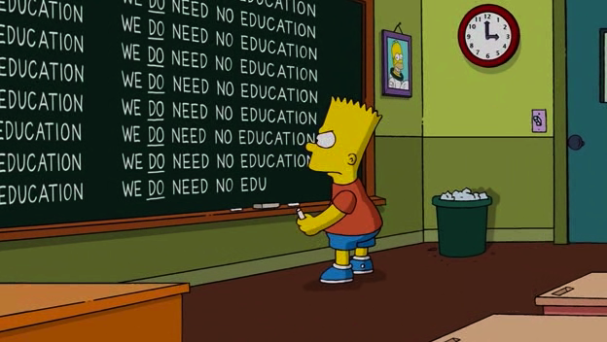
Education
No education required

Slide 4
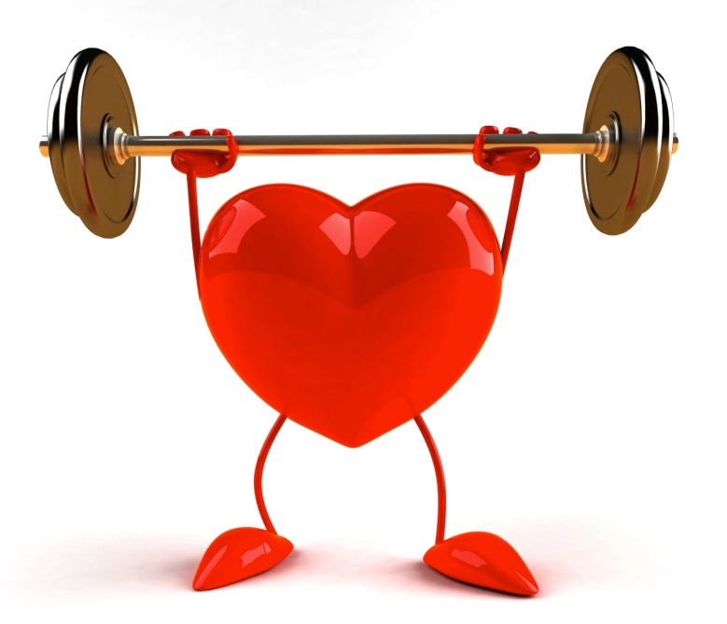
Requirements
Health,
strenght,
discipline,
Good desicion,
accuracy.

Slide 5
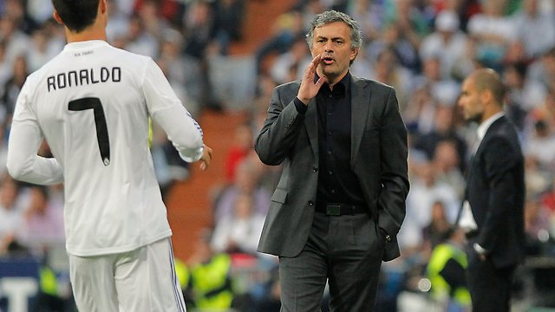
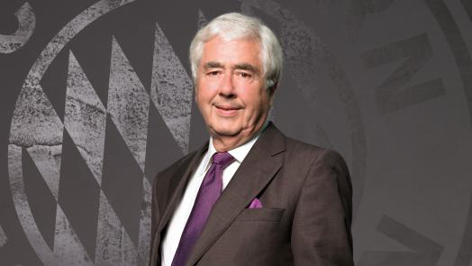
What can you do
Coach,
coach assistent,
player,
president of football club.

Slide 6
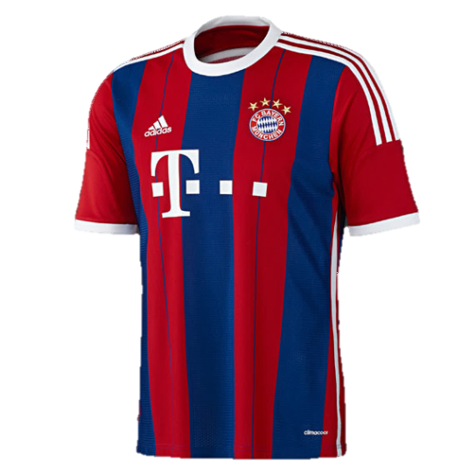
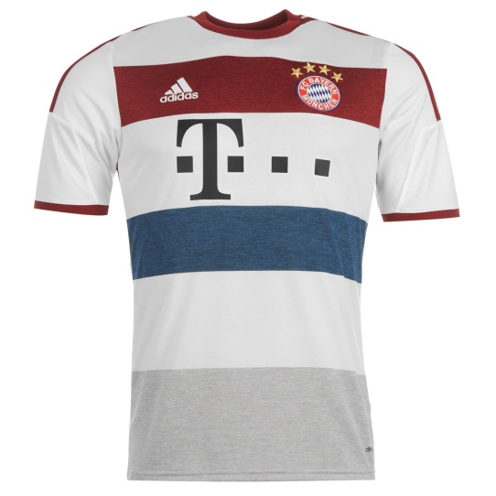
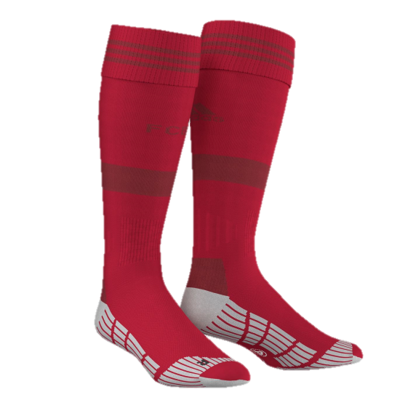
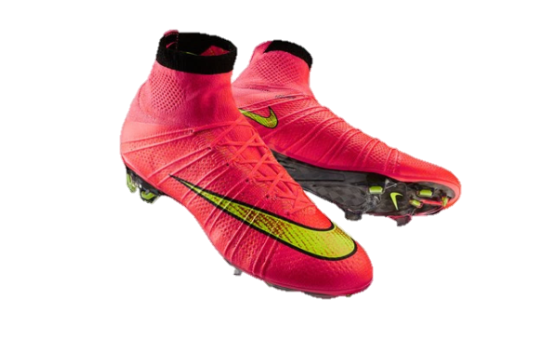
Uniform
Jersey,
jersey shorts,
football socks.

Slide 7
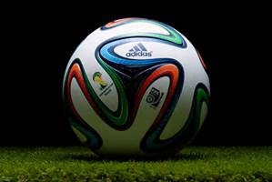
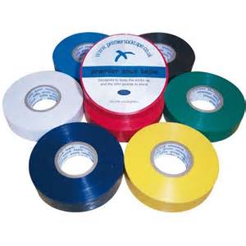
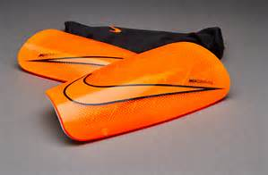
Tools
Football,
shinguards,
tape.

Slide 8
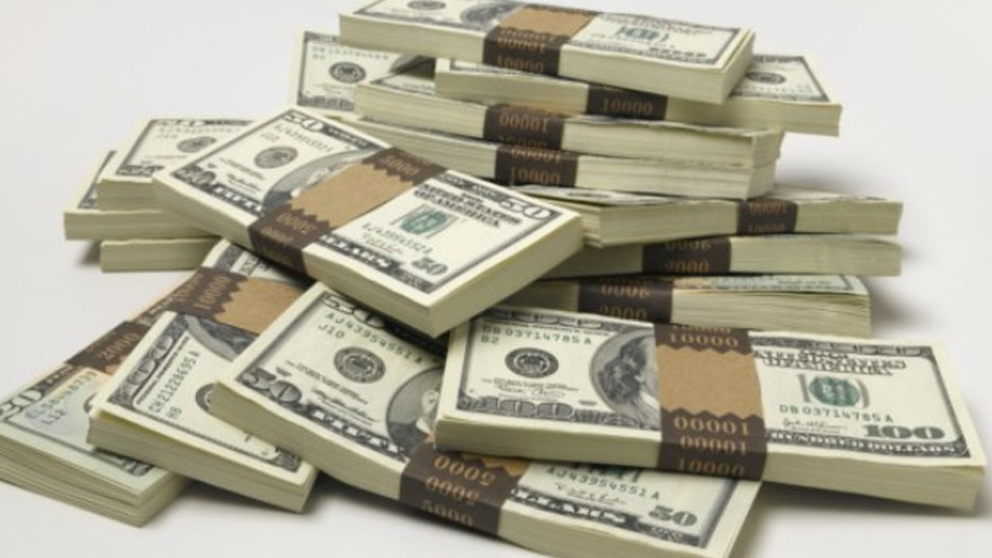
Pros
Very well paid,
New friendships,
Very known,
Awesome.

Slide 9
Cons
Not much time,
traveling,
injuries,
trainings.

Slide 10
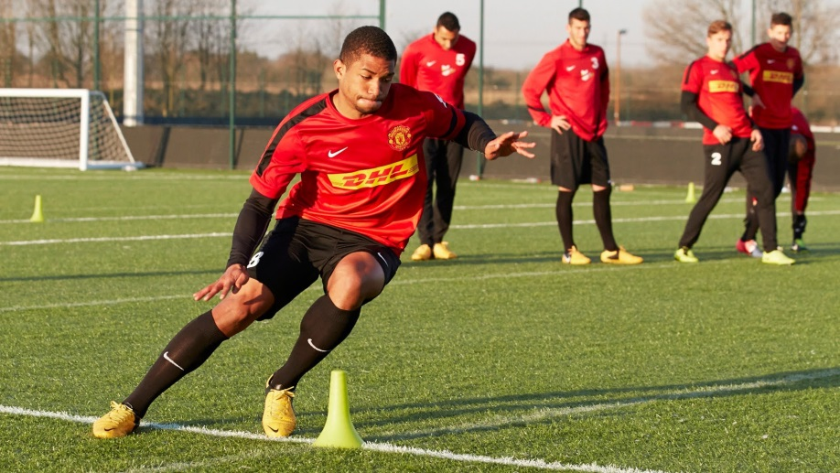
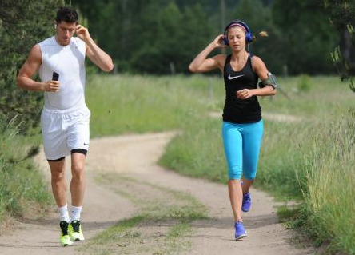
Every day
Waking up,
training,
family,
dinner,
free time,
training,
home,
sleep.

Slide 11
Interview
WHO INSPIRED YOU FOR THIS JOB?
I was inspired by a lot of great football players and i wanted to be like them when i grow up and now my dreams came throug.
HOW LONG DO YOU WANT TO PLAY PROFESSIONAL FOOTBALL?
I think I’m gonna play football until i will feel that i am no more for this job.
WHO IS THE BEST FOOTBALL PLAYER IN THE WORLD?
In my opinion the best player is Zlatan Ibrahimović.

