Slide 1
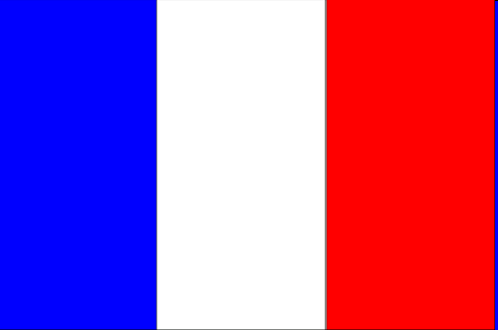
FRANCE

Slide 2
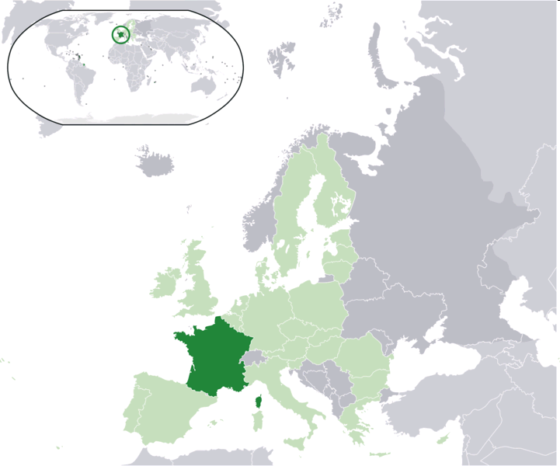
Geographical position
Mediterranean Sea
English Channel
North Sea
Rhine
Atlantic Ocean

Slide 3
GEOGRAPHY
547.030 square kilometres
65.1 million people
European continent
Rivers: Loire, Garonne, Seine, Rhone
Largest cities: Paris, Lyon, Lille
Toulouse, Nice, Nantes

Slide 4
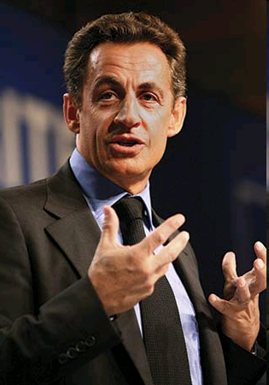
Government
Capital: Paris
President: Nicolas Sarkozy
European Union
Currency: euro ( €)
Language: french

Slide 5
RELIGION

Slide 6
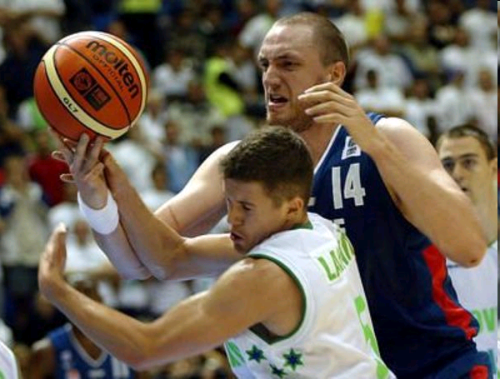
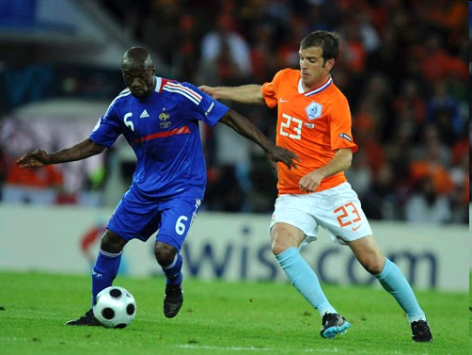
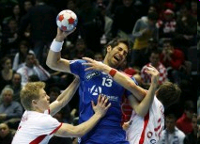
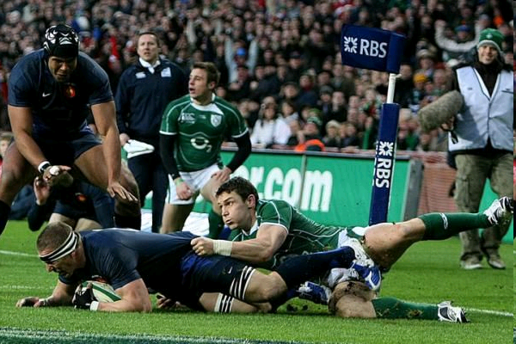
SPORT
Football
Rugby football
Basketball
Handball

Slide 7
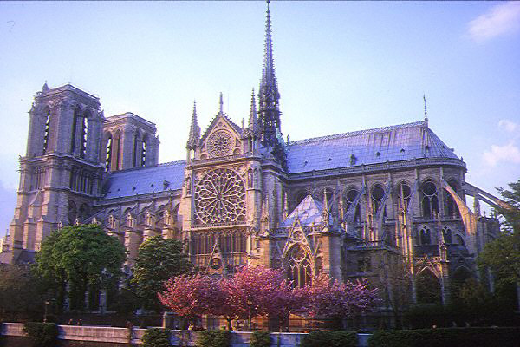
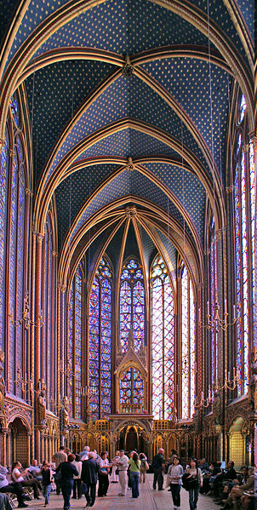
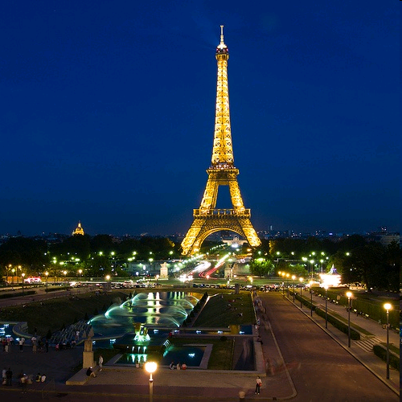
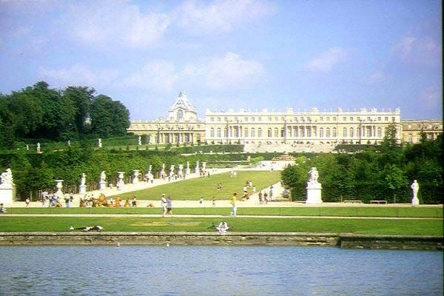
Architecture
Sainte-Chapelle
Eiffel Tower
Notre – Dame
Versailles

Slide 8
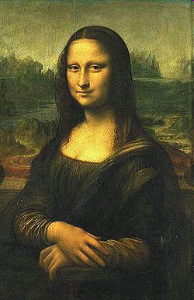
Interesting thing
Leonardo da Vinci ( Mona Lisa)

Slide 9
THE END

Slide 10
SOURCE
http://en.wikipedia.org/wiki/France
https://dijaski.net/

