Slide 1
FREETIME
Watching tv, cinema, theatre
Notes:
Najdi en fajni template.

Slide 2
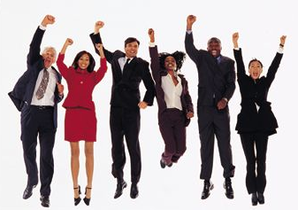
Jupi! FREETIME!
We can do whatever we want, don’t we?

Slide 3
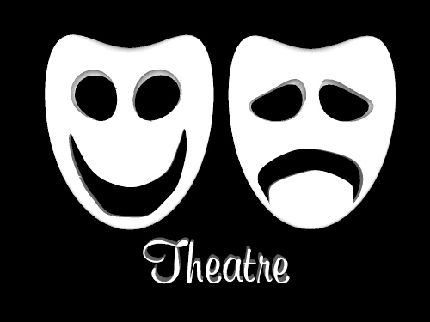
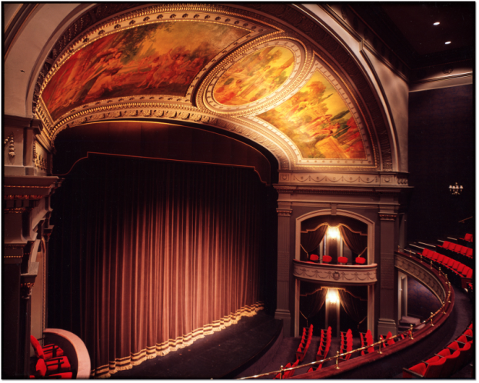
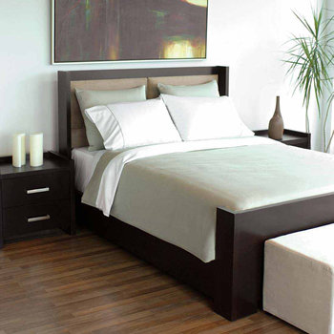
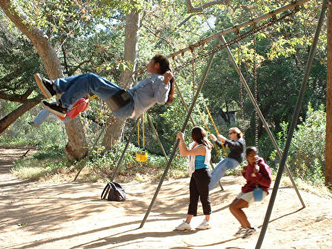
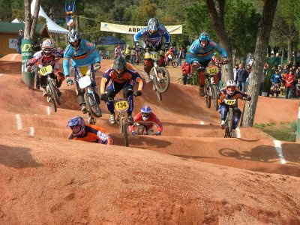
Notes:
Napelji na temo gledanja televizije, kina in gledališča, verjetno bo uporabo samo glede gledališča in kina ….

Slide 4
What is free time?
Free time / spare time / leisure time / pastime is something that everybody looks forward to. This is the time we are free to work or other duties and we can do what we like.

Slide 5
Why is free time important?
To relax
To escape the everyday routine, stress
To do things we cannot do while at school/work
To have time for your family/ friends and hobbies
To work more easily and efficiently

Slide 6
How can we spend our free time?
By doing nothing (TV,…)
By being active (sports,…)
By being of some use to society
By socializing
By making things with hands
By being creative
By staying outdoors, in fresh air
By going to the theatre/ cinema/ to the opera/ to a concert, by visiting art galleries/ museums/ various exhibitions
Notes:
By doing nothing = being physically inactive(watching TV, reading books/ magazines/ newspapers, watching sports in the playground)
By being active (sports, gardening)
By being of some use to society (doing voluntary work as members of different charities, societies, institutions or political parties)
By socializing (visiting friends, discussing current issues with them, arguing, gossiping)
(needlework, sewing, knitting, crocheting, do-it yourself, model-making)
By being creative (joining an orchestra/band/choir, drawing, painting, writing poems, acting, pottery, bird-watching, photography)
By staying outdoors, in fresh air (nature walks, walking, mountaineering,/hiking, climbing)

Slide 7
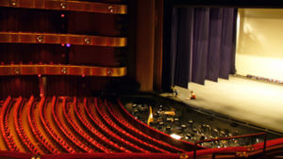
Theatre
building, room or outside structure with rows of seats, each row usually higher than the one in front, from which people can watch a performance or other activity:

Slide 8
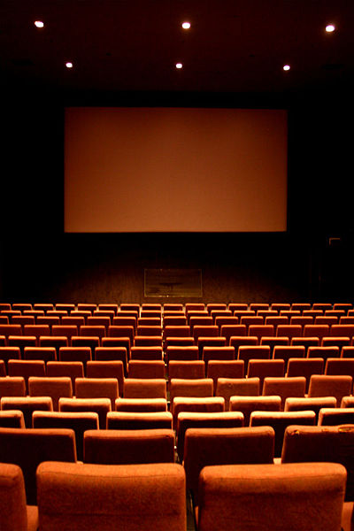
Cinema
A movie theater (aka. a cinema in Australia, New Zealand, the United Kingdom and Ireland) is a venue, usually a building, for viewing motion pictures ("movies" or "films").

Slide 9
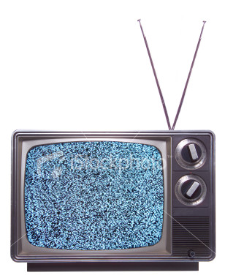
Television
(often abbreviated to TV) is a widely used telecommunication system for broadcasting and receiving moving pictures and sound over a distance.
UK informal: telly
TV’s are commercially available since late 1930s

Slide 10
Conclusion
Free time is definitely very important thing.
And it’s best to organized it and use it for things you like (different hobbys, sports, socializing,..)
It’s all right to watch TV, but isn’t it better to go outside and have fun playing sports or to visit your friend?

Slide 11
The end.

