Slide 1
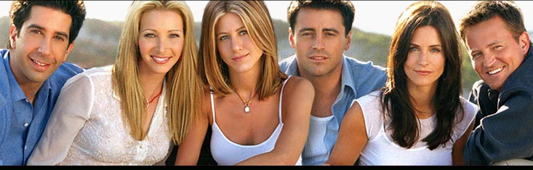

Slide 2
I`ll be there for you…
So no one told you life was gonna be this way Your job's a joke , you're broke, your love life's D.O.A. It's like you always stuck in second gear When it hasn't been your day, your week, your month, or even year but, I'll be there for you When the rain starts to pour I'll be there for you Like I've been there before I'll be there for you Cause you're there for me too.

Slide 3
Jennifer Aniston Rachel Green
Born in California, February 11, 1969
Films: The Object of My Affection, She’s the One, Rock Star, Bruce Almighty,…
Awards: nominated for an Emmy, Favorite Female Television Performer, Golden Globe

Slide 4
Courteney Cox Monica Geller Bing
Born in Alabama, June 15, 1964
Films: 3000 Miles to Graceland, Scream, Ace Ventura: Pet Detective, Blue Desert, Mr. Destiny,…
Guest-starring parts: Murder, She Wrote, Seinfeld,…

Slide 5
Lisa Kudrow Pheobe Buffay
Born in California, July 30, 1963
Films: Analyze This, Lucky Numbers, Clockwatchers, Hanging Up,…
Awards: five Emmy Award nominations, American Comedy Award, Golden Globe, Blockbuster Award

Slide 6
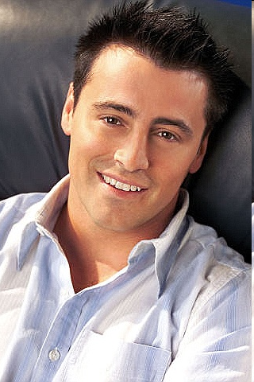
Matt LeBlanc Joey Tribbiani
Born in Massachusetts, July 25, 1967
Films: Charlie's Angels, Lost in Space, All the Queen's Men,…
Awards: Emmy, People's Choice Award and two Golden Globe Awards nominations

Slide 7
Matthew Perry Chandler Bing
Born in Massachusetts, August 19, 1969
Films: The Whole Nine Yards, She’s Out of Control, Almost Heroes, Three to Tango
Awards: Emmy nomination

Slide 8
David Schwimmer Ross Geller
Born in New York, November 12, 1966
Films: The Odyssey, The Jungle, The Master and Margarita, The Idiot, Since You’ve Been Gone,…
Awards: Emmy Award nomination

