Slide 1
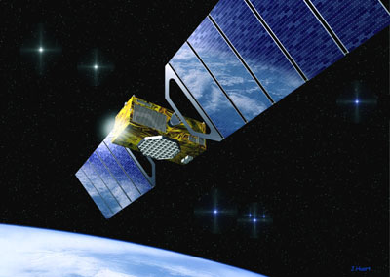
GALILEO

Slide 2

FACTS:
The European programme of civil radio-navigation
Initiated by the EC and the ESA
Works by triangulation
4 visible satelites are required

Slide 3

FACTS:
Completion in 2008
The Galileo program isn't military
Will provide more precise information(2m) than GPS(15m)
Continuous and guaranteed signal

Slide 4
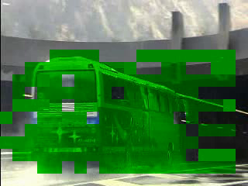
FACTS:
Will allow geo-localised services
Has a safety role to paly (roads)
First satelite already in orbit (2005)

Slide 5
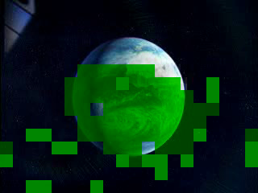
FACTS:
Next 4 satelites to be launched by the end of 2006
Sistem wil consist of 30 staelites
Satelites will circle the Earth in 3 orbits
Galileo is compatible and interoperable with the American GPS

Slide 6
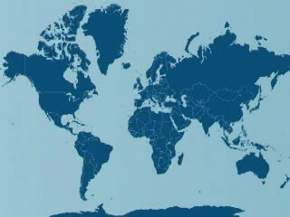
Financing:
Co financing agremants signed with: Israel, India, China, Ukraine, Russia, S. Korea, Australia, the MEDA countries, Brasil, Argentina, Chile and Mexico
Primary funds provided by EC and ESA

Slide 7
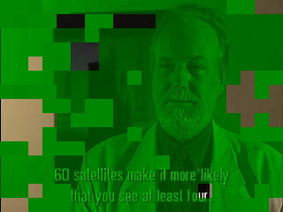
Financing:
The EC is to sign joint exploitation agreaments with private sector

Slide 8
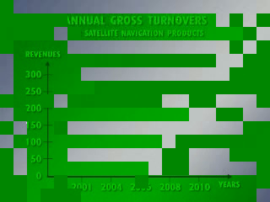
Commercial
attraction:
Marcet will increase from close to 0 in 2001 to 300 bilion € in 2010
Mass marcet usage of the service to increase from 40% in 2001 to 75% by 2010
Requiered investment only 3,2 bilion €

Slide 9
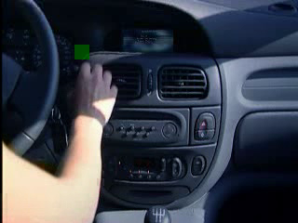
Consequences:
Galileo to be the first major ifrastructure bringing together all the EU states
more than 100 000 direct jobs in Europe
3 bilion receivers will be in use by 2010

