Slide 1
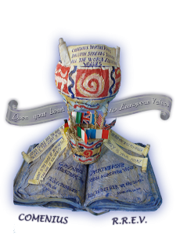
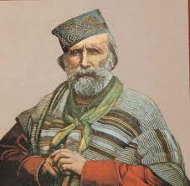
an italian hero
ISTITUTO COMPRENSIVO DI GATTEO
A COMENIUS PROJECT R.R.E.V.
GIUSEPPE GARIBALDI (1807-1882)

Slide 2
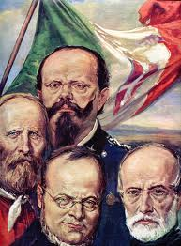
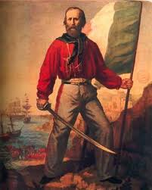
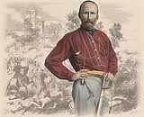
G A R I B A L D I C A V O U R M A Z Z I N I
A N D V I TT O R I O E M A N U E L E II
The Italian soldier Giuseppe Garibaldi (1807-1882) was the key
military figure in the creation of the kingdom of Italy and he
devoted his life to fighting oppression. Garibaldi was one of the
three great leaders who freed the Italians from foreign rule and
unified the country: Cavour is considered the "brain of
unification," Mazzini the "soul," and Garibaldi the "sword”. When
the Italian patriot and soldier Garibaldi was born, there was no
Italy, only a group of small states. These states had long been
under foreign domination. In the north, Lombardy was held by
Austria, and the States of the south were in the hands of the old feudal
regime of the Bourbons.

Slide 3
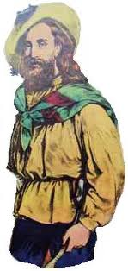
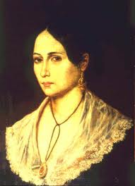
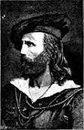
A N I T A G A R I B A L D I
G I U S E P P E I N U R U G U A Y
Giuseppe Garibaldi was born on July 4, 1807, at Nice, which was at that time a French town. His father, Domenico, was a fisherman and a modest tradesman, and for this reason Giuseppe chose for a life at sea. He was a handsome man with long hair, a full beard, and burning eyes.
Garibaldi entered the Piedmontese navy and in 1833 joined Young Italy, the revolutionary association of Giuseppe Mazzini, another Italian irredentist and patriot; he became involved in a mutiny in Piedmont, which was economically the strongest of the Italian provinces, but the plan failed and Garibaldi was condemned to death and went to Marseilles.
In 1836 Garibaldi sailed for Rio de Janeiro from Marseilles. He met a woman named Anna Maria Ribeiro da Silva, called "Anita”, and they married in 1842. He then entered the service of Uruguay, becoming commander of the new Italian Legion at Montevideo in 1843 and his victories did much to ensure the liberty of Uruguay. Garibaldi's years in South America taught him the skills of war; for his many military adventures both in Europe and South America he gained the nickname "Hero of the Two Worlds"

Slide 4
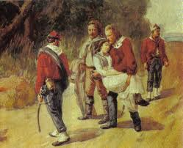
In 1847 news of revolutionary agitation in Italy encouraged Garibaldi to lead some sixty members of his legion home for the liberation and unification of the peninsula. In 1849 he participated in the defence of the Roman Republic with Mazzini but, unfortunately, the Republicans were defeated and Garibaldi had to leave Rome. During his escape he lost many faithful companions, including his beloved wife Anita, he managed to reach the territory of the Kingdom of Sardinia. He offered his services to Charles Albert King of the Piedmont and in August he was in command of a volunteer army at Milan. Garibaldi changed from a republican to a royalist because he believed that the King of Piedmont was the only one who could defeat the Austrians and unite Italy. This change was the end of a good relationship between Mazzini and Garibaldi. Therefore the war went badly for the revolutionaries. Garibaldi turned up in America, but in 1855 he returned to Italy and bought part of the island of Caprera, north of Sardinia, where he built a home.

Slide 5
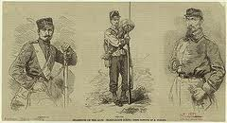
The hunters
of the Alps
In 1858 a fateful meeting took place at Turin between Garibaldi and Camillo di Cavour, the prime minister of the Piedmontese kingdom. The count, looking forward to another war with Austria, asked the soldier to form an army of volunteers. Garibaldi accepted and was made a general in the Piedmontese army. In April 1859 he formed his corps, the “Cacciatori delle Alpi” (Hunters of the Alps), and in the same month war broke out. A rapid series of victories in May drove the Austrians out of northern Italy, all the way to the Tirol. He also wanted Rome and Venetia and Naples and Sicily to be a part of the Unification.
But Garibaldi was not permitted to attack the papal states in November and bitterly returned to civil life. He was quickly elected to the Piedmontese Parliament, and in April 1860, he publicly attacked Cavour for ceding Nice to France. Meanwhile he was planning, with British encouragement, the invasion of Sicily. His plan was to advance through the Napal states onto Rome and therefore complete the Unification of Italy, but the armistice of Villafranca with Austria stops its operations and its hunters.

Slide 6
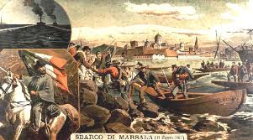
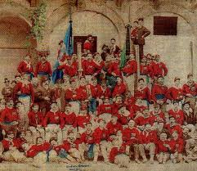
The famous “ red shirts”
On May 11, 1860, Garibaldi landed at Marsala with a thousand men known as “I Mille” or “The red shirts” and, at Calatafimi, he defeated the opposing army. By May 25, Palermo, the capital of Sicily, was in his hands. Then, his forces crossed the Straits of Messina, and, on September 7, Garibaldi triumphantly entered Naples. Italians greeted Victor Emmanuel, King of the Piedmont, as he travelled south through the country to meet Garibaldi near Naples. On November 7, 1860 the soldier formally gave to Victor Emmanuel all of southern Italy and proclaimed him king of a united land. Victor Emmanuel and Cavour believed that Garibaldi’s political job was done, since all of Italy was united except Rome and Venetia. Austria still possessed the Trentino, and the territory of the Church, protected by the French, still lay as an obstacle across central Italy.

Slide 7
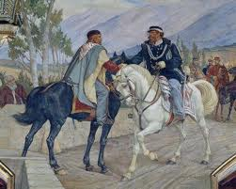
In 1862, Garibaldi returned to Sicily from Caprera and collected over 3000 volunteers to set up an army for the conquest of Rome. This attempt failed and Garibaldi was sent back to Caprera. After travelling in 1864 to England, Garibaldi formed another volunteer army to defeat once again with the Austrians. And again his army seemed invincible. He won battle after battle until, when about to attack the Trentino, he was ordered by his superior, Gen. Lamarmora, to withdraw. The order came on July 21, 1866, and Garibaldi's answer, "Ubbidisco" (I obey), has often been called a marvellous example of a soldier's subordination of his own wishes to the command of a superior
Garibaldi and Vittorio Emanuele II at Teano
In 1867 he thought the time was right for another attack on the papal territory. Before he could put his plan into operation, he was once again arrested by the Italian government and brought back to Caprera. It was ironic that when, in 1870, the Italian kingdom finally absorbed the remainder of the States of the Church, the great ”condottiere” was not directly involved. Garibaldi went on to help France's Third Republic in her war against Prussia.

Slide 8
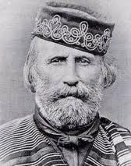
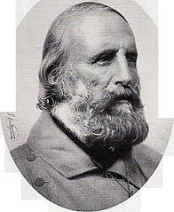
Already a popular hero he "served as a global exemplar of mid-19th century revolutionary nationalism and liberalism." Garibaldi used his liberal beliefs, his powers and skills as an organizer and leader of men, and also his dream of a unified Italy to fight for and make that dream possible. Garibaldi died on June 2, 1882, on the island of Caprera where he was interred.

