Slide 1
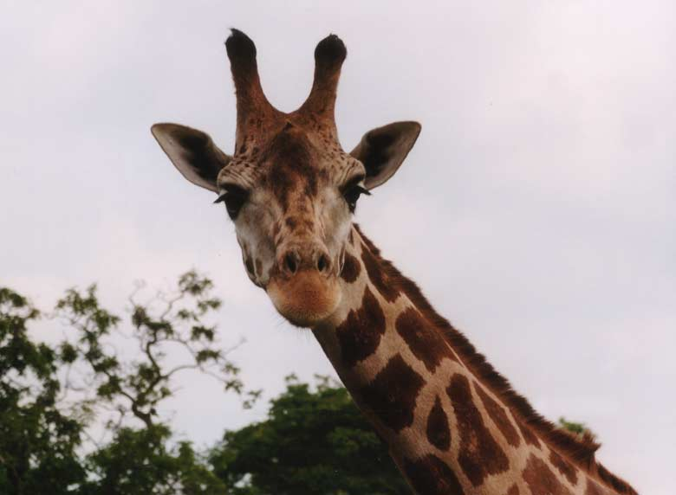
GIRAFFE

Slide 2
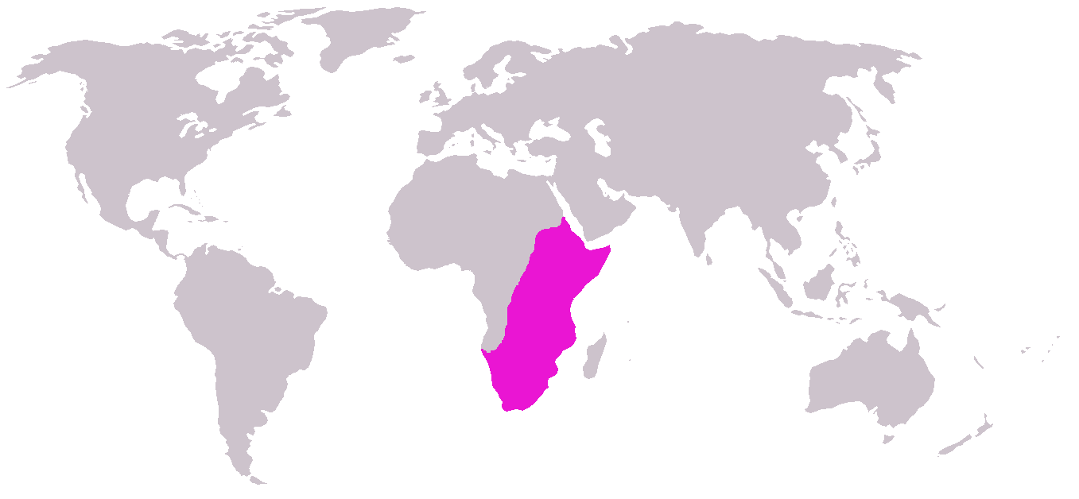
About giraffe…
is related to deer and cattle, but is placed in a separate family, the Giraffidae,
Its range extends from Chad to South Africa

Slide 3
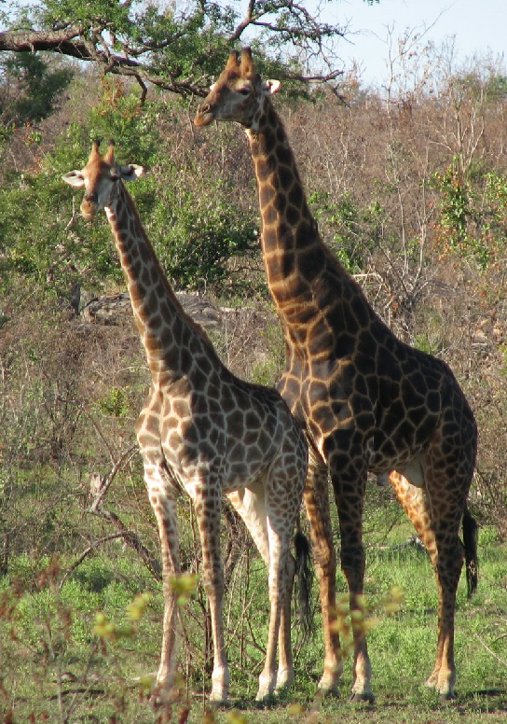
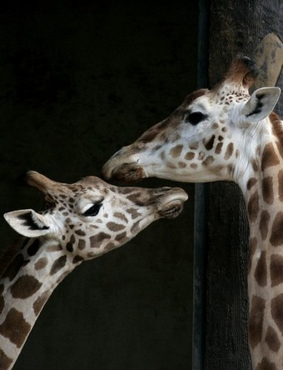
Female giraffes: are 30-60 cm shorter 200-400 kg less than males | Male giraffes : 4.8-5.5 m tall 1300-1700 kg

Slide 4
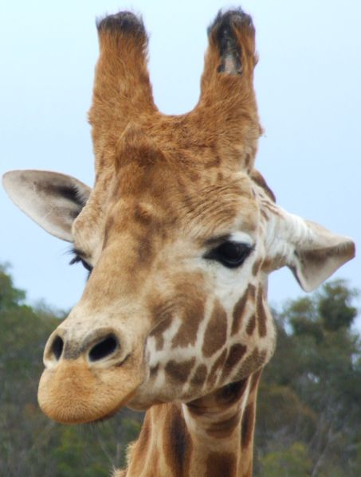
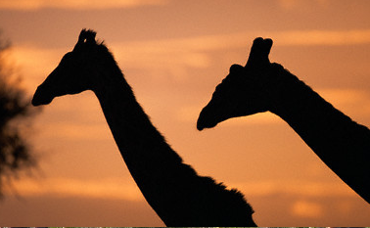
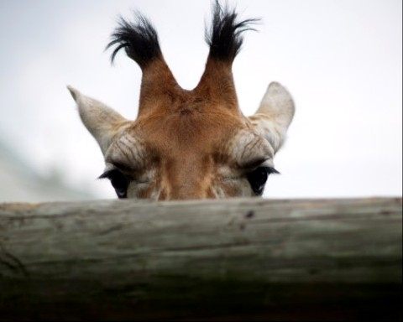
Horns:
female male
identifying the sex of giraffes:
females displaying tufts of hair on the top of the horns,
males' horns tend to be bald on top

Slide 5
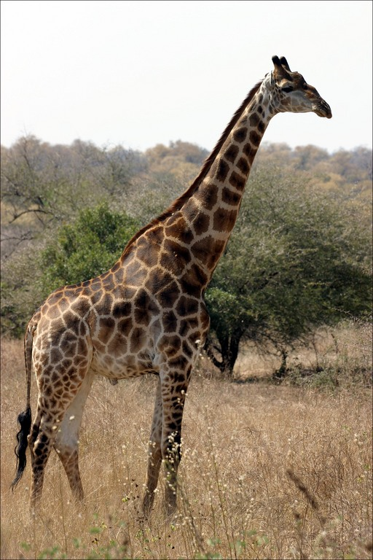
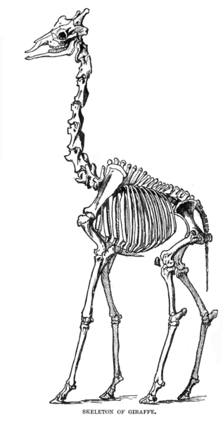
Neck:
long necks which they use to browse tree leaves
seven vertebrae in the neck that are elongated

Slide 6
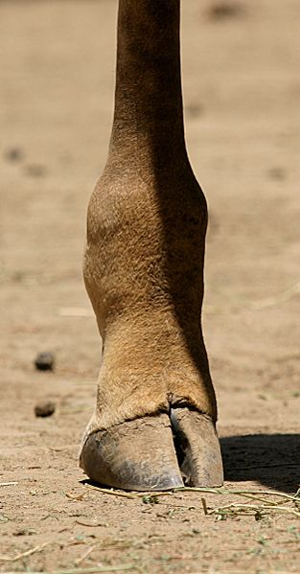
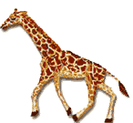
Legs and pacing:
have slightly elongated forelegs, about 10% longer than their hind legs
The pace of the giraffe is an amble
it can run extremely fast, up to 55 km/h
at low speed:
the left legs moving together followed by right
at high speed:
the back legs crossing outside the front
giraffe defends itself with a powerful kick

Slide 7
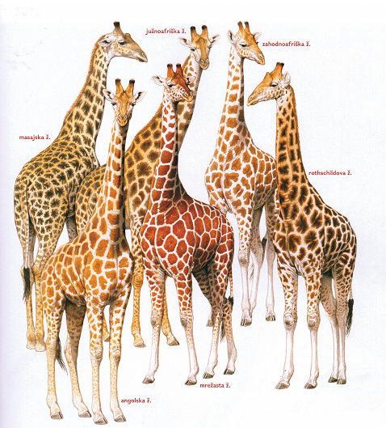
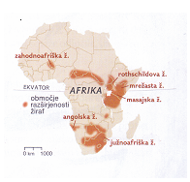
Spots:
We know a lot of many diferent speces of giraffe, they are differente of the pattern of spots:
1.Sauth African Giraffe
2.Smoky Giraffe
3.Masai Giraffe
4.Somali Giraffe
5.Rothschild Giraffe
6.West African Giraffe

Slide 8
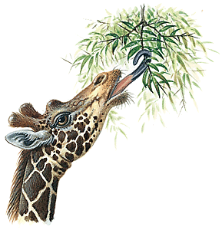
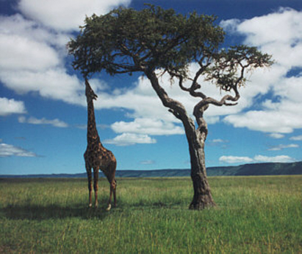
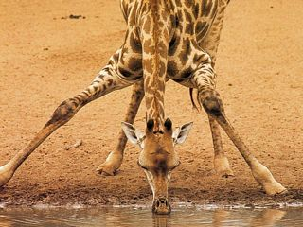
Food…
browses on the twigs of trees
it can live without inconvenience on other vegetable food
63 kg of leaves and twigs daily

Slide 9
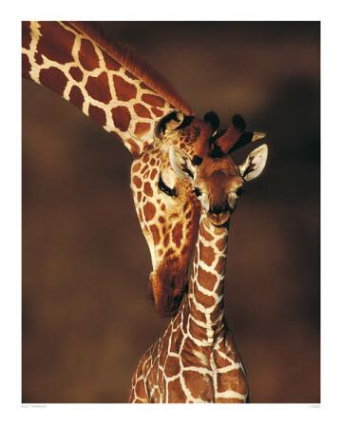
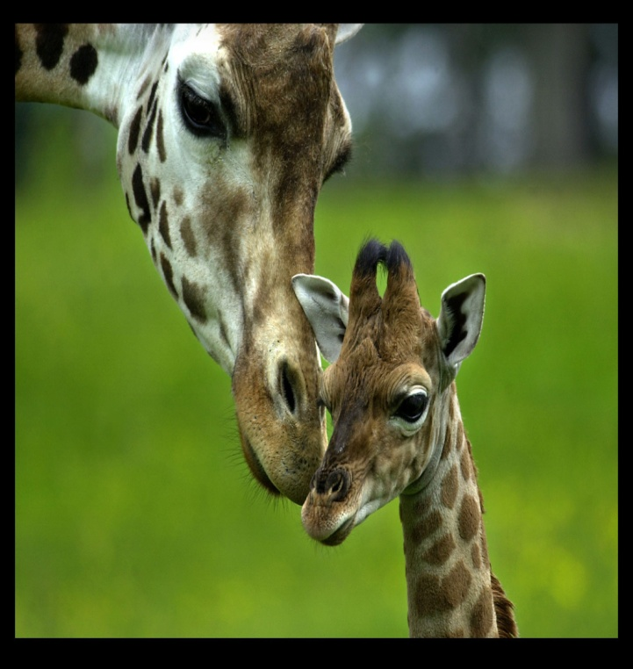
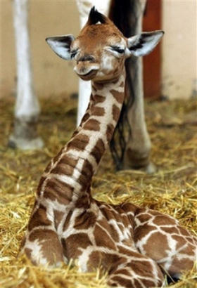
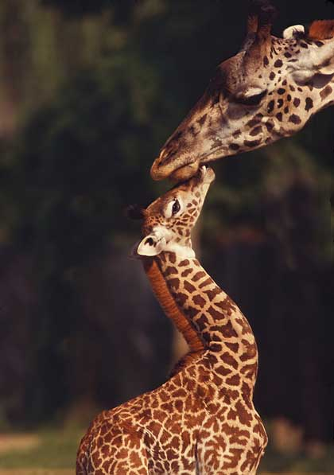
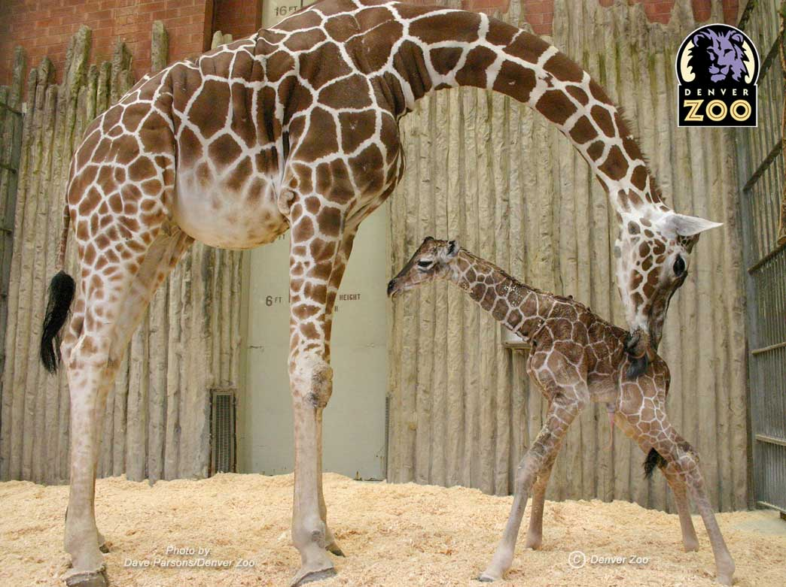
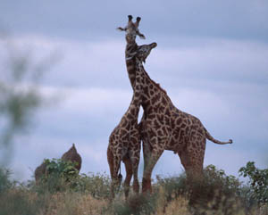
Some pictures….

Slide 10
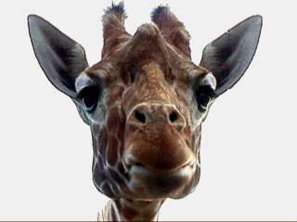
Thank you for whaching!

