Slide 1
GLOBAL ISSUES

Slide 2
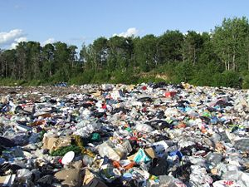
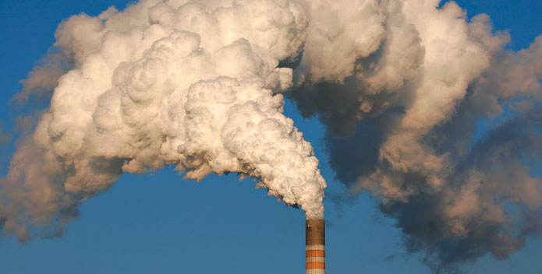
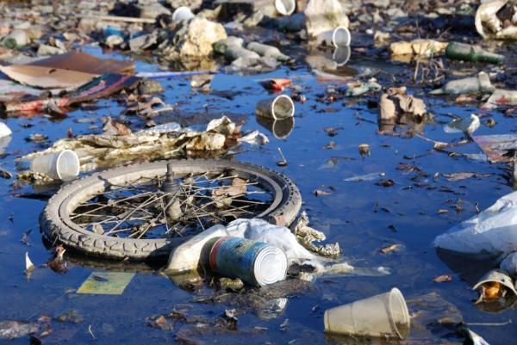
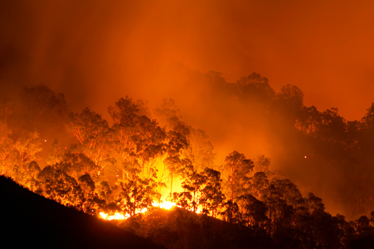
ENVIRONMENTAL PROBLEMS
POLLUTION
ground
Air&athmosphere
water
forests

Slide 3
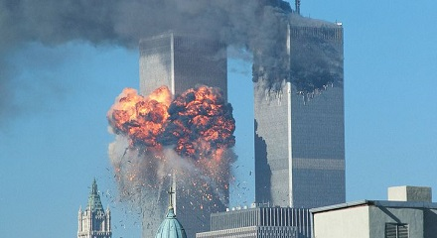
POLITICAL PROBLEMS
Gender roles
Human rights
Death panels
Terrorism

Slide 4
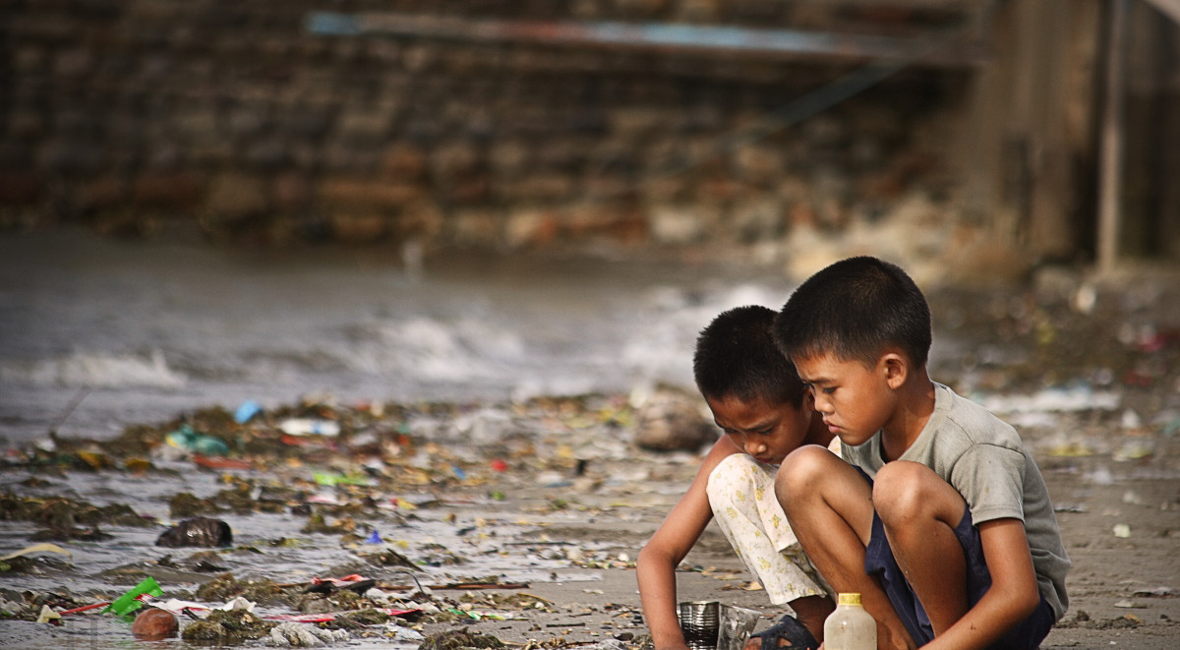
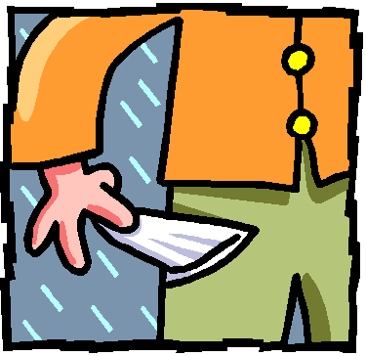
SOCIAL PROBLEMS
Overcomsumption
Violent toys
Poverty

