Slide 1
Global Warming

Slide 2
Global Warming
13.4 °C
14 °C
16 °C
150 years ago
present
2090

Slide 3
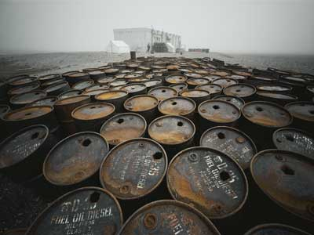
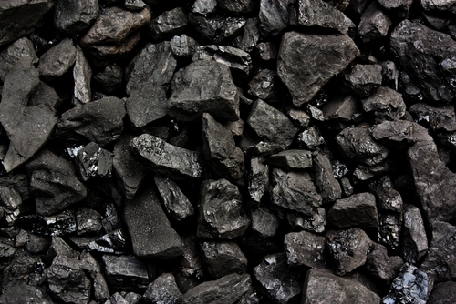

Slide 4
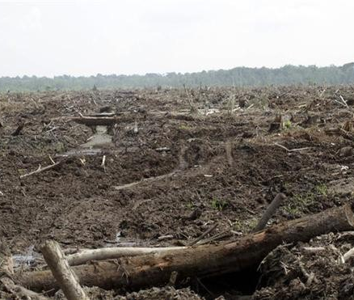
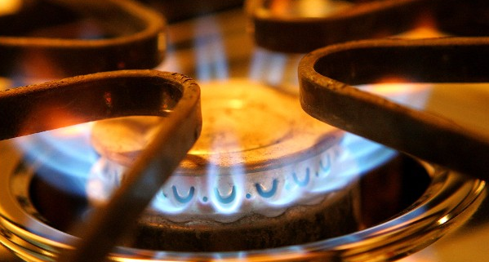

Slide 5
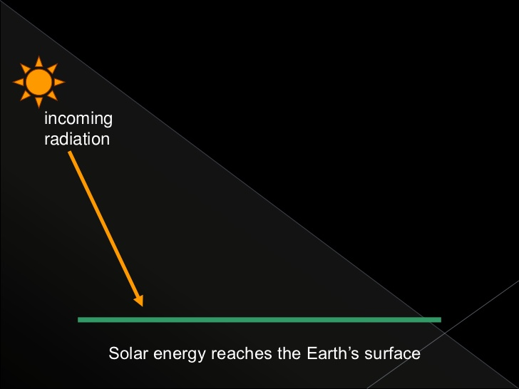
Greenhouse Effect

Slide 6
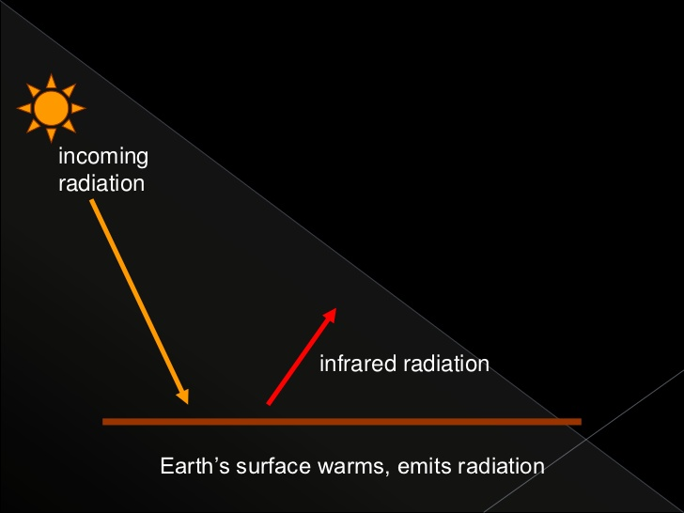
Greenhouse Effect

Slide 7
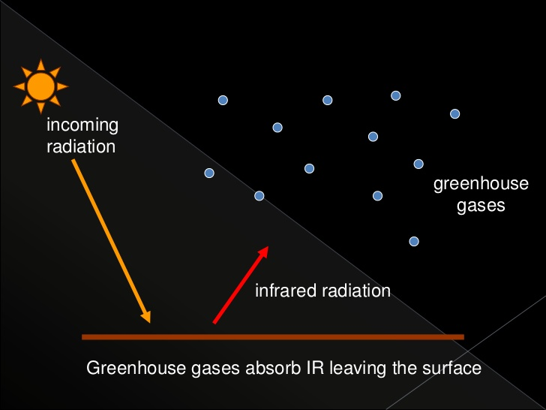
Greenhouse Effect

Slide 8
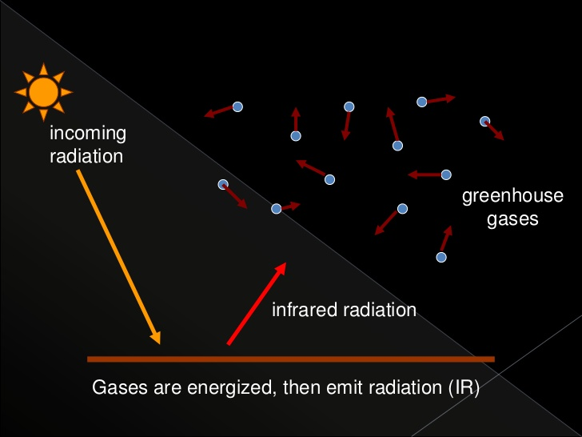
Greenhouse Effect

Slide 9
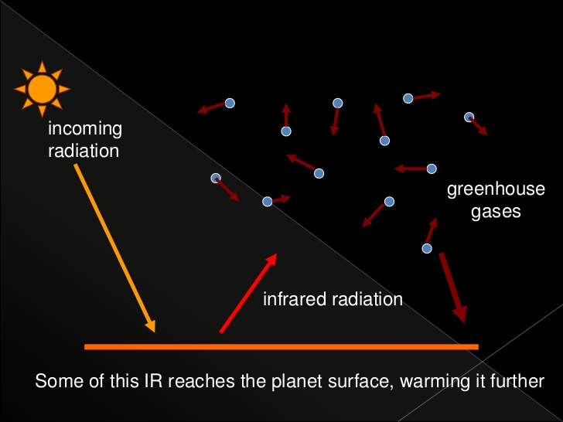
Greenhouse Effect

Slide 10
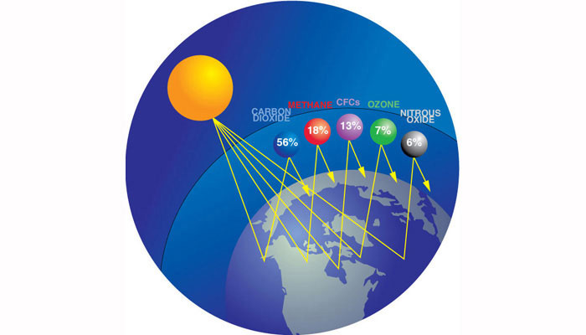
Greenhouse Gases

Slide 11
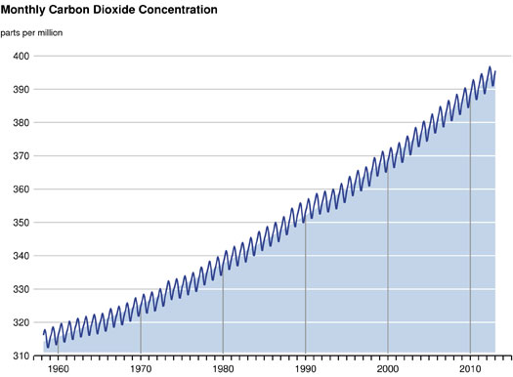
Role in Climate Changes

Slide 12
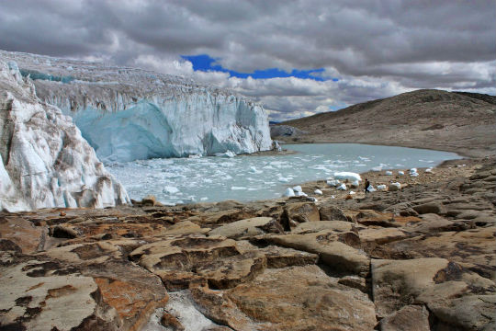
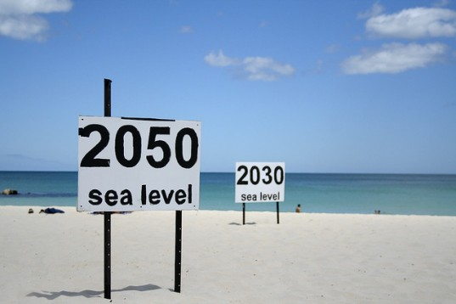
Consequences

Slide 13

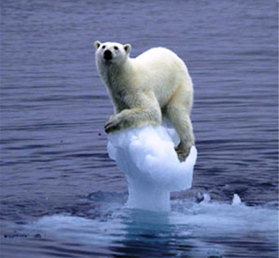
Consequences

Slide 14
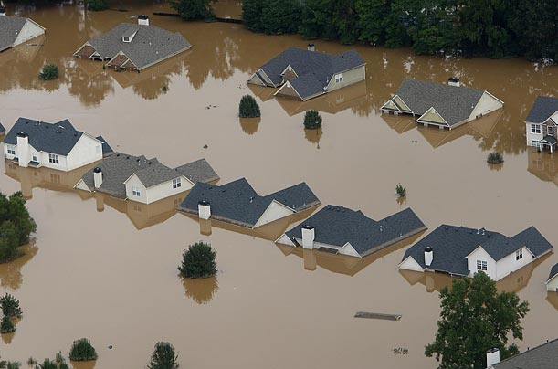
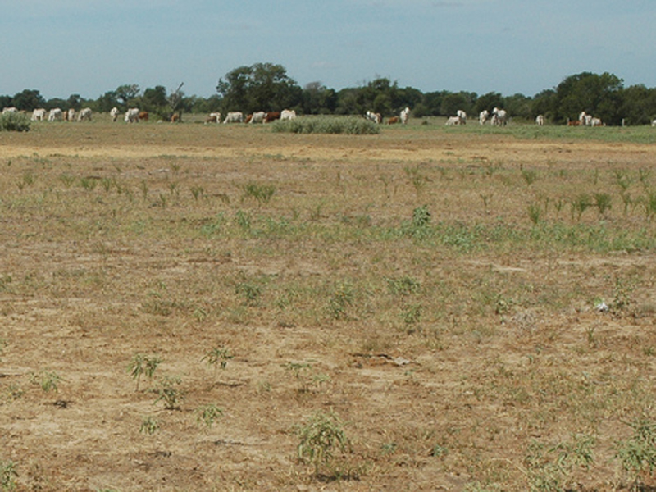
Consequences

Slide 15

Reducing

Slide 16
Sources
SLOVENSKI veliki leksikon. Ljubljana; Mladinska Knjiga. 2007.
GLOBAL warming. [elektronski vir]. 2014. [citirano: 3. december 2014]. Dostopno na URL-naslovu: http://www.nrdc.org/globalwarming/
GREENHOUSE effect. [elektronski vir]. 2014. [citirano: 3. december 2014]. Dostopno na URL-naslovu: http://en.wikipedia.org/wiki/Greenhouse_effect
KYOTO protocol. [elektronski vir]. 2014. [citirano: 3. december 2014]. Dostopno na URL-naslovu: http://unfccc.int/essential_background/kyoto_protocol/items/6034.php
GREENHOUSE effect. [elektronski vir].[dostopno: 3. december 2014]. Dostopno na URL-naslovu: http://www.edfenergy.com/energyfuture/images/schematic/greenhouse-effect.jpg

