Slide 1
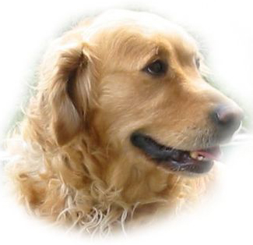
MY FAVORITE ANIMAL
DOG GOLDEN SHEEP
Notes:
INTERNET! KAK SE PRAVILNO ANGLEŠKO REČE {napiše} PRINAŠALEC!

Slide 2
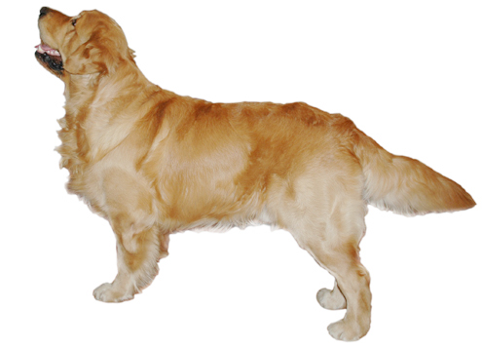
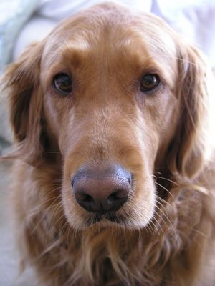
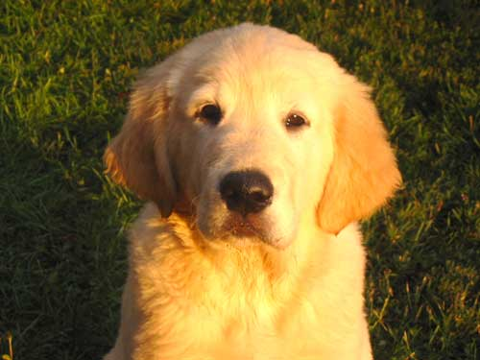
APERANCE
VERY CUTE
COLOUR: GOLD, BROWN OR WHITE
EYES: BIG AND BROWN
QUITE BIG
QUITE FAT
4 LEGS

Slide 3
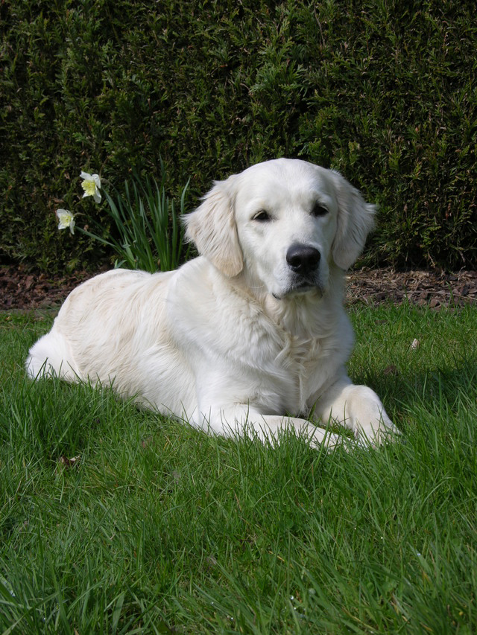
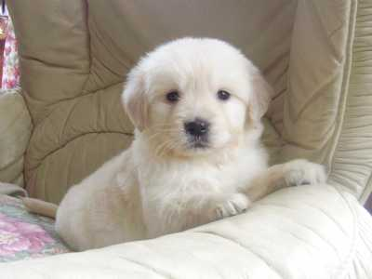
PERSONALITY
HAPPY
VERY LAZY
HONEST
FRIENDLY
VERY PLAYFUL
DOESEN˙´T LIKE BE ALONE

Slide 4
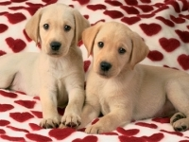
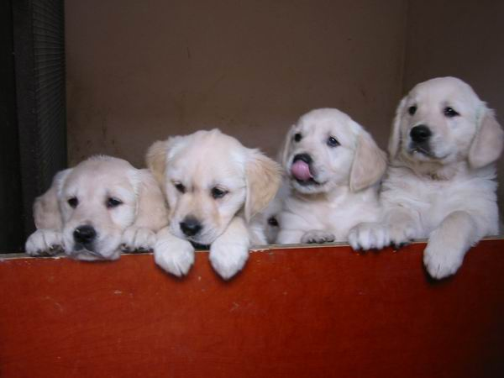
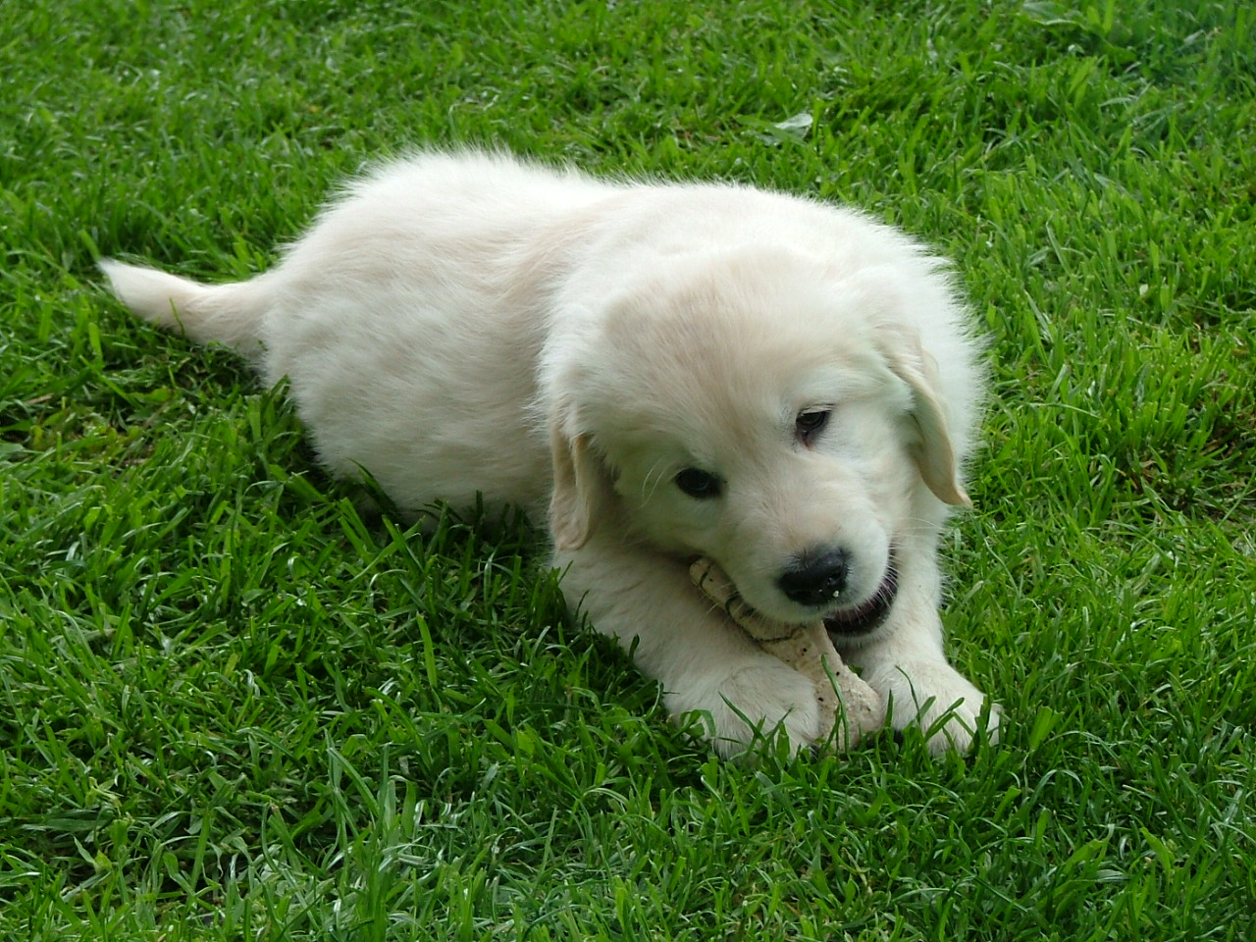
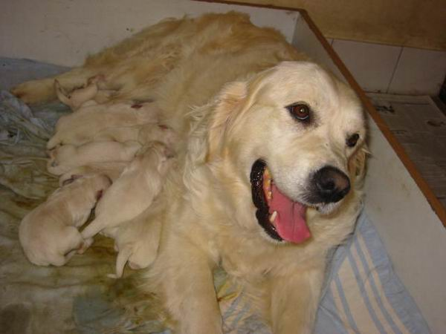
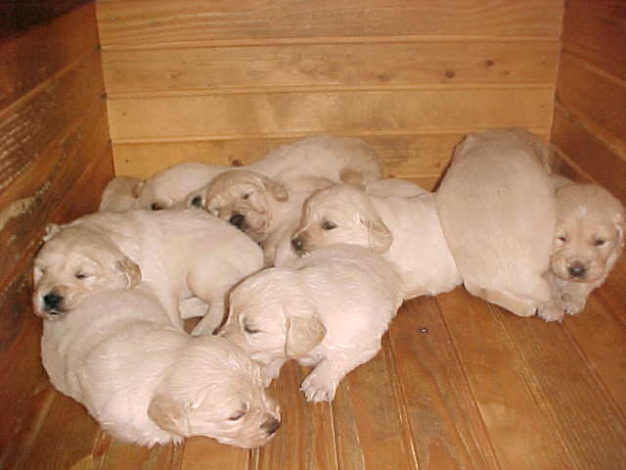
Puppies
VERY FAT
NICE
PLAYFUL

Slide 5
OLD DOGS:

Slide 6
PICTURES:

Slide 7
Teacher: Lidija Strmšek Pisanec
Information by:
-my self
-internet

