Slide 1
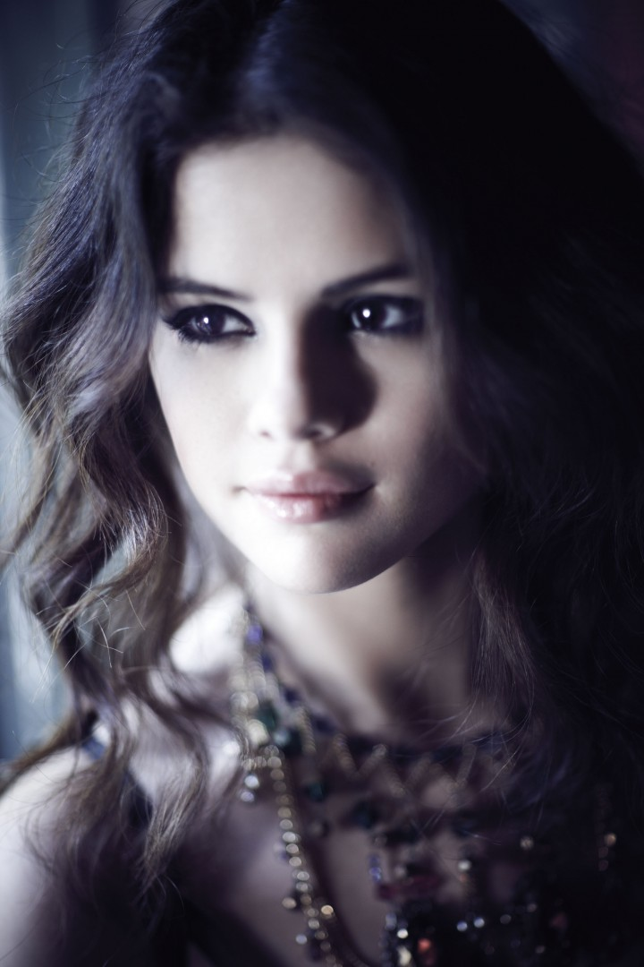
Selena Gomez

Slide 2
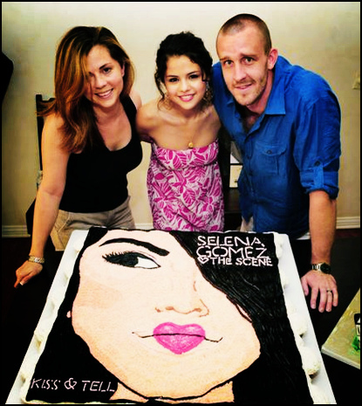
BIRTH AND FAMILY
Born in Grand Texas 22.july.1992
Mother: Mandy Teefey
father: Ricardo Joel Gomez
She also has a half-sister Gracie
Her parents divorced when she was 5
Years old

Slide 3
EDUCATION
She was educated at home
In May 2010, received a diploma of secondary school
The school will continue later

Slide 4
EMPLOYMENT AND CURRENT JOB
She signed a contract with Disney
She already played in alot of movies and series
In 2008 she have started music career

Slide 5
MOVIES
She's already played in 14 movies

Slide 6
ALBUMI
Kiss and tell (2009)
A year without rain (2010)
When the sun goes down (2011)
Stars dance (2013)
She has released 4 albums:

Slide 7
MUSIC AWARDS
She has won more than 35 music awards

Slide 8
ATTRACTIONS
Project: Runway for life
Project: A day made better
RAISE hope for Congo
PETA~help animals
She raised money for people from socially endangered environment
Ambassador to UNICEF
Good works:

Slide 9
VIRI
http://www.aceshowbiz.com/celebrity/selena_gomez/awards.html
http://sl.wikipedia.org/wiki/Selena_Gomez#Dobrodelna_dela
http://selenagomez.com/
http://www.imdb.com/name/nm1411125/

Slide 10
THANK YOU FOR
WATCHING ☺

