Slide 1
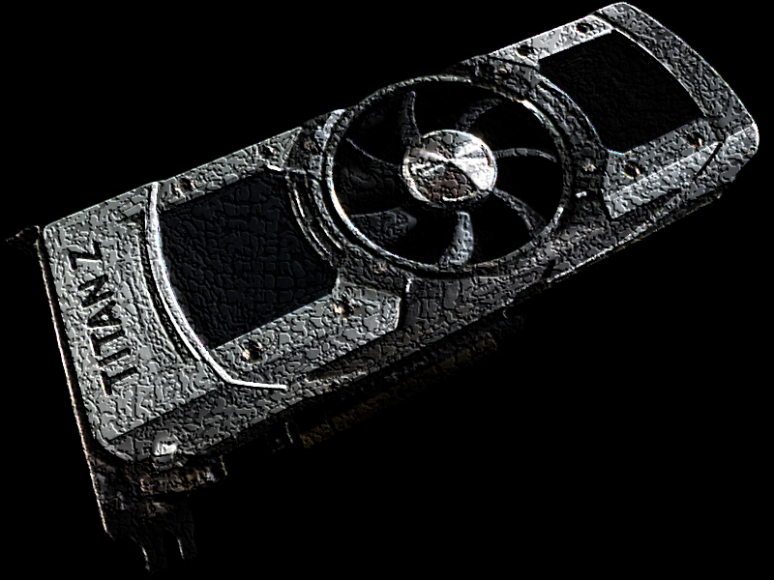
GRAPHIC CARD

Slide 2
review
Graphic card
existing tipes
history
modern card
size
literature

Slide 3
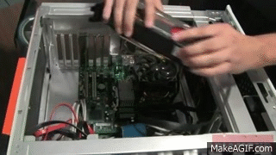
Graphic card
Graphic card is a computer part responsible for image display some computers have it integrated on the mother board, others have it given trough expansible lines. The card is made out of processing unit, heat pointer, BIOS video, video memory, ramdac and many outputs.

Slide 4
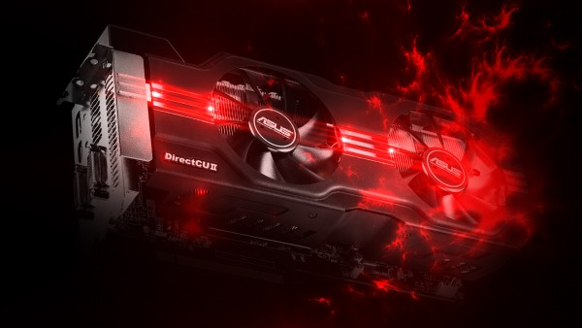
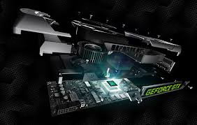
Existing types
we know cards that are integrated on the mother board, cards given trough expansible lines , cards of bigger and smaller profiles and older and newer cards. We also know cards that can be combined between.

Slide 5
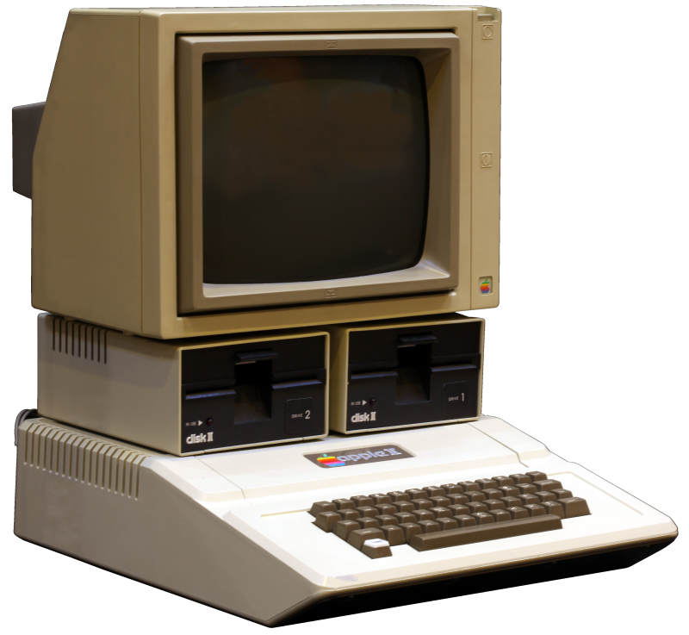
history
the card was first introduced by Apple in model called Apple 2, the first cards were only one collored.
Graphic card evolution:
CGA from1981, EGA from 1984, VGA from1989,
After that IBM lost control of the market and many new standards arrive (SVGA,XGA,…).

Slide 6
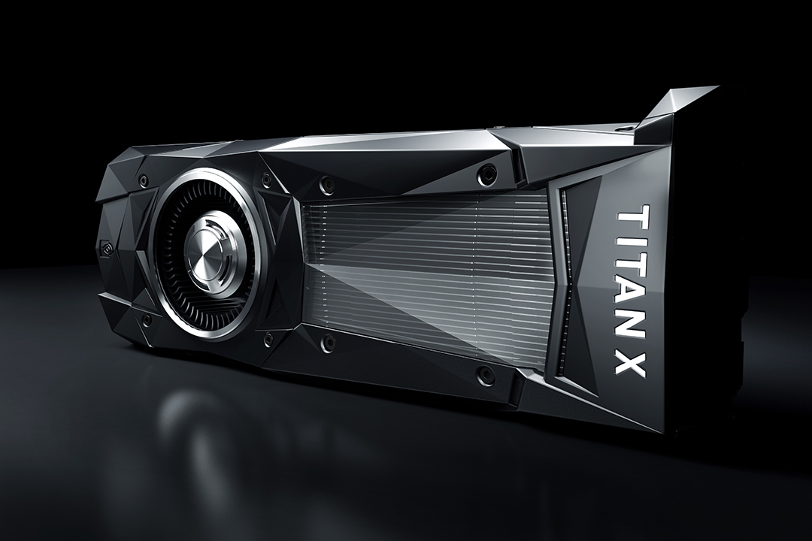
Modern graphic card
Modern graphic card is better than its previous modelds in every way. It has bigger ram – space, bigger and better resoloution, better color dispaly, less overheating, its size is much smaller and for less money we get more than we ever did. The best card curentlly in market is Titan XP.

Slide 7
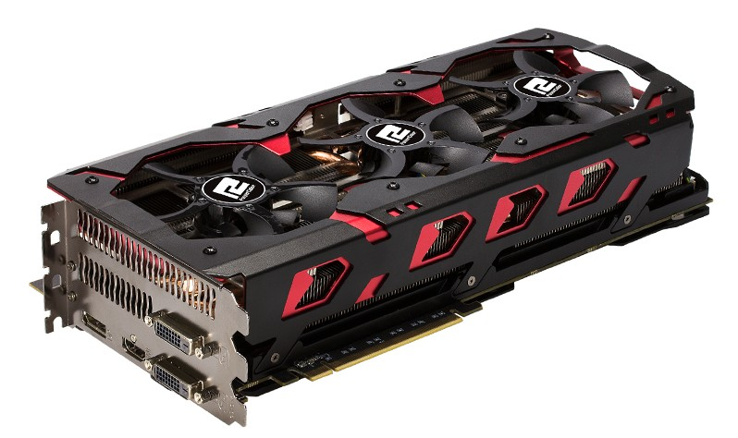
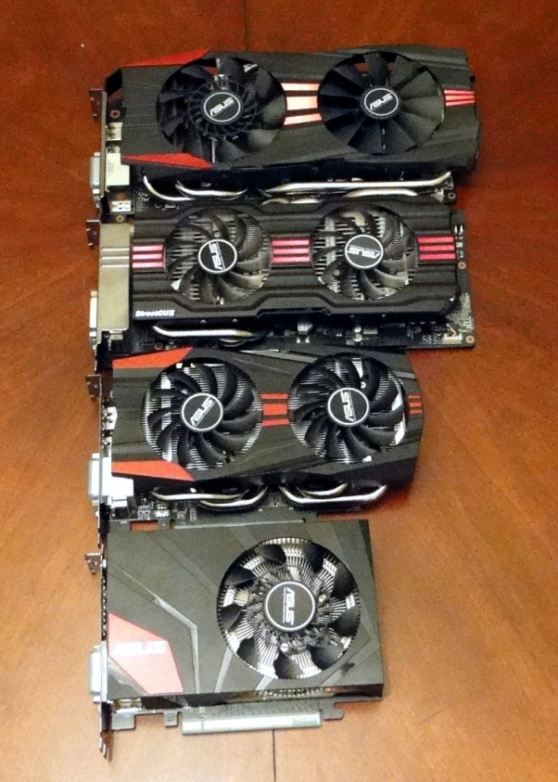
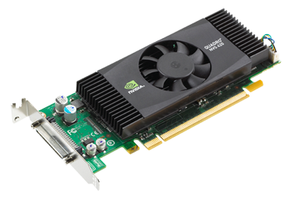
size
Computer graphic cards can be in one of two size profiles. Which allows card to be inserted into smaller computers as weal, some cards are not in ordinary sizes and are called lower profile cards. Their size is measured by their widthness and pick up less space in computer than its actual widthness. Length and thickness of the card can be diversed greatly and with cards of bigger profiles we can fill up to three spaces in the computer.

Slide 8
literature
[1]https://sl.wikipedia.org/wiki/Grafi%C4%8Dna_kartica
[2]http://www.techradar.com/news/computing-components/graphics-cards/best-graphics-cards-1291458
[3]https://en.wikipedia.org/wiki/Video_card
[4]http://computer.howstuffworks.com/graphics-card.htm

