Slide 1
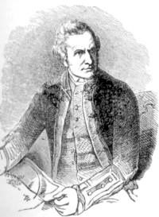
GREAT EXPLORERS
James Cook

Slide 2
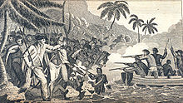
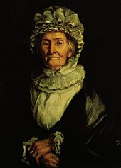
BASIC INFORMATION
NAME: Captain James Cook
BORN: 7. NOVEMBER 1728, ENGLAND
DIED: 14. FEBRUARY 1779, HAVAJI
NATIONALITY: BRITISH
FAMILY:
Wife Elizabeth Batts
Children: James Cook, Nathaniel Cook, Elizabeth Cook, Joseph Cook, George Cook, Hugh Cook
James Cook was an explorer, navigator and cartographer

Slide 3
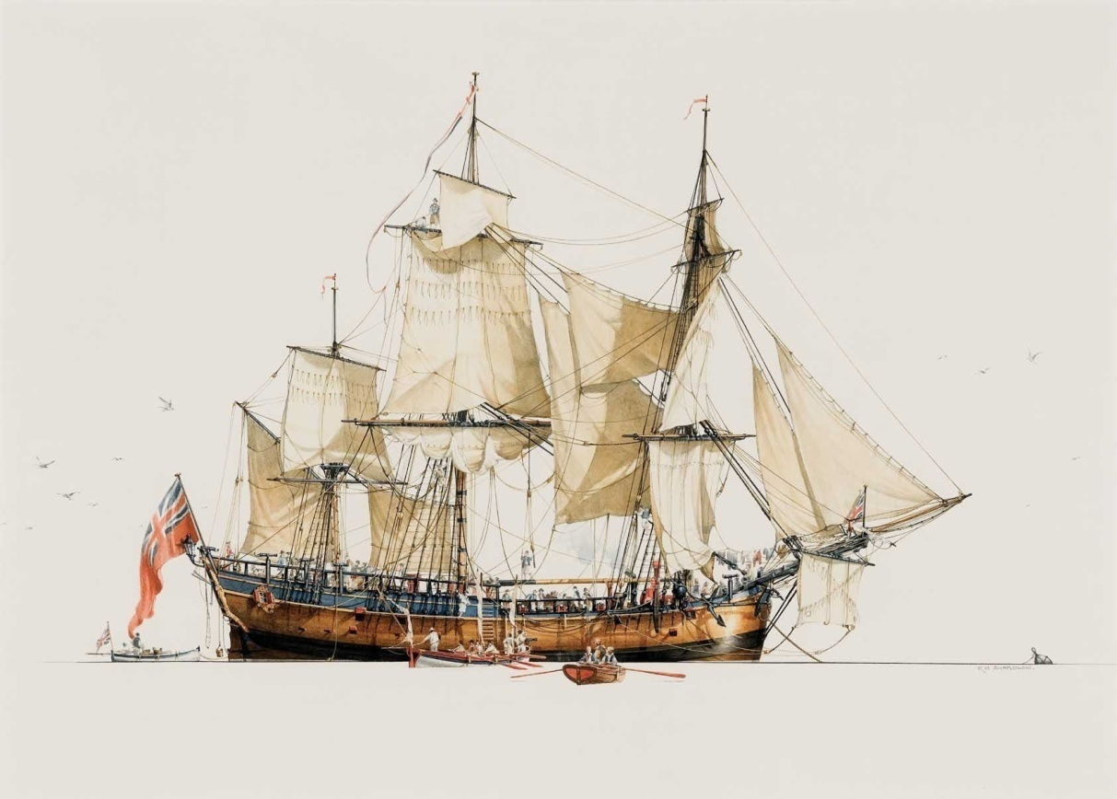
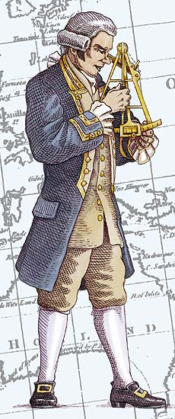
Young Cook
He was the second of the eight children of James Cook
In Whitby, he was taken as a Merchant navy apprentice
After a few years he thought that his career would
advance faster if he would join military service
Betwen Seven years war he drew lots of maps
Admiralty and Royal Society made him a commander of HM
Bark Endeavour

Slide 4
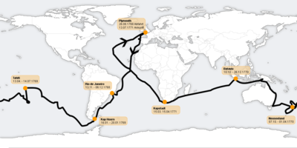
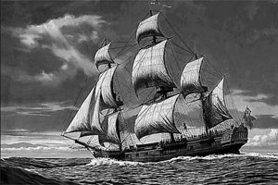
1. voyage
In 1766 Cook traveled to Pacific Ocean to observe and record transit of Venus over sun
TRAVEL PATH:
ENGLAND (STARTED 1766)
AROUND CAPE HORN (ACROSS THE PACIFIC)
TAHITI (COMPLETE HIS JOB)
AUSTRALIA
GREAT BARRIER REEF (THEY RAN AGROUND)
ENGLAND (ENDED 1771)

Slide 5
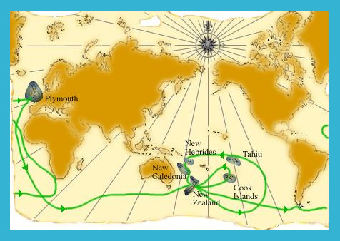
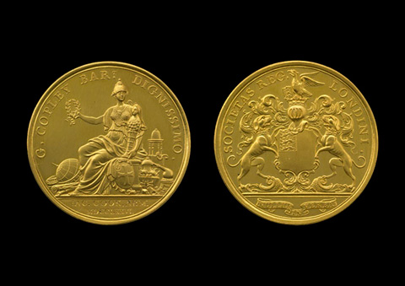
2. voyage
In 1722 Cook again passed the Pacific search for the hypothetical Terra Australis
Cook commanded on HMS Resolutiom and Tobias Furneaux commanded on its companion ship, HMS Advanture
TRAVEL PATH:
Arctic circle
He discovered Clark Rocks and the South Sandwich
islands
Cook almost encountered the mainland of Antarctita
Tahiti
Friendly islands
Easter island
Norfolk island
New Caldonia, Vanuatu

Slide 6
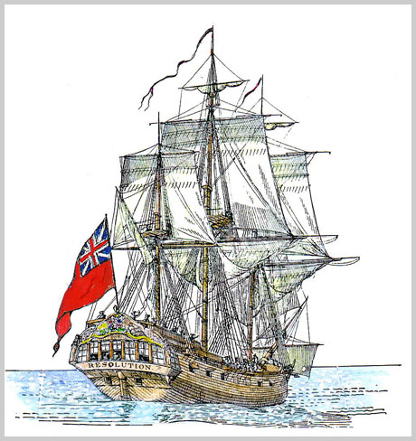
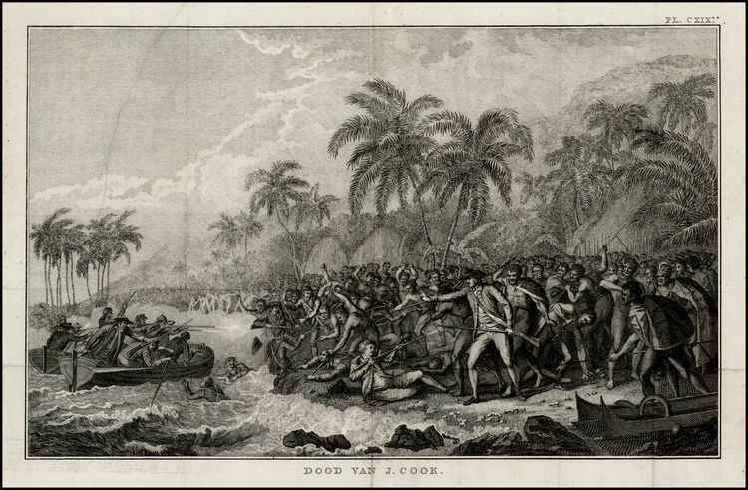
3. voyage
Cook again commended on HMS Resolutiom and captain Charles Clerk commended on HMS Discovery
Cook had to return Omai to Tahiti, but the main reason was to
discover Northwets passage
After he returned Omai, he was the first European on the
Hawaiian island (Sandwich islands)
THEN HE WENT TO:
North America to explore the coast
Yuquot (trade with natives)
Bering Strait (Cook Intlet)
He returned to Hawaii 1779 where he was killed by natives

Slide 7
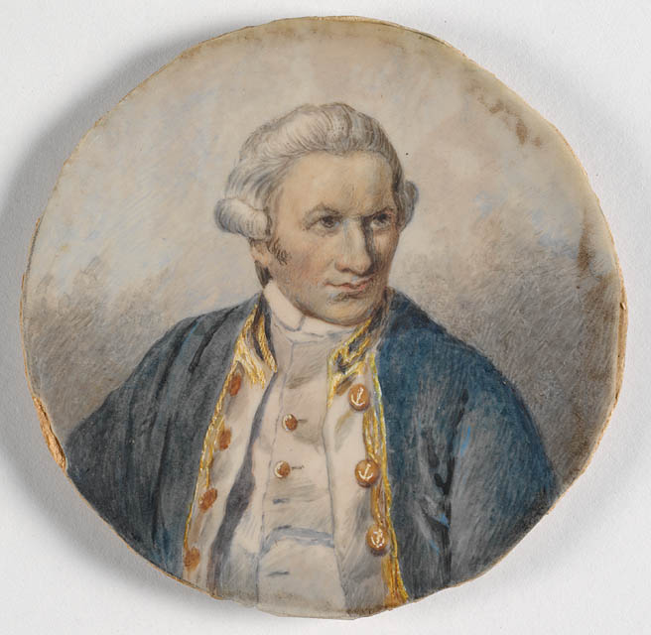
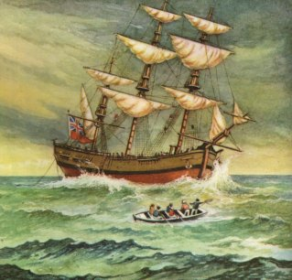
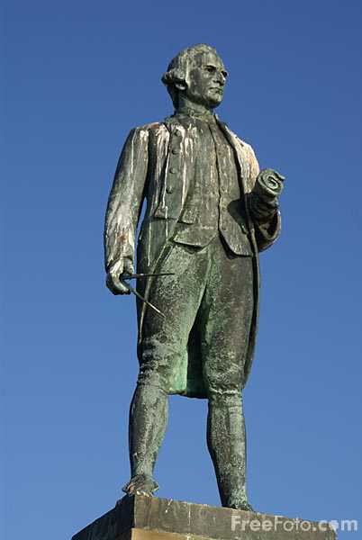
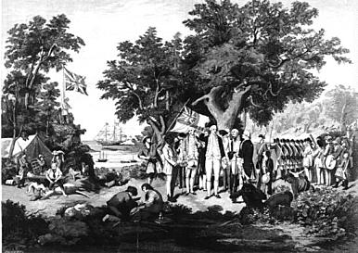
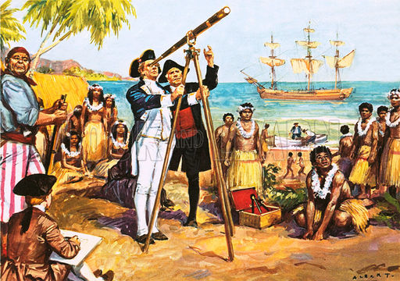

Slide 8
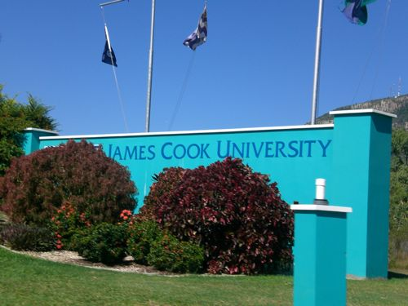

Slide 9
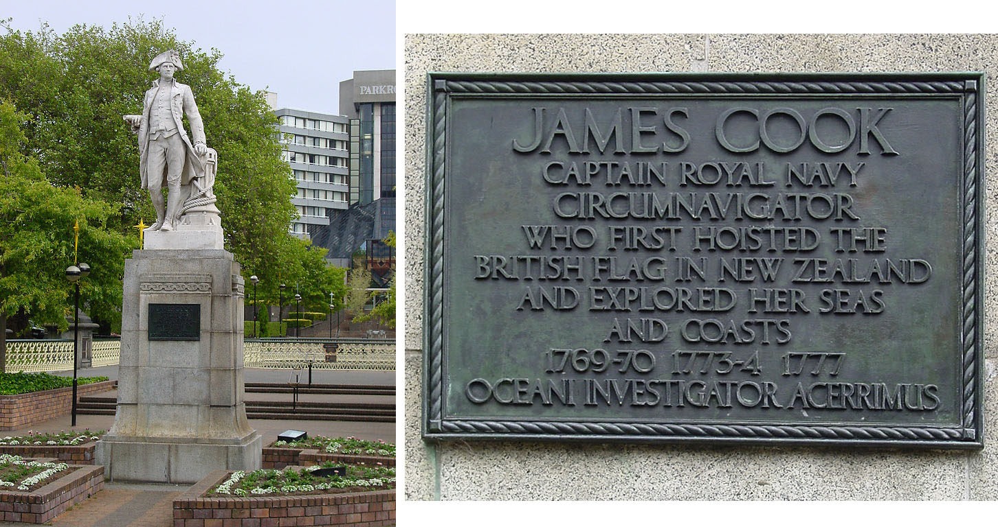
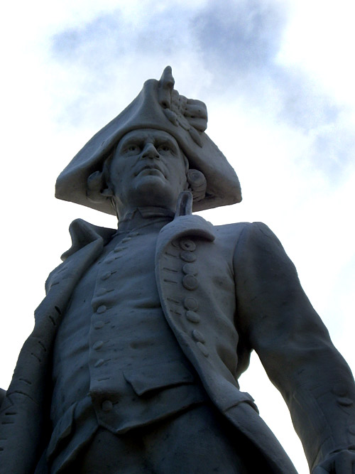
Legacy
James Cook lots of new islands and a continent, Australia
In England, there are lot of statues and schools and even a university

Slide 10
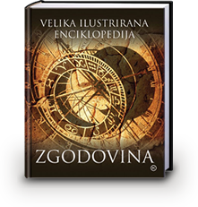
Resources
Wikipedia
Velika ilustrirana enciklopedija ZGODOVINA
RESNIČNE PUSTOLOVŠČINE: Raziskovalci in odkritja

