Slide 1
GUINNESS WORD RECORDS
Until 2000 as The Guinness Book of Records (before U.S. editions as The Guinness Book of World Records)
Collection of world records
Human achievements and extrems of the natural world

Slide 2
History
The book itself holds a world record, as the best-selling copyrighted series of all-time
The group was owned by Guinness Brewery and subsequently Diageo unitl 2001.
Now is owned by Ripley Entertainament.
Guinness World Records was formed in 1954 to publish the first book
Example of the certificate that recorders recived.

Slide 3
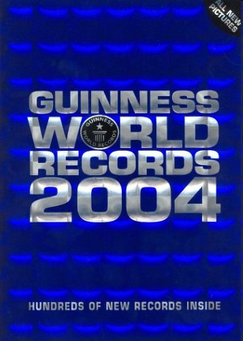
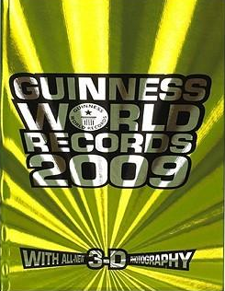
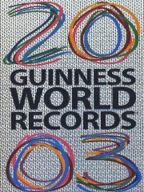
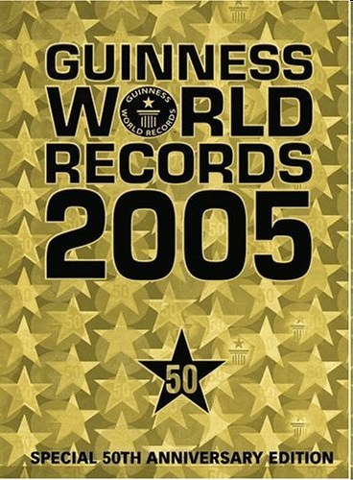
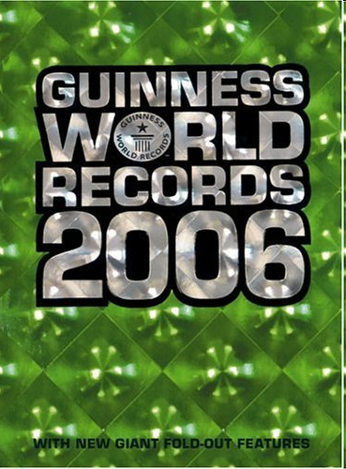
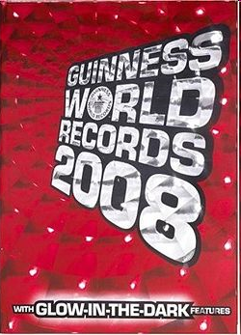
Book of Guinness world records
First year (1954) were printed 1000 copies and given away.
The following year in the U.S., were sold 70,000 copies.
Then the book became a surprise hit.

Slide 4
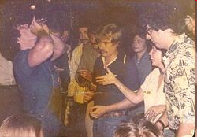
Ethical issues and safety concerns
Several world records in the book have been removed for ethical reasons.
The Guinness Book dropped records within their "eating and drinking records“ and records like "heaviest cat“.
Chain letters sent by post or e-mail are also not allowed. (No matter if it says that Guinness World Records and the postal service are involved, they are not! )
For example:
Steven Petrosino drinking 500 mL beer in 0.4 seconds in June 1977. Guinness accepted only the record for one litre, but later dropped all beer and alcohol records from their compendium in 1991.

Slide 5
Human body
Smallest Waist on a Living Person
- Cathie Jung
38.1 cm
Age and Youth
Body Parts
Body Beautiful
Medical Marvels
Against All Odds
Extreme Bodies =>
Tallest Woman - Living

Slide 6
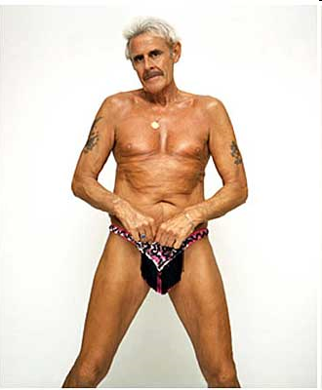
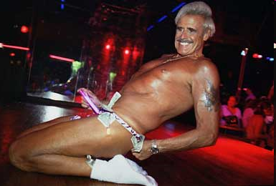
Amazing Feats
Oldest Male Stripper
-Bernie Barker
- was 67 years old
Unusual Skills
Tests Of Strength
Courage & Endurance
Marathon Efforts
Mass Participation
Teamwork
Early Starters
Big Stuff
Small Stuff
Golden oldies =>
Oldest Male Stripper

Slide 7
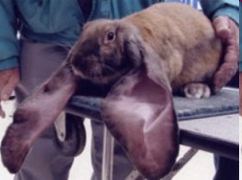
Natural World
Creepy Crawlies
Animal Extremes
Extraordinary Animals
Plant World
Fantastic Pets =>
Longest Ears on a Rabbit
Longest ears on a Rabbit
Nipper's Geronimo
79 cm

Slide 8
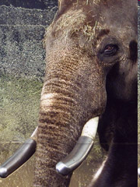
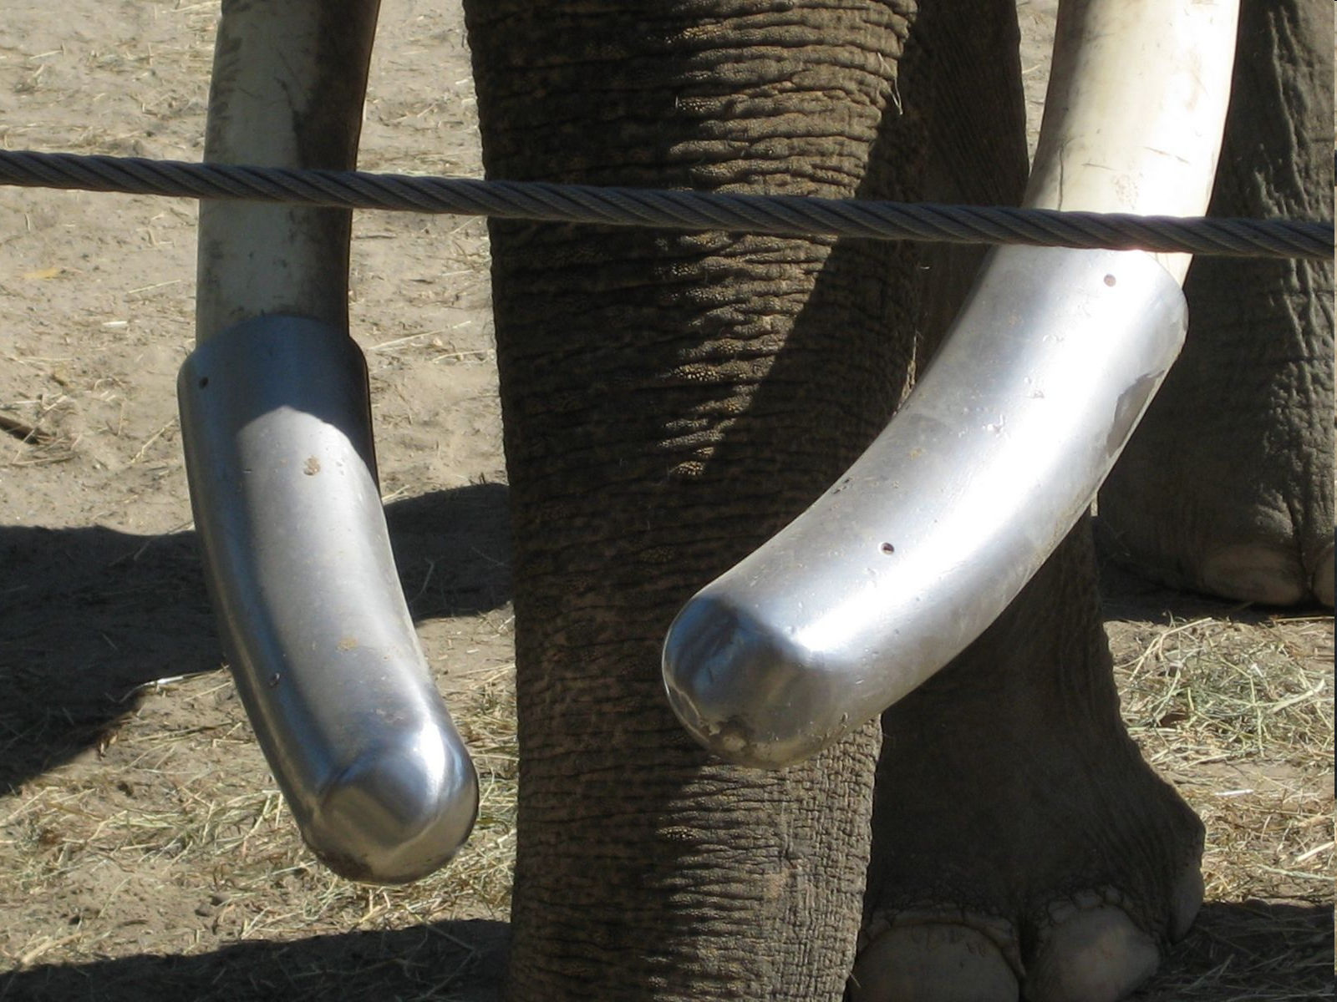
Science & Technology
Gadgets
Internet
Buildings
Structures
Amazing Science =>
Largest Dental Caps
Largest Dental Caps
Spike
50 cm

Slide 9
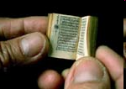
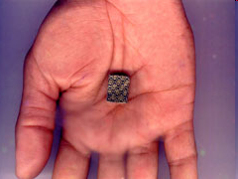
Arts & Media
Music Feats & Facts
TV Shows
Stunts & Special Effects
Cartoons & Animation
Art & Sculpture
Toys
Books & Magazines => Smallest Koran
Smallest Koran
Muhammad Karim Beebani
1.7 x 1.28 x 0.72 cm

Slide 10
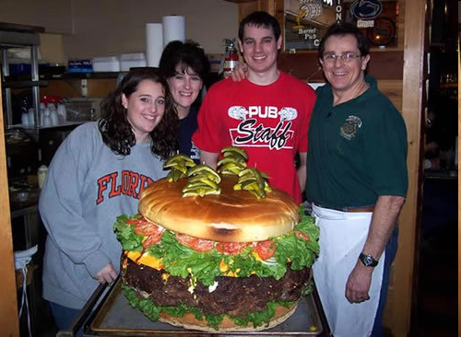
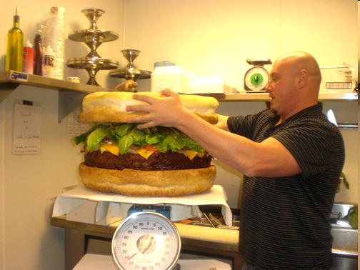
Modern Society
Collections
People & Places
Big Money
Fashion
Big Food =>
Largest hamburger
Largest hamburger commercially available
Mallie's Sports Grill & Bar
74.75 kg

Slide 11
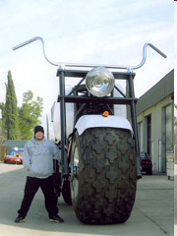
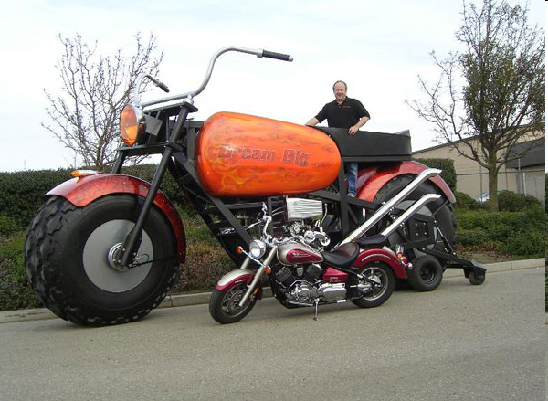
Travel & Transport
Aircraft
Cars
Epic Journeys
Air & Sea Heroes
Bikes & Motorbikes =>
Tallest Rideable Motorcycle
Tallest Rideable Motorcycle
Gregory Dunham
3.429 m

Slide 12
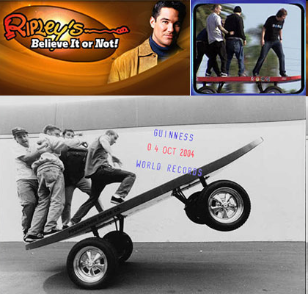
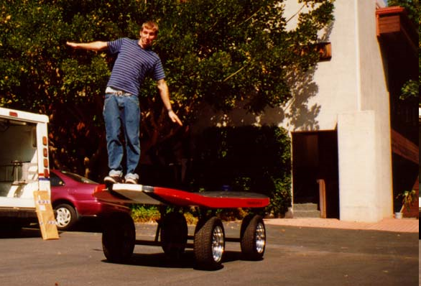
Sports & Games
Gymnastics & Weights
Combat & Martial Arts
Ball Sports
Soccer
Golf
Racket Sports
Animal Sports
Games & Gambling
Water Sports
Athletics
Action Sports =>
Largest Skateboard
Largest Skateboard
Students of Jerry Havill's
Team
9.4 m long, 2.4 m wide and
1.19 high

Slide 13
THE BEST world guinness records

Slide 14
Thank you for your attention!

