Slide 1
GUNS N´ ROSES

Slide 2
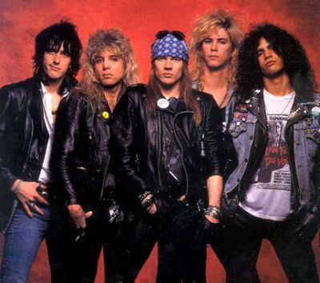
ABOUT
HARD ROCK
ORIGINALMEMBERS:
SLASH (LEAD GUITAR)
AXL ROSE (SINGER)
IZZY STARDLIN (RHYTHM GUITARIST)
DUFF MCKAGAN (BAS GUITAR)
STEVEN ADLER (DRUMS)
6 STUDIO ALBUMS
BAND WAS FORMED IN 1986

Slide 3
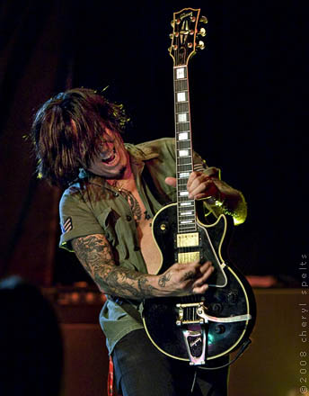
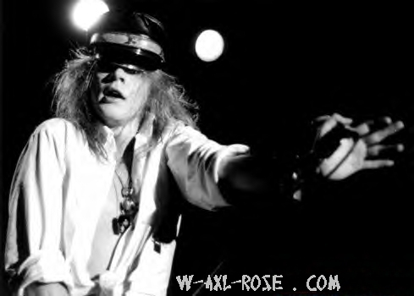
FORMATION
FIRST IT WAS FORMED BY TRACCI GUNS, AXL
ROSE, ROB GARDENR, IZZY STARDLIN, OLE BEICH
SOON GUNS WAS REPLACED WITH SLASH, BEICH
WITH DUFF MCKAGGAN, GARDNER WITH STEVEN ADLER
IN 1987-1989 THEY RELEASED THEIR FIRST ALBUMS
Appetite for Destruction and G N' R Lies (1987–1989)

Slide 4
Appetite for Destruction and G N' R Lies (1987–1989)
Appetite for Destruction WAS RELEASED ON JULY 1987. IN THE U.S. Welcome to the jungle WAS ISSUIED AS THE ALBUM’S FIRST SINGLE.
Appetite for Destruction WAS NO. 1 ON BILLBORD200
G N' R Lies WAS RELEASED ON NOVEMBER 1988.
NO. 2 ON BILLBORD200

Slide 5
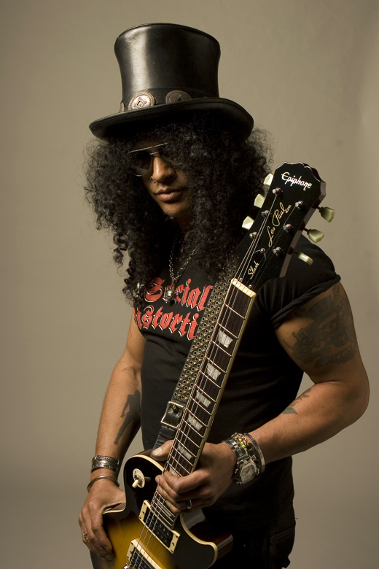
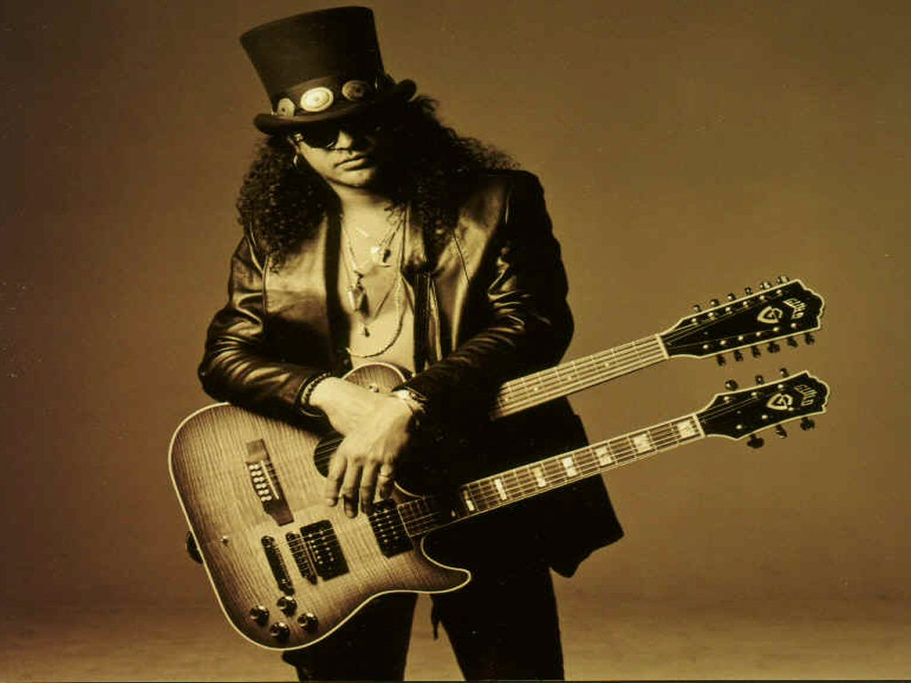
SLASH
SOUL HUDSON
BORN: 23.7.1965
WAS THE LEAD GUITARIST IN GNR
TODAY HE PLAYS IN VALVET REVOLVER
SOLO ALBUMS
HE LEFT THE BAND IN 1997 AFTER THE BIG FIGHT WITH ROSE

Slide 6
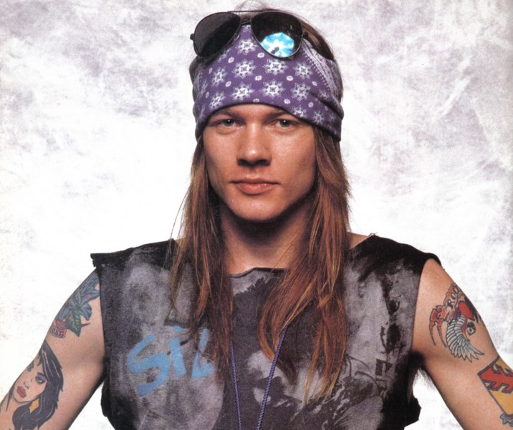
AXL ROSE
BORN: 6.2.1962
ONLY ORIGINAL MEMBER IN GNR
SINGER, HE PLAYS PIANO

Slide 7
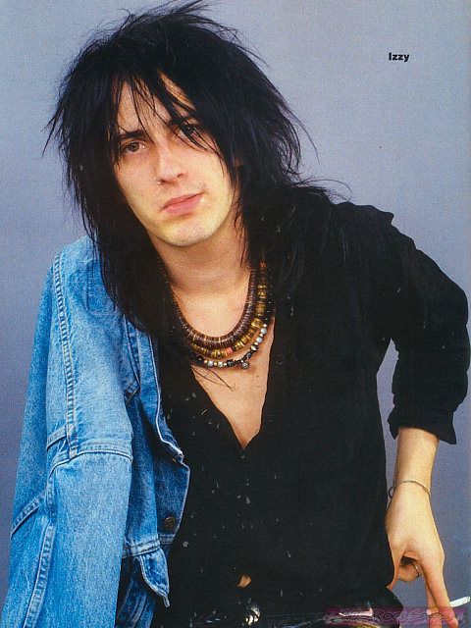
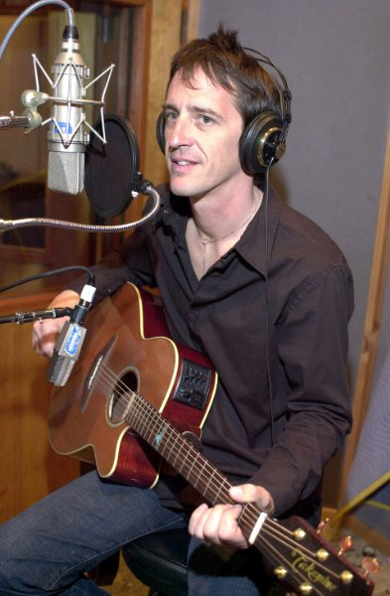
IZZY STARDLIN
BORN: 6.4.1962
HE WAS RHYTHM GUITARIST IN GNR
SOLO WRITTER

Slide 8
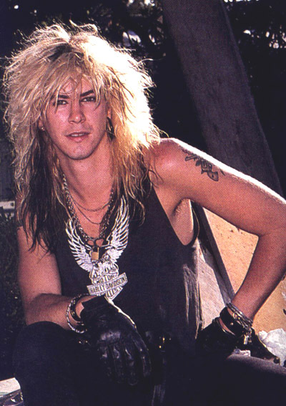
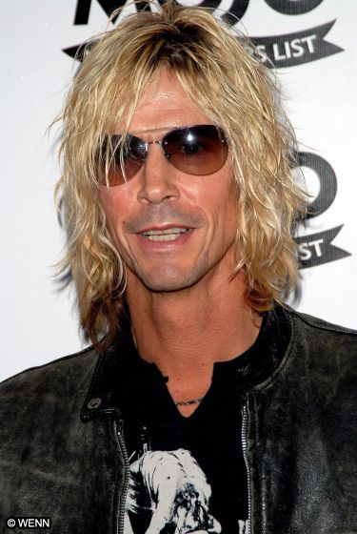
DUFF MCKAGAN
BORN: 5.2.1964
NOW HE PLAYS IN VALVET REVOLVER
HE WAS BASSIST IN GNR
HE LEFT AFTER SLASH DID

Slide 9
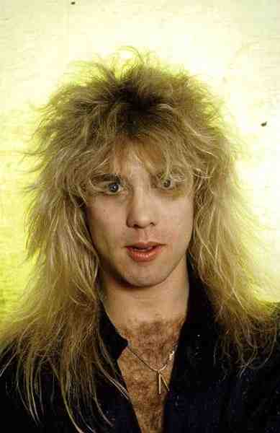
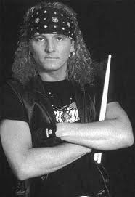
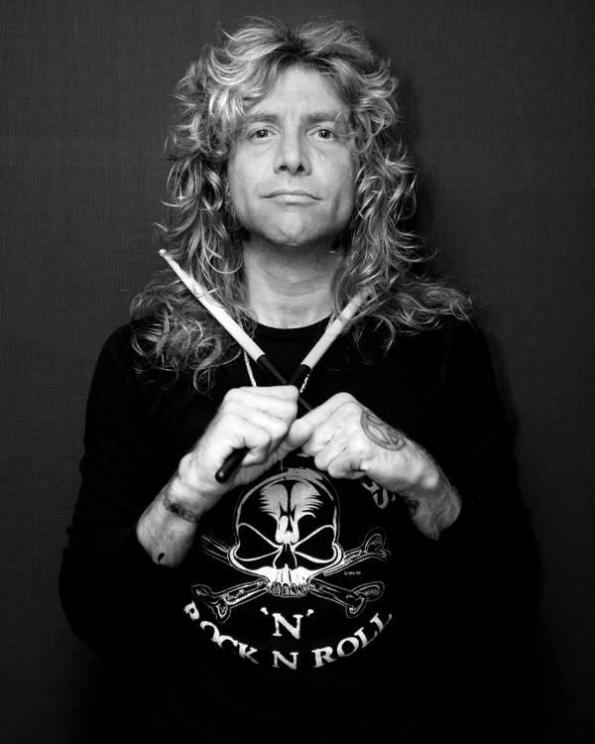
STEVEN ADLER
BORN:22.1.1965
HE WORKS ON HIS OWN PROJECT
HE WAS DRUMMER IN GNR
HE WAS FIRED IN 1990 AND HE WAS REPLACED WITH MATT SOURUM

Slide 10
ALBUMS
Appetite for Destruction (1987)
G N' R Lies (1988)
Use Your Illusion I (1991)
Use Your Illusion II (1991)
"The Spaghetti Incident?" (1993)
Chinese Democracy (2008)

Slide 11
NEW GNR
TODAY ROSE IS THE ONLY ORIGINAL MEMBER LEFT
MEMBERS:
AXL ROSE (LEAD VOCAL)
DIZZY REED (KEYBOARDS)
TOMMY STINSON (BASS)
CHRIS PITMAN(KEYBOARDS)
RICHARD FORTUS (GUITAR)
BUMBLEFOOT (LEAD GUITAR)
FRANK FERRER (DRUMS)
DJ ASHBA (LEAD GUITAR)
CHINESE DEMOCRACY (2008)

Slide 13
SORCES
http://en.wikipedia.org/wiki/Guns_N'_Roses#Discography
http://www.rockonthenet.com/artists-g/gunsnroses_main.htm
Google slike

Slide 14
BY

