Slide 1
guns n roses

Slide 2
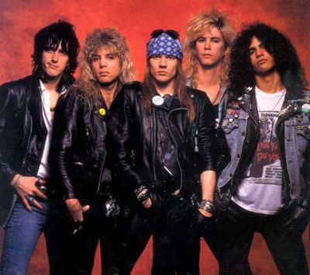
ABOUT
ORIGINALMEMBERS:
AXL ROSE (SINGER)
SLASH (LEAD GUITAR)
IZZY STARDLIN (RHYTHM GUITARIST)
DUFF MCKAGAN (BAS GUITAR)
STEVEN ADLER (DRUMS)
6 STUDIO ALBUMS
BAND WAS FORMED IN 1986
They are sold90,000,000 albums

Slide 3
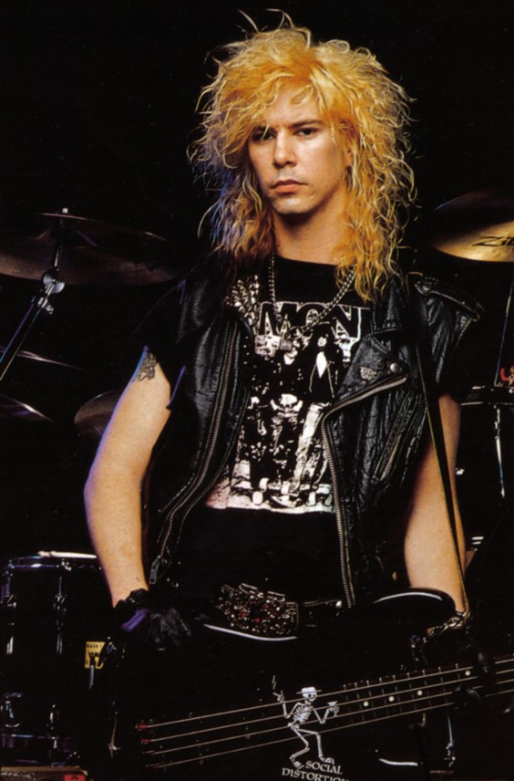
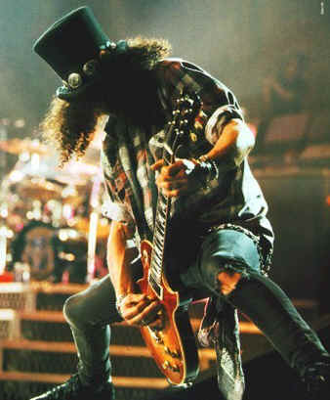
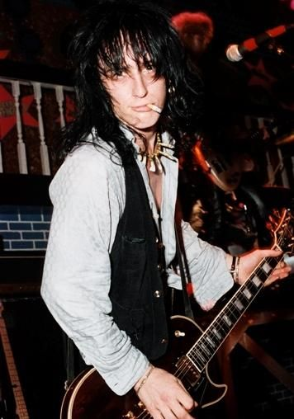
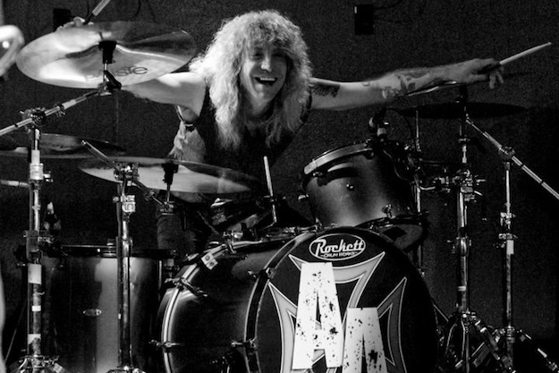

Slide 4
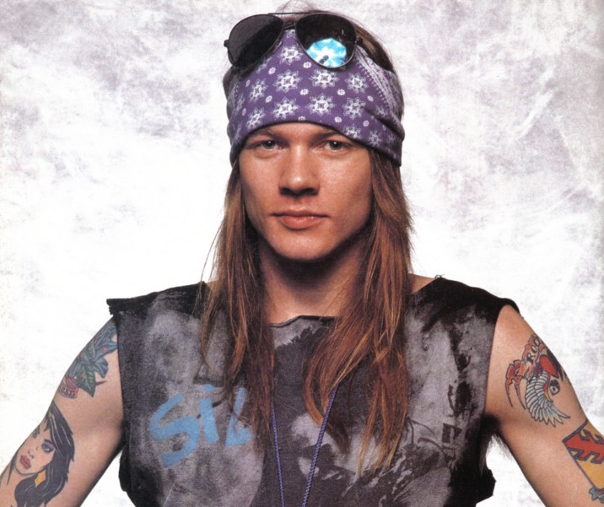
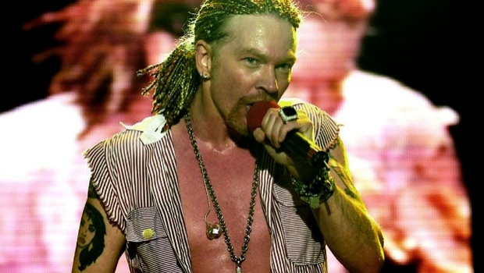
AXL ROSE
BORN: 6.2.1962
ONLY ORIGINAL MEMBER IN GNR
SINGER, HE PLAYS PIANO

Slide 5
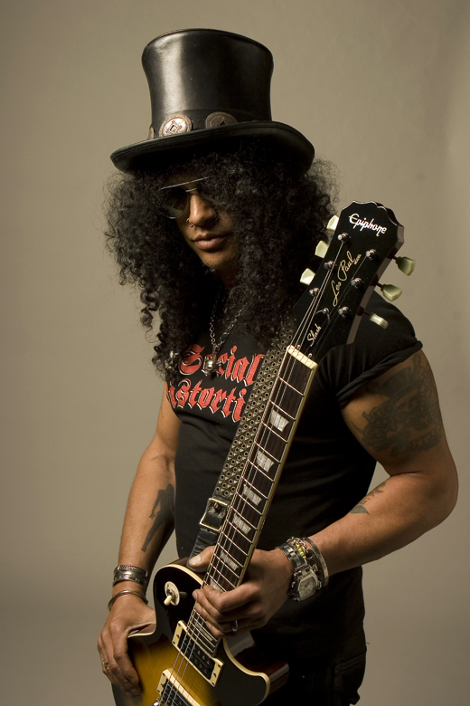
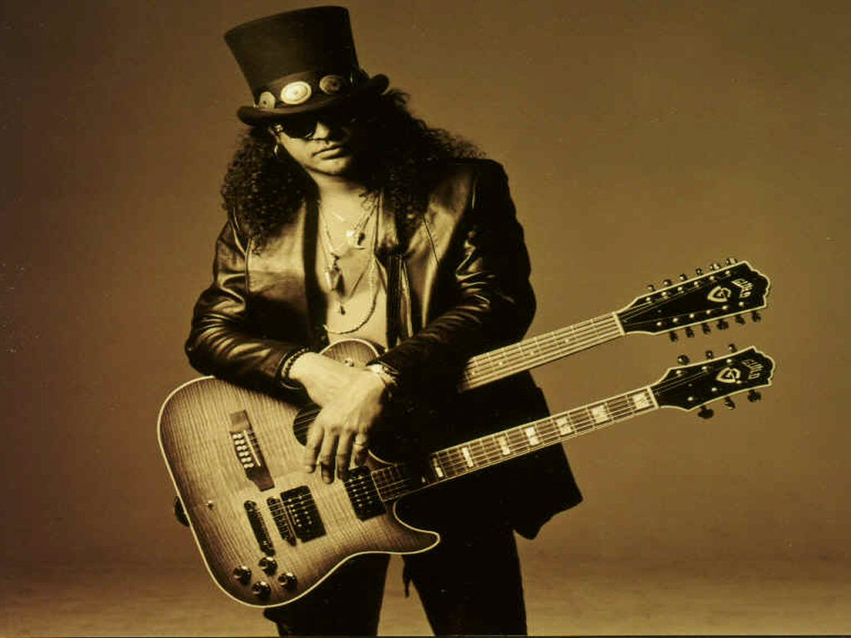
SLASH
SOUL HUDSON
BORN: 23.7.1965
WAS THE LEAD GUITARIST IN GNR
TODAY HE PLAYS IN VALVET REVOLVER
SOLO ALBUMS
LEFT THE BAND IN 1997 AFTER THE BIG FIGHT WITH ROSE

Slide 6
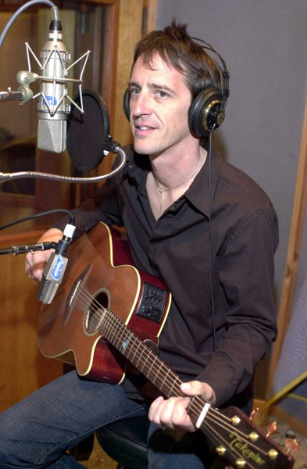
IZZY STARDLIN
BORN: 6.4.1962
HE WAS RHYTHM GUITARIST IN GNR
SOLO WRITTER

Slide 7
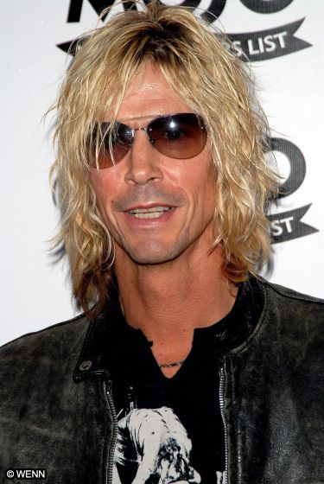
DUFF MCKAGAN
BORN: 5.2.1964
NOW HE PLAYS IN VALVET REVO
HE WAS BASS GUITAR IN GNR
HE LEFT AFTER SLASH DID

Slide 8
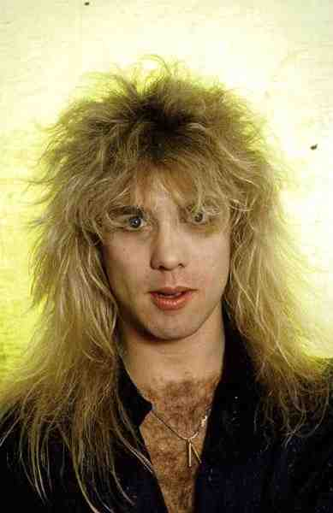
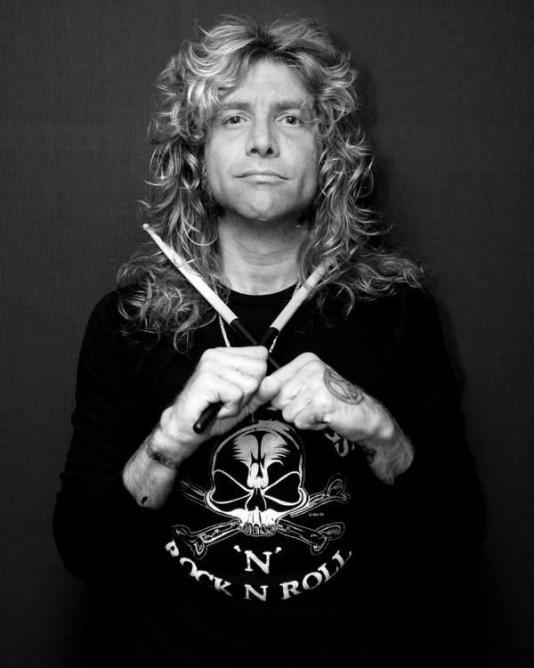
STEVEN ADLER
BORN:22.1.1965
HE WORKED ON HIS OWN PROJECT
HE WAS DRUMMER IN GNR
HE WAS FIRED IN 1990 AND HE WAS REPLACED WITH MATT SOURUM

Slide 9
AWARDS
 | AWARDS | NOMINATED
American music award | 4 | 8
Brit Award | 0 | 4
Grammy Award | 0 | 3
MTV video music Award | 4 | 8
World music Award | 2 | 2

Slide 10
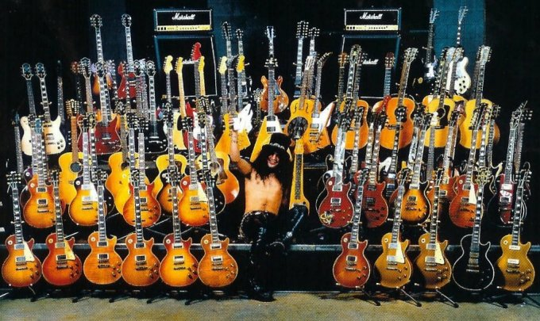

Slide 12
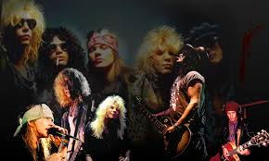
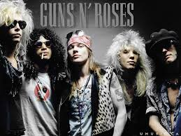

Slide 13
SONGS
https://www.youtube.com/watch?v=o1tj2zJ2Wvg
https://www.youtube.com/watch?v=zRIbf6JqkNc
https://www.youtube.com/watch?v=Rbm6GXllBiw

Slide 14
SORCES
http://en.wikipedia.org/wiki/Guns_N'_Roses#Discography
Google slike
Evropski slovar

Slide 15
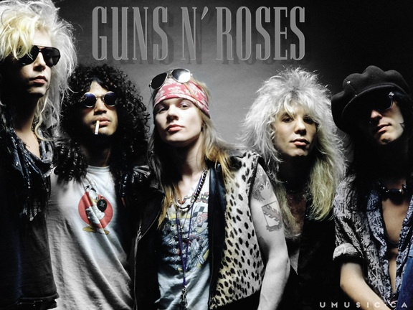
THANKS FOR YOUR ATTENTION!
BY

