Slide 1
HALLOWEEN

Slide 2
History
The Celts, who lived 2,000 years ago in the area that is now Ireland, the United Kingdom, and northern France, celebrated their new year on November 1. This day marked the end of summer and the harvest and the beginning of the dark, cold winter, a time of year that was often associated with human death. Celts believed that on the night before the new year, the boundary between the worlds of the living and the dead became blurred. On the night of October 31, they celebrated Samhain, when it was believed that the ghosts of the dead returned to earth. In addition to causing trouble and damaging crops. In the seventh century, Pope Boniface IV designated November 1 All Saints' Day, a time to honor saints and martyrs. It is widely believed today that the pope was attempting to replace the Celtic festival of the dead with a related, but church-sanctioned holiday. The celebration was also called All-hallows or All-hallowmas (from Middle English Alholowmesse meaning All Saints' Day) and the night before it, the night of Samhain, began to be called All-hallows Eve and, eventually, Halloween.

Slide 3
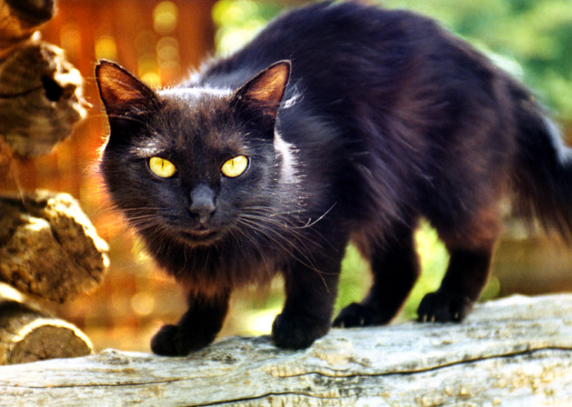
Black cat
Black cats were sometimes used in magical rituals, sometimes as purported participants, other times as sacrifices. Someone thought that they were astablishment of the Devil.

Slide 4
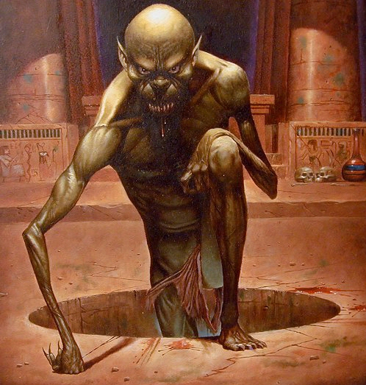
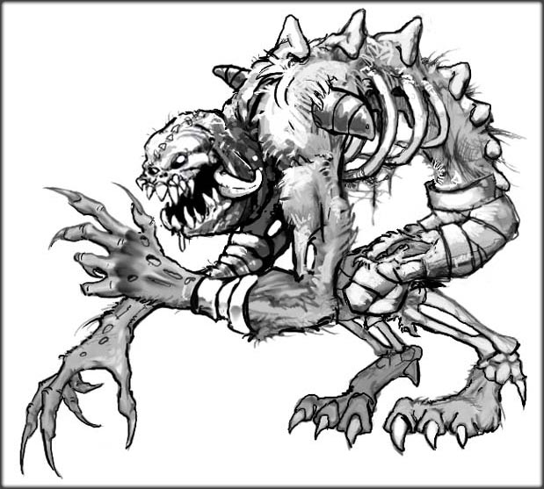
Ghoul
A monster from ancient Arabian folklore that dwells in graveyards and other uninhabited places. It can became any animal, but mostly hyena. The creature also preys on young children, robs graves, and eats the dead.

Slide 5
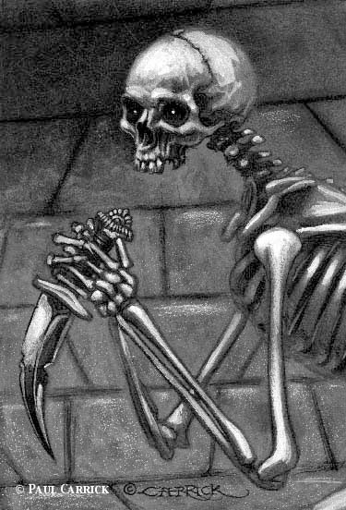
Skeleton
Dead corpse risen from the grave. It haunts and kill people.

Slide 6
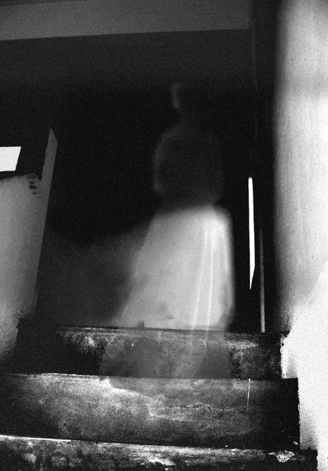
Ghoust
The spirit or soul of the person who died. Many times used to spook people, but sometimes people claim that they saw one and even have pictures to prove that.

Slide 7
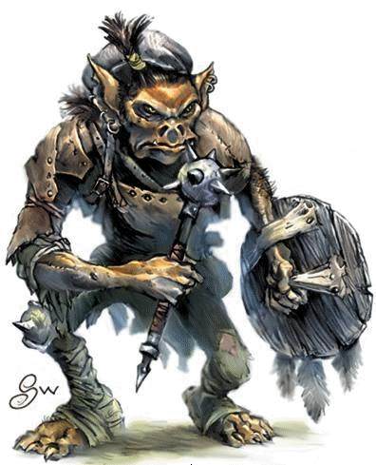
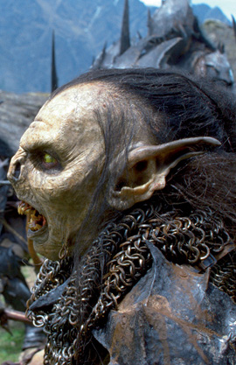
Goblin
Goblins are grotesque fairies of about dwarf height.
They have a somewhat bestial appearance: their brow is fully covered with thick hair and their mouth is filled with yellowed, crooked teeth.
In recent depictions Goblins have been portrayed as green in color.

Slide 8
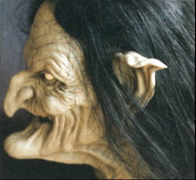
Witch
. A witch is a person who practices witchcraft, and may be male or female. In historical, mythological and demonological contexts a male "witch" is more frequently termed a wizard, sorcerer, warlock, or simply a magician.

Slide 9
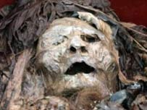
Mummy
A mummy is a corpse whose skin and dried flesh have been preserved by either intentional or accidental exposure to chemicals, extreme cold or dryness, or airlessness.

Slide 10
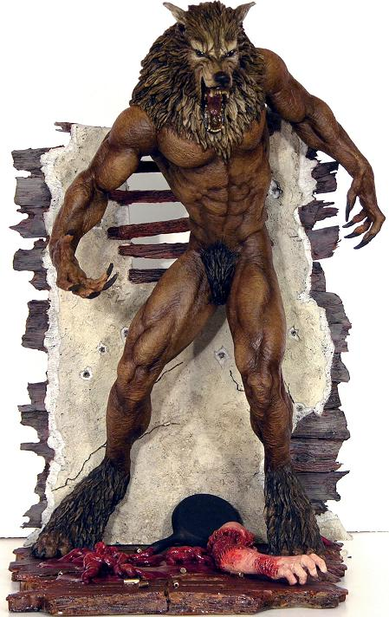
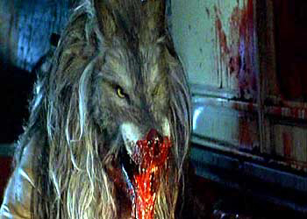
Warewolf
A hystorical creature, half man half wolf. Every fool moon it would change from a person to a wolf and killed anything alive. It was mostly known in Transilvania, associated with vampires and count Dracula.

Slide 11
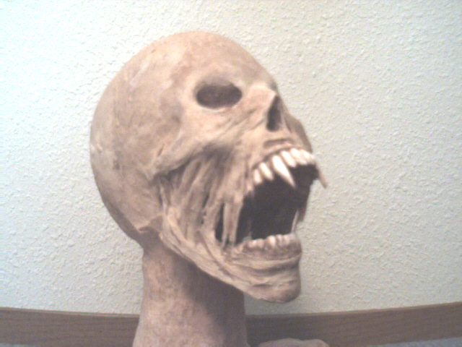
Monster
Is a term for any number of legendary creatures that frequently appear in mythology, legend, and horror fiction. The word originates from the medieval vulgar Latin verb monstrare, which translates either "to exhibit" or "to point out". Ancient peoples considered the birth of these freaks as representations of the wrath of the gods.

