Slide 1
Harry Potter and The Goblet of Fire
J. K. ROWLING

Slide 2
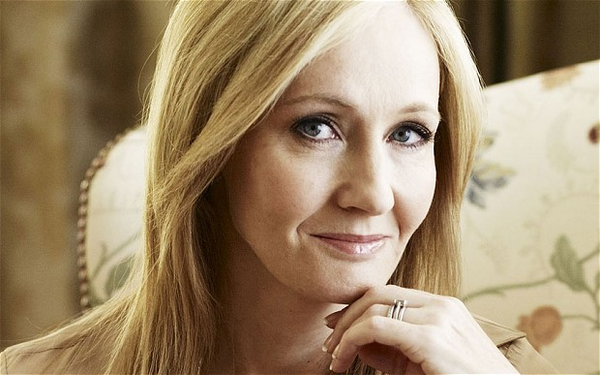
Joanne „Jo“ Rowling
31 July 1965
Novelist, screenwriter, film producer
Born in Yate
Amnesty International
Problems
Records
Author of the Year

Slide 3
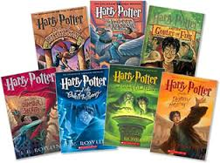
Previous Books
Harry Potter
Family
Lord Voldemort
Hogwarts School of Witchcraft and Wizardry
Ron Weasley and Hermione Granger

Slide 4
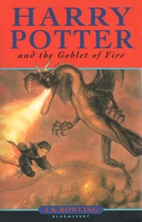
This Book
Frank Bryce
Quidditch World Cup
The Dark Mark
Triwizard Tournament
Beauxbatons Academy
Durmstrang Institute

Slide 5
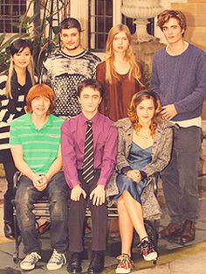
First task-dragons
Yule Ball
Tip from Cedric
The Black Lake
Second task
Final task – maze
portkey

Slide 6
Cedric die
Duel
Escape
Moody=Barty Crouch Jr.
Winner of the Triwizard Tournament

Slide 7
My Opinion
My favourite
Hermione Granger
Huflepuff
10/10

