Slide 1
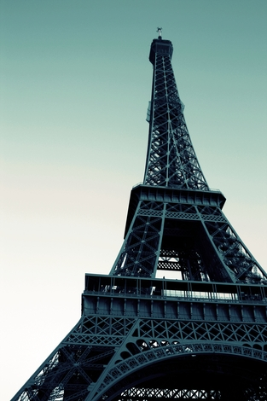
HOLIDAYS AND TRAVELLING
“Tour d’Eiffel”, Paris

Slide 2
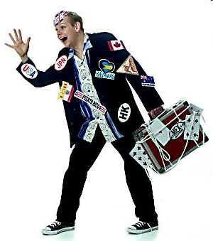
Definition
Holidays and travelling → tourism
Tourism is travel for recreational, leisure or business purposes.
Tourists are people who travel to and stay in places outside their usual environment for more than twenty-four hours.
Tourism has become a popular global leisure activity. In 2008, there were over 922 million international tourist arrivals.

Slide 3
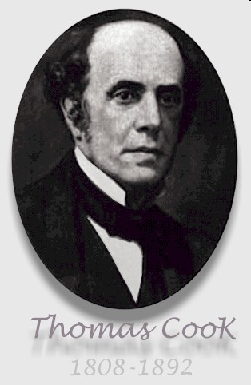
A history of tourism
Wealthy people have always traveled to distant parts of the world.
The Romans started a tourism with their holiday villas in the Bay of Napels.
In the 19th century, Grand Tour of Europe’s cultural sites.
In 1845 Thomas Cook organized the first package tour.

Slide 4
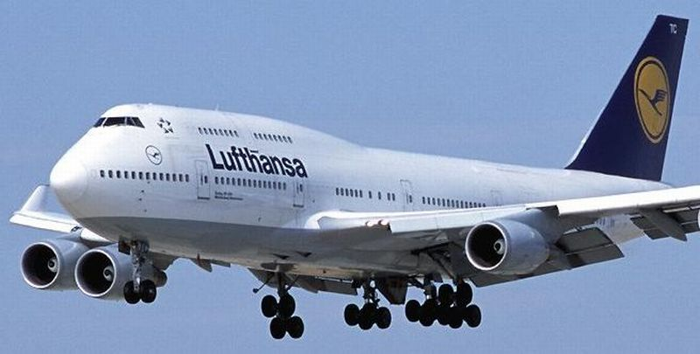
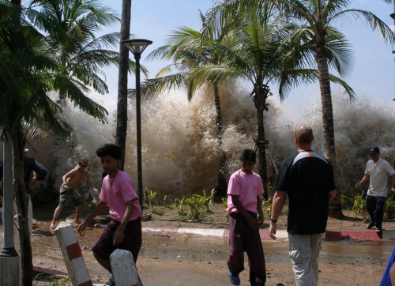
Recent developments
People have more money to spend and greater leisure time and they are also better-educated and have more sophisticated tastes.
The developments in technology and transport infrastructure, such as jumbo jets, low-cost airlines have made many types of tourism more affordable.
There have been a few setbacks in tourism:
Terrorist threats to tourist destinations (11th september).
A tsunami (2004). Thousands of lives were lost.
Airbus A380 (853 passengers)
Tsunami, Asia
Notes:
1. , so they travel more

Slide 5
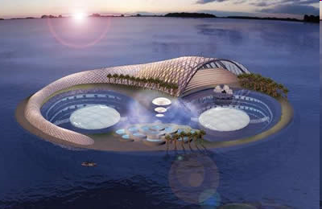
Tourism in the future
Lascaux cave paintings
The tourist idustry is growing very fast and will soon be the largest industry in the world.
Because the tourists are destroying sites some replicas have been built (Lascaux caves – France)
Technological improvement is likely to make:
Underwater hotels (Hydropolis in Dubai )
Space tourism
Hydropolis, Dubai

Slide 6
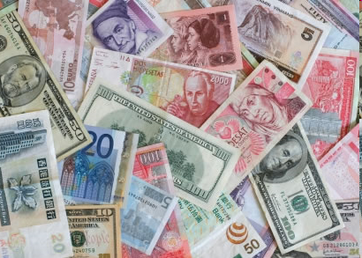
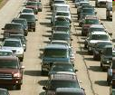
Effects of tourism
Positive:
Economic effects:
It brings profit to the local and regional area
It creates new jobs (tourist guides, souvenir sellers…)
Social & cultural effects:
Developing positive attitudes towards each other
Learning about each other’s culture and customs
Reducing negative stereotypes
Developing friendships
Developing appreciation, understanding, respect, and tolerance for each other’s culture
Negative:
Environmental Effects:
It destroys ecosystems and environments
Traffic jams, litter
Natural areas - parks,rivers,woody areas get polluted and destroyed
Destroying sites (scratching names into the rocks…)
Social effects
More crime - tourists bring money, bad people rob them
Popular tourist destinations are abandoned by all local residents
Notes:
Tourism's primary benefit is the profit it brings the local and regional area

Slide 7
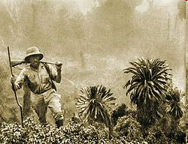
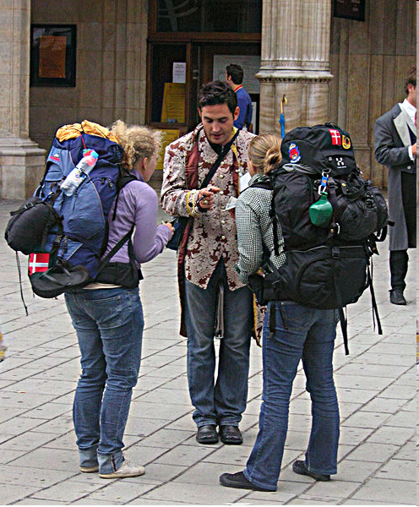
Types of travelling
Explorers are people who travel in a particular continent or country for the purpose of learning about it and to discover something new.
Lesure travel
winter tourism
visiting family and relatives (VFR) tourism
religious tourism
educational tourism
extreme tourism (adventure tourism, backpackers)
medical tourism
express tours
An explorer
Two backpackers
Notes:
At first we have to make difference between explorers and leisure travellers. Explorers are people who travel in a particular continent or country for the purpose of learning about it and to discover something new. (for example they study animals, plants, culture there). The most famous are expeditions to Antarctica, because the Ice retains a lot of ancient atmospheric samples and meteorites.
Leisure travellers travel in their free time for their pleasure.
We know many types of leisure travel. I will present some of them.
WINTER TOURISM – Winter sports such as skiing, snow boarding contribute to winter tourism. People travel to ski resorts usually during the winter holidays. Major ski resorts are located in many European countries for ex. Austria, Switzerland, France, Italy…Ski festivals have variety of events like ski competitions, ski and snow board lessons, performances and recreational activities.
RELIGIOUS TOURISM - is a form of tourism, where people travel because of their religious belief. Members of many major religions participate in pilgrimages. Most Muslims try to go on a pilgrimage to Mecca at least once in their life.
EDUCATIONAL TOURISM -Educational tourism developed, because of the growing popularity of teaching and learning of knowledge. In educational tourism, the main focus of the tour includes visiting another country to learn about the culture or to improve your foreign language. Student Exchange Programs are very popular nowadays.
EXTREME TOURISM - Extreme tourism is for people interested in risky activities. It includes adventure tourism such as climbing mountains and hiking, scuba diving, sailing around the world, backpacking… Backpackers travel with backpack and they don’t know where they will sleep or eat. Backpacking is a low-cost, independen and also quite risky travel.
MEDICAL TOURISM -Travel that includes arrangements for medical procedures, most often dentistry and plastic surgery. People travel when there is a significant price difference between countries for a given medical procedure. For example Americans now routinely cross to Mexico for medical care. Mexican dentists often charge one-fourth of US prices. Medical tourism also includes health tourism. This sort of tourism is associated with spas or places with health-giving mineral waters and so on.
EXPRESS TOUR – is a package tour. Travelers see a lot of countries and famuous sites in a very short time.
(package tour : a holiday at a fixed price in which the travel company arranges your travel, hotels and sometimes meals for you )

Slide 8
Most visited countries
Rank | Country | Tourist arrivals (2008)
1 | France | 79.3 million
2 | United States | 58.0 million
3 | Spain | 57.3 million
4 | China | 53.0 million
5 | Italy | 42.7 million
6 | United Kingdom | 30.2 million
7 | Ukraine | 25.4 million
8 | Turkey | 25.0 million
9 | Germany | 24.9 million
10 | Mexico | 22.6 million

Slide 9
Most visited cities
Rank | City | Country | Tourist arrivals (2008)
1 | Paris | France | 15.6 million
2 | London | United Kingdom | 14.8 million
3 | Bangkok | Thailand | 10.8 million
4 | Singapore | Singapore | 10.0 million
5 | New York City | United States | 9.5 million
6 | Hong Kong | China | 7.9 million
7 | Istanbul | Turkey | 7.0 million
8 | Dubai | UAE | 6.9 million
9 | Shanghai | China | 6.6 million
10 | Rome | Italy | 6.1 million

Slide 10
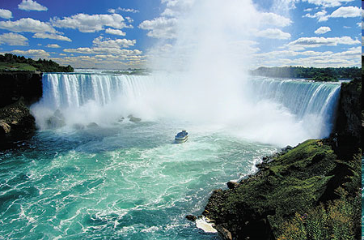
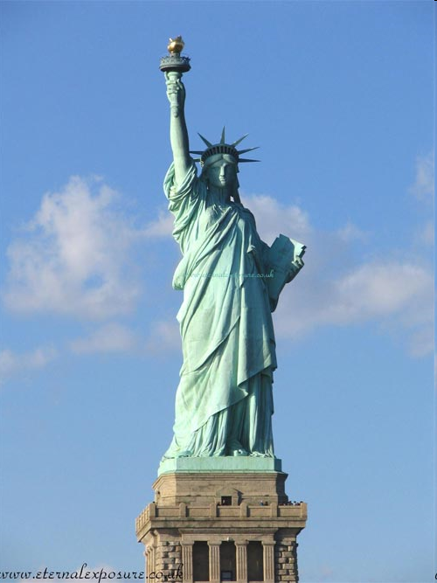
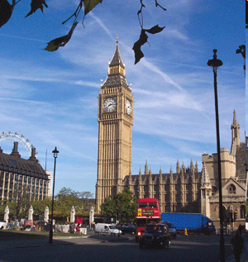
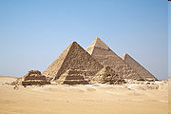
Most popular sites
Niagara Falls, USA, Canada
The Statue of Liberty, New York
Big Ben, London
The Giza Necropolis, Egypt

Slide 11
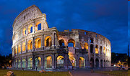
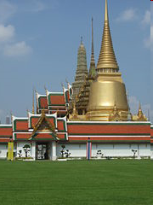
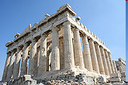
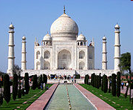
Most popular sites
Sydney Opera House, Australia
Colosseum in Rome, Italy
The Temple of the Emerald Buddha in Bangkok, Thailand
Parthenon in Athens, Greece
The Taj Mahal, India

Slide 12
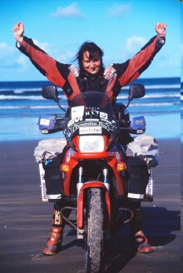
Benka Pulko
Benka Pulko is a Slovenian world traveler.
She travelled across 75 countries and seven continents on a motorcycle.
Her journey lasted five and a half years.

Slide 13
Sources
Liz & John Soars – New Headway English Course, Oxford University Press
Wikipedia: http://en.wikipedia.org/wiki/Tourism
Ehow:
http://www.ehow.com/facts_5244298_positive-negative-effects-tourism.html
http://www.benkapulko.com/en

Slide 14
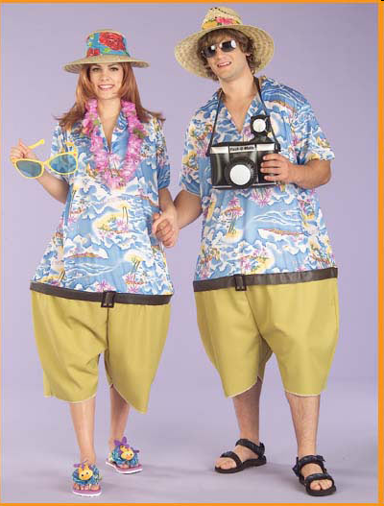
Thank you for your attention!

