Slide 1
HOME LIVE

Slide 2
PERENT
Wake up at 5:00(am)
Eat breakfast at 5:30(am)
Go to work at 6:00(am)
They come from work at 2:00(pm)

Slide 3
KIDS
Wake ap at 6:00(am)
Eat breakfast at 6:30(am)
They go to school at 7:00(am)
They comes out of school at 1:oo(pm)

Slide 4
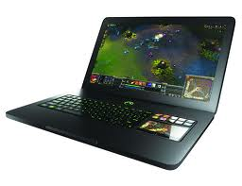
FREE TIME
Free time have from 2:00(pm) to 3:00(pm)
At the free time I'm on the computer

Slide 5
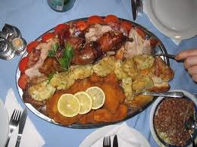
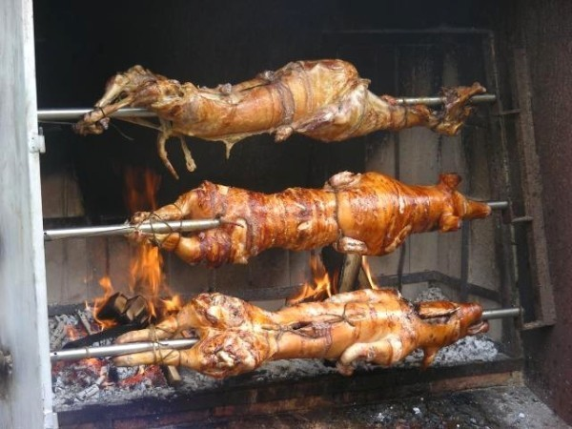
DIET
The diet is varied and balance

Slide 6
THE END

