Slide 1
Zefir

Slide 2
Zefir
Founded in 2001,
Company logo – eight corner shuriken, 1989-the discovery of the shuriken
North-west of Slovenia; Lenart, slovenska ulica 24,
200 staff employed,
Safety and security industry.

Slide 3
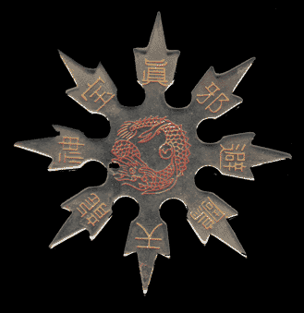
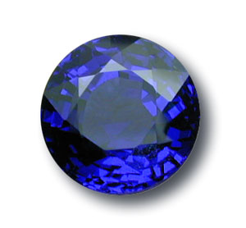
A sapphire
The shuriken

Slide 4
Zefir
Jewellery guards; protect jewels and jewellery
Bodyguards; strong, smart, tall, risk of death, serious injury
As long as exhibition is open; as long as needed protection, 24+ hours; 6-9 hours shifts

Slide 5
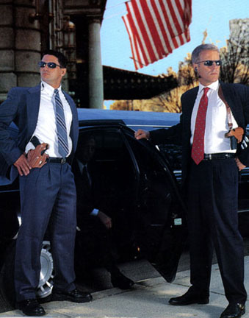
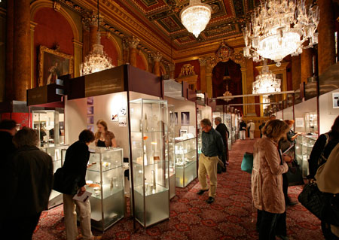
Bodyguard
Jewellery exhibition

Slide 6
Zefir
Quite successful, high profit numbers
Raise salaries
Within next 2 years spread across whole Slovenia, within next 5 years neighboring countries.

Slide 7
Zefir
Picture sources:
http://www.palagems.com/Images/sapphire_connoisseurship/burma_sapphire_5.50_ct.jpg [10 May, 2010]
http://www.completemartialarts.com/information/weapons/images/shuriken.gif [10 May, 2010]
http://iconicchic.files.wordpress.com/2008/09/goldsmithsfair.jpg [10 May, 2010]
http://www.guysdothat.com/pictures/wp-content/uploads/2010/03/bodyguard-security.jpg [10 May, 2010]

