Slide 1
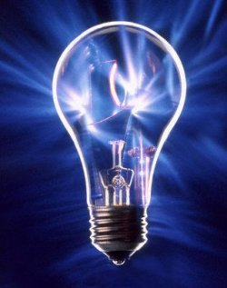
INVENTIONS

Slide 2
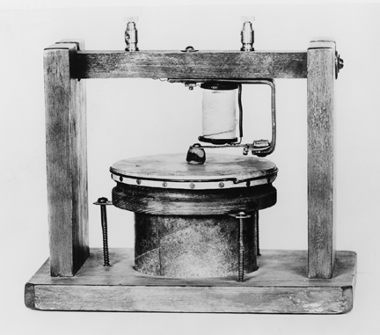
THE TELEPHONE
(Alexander Graham Bell)
1875
transmitting electrially the human voice

Slide 3
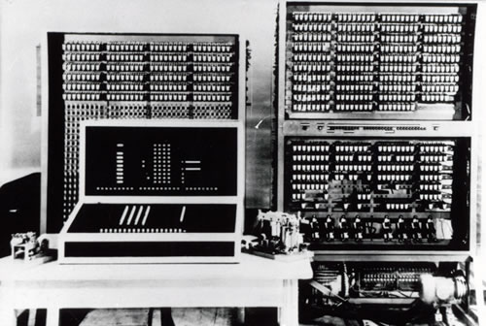
COMPUTER
(Kondrad Zuse)
1936
freely programmable computer

Slide 4
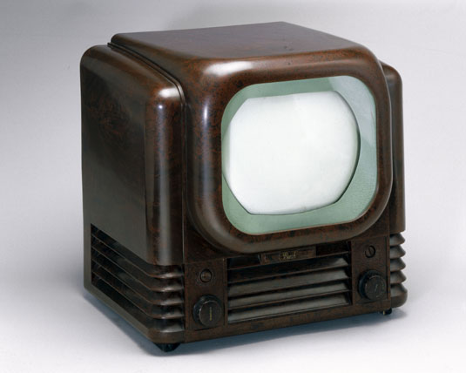
TELEVISION
(Paul Nipkow)
1884
used a rotating metal disk technology with 18 lines of resolution

Slide 5
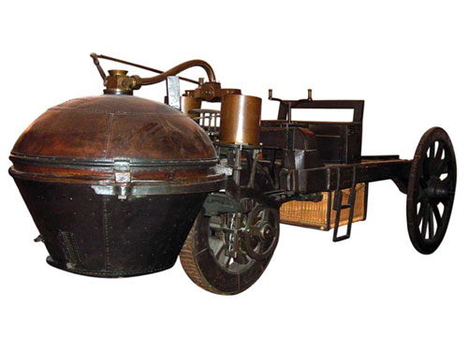
THE AUTHOMOBILE
(Nicolas Joseph Cugnot)
1769
self-propelled road vehicle

Slide 6
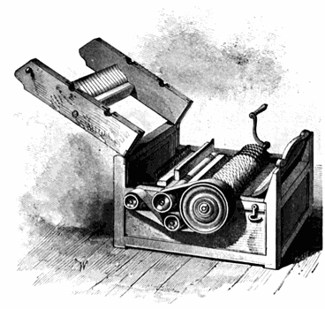
THE COTTON GIN
(Eli Whitney)
1794
machine that seperates seed, hulls…

Slide 7
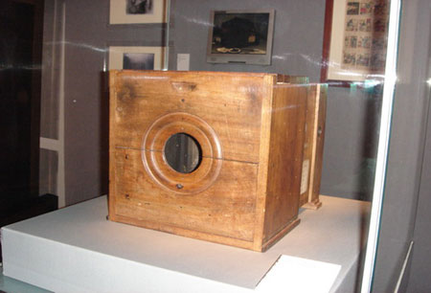
THE CAMERA
(Joseph Nicephore Niepce)
1814
photographic image

Slide 8
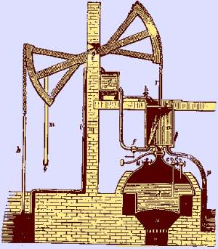
THE STEAM ENGINE
(Thomas Savery)
1698
patented crude steam engine

Slide 9
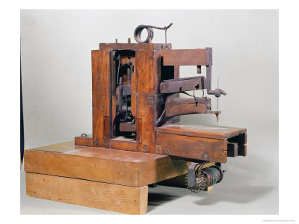
THE SEWING MACHINE
(Barthelemy Thimonnier)
1830
invented

Slide 10
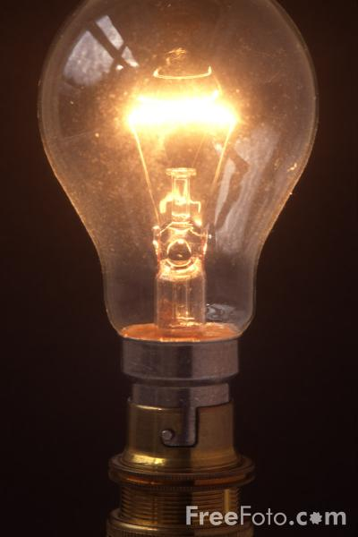
THE LIGHT BULB
(Humphry Davy)
1809
electric light

Slide 11
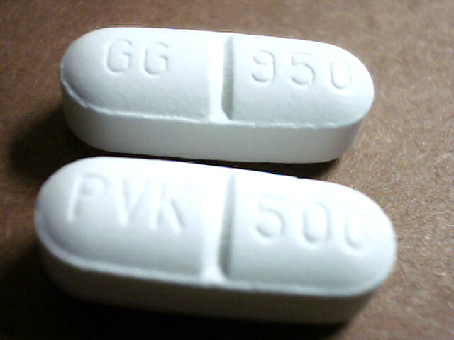
PENICILLIN
(Alexander Fleming)
1928

Slide 12
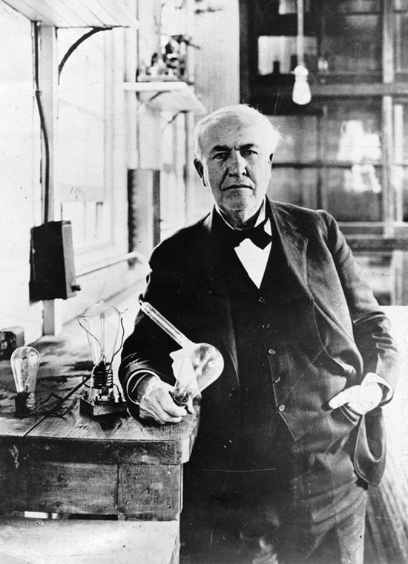
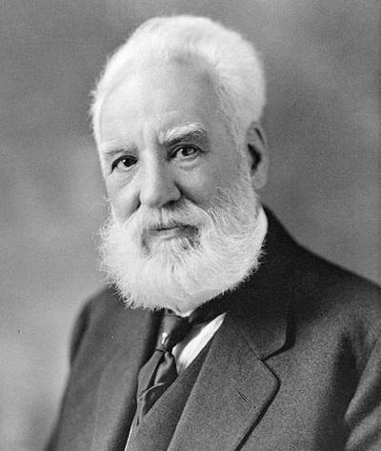
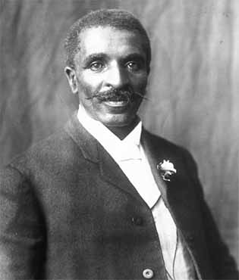
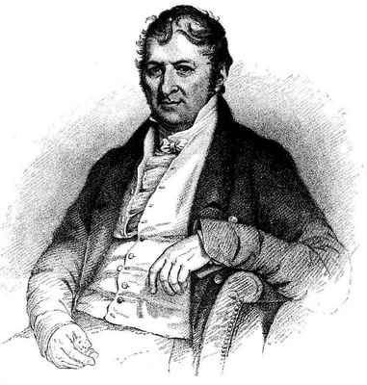
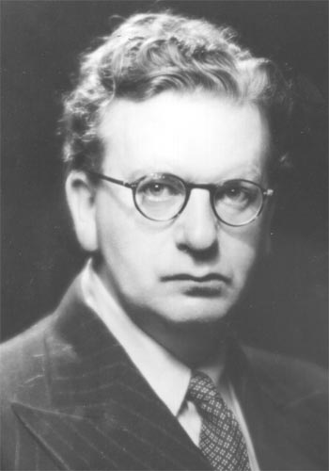
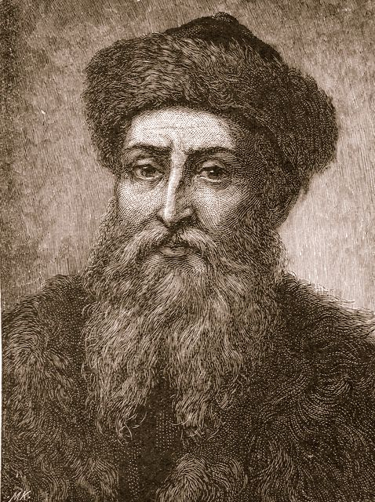
THOMAS EDISON (1847-1931)
ALEXANDER GRAHAM BELL (1847-1869)
GEORGE WASHINGTON CARVER (1864-1943)
ELI WHITNEY (1765-1825)
JOHANNES GUTENBERG (1394-1468)
JOHN LOGIE BAIRD (1888-1946)

Slide 13
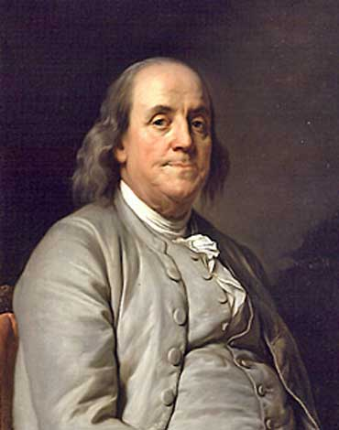
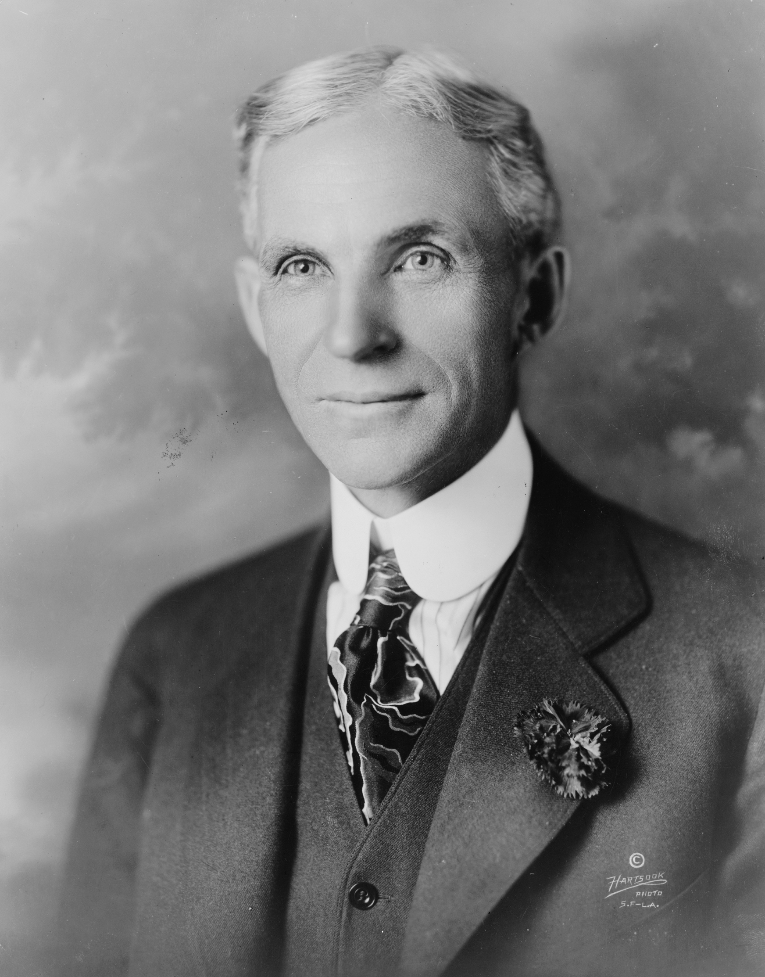
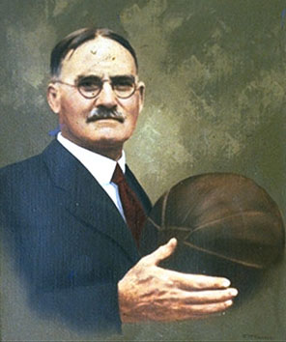
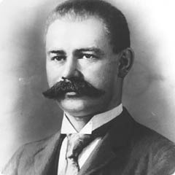
7) BENJAMIN FRANKLIN (1706-1790)
8)HENRY FORD (1863-1947)
9) JAMES NAISITH (1861-1939)
10) HERMAN HOLLERITH (1860-1929)

