Slide 1
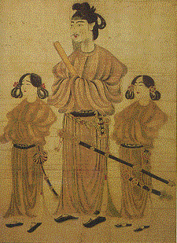
Japanese history, language and animation

Slide 2
HISTORY
First settlements in 12000 BC
Great influence from China 1000 BC – 1000 AD

Slide 3
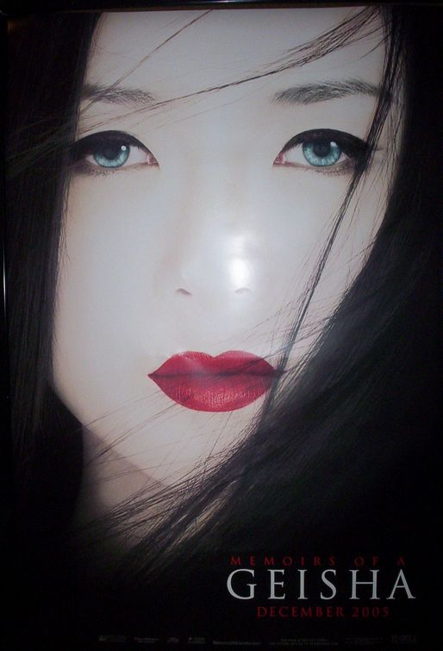
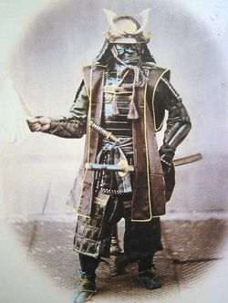
HISTORY II
Feudal Japan with Shogun and Daimyo, isolationism for 7 centuries
In 1853 they opened to the world

Slide 4
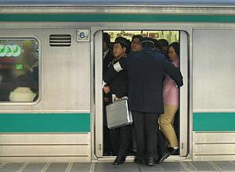
HISTORY III
The 1st and the 2nd World War-in the 1st they were at the winning side, at the second they lost, the occupation after the war
Extremely quick developement

Slide 5
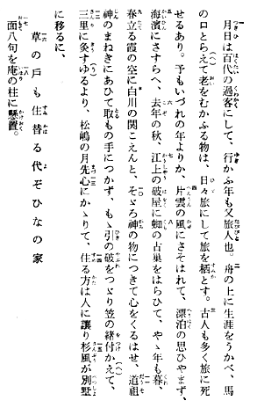
4 writings:
Rōmaji (ローマ字)
Katakana (片仮名)
Hiragana (平仮名)
Kanji (漢字) (Dainkawa Jiten)‏

Slide 7
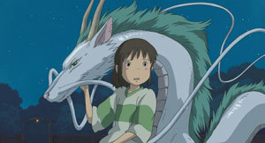
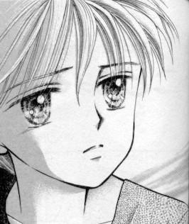
Japanese animation
First introduced in the beginning of the 20th Century
Golden age: 1970s, 1980s.

Slide 8
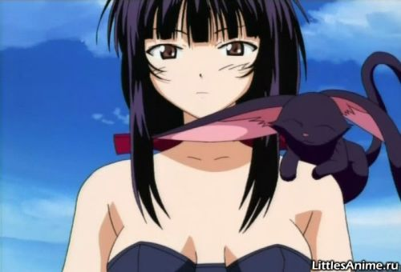
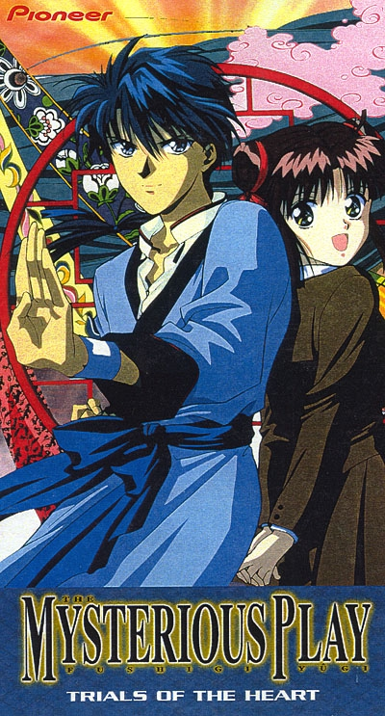
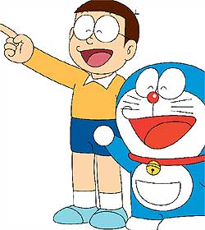
Genres
Bishōjo
Bishonen
Ecchi
Kodomo

Slide 9
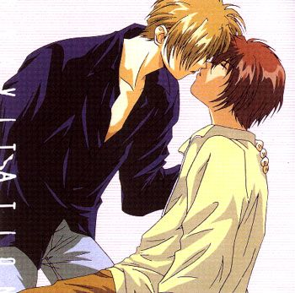
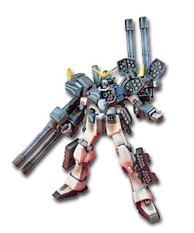
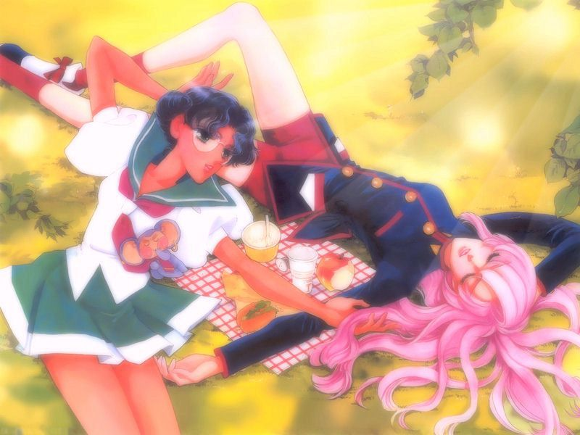
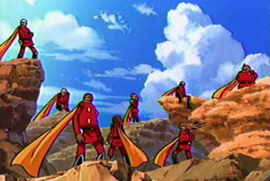
Genres II
Shōnen-ai
Mecha
Sentai
Shōjo-ai

Slide 10
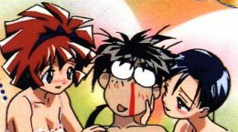
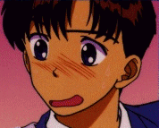
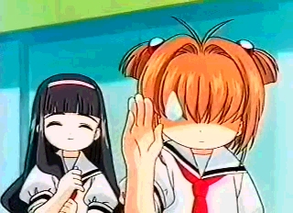
Anime stereotypes

Slide 11
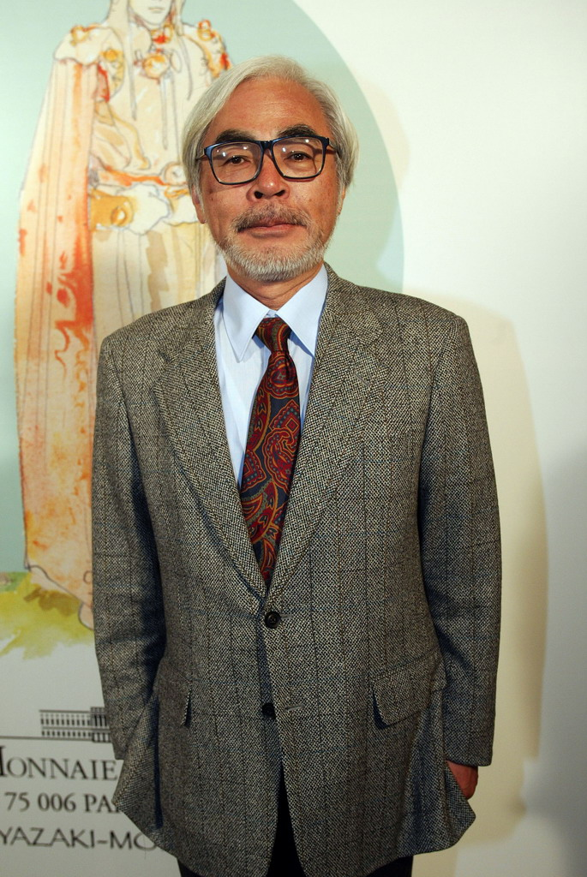
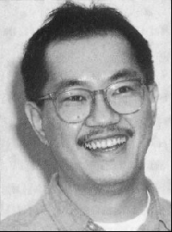
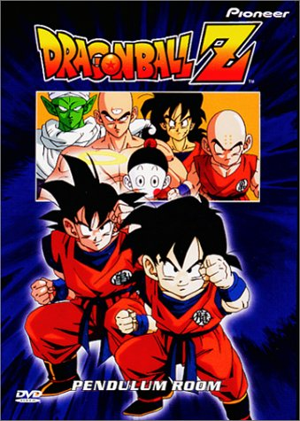
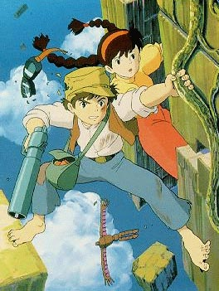
Legends of animation

Slide 12
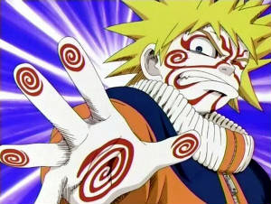
Where to study japanese?
Short courses
Faculty of Arts
Go to Japan! ^-^
Domo arigato gozaimasu!

