Slide 1
Steve Jobs

Slide 2
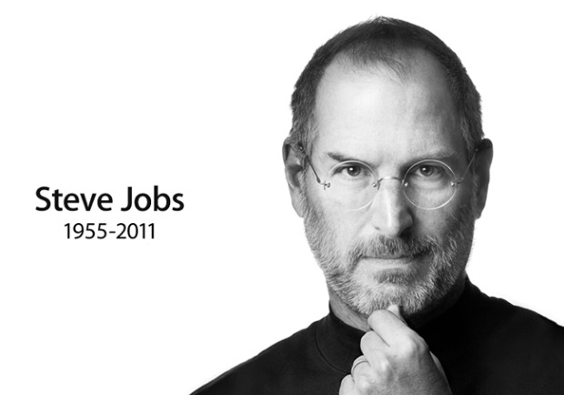
Steve Jobs
Name: Steven Paul Jobs
Nationality: American
Signature:
Born: San Francisco February 24, 1955

Slide 3
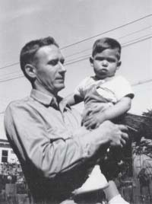
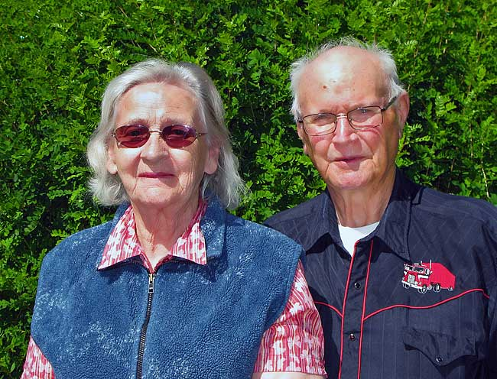
Family
Adopted-Paul, Clara Jobs
City-Mountain View

Slide 4
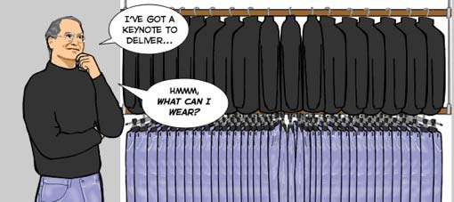
Style
wardrobe evolution

Slide 5
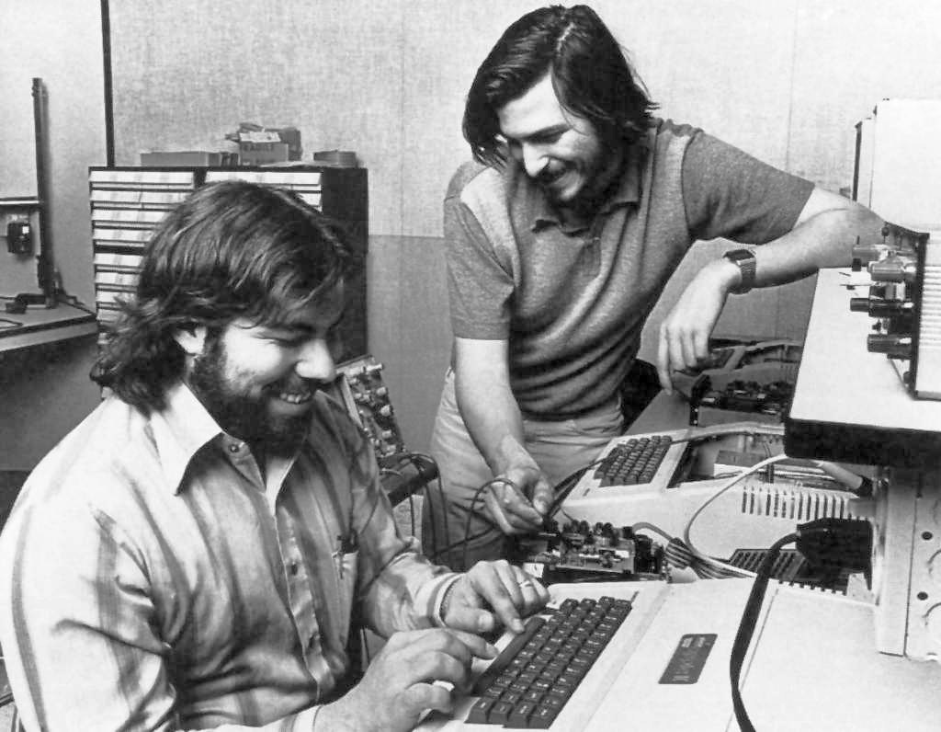
Interested in
technology
Jobs and Woz

Slide 6
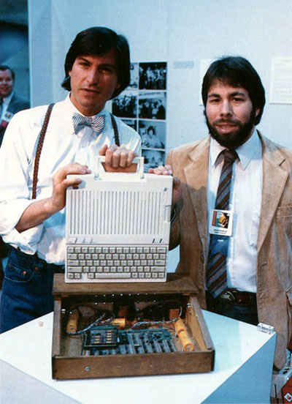
Company Apple
Steve Jobs
Steven Wozniak
Great success
Apple symbol

Slide 7
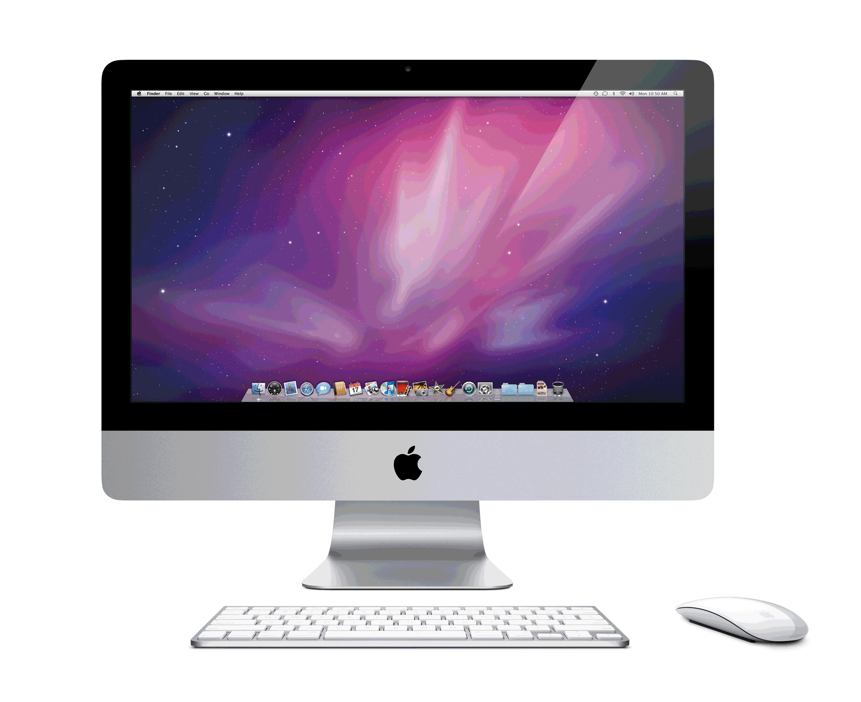
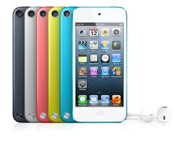
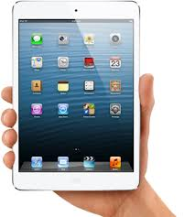
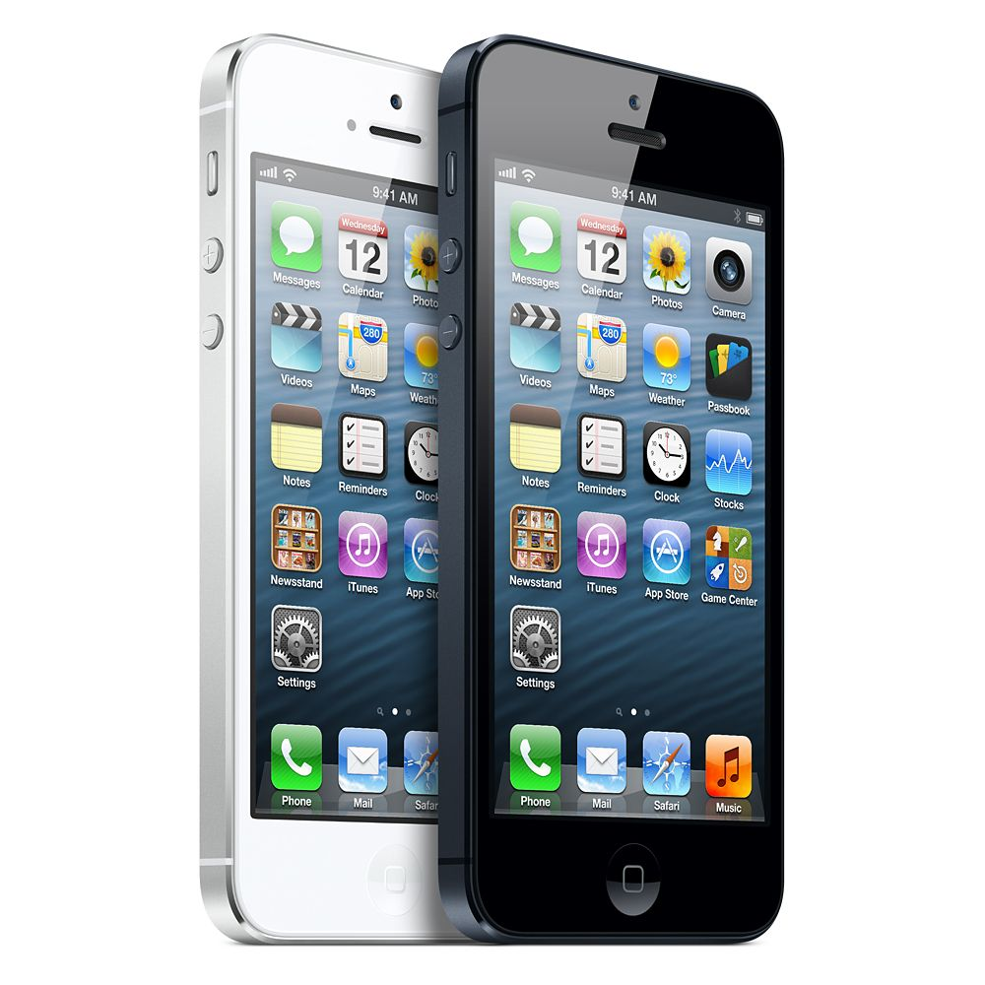
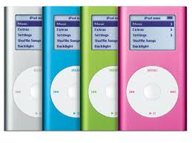
Apple's products

Slide 8
iPad

Slide 9
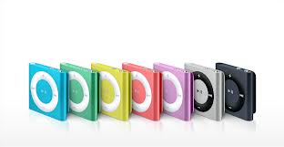
iPod

Slide 10
iPhone

Slide 11
iMac

Slide 12
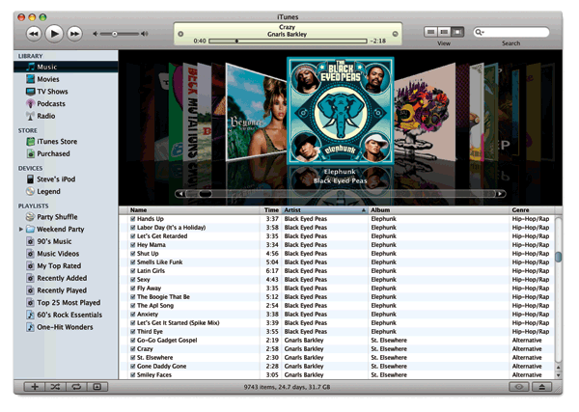
iTunes
Play
Download
Organize

Slide 13
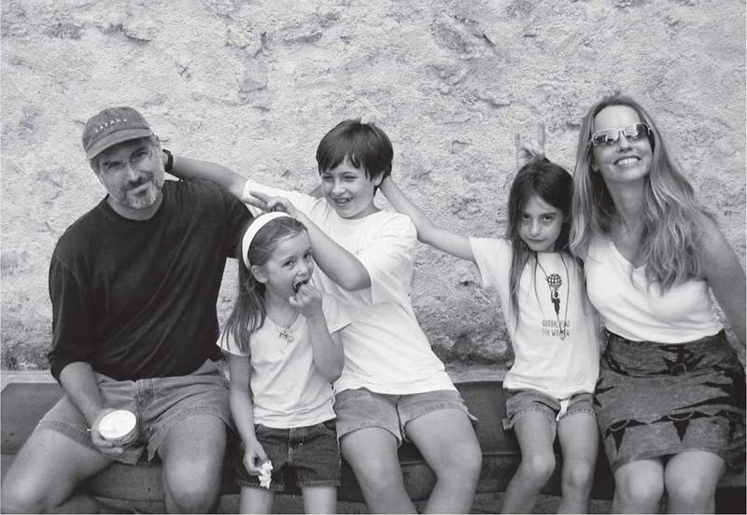
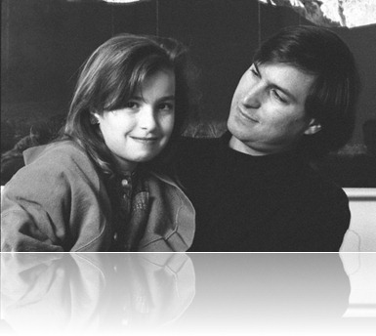
His Family
Eve Jobs, Reed Jobs, Erin Jobs
Laurene Powell Jobs
Lisa Nicole Brennan-Jobs

Slide 14
October 5, 2011
Cancer
56 years old
Great inventor

Slide 15
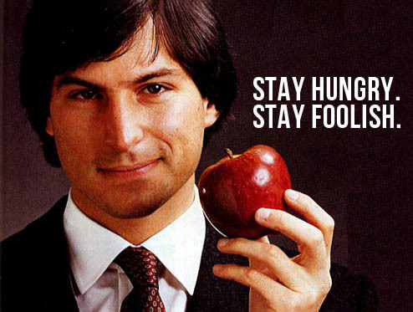
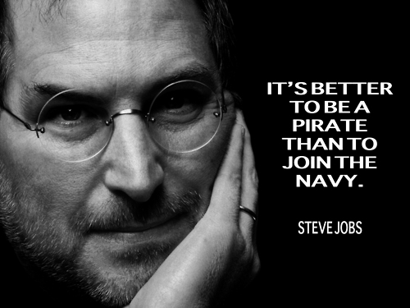
Quotes

Slide 16
Sources
http://sl.wikipedia.org
http://allaboutstevejobs.com/
http://www.imdb.com
Walter Isaacson-Steve Jobs

Slide 17
Thank you

