Slide 1
Steve Jobs

Slide 2
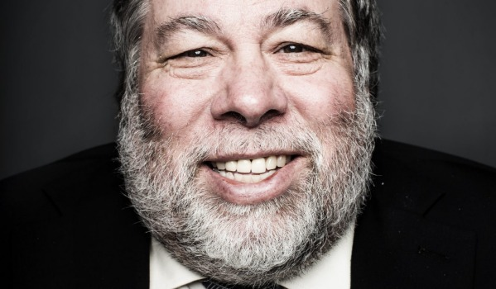
Co-founder
Chairman (Person in charge of organisation)
CEO of Apple Incoparation. (Chief Executive Officer)
A pioneer of PC revolution.

Slide 3
His life
Born in San Francisco
Adopted at birth
Attended Reed College
Travel to India

Slide 4
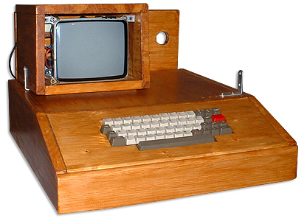
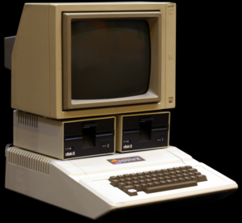
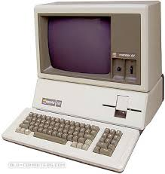
In 1974 back to San Francisco
Worked for Atari
In 1976 founded Apple 1
1977 introduced Apple 2 (very successful)
1980 introduced Apple 3 (not successful)

Slide 5
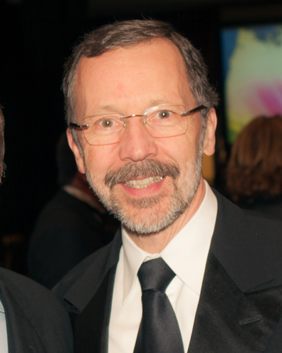
1985 Jobs left Apple and founded another company named NeXT. (Not succesful)
1986 Jobs and Catmull founded Pixar (Became successful)
1996 Apple bought NeXT.
1997 Jobs became head of the government.

Slide 6
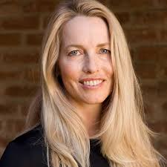
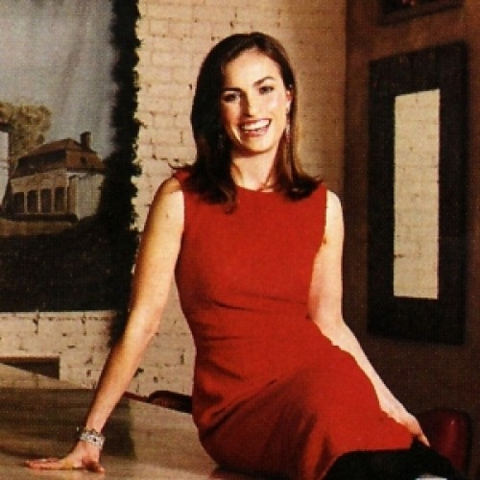
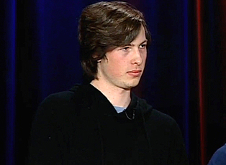
Family
Married 1991 to Laura Powell
4 children

Slide 7
Interesting fasts about Steve Jobs
Guinness world record (worst paid boss)
He had his own aircraft (worth 90 milions dollars)
30 milions shares of Apple

Slide 8
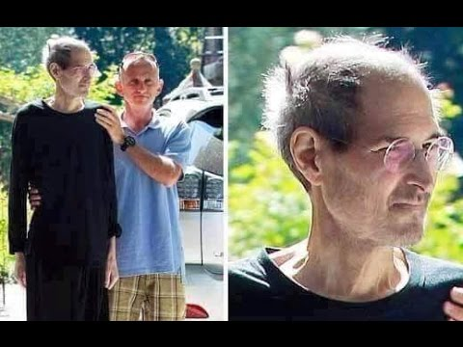
Death
5 October 2011
He died of cancer

Slide 9
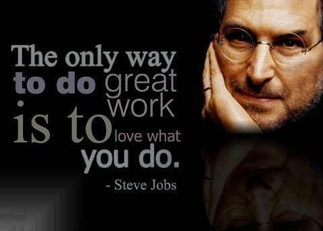
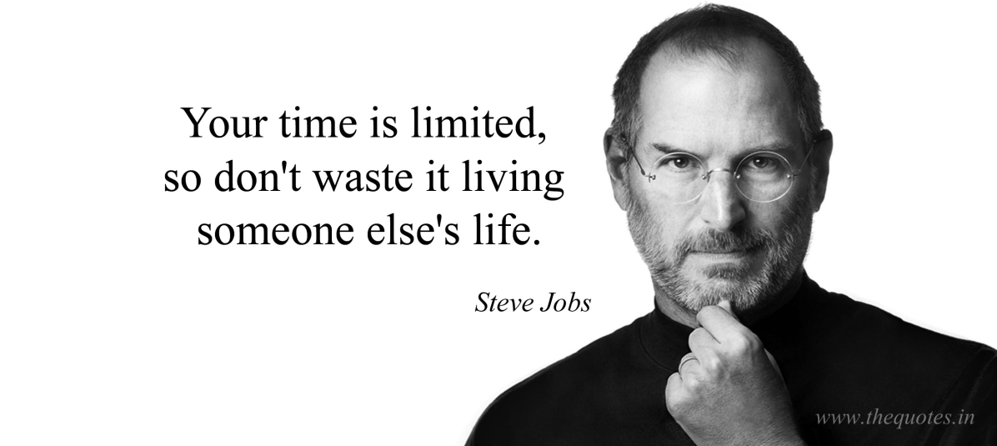
Steve Jobs Sayings

Slide 10
Vocabulary
a chairman - a person in charge of a meeting or organization
CEO - abbreviation for chief executive officer : the person with the most importantposition in a company
abbreviation: a short form of a word or phrase
a pioneer -a person who is one of the first people to do something
to establish: to start a company or organization that will continue for a longtime:

