Slide 1
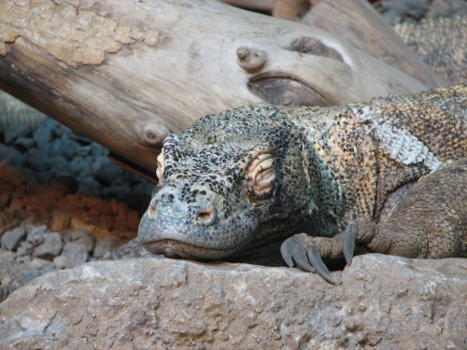
Komodo Dragon

Slide 2
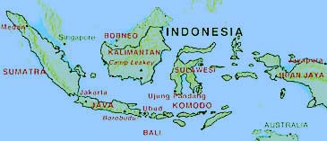
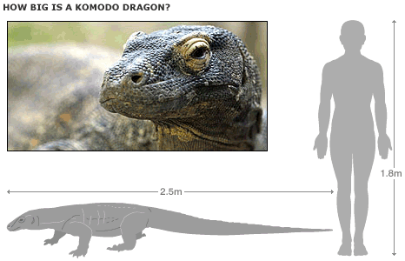
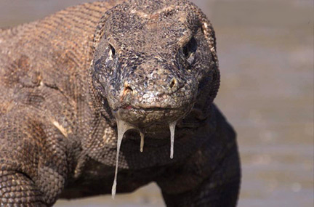
They live in the Indonesian islands.
Average lengt: 2.5 meters
Weight: 70 kg
Poisonous saliva
Gums over teeth cause bleeding, and so deadly bacteria grow in they’re mouth.

Slide 3
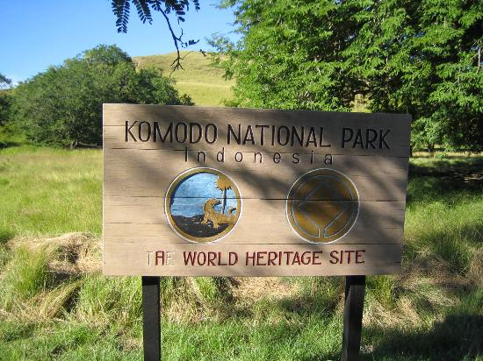
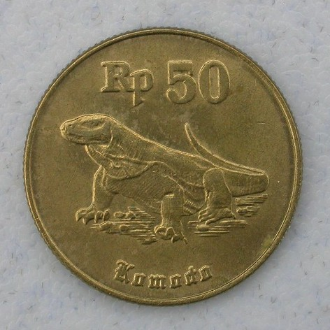
First introduced by Dutch scientists in 1910.
Komodo islands expedition in 1926
Komodo national park in Indonesia
Indonesian money

Slide 4
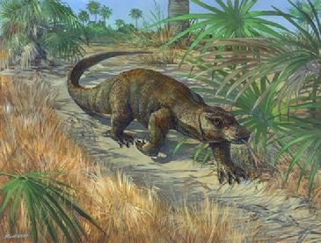
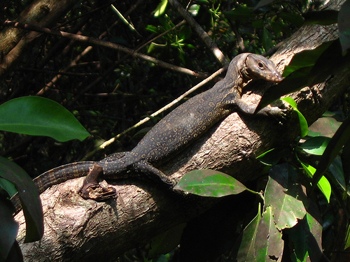
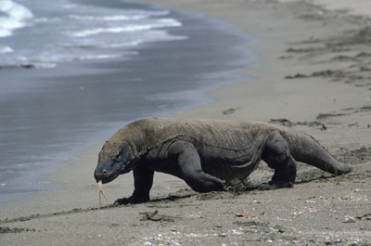
Natural habitat: hot grasslands & savannas
When young in tall trees
Can but doesn't prefer to swim.

Slide 5
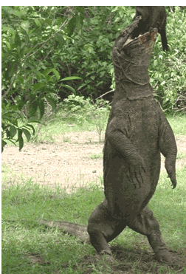
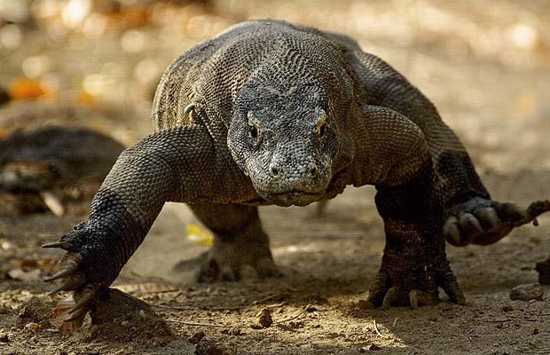
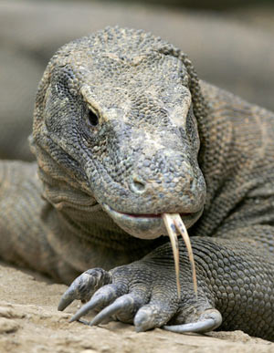
Long stong tail
60 sharp teeth
Sharp front claws
Bad hearing senses
Don’t smell with they’re nose much
Poor eyesight
Excellent detection, taste & smell with tongue.

Slide 6
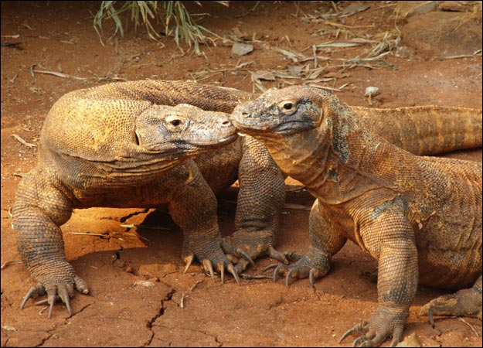
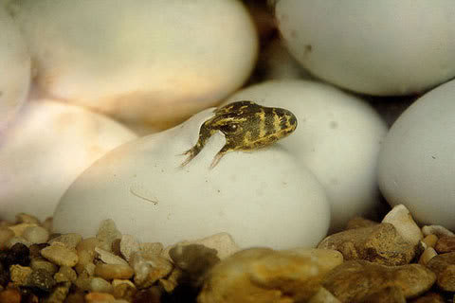
Females lay eggs in winter.
Babys hatch in summer.
They’re alone and live in trees eating insects.

Slide 7
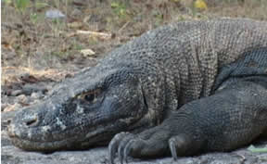
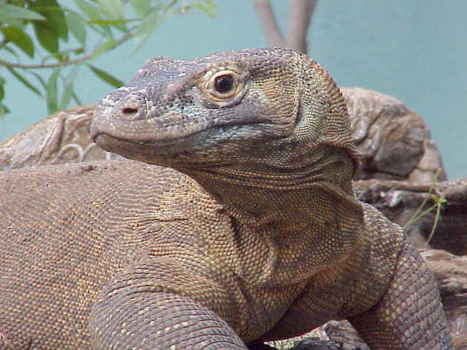
No natural enemies
On top of the food chain.
Carnivores
Also hunt prey by ambushing.
Poisonous saliva is they’re main weapon.

Slide 8
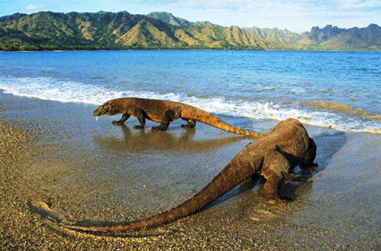
The End

Slide 9
text
The Komodo dragon is a large species of lizard found in the Indonesian islands
A member of the lizard family, it is the largest living species of lizard in the world.
It’s average length is 2.5 m but it can grow to a maximum length of 3 m and weight up to 70 kg.
The name Komodo dragon comes from he’s unique saliva structure. It doesn’t really breathe fire like a dragon but it has a deadly venomous bite that kills with ease. They’re saliva contains many poisonous and deadly bacteria because they’re teeth are almost covered by its gums so when they eat they bleed from them and creating bacteria. But other komodo dragons aren’t affected by it which is still a mystery why.
Komodo dragons were first documented by Dutch scientists in 1910, and in 1926 was the first expedition to the Komodo islands, devoted to study the newly-discovered lizards. Nowadays there is a national park on Komodo island, that cares and preserves the reptiles and is also a tourist attraction.
They live in hot open grasslands and savannas. When young they climb trees for shelter. When older they tend to move on the ground. They’re also very good swimmers but don’t prefer to get wet.
They sleep and rest in deep holes, that they dig themselves, and hunt in the afternoon.
It has a tail as longs as he’s body. They’re skull is big and flexible so they can consume large pray. They have 60 sharp teeth mainly covered in they’re gums.
They’re sense of hearing is very bad also they’re eye sight is only 300 meters long, although they can see in colors they’re night vision isn’t good so they aren’t nocturnal animals. They’re nostrils also aren’t of much use.
But they detect, taste and smell with they’re sensitive tongue like many other reptiles. As they walk they swing they’re head so they make wind which blows on they’re tongue so they can sense they’re surroundings.
The claws on they’re front legs are sharper and are used for combats with other dragons. They can also stand on they’re hind legs while using they’re tail for support.
Females lay eggs in winter and abandon them. In the summer the new baby dragons hatch and for the first few months of they’re lives they live in trees and eat insects.
The Komodo dragons are carnivores so they mostly eat carrion. The komodo dragons don’t have any natural enemy hence being on top of the food chain. They can hunt down pigs, deer, other small mammals and dragons and even humans.
They hunt by stealthy approaching they’re prey and ambushing it with a poisonous bite. The poisonous saliva enters the animals blood and the prey faints soon and dies a slowly death. The dragons use they’re tongues to track down they’re dead pray and then eats it.
The komodo dragons are very interesting creatures. It’s a very awesome animal because of its unique features and way of life. I hope you liked my presentation on these reptiles.

