Slide 1
Srednja šola Ravne
Referat pri Angleščini
Racism group: KU KLUX KLAN

Slide 2
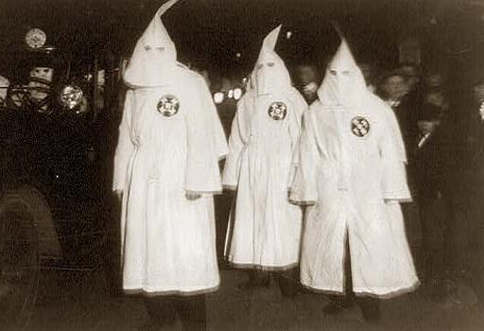
1. Creation
Ku Klux Klan (KKK) is the name of organizations in the United States. These organizations have often used terrorism, violence, and acts of intimidation, such as cross burning and lynching. Especially they hated African Americans and other social and ethnic groups.
The Klan groups were extremely violent.
The Klan started in 1866 after the American Civil war by six educated, middle-class Confederate veterans

Slide 3
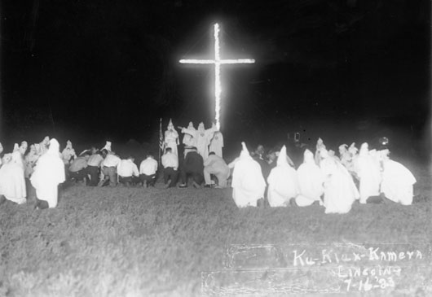
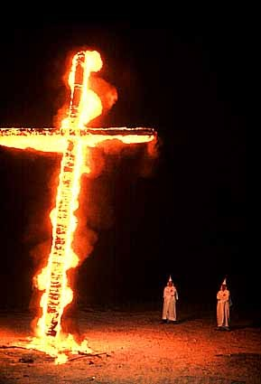
Collection to KKK

Slide 4
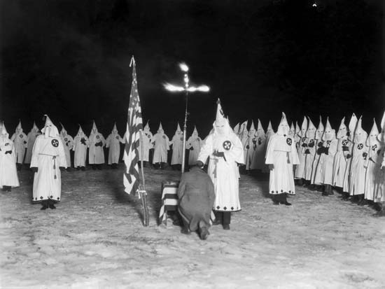
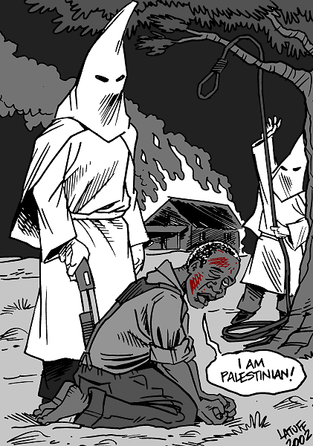
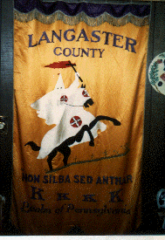

Slide 5
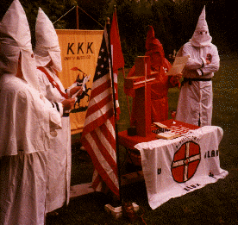
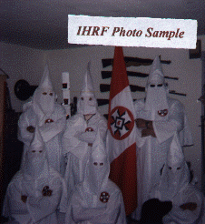

Slide 6
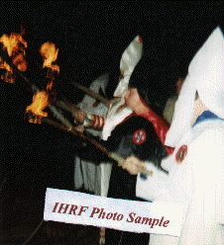
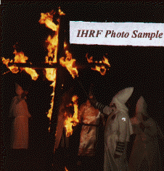
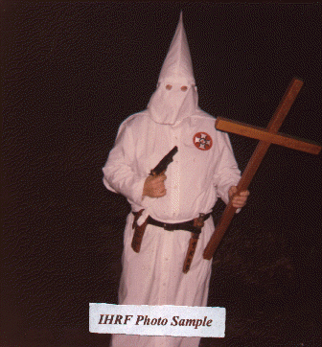
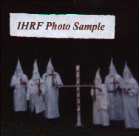
2. Activities
The Klan wanted to control the freed slaves. Specifically, to stop black education, voting rights, and the right to bear arms. However, the Klan's focus was mainly on African Americans (black people), immigrants and sympathetic whites . The violence achieved its purpose. They just wanted to make sure that white people are something more than black people.

Slide 7
In a 2002 there was a report, which denied the KKK. But some of the larger KKK organizations include:
Bayou Knights of the Ku Klux Klan, prevalent in Texas, Oklahoma,
Arkansas, Louisiana and other areas of the Southeastern U.S.
Church of the American Knights of the Ku Klux Klan
Imperial Klans of America
Knights of the White Kamelia
Knights of the Ku Klux Klan
They just changed the names.

Slide 8
The KKK is still working. The following table shows the change in the Klan's membership over time.
year | membership
1920 | 4,000,000
1924 | 6,000,000
1930 | 30,000
1970 | 2,000
2006 | 5,000
As you can see, the number is falling down, but the KKK is still present today. The number is raising, the KKK has more and more members again.

Slide 9
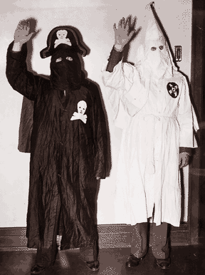
2.1 Black Legion
In 1920s and 1930s started kind of KKK, named The Black Legion. They wore black clothes with the pirate signs.They were the most violent members in the KKK.

Slide 10
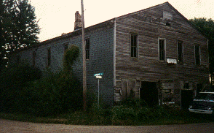
2.2. The Museum of Americanism
The secret Klan museum is where Klan artifacts, records, history and all other documentation of the KKK (as far as is known and preserved) are stored. Do not ask the location of the museum. Do not ask if you can visit the museum. The answer is "NO!" Only a select few who are in the "know" are permitted to see the museum. None of these items are for sale. They are museum exhibits only.

Slide 11
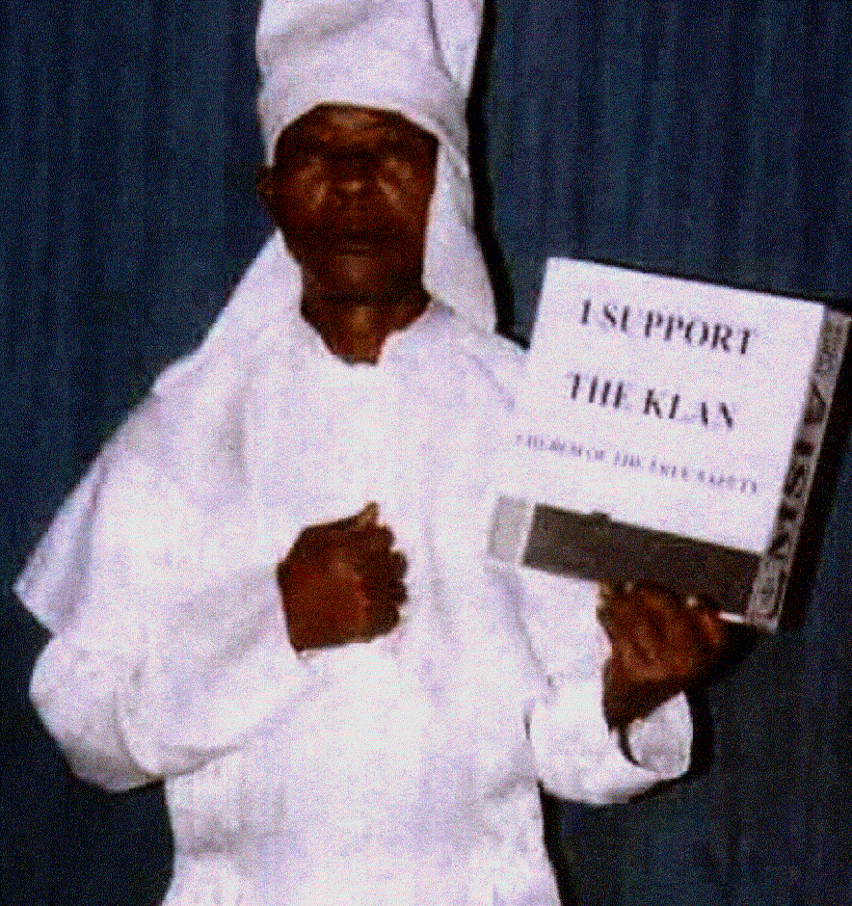

Slide 12
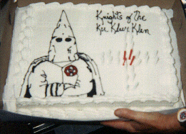
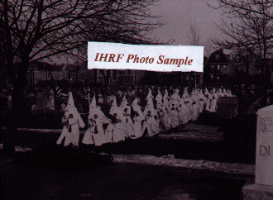
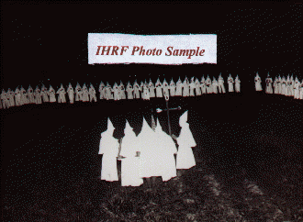
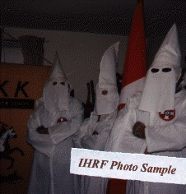

Slide 15
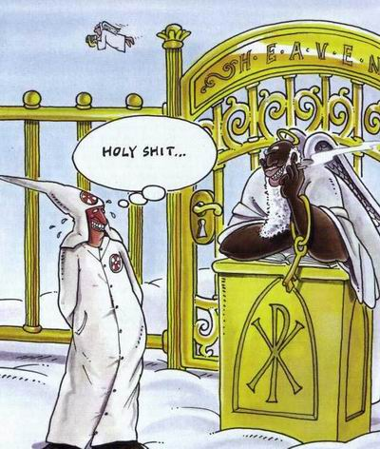
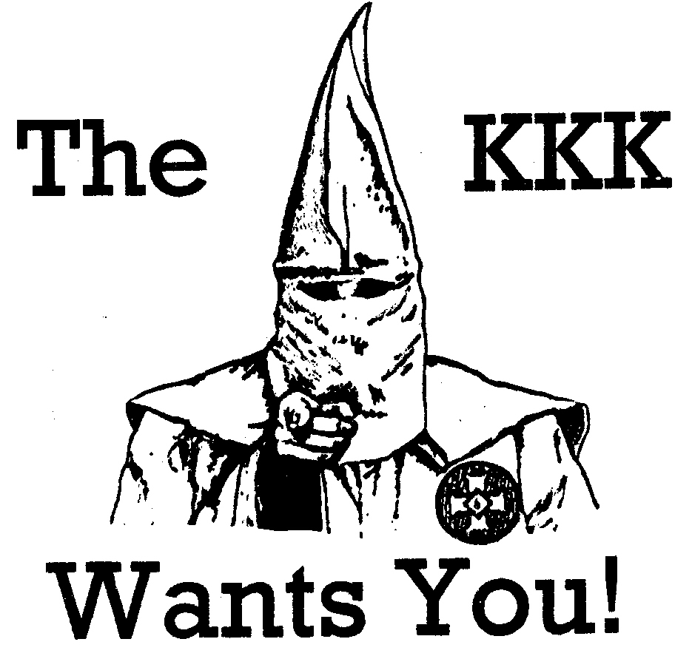
Thanks upon I thoughtfulness
Source:
http://www.kkklan.com
aunt Wikipedia
uncle Google

