Slide 1
LIFE IN SLOVENIA
CAPITAL CITY - LJUBLJANA
POPULATION
SCHOOL and WORK
CHILDREN FREE TIME

Slide 2
CAPITAL CITY
Capital city is Ljubljana
There are 270.000 people
River Ljubljanica
Goverment, parliament, Office of president Janez Drnovšek
Mayor is Zoran Janković
Many tourist atractions

Slide 3
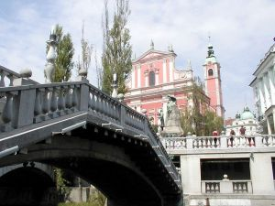
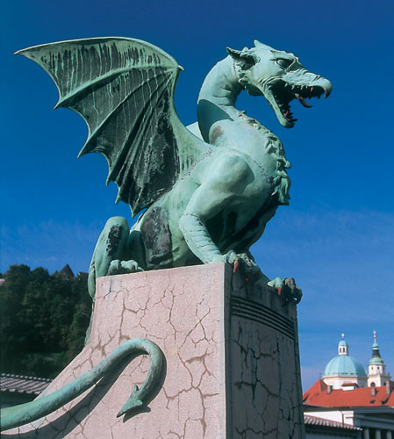
LJUBLJANA

Slide 4
POPULATION
There are 2 milion people in Slovenia

Slide 5
SCHOOL
Children start with primary school at the age of 6 and they finish when they are 14 or 15 years old.
Lessons start at around 8 o’clock and they finish after 2 pm.
After primary school students got to secundary school and then to highschool.

Slide 6
WORK
Main industries are ferrous metallurgy and aluminum products, electric power equipment, wood products, machine tools, textiles, chemicals and pharmaceutical.
People usually go to work around 7 o’clock and they finish at around 4 o’clock

Slide 7
WORK

Slide 8
CHILDREN’S FREE TIME
Sports:
Football, basketball, volleyball, hockey, tennis, balley, athletics, bowling, cycling, rollerblading, skiing,…
Other:
Using the internet, playing computer games, go to cinema, play hide and seek,…
Music school

Slide 9
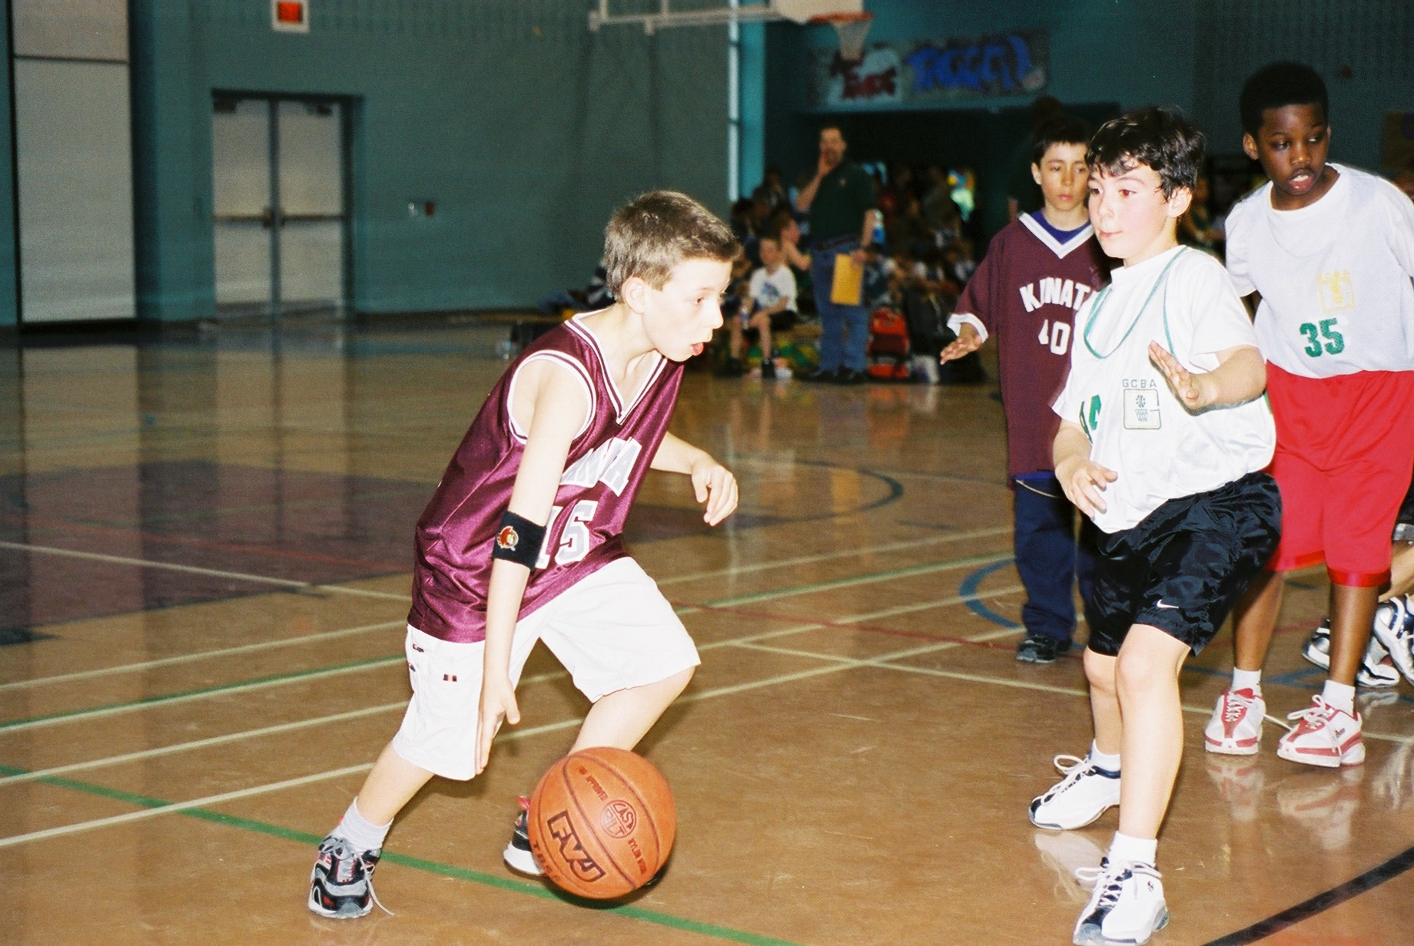
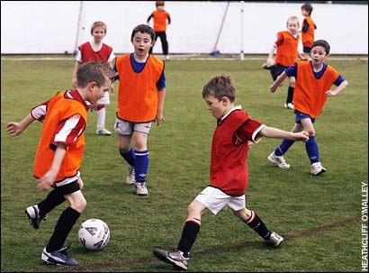
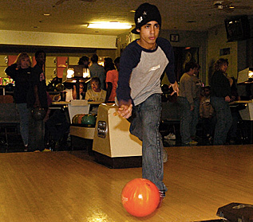
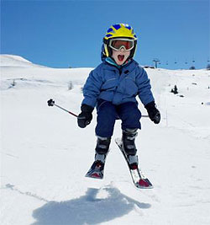

Slide 10
MY TYPICAL DAY
My morning
In school
Afternoon (music school, using computer,…)
Evening (dinner, going to bed,…)

Slide 11
IN THE MORNING
I usually wake up at 7.30 am.
I brush my teeth.
I dress up.
I never eat breakfast.
I often walk to school.

Slide 12
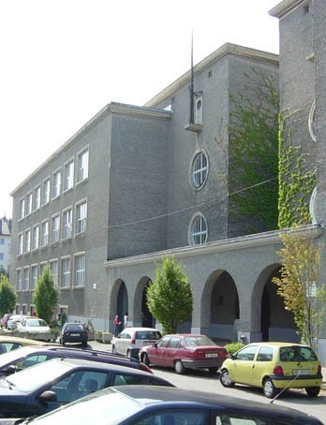
AT SCHOOL
I always start at 8.30 am. and I finish at half past two.
I like P.E., English, Science, and brakes.
I hate Maths.
I have lunch in school canteen every day.

Slide 13
AFTERNOON
I go to music school two times a week.
I have Religious Studies every Tuesday.
I do my homework.
I use the computer.
I sometimes practice the piano.

Slide 14
IN THE EVENING
I watch TV and read books.
I have a shower.
I brush my teeth.
I usually go to sleep at nine o’clock.

Slide 15
QUESTIONNAIRE
There are 24 students in class 7.a. How do they come to school?

Slide 16
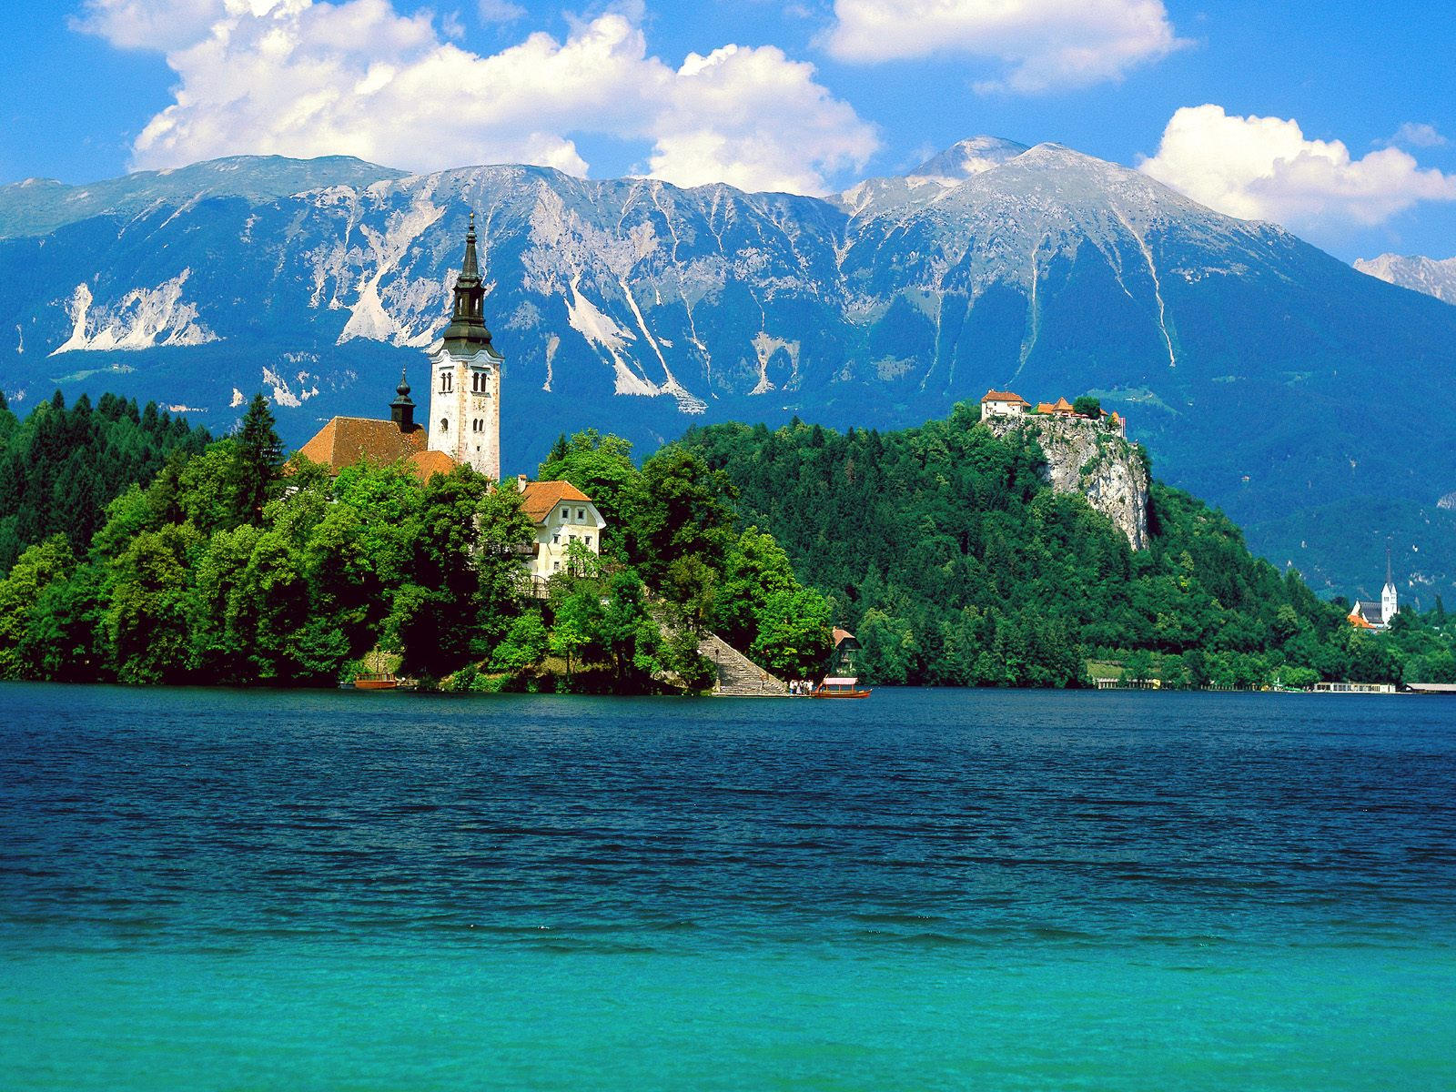
Thank you for your patience!!!
BLED CASTLE

