Slide 1
WHAT
CONSEQUENCES
EFFECTS
Photo pollution/ Luminous pollution

Slide 2
Excessive artificial light → increased brightness
The International Dark-Sky Association (IDA)→ adverse effect :
sky glow
glare
light trespass
light clutter
Decreased visibilyty
Energy waste

Slide 3
Indoor = lighting in houses or apartments (North America, Europe, Japan, Middle East, North Africa)
Outdoor (main pollutants):
more necessary (roadside lamps, traffic lights, vehicle lights, road sign lights, emergency vehicle lights...)
Less necessary (store, commercial sign lights, the lights that enlight statues and buildings...)

Slide 4
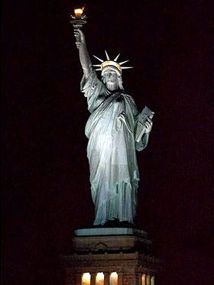
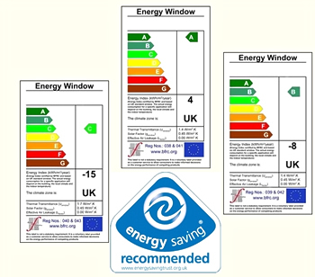
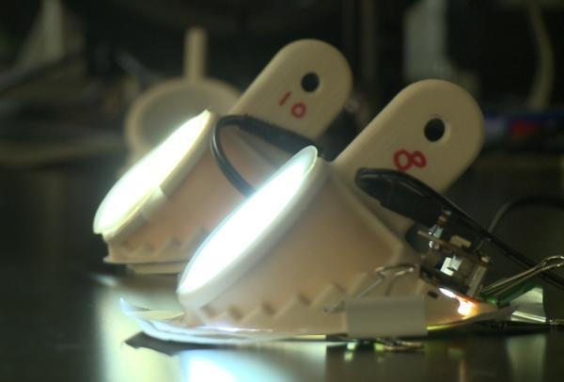
Energy waste
light bulbs
energy resource deficiency → wars
dishwashers
energy crysis → save energy:
energy saving
washing machines
refrigerators

Slide 5
sky observing interference
telescope efficiency → dark sky
La Silla observatory in Chile →
6 hundred kilometres away from light
Hinder to acquire knowledge

Slide 6
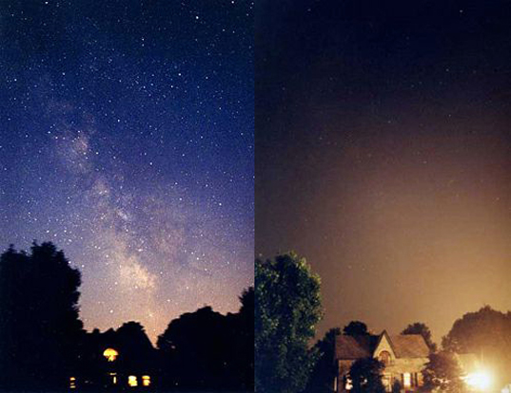
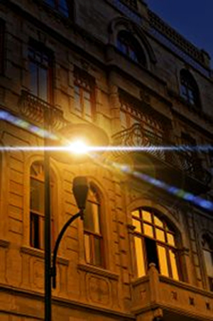
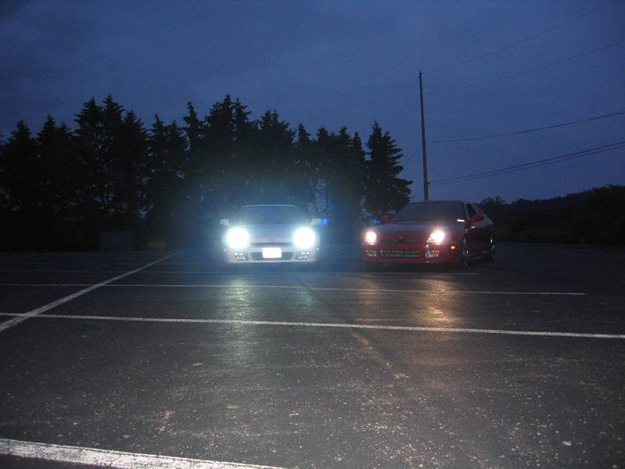
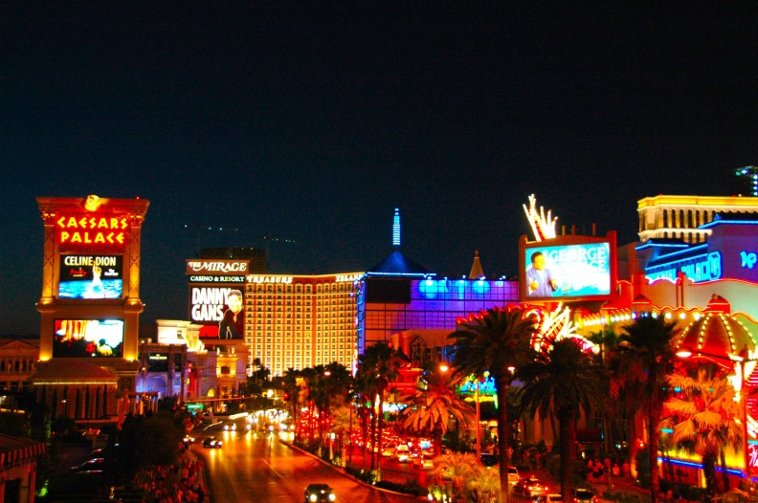
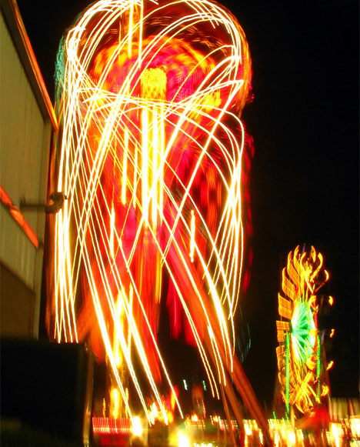
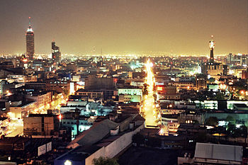
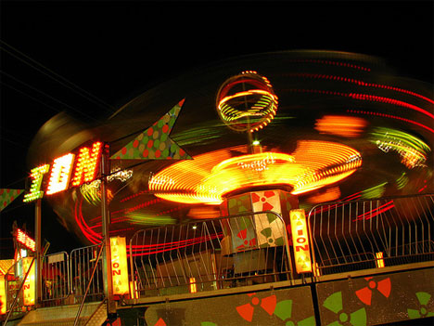
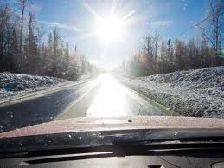
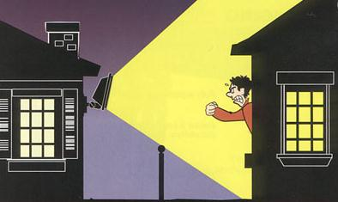
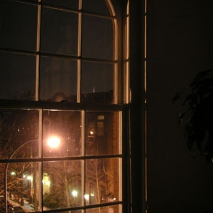
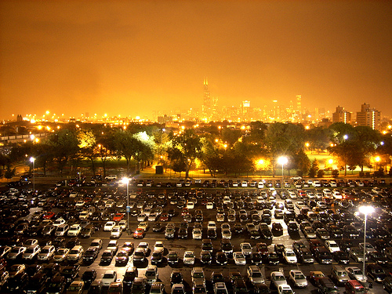
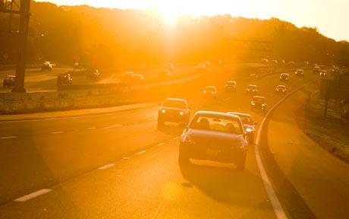
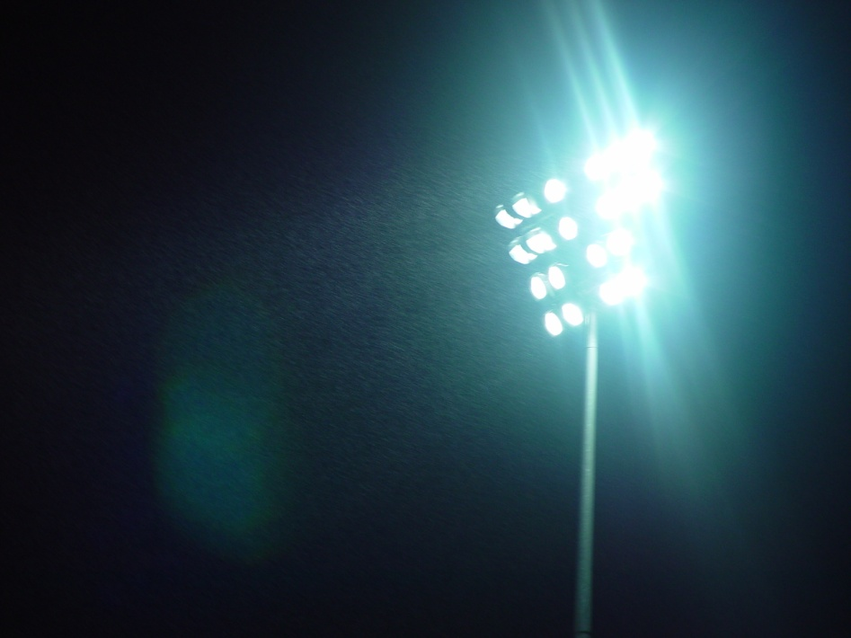
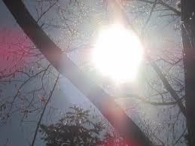
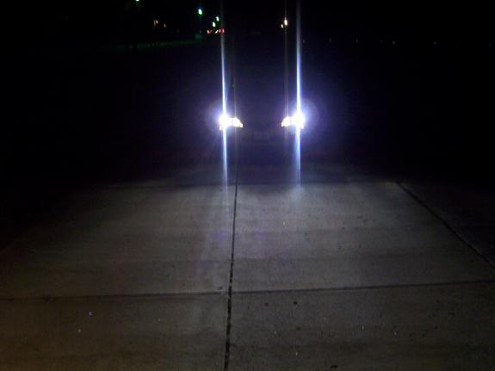
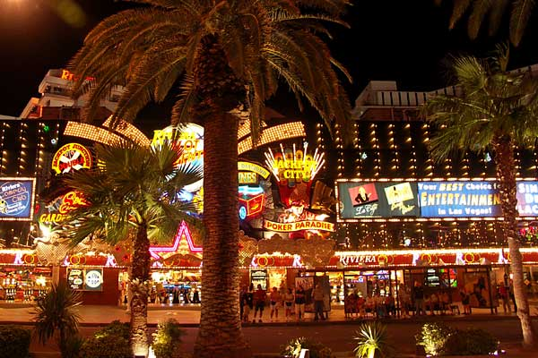
Types of pollution
Light trespass
Glare :
Blinding glare
Disability glare
Discomfort glare
Light clutter
Sky glow

Slide 7
Human health
Fluorescent lighting → elevate blood pressure by 8 points, increased stress & fatigue → worker errors → over-illuminating and bad planning of lighting (not light pollution)

Slide 8
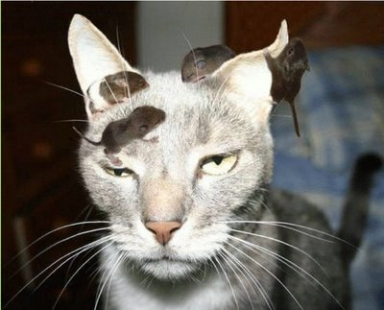
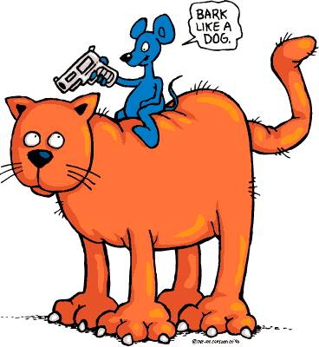
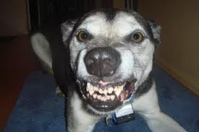
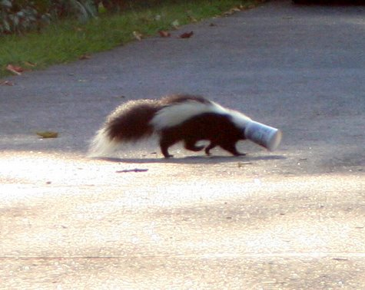
Animals
Changed mood & behaviour
confuse animal navigation
alter competitive interactions
change predator-prey relations
more aggressive

Slide 9
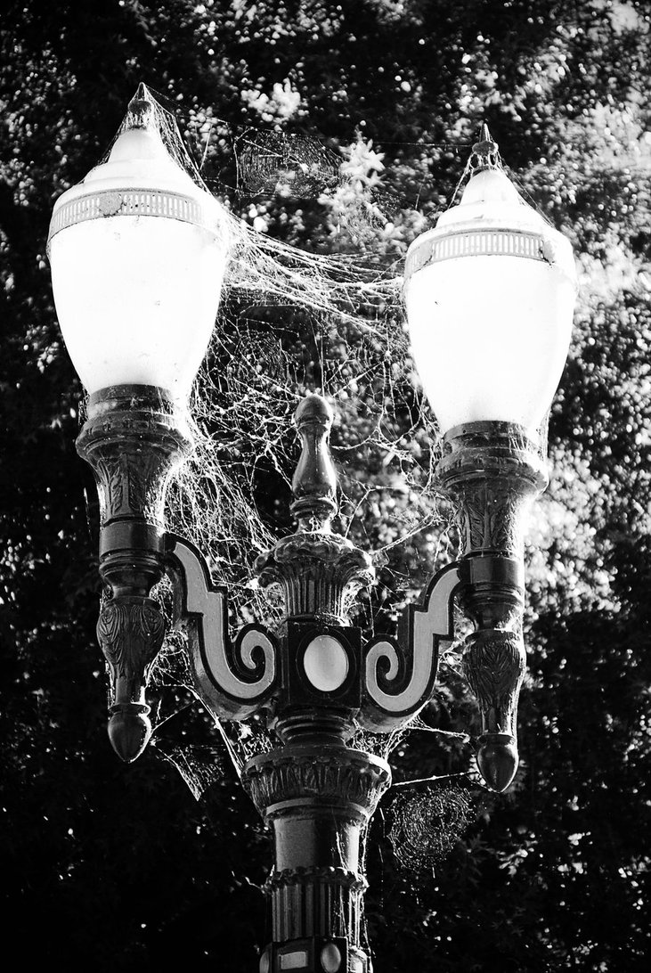
Disruption of ecosystems
It can be:
beneficial
neutral
damaging
Spiders

Slide 10
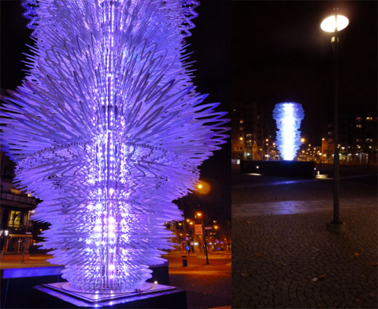
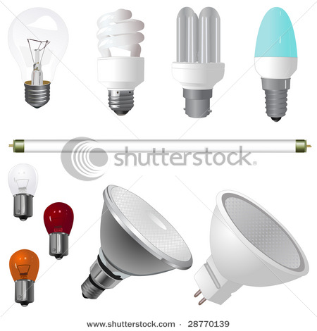
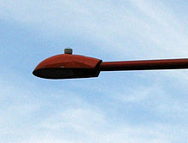
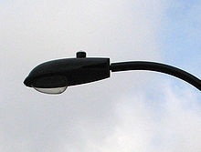
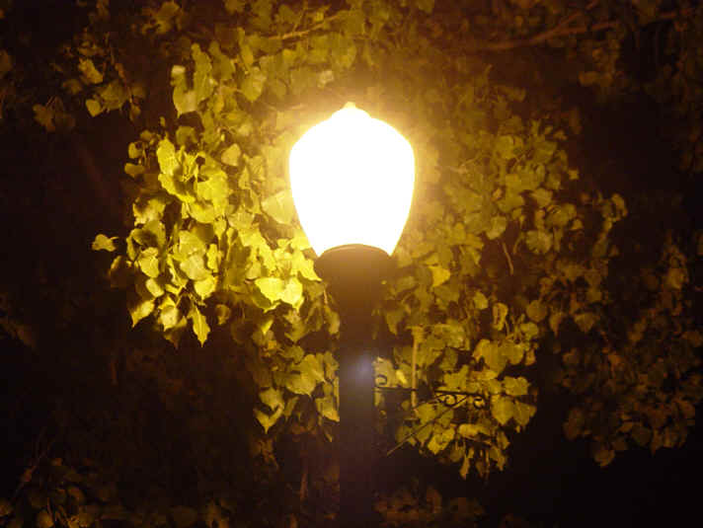
Solutions
adjusting light’s intensity
turning lights off
improving lighting fixtures
adjusting the type
evaluating the necessity of lights

Slide 11
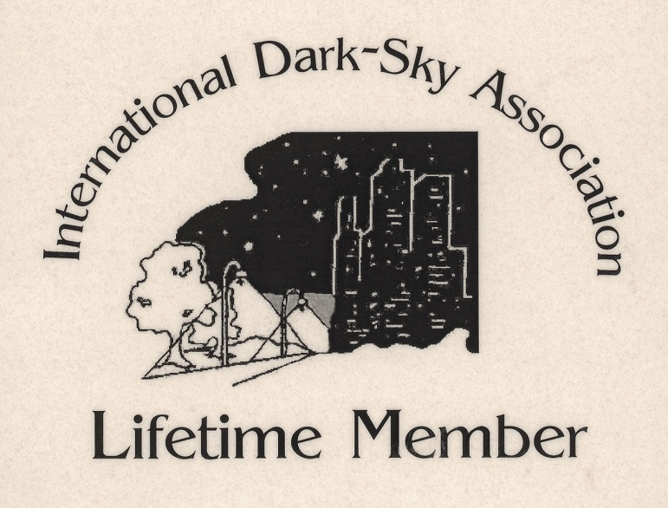
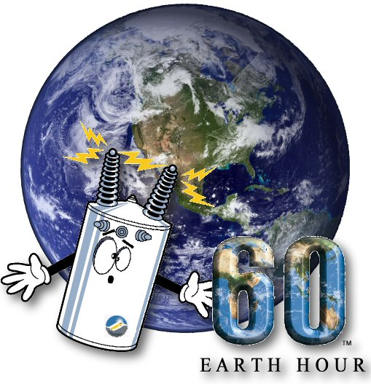
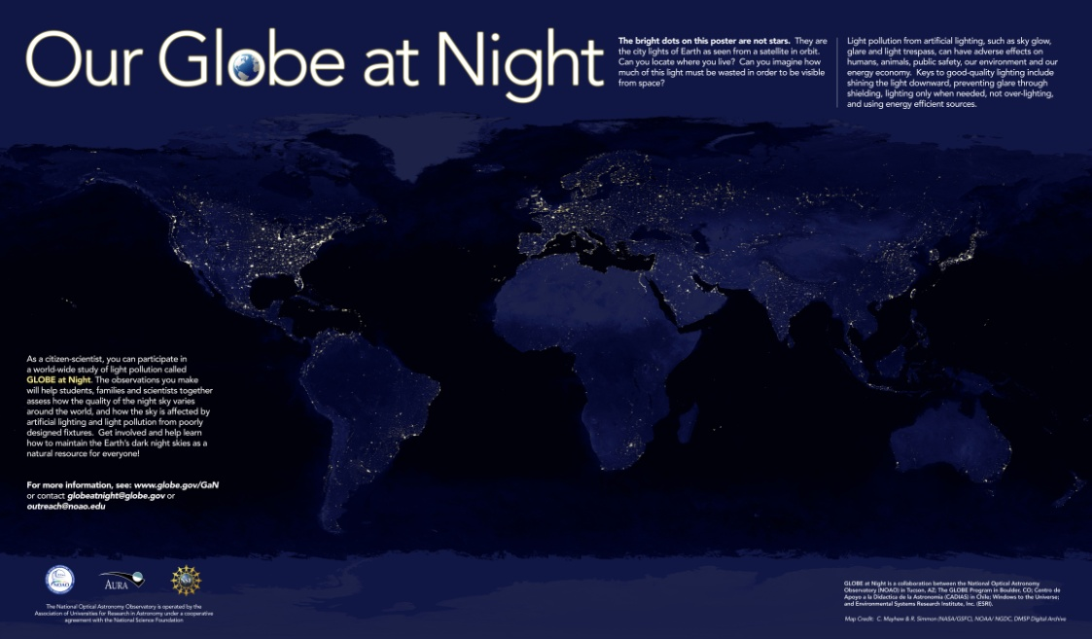
Organisations and campaigns
the IDA
Globe at Night (global)
‘’Nebo ponoči’’ in Slovenia
Earth Hour

Slide 12
Not really dangerous just disturbing and hindering

Slide 13
SOURCES
http://www.darksky.org/, 01.01.2012
http://en.wikipedia.org/wiki/Light_pollution, 01.01.2012
http://www.astrosociety.org/education/publications/tnl/44/lightpoll.html, 01.01.2012
http://sl.wikipedia.org/wiki/Svetlobno_onesna%C5%BEenje, 30.12.2011
Pictures: Google

