Slide 1
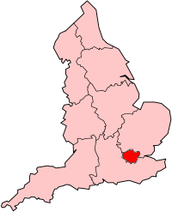
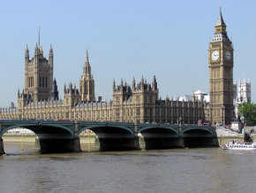
London
The capital city of UK.
Population: 7,5milon, Londoners.
Density : 4,697/km2
River Temza cros the city
House of parlament and Big ban
Metropolitan area : 12 and 14 milions of people.
Torist remarkableness: House of Parlament (whit Big ben),
Tower Bridge, British Museum, National Galery.
London is region of England, London called Greater London
and Greater London has a center whitch called City of London.

Slide 2
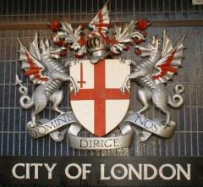
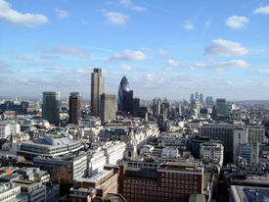
City of London
Population: 8,600
Density: 2,966/km2
The City of London is a small area in the
Greater London.
It`s London`s main financial district and is part of London`s
City centre.
It has two independent enclaves:
Inner Temple and Middle Temple.
Here work around 320,000 of people.

Slide 3
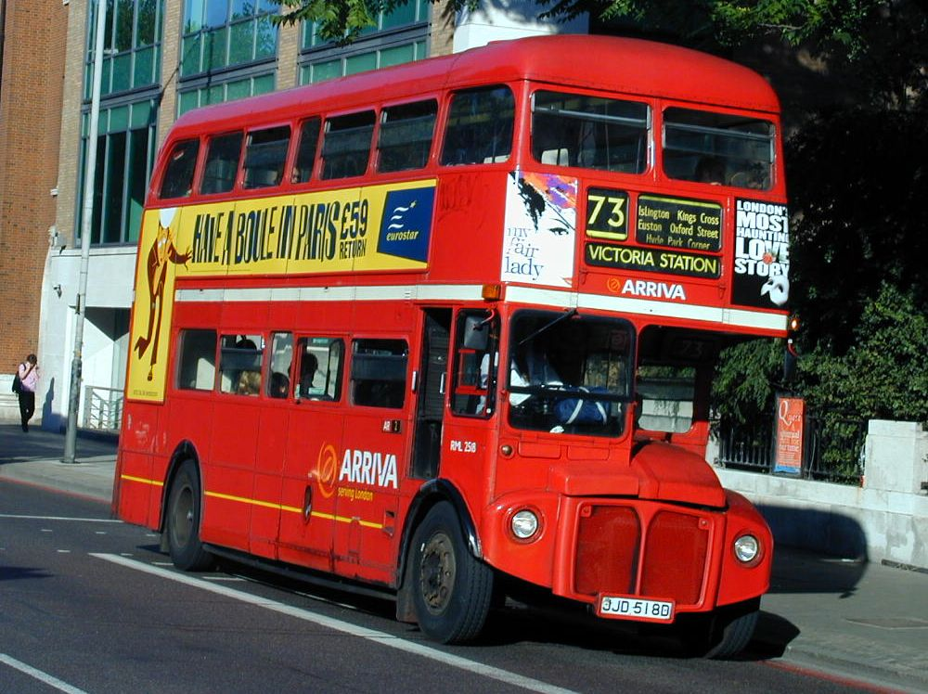
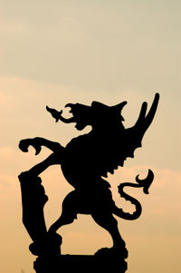
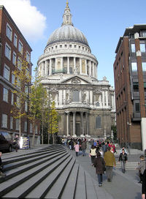
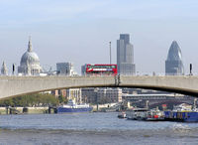
Remarkablenses of City London
Dragon, symbol of London
London bus whitch is wery popular
St, Paul`s Catedral
Waterloo Bridghe

Slide 4
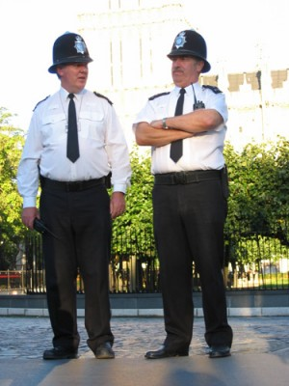
Other functions
They have a own independent police force.
Schools in the City of London are independent
for Male and Female.
Local goverment
City of london has uniqe political status.
It`s administered by the Corporation of London, headed by the
Lord Mayor of London.
Elections
City has electoral system, they dont follow
the rules of democray.

Slide 5
Vocabulary

