Slide 1
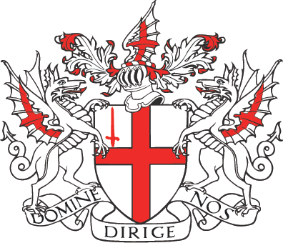
london

Slide 2
The capital city of the United Kingdom.
Population: 7,512,400.
Lord Mayor : Ian Luder.

Slide 3
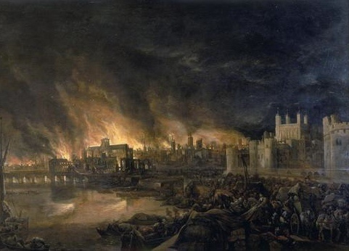
HISTORY
Founded by the Romans (Londinium) – it was decay.
Anglo – Saxons created a new city (Lundenwic).
Than the Danisch conquered it.
London had become the largest city in England.
1666 - The Great Fire of London destroyed the original city.
After 10 years the London became the largest city in the World.

Slide 4
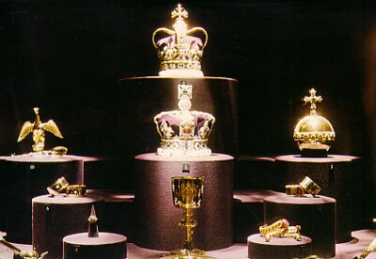
TOWER OF LONDON
A historic monument in central London.
At first was a fortress, a royal palace, and a prison.
Now it is the home for the Crown Jewels.

Slide 5
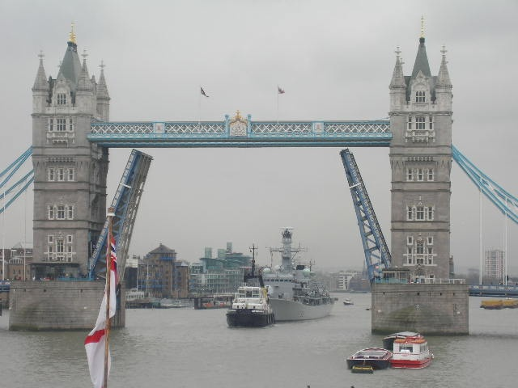
TOWER BRIDGE
A bascule bridge in London.
Built in 1894 and become an iconic symbol of London.
It is one of the world’s most famous bridges.

Slide 6
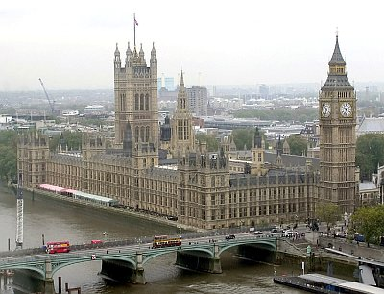
HOUSES OF PARLAMMENT
Aloso the Palace of Westminster.
There two houses of parlament meet.
It has around 1100 rooms.
In Commons Chamber Members of Parliament debate policy.

Slide 7
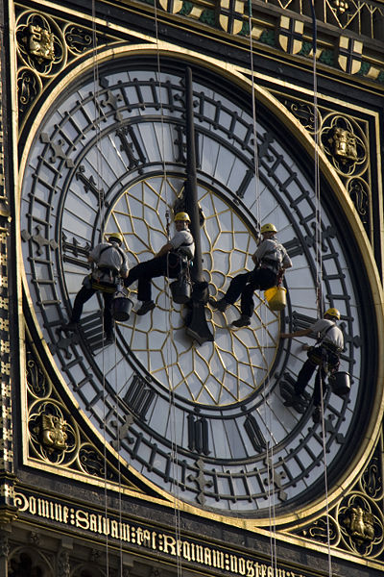
BIG BEN
Nickname for the bell of clock in the clock tower of the Palace of Westminster.
The largest chiming clock on the World.
First time it broke down in year 2007.

Slide 8
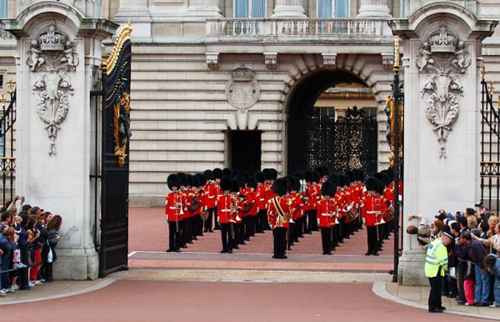
BUCKINGHAM PALACE
The official residence of the British monarch.
Queen use it for royal lunches, diners, receptions…

Slide 9
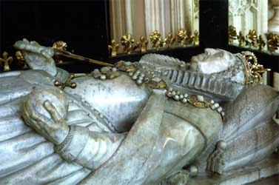
WESTMINSTER ABBEY
The burial place of Britain's monarch.
Use for royal weddings and coronations.

Slide 10
LONDON EYE
The biggest Ferris wheel in Europe.
Opened in 2000.
In half hour you can see the whole London.

Slide 11
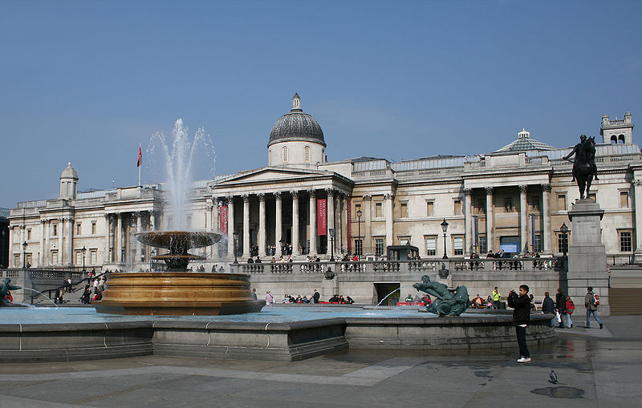
TRAFALGAR SQUARE
One of the most popular tourist important place.
Statue of the admiral Lord Nelson, National Gallery and fountains.

Slide 12
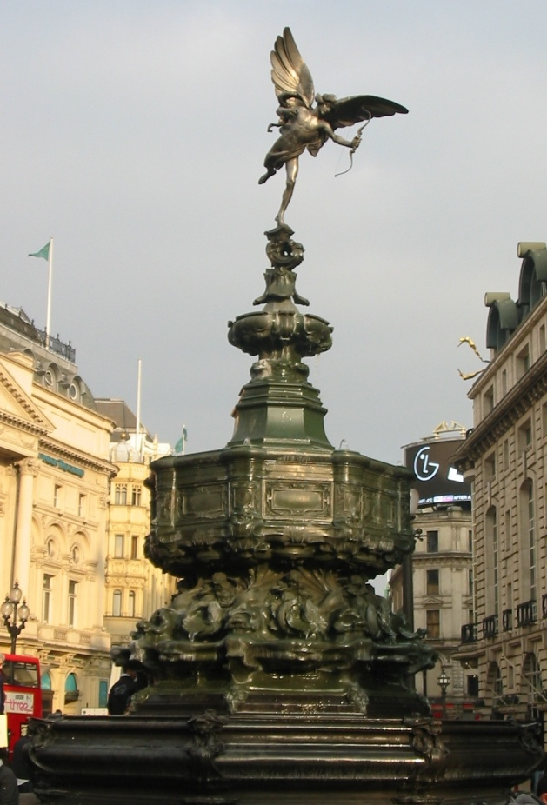
PICCADILLY CIRCUS
A famous public space in London.
Known for video display and neon signs mounted.
Memorial fountain and statue - Eros

Slide 13
BRITISH MUSEUM
Museum of human history and culture.
One of the largest in the world.
It show us the story of human culture from beginning to the present.

Slide 14
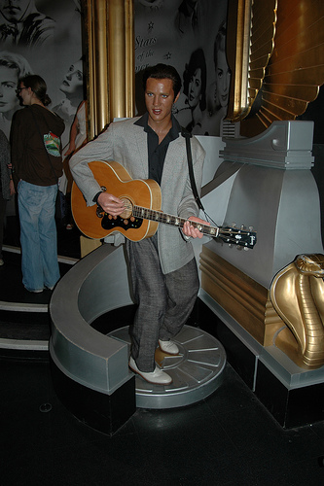
MADAME TUSSAUD
Famous wax museum.
Set up by wax sculptor Marie Tussaud.

Slide 15
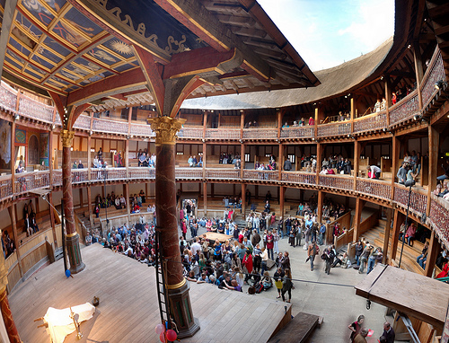
Globe Theatre
A theatre associated with William Shakespeare.
Many of Shakespeares plays were first performed in this theatre.

Slide 16
London is recognize in Europe over:

