Slide 1
LOS ANGELES
Angleščina

Slide 2
LOS ANGELES
The City Of Angeles
the Second Largest Country In
The U.S.A., AFTER NEW YORK CITY
WITH A POPULATION OF 3.8 MILION PEOPLE

Slide 3
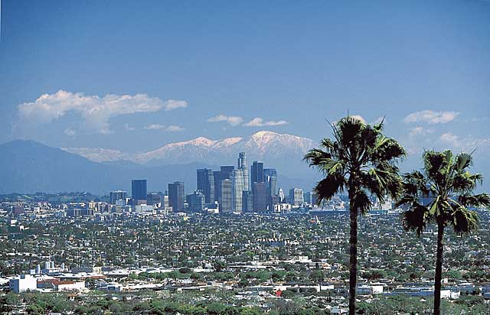
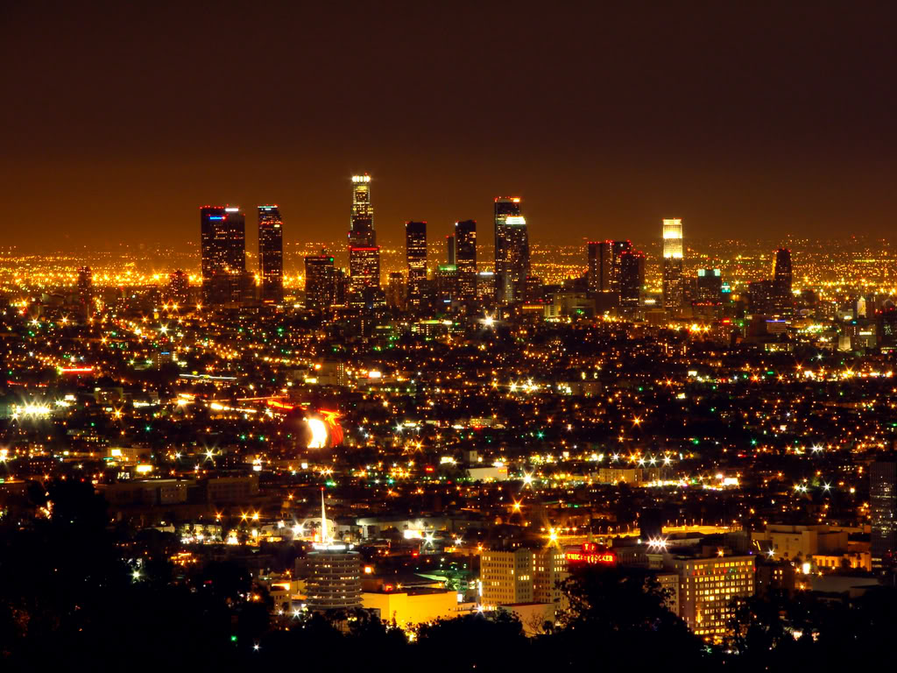
los angeles
L.A. AT NIGHT:

Slide 4
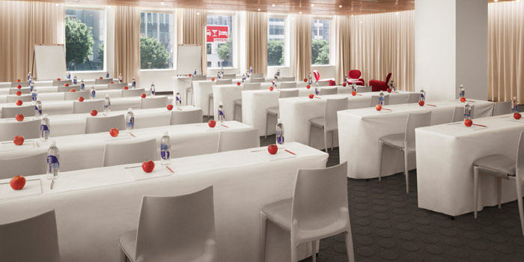
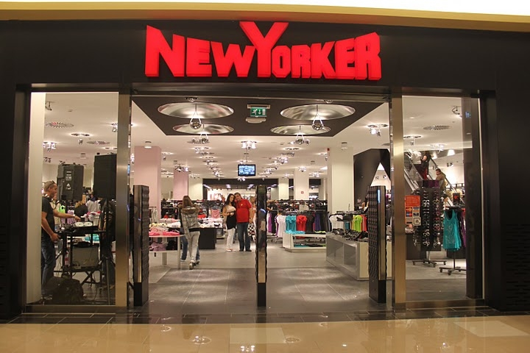
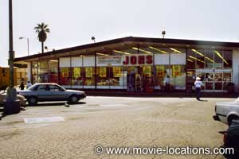
los angeles
RESTAURANTS
Shops
Supermarkets

Slide 5
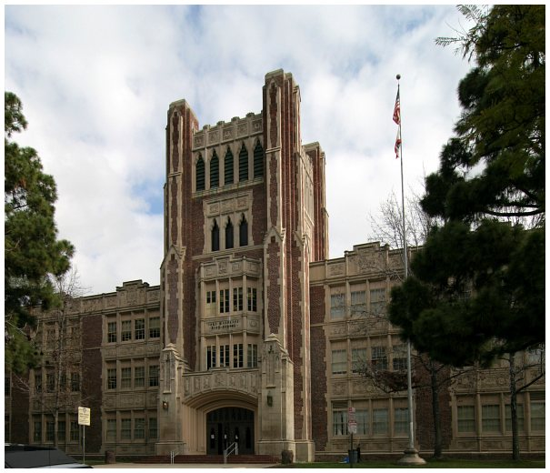
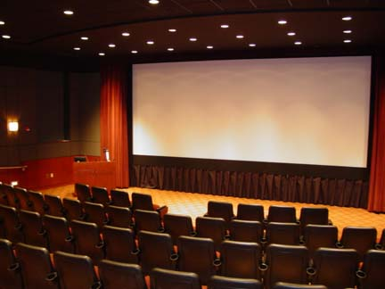
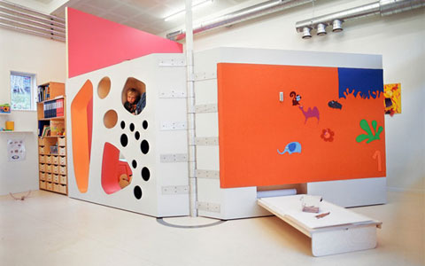
los angeles
Schools
Cinemas
Kindergardens

Slide 6
MY DREAM HOUSE

Slide 7
MY HOUSE
FOUR BEDROOMS
TWO BATHROOMS
KITCHEN
DINING ROOM
LIVING ROOM
HOOL
GARDEN

Slide 8
kitchen
Lights
Window
Cooker
Carpet
Cupboard

Slide 9
dining room
Windows
Lights
Table
Chairs

Slide 10
living room
Television
Table
Carpet
Sofa

Slide 11
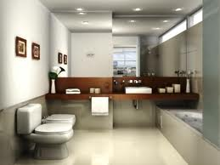
baTHROOM
TOILET
BIG MIRROR
SINK
BATH
WINDOWS

Slide 12
hool
Kitchen
Stairs

Slide 13
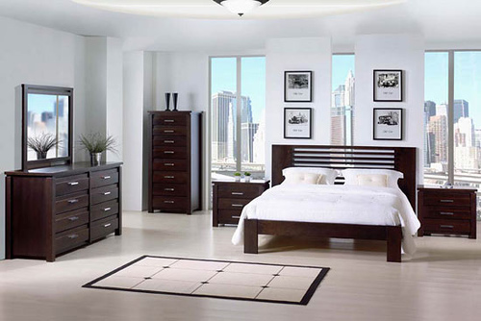
GRANDMA’S ROOM
BED
CARPET
WINDOW
BED SAID TABLE
MIRROR
PICTURES

Slide 14
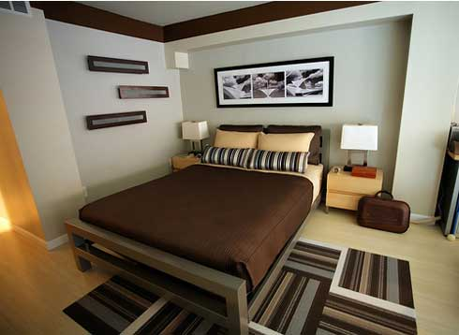
MUM’S ROOM
BED
PICTURES
LIGHTS
CARPET

Slide 15
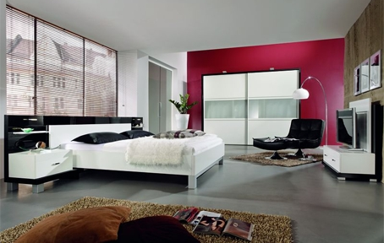
MIŠA’S ROOM
BIG WARDROBE
BED
CARPET
ARM CHAIR
LIGHTS
…

Slide 16
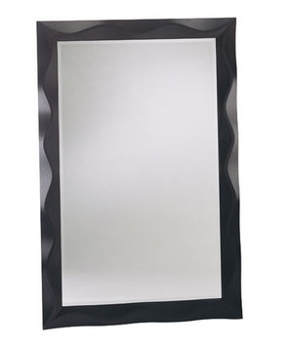
BATHROOM
Sink
Bath
Toilet
Mirror

Slide 17
MY ROOM
Window
Bed
Computer
Chair
Desk
Bed side table
Carpet
Wardrobe

