Slide 1
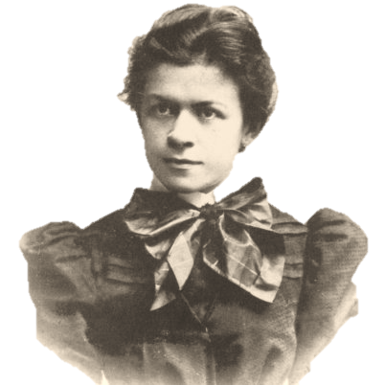
MILEVA MARIĆ

Slide 2
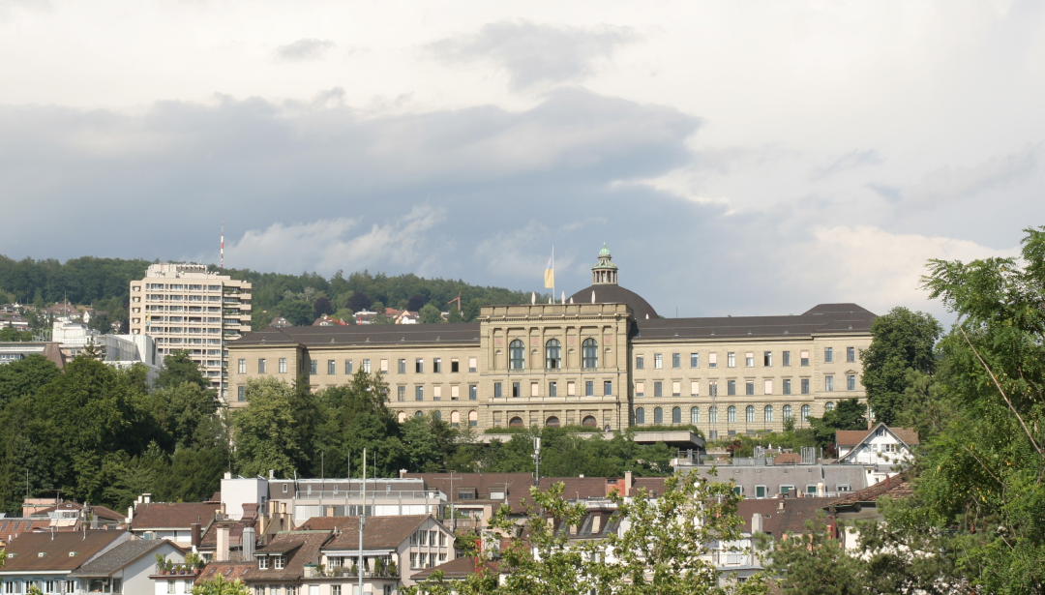
EARLY LIFE…
She was born on 19th December in 1875 (Titel, Serbia).
CONTINUED IN THE ZURICH
POLYTECHNIC SCHOOL
1875
1891
1896
Went to University of Zurich.
Royal Classical High School in Zagreb (she was the first girl who could share a classroom with boys).

Slide 3
Relationship with Einstein…
Mileva and Albert began writing to each other. He nicknamed her „Dollie“. He actively courted her.
Mileva became pregnant . Albert saw her rarely, because she was in Heidelberg.
1897
1901
WORK IN LAB
1897
1900
1902
Mileva spent semester in the Univ. of Heidelberg (Germany).
Mileva failed her exams.
Mileva gave birth to Lieserl.
Einstein`s parents were against the relationship, because she was from different religious and cultural background.

Slide 4
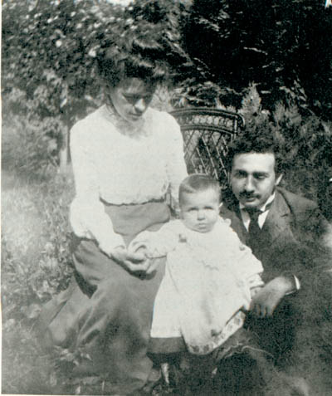
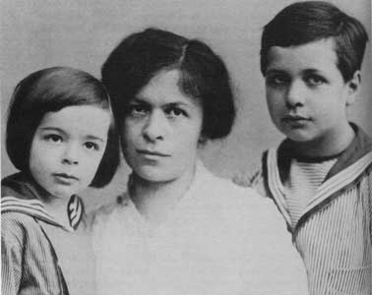
Marriage with Einstein…
They moved to Prague where Albert became a professor at the German University.
They got their first son – Hans Albert.
1910
1904
1903
1910
1911
They got their second son – Eduard.
Albert and Mileva got married in the Bern City Hall on January 6.
Einstein became famous and he traveled a lot. He had an affair with his cousin, Elsa Lowenthal.

Slide 5
Divorce from Einstein…
Mileva and children moved, because Albert had a job in Berlin.
After seven nominations, Albert wins the medal for Nobel prize in physics. He gives the prize money to Mileva.
1914
Mileva died in hospital in Zurich.
1919
1921
1945
LIFE AFTER DIVORCE

Mileva and Albert got divorced.
Son Eduard suffered for schizophrenia.
In 1933 last time when Mileva saw Albert.
Mileva had many problems with her health.
Albert gives Mileva a written list of harsh rules to obey if she wants to stay married. Within 3 months Mileva and the boys return to Zurich.

Slide 6
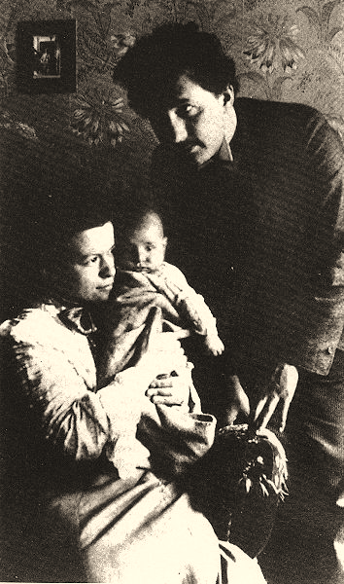
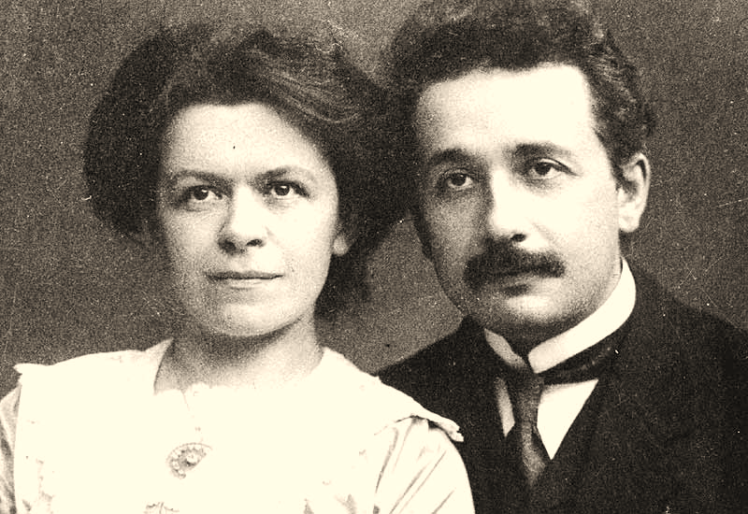
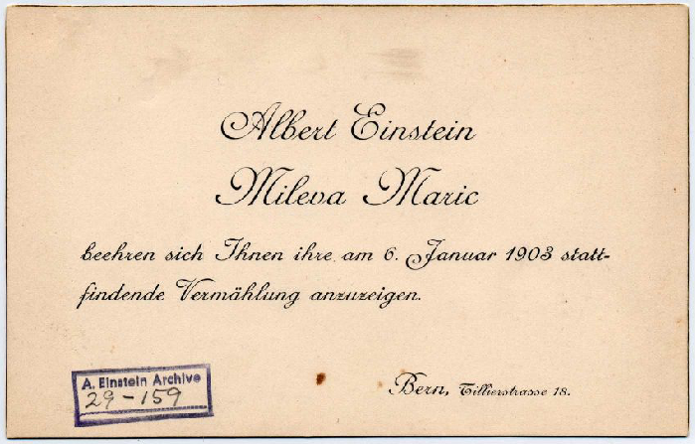
Einstein`s marriage picture
Announcement of Einstein marriage
Mileva with family

Slide 7
Mileva’s and Einstein’s relationship was…
very lovely and professional.
Albert saw a friend, a companion and co-worker in Mileva.

Slide 8
THE END

