Slide 1
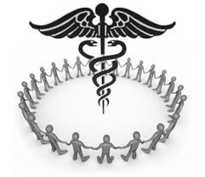
MEDICINE

Slide 2
MEDICINE
Alternative
(traditional)
Modern

Slide 3
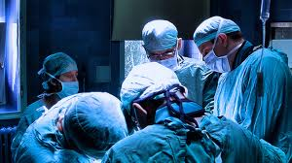
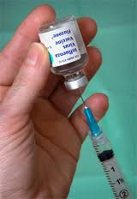
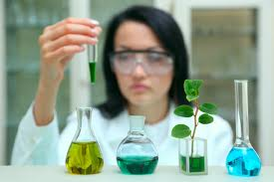
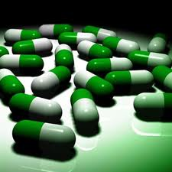
MODERN MEDICINE
Doctors and pharmacists
Western world
Developin through years
The most known medicine in the world

Slide 4
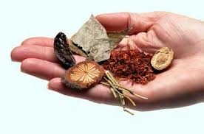
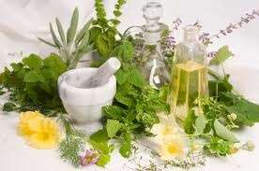
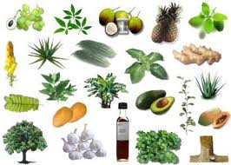
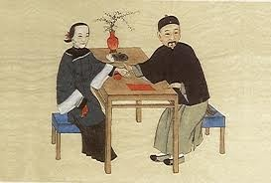
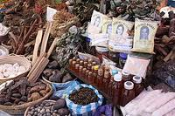
TRADITIONAL MEDICINE
Acupuncture
Herbalism
Reflexology
Homeopathy

Slide 5
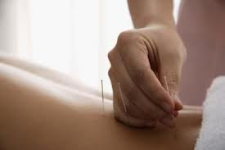
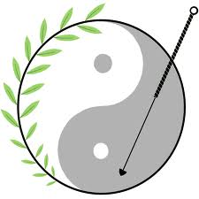
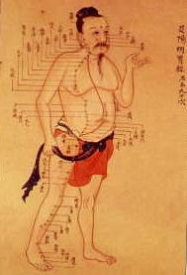
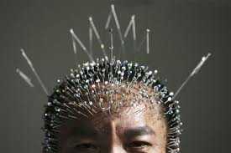
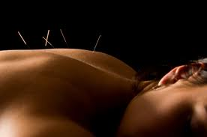
Acupuncture
From China
Started 1600 BC
Firstly used rocks, than needles
Today we know many ways of acupuncture

Slide 6
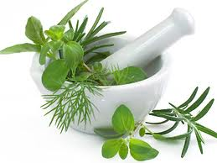
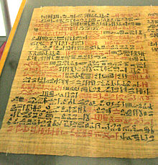
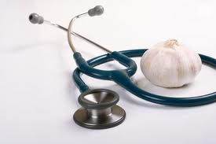
Herbalism
Started way before acient Egypt
Reached climax before parmacy revolution
Since than is not very used
Garlic, ginger, eucayptus

Slide 7
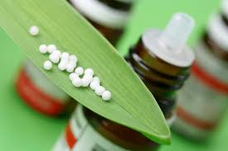
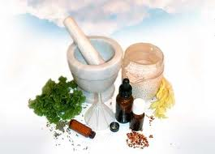
Homeopathy
Homeopathy means like to suffer
Started in1796 by Samuel Hahnemann
Consuming small amount of toxic

Slide 8
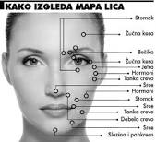
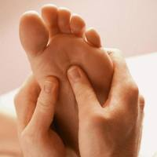
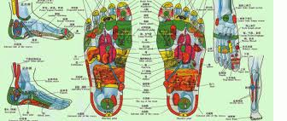
Reflexology
From ancient Egypt
Firstly just massage
Real medicine since 1940
Massagin hands and feets

Slide 9
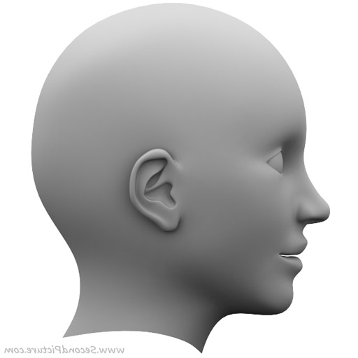
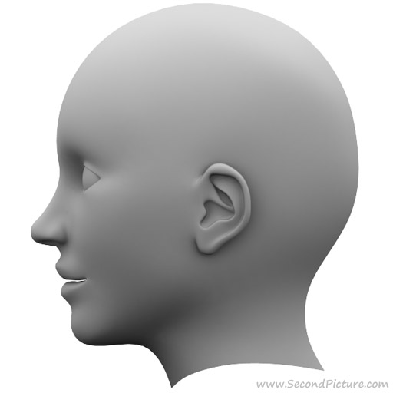
HEAD TO HEAD
ALTERNATIVE
MODERN

Slide 10
Traditional - Advantages
It is natural
It has long history
It can heal things that modern can not
Some ways are cheap
Do not have to wait long period

Slide 11
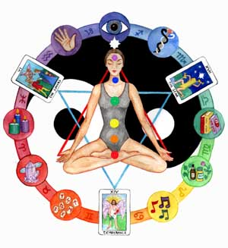
Traditional- Disadvantages
Some ways are expencive
It is not known enough
Health insurance does not cover it
Healer can not be a pro

Slide 12
Modern - Advantages
It is known enough
Cover by health insurance
Pacient’s healer (doctor) is pro

Slide 13
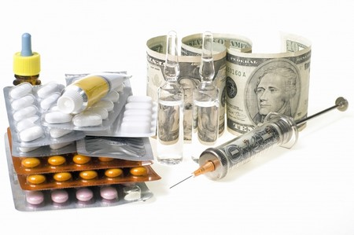
Modern- Disadvantages
It can effect bad on your life
You should wait long period of time
Some doctors do not want to take time to their pacients

Slide 14
Conclusion
I think, that we should use more natural remedies and use more alternative medicine than we are using now.

Slide 15
SOURCES
http://en.wikipedia.org/wiki/Traditional_medicine (16.1.2013; 22:02)
http://www.who.int/topics/traditional_medicine/en/ (16.1.2013; 22:02)
http://altmedicine.about.com/ (16.1.2013; 22:02)
http://en.wikipedia.org/wiki/Acupuncture (16.1.2013; 22:02)
http://en.wikipedia.org/wiki/Herbalism (16.1.2013; 22:02)
http://en.wikipedia.org/wiki/Reflexolgy (16.1.2013; 22:02)
http://en.wikipedia.org/wiki/Homeopathy (16.1.2013; 22:02)
http://www.google.si/imgres?hl=sl&client=firefox-a&hs=a9v&sa=X&tbo=d&rls=org.mozilla:sl:official&biw=1280&bih=896&tbm=isch&tbnid=1AUSQ71PKg9QBM:&imgrefurl=http://www.thestrengthsfoundation.org/3-tips-for-behaving-ethically-at-your-tylenol-moments/scales-of-justice&docid=QzlQtHp2pD_MxM&imgurl=http://www.thestrengthsfoundation.org/wp-content/uploads/2010/12/Scales-of-justice.jpg&w=2240

