Slide 1
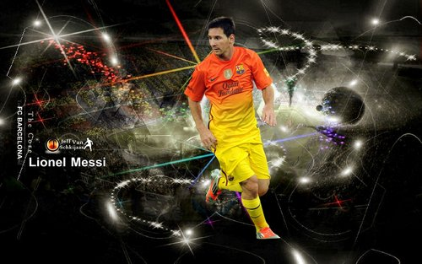
Lionel Messi

Slide 2
Me
My name is Domen and I’m 14 years old. I live in Gasteraj in a house with my parents,my sister and my brother. I’m a verry happy and active person. I play football for FC Jurovski Dol. In my free time I like telephoning with my friends, going for a walk, going out with my friends, listening to music and the most often I surf on the Internet. Like most of boys I like computer games. This year I'm going to secondary school in Maribor. My birthday is on 27th November. In the future I hope will succeed in the elementary school and enroll on a high school.

Slide 3
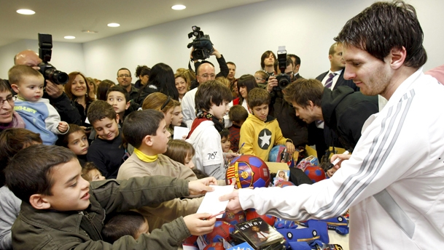
Why have I chosen this person?
I’ve chosen this person because:
He is a footballer like me
Despite glory and wealth he remains humble and modest
He helps kids around the world and he has his own charity. It ‘s called Leo Messi foundation and he helps children.
He had a disease.

Slide 4
The past
Messi was born in Rosario, to parents Jorge Messi and Celia Maria. He has two older brothers, Rodrigo and Matias, and a sister Maria. He started to play football when he was 5 years old. He played for club Grandoli, trainer of which was his father. In 1995 he started to play for club Newell's Old Boys. When he was 11 years old he got a diagnose that his body didn't produce enough testosterone. At the same time club River Plate got interested in him, but they couldn't pay his treatment. But sports director of FC Barcelona has also recognized his talent and Barcelona has made a contract with him and they also paid his treatment and made him new life in Spain. Messi moved to Spain with his family when he was 13 years old. After that he quickly showed his talent in Barcelona and he soon came to first team. Argentina fans call Messi La Pulga.

Slide 5
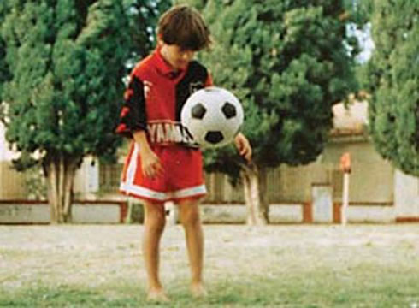
Lionel Messi, when he was 8 years old.

Slide 6
How did he become famous?
He played his first official match against Espanyol on 16th October 2004. On this day he became the youngest player that has ever played in Spanish League called La Liga. On 4th August 2005 Messi was called to Argentina national football team. In season 2006/07 he showed his good form on El Clasico. He scored a hat-trick. He is the youngest player ever scored on El Clasico. With this match he started his best form in this club. Messi got a nickname New Maradona, because he scored almost the same two goals as Diego Armando Maradona did. Spanish gave him a nickname Messidona.
But I think Messi became famous because he plays football with passion. What is more, he doesn’t want to make fake injuries or dive, he is born to play football how it’s meant to be played.

Slide 7
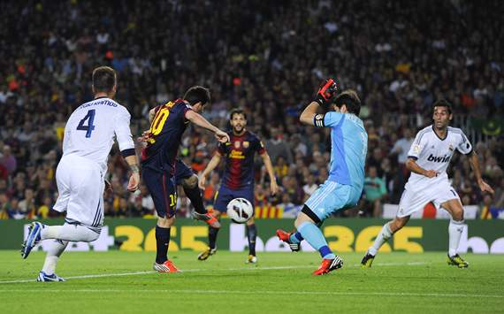
Messi against Real Madrid 2012

Slide 8
Argentina
Messi is also the captain of the Argentina national team and has played in two World Cups (2006 and 2010) and two Copa Americas (2007 and 2011). In the summer of 2008 he also played at the Beijing Olympics, and came home with a gold medal.

Slide 9
Messi with Gold Medal

Slide 10
Changes
How has his life changed since he became famous:
He has become rich and a celebrity
He’s started to appear on television
He’s helped humanitarian organizations
People recognize him on streets

Slide 11
Playing style
Messi has been compared to Diego Maradona. His quick feet allow him to keep control of the ball when dribbling at speed. Like Maradona before him, Messi is dominantly a left footed player. With the outside of his left foot, he usually begins dribbling runs, he uses the inside of his foot to finish and provide passes and assists to team mates.

Slide 12
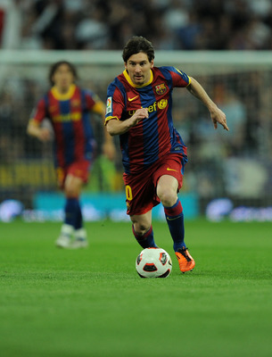
Messi dribbling at speed

Slide 13
Personal life
His girlfriend is Antonella Roccuzzo,since January 2009. On 2 November 2012, Messi became a father for the first time following the birth of his son Thiago. When his son was born ,Messi say:Today I am the happiest man in the world, my son was born and thanks God for this gift!
Messi and Antonella, his girfriend

Slide 14
Honours
He has a lot of honours with club, national team and the most have individual awards
With Barcelona he won:

Slide 15
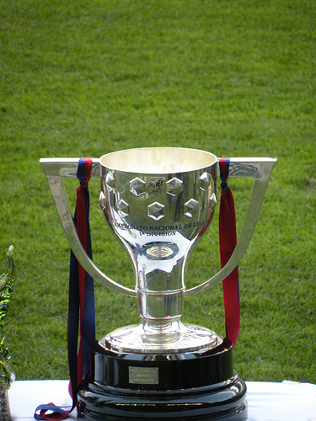
La Liga: 6 Titles

Slide 16
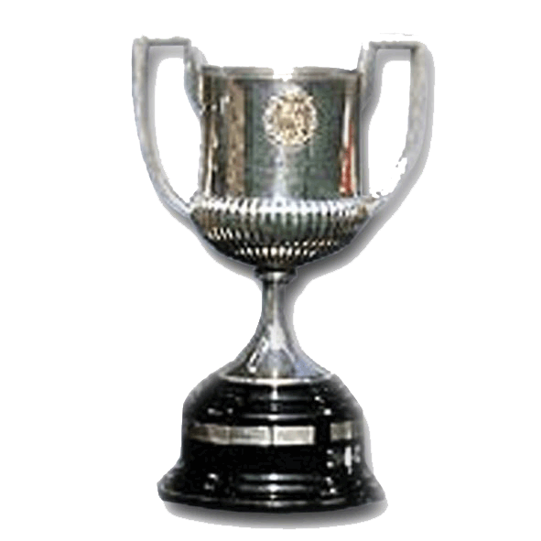
Spanish Cup: 3 Titles

Slide 17
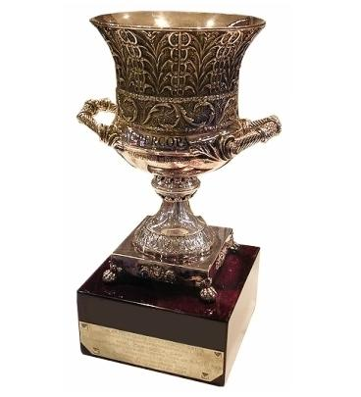
Supercopa de Espana: 5 Titles

Slide 18
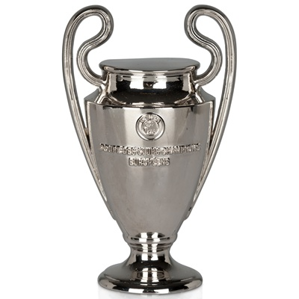
UEFA Champions League: 3 Titles

Slide 19
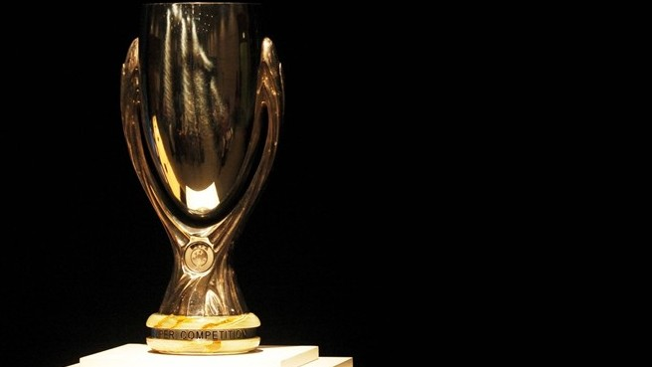
UEFA Super Cup: 2 Titles

Slide 20
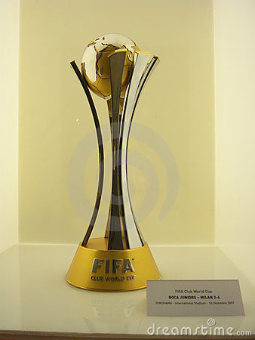
FIFA Club World Cup: 2 Titles

Slide 21
Argentina
FIFA World Cup: 2005
South American Youth Championship: 2005
Olympic Gold Medal: 2008
FIFA World Cup: 2005

Slide 22
Individual
FIFA Ballon d'Or
FIFA World Player of the Year
World Soccer Player of the Year
World Soccer Young Player of the Year
ESM Team of the Year
European Golden Shoe
Pichichi Trophy
La Liga Player of the Year
LFP Best Player
LFP Best Forward
La Liga Foreign Player of the Year
La Liga Ibero-American Player of the Year
UEFA Champions League Top Goalscorer
UEFA Best Player in Europe Award
UEFA Club Footballer of the Year
UEFA Champions League Forward of the Year
UEFA Team of the Year
Tuttosport Golden Boy
Sportsperson of the Year of Argentina
Footballer of the Year of Argentina
Male Best Athlete in Latin America
IFFHS World's Top Goal Scorer
Best International Athlete ESPY Award
FIFA/FIFPro World XI

Slide 23
Messi with Ballon d'or
On 7th Janurary 2013 he got 4 Ballon d’or

Slide 24
Records
World
Guinness World Records title for the most goals in a year: 91 goals.
Most international goals in a year (club and national team): 25 goals (shared with Vivian Woodward).
Most goals scored in FIFA Club World Cup: 4 goals (shared with Denilson and Mohamed Aboutrika).

Slide 25
Spain
Most goals scored in La Liga in a season: 50 goals.
Most La Liga hat-tricks in a season: 8 hat-tricks.
Most goals scored in the Supercopa de España: 10 goals.

Slide 26
Barcelona
Top scorer in official competitions: 289 goals.
Top scorer in La Liga: 196 goals.
Top scorer in UEFA Champions League: 56 goals.
Top scorer in European Competitions: 57 goals.
Top scorer in international Competitions: 61 goals.

Slide 27
Some great players about Messi
Maradona: The ball stays glued to his foot; I’ve seen great players in my career, but I’ve never seen anyone with Messi's ball control.
Cristiano Ronaldo: Messi has his personality and I have mine. He has his game and I have mine. I also play in a big club like him. We are different in every aspect. But right now, he is the best.

Slide 28
Tape
http://www.youtube.com/watch?v=06pmWho75lg

Slide 29
Resources
http://en.wikipedia.org/wiki/Lionel_Messi
http://www.biography.com/people/lionel-messi-555732
http://www.fcbarcelona.com/football/first-team/staff/players/messi/biography
http://www.lionel-messi.co.uk/biography/
http://www.jockbio.com/Bios/Messi/Messi_bio.html
Book:
L. Caioli, Messi (žepna knjiga), 2012, Učila International d.o.o.
Photos are all from Web.

