Slide 1
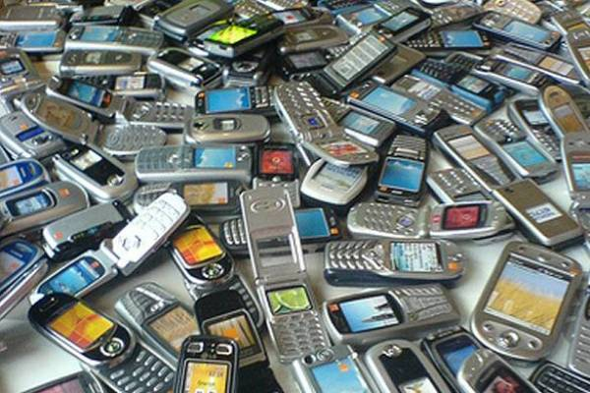
Mobile Phones

Slide 2
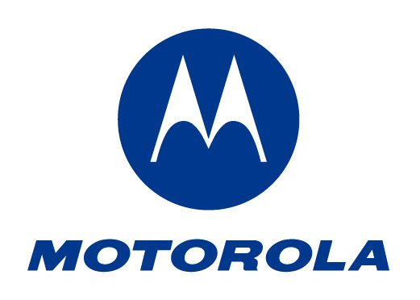
Mobile phones
Every second people has one in Slovenia.
Mobile phones have camera, wireless lan conection,bluetooth…
We known:

Slide 3
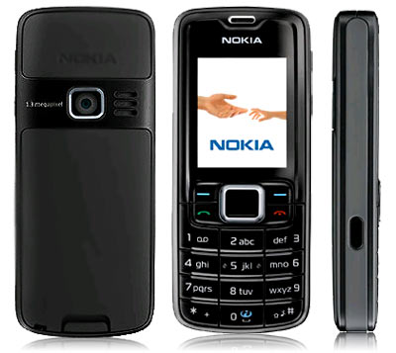
300 models of phones.
Is the most popolare phone.
The phones are very cheap.

Slide 4
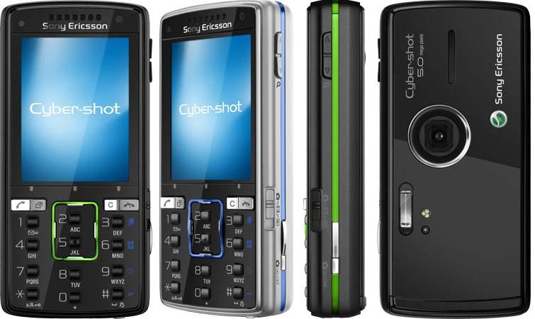
Sony ericsson has the most beautiful phones. And the expensive .

Slide 5
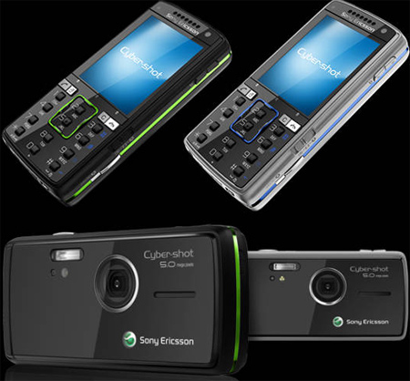
Sony Ericsson K850i
This is sony ericsson k850i.
It has a lot of functions.
5.0 mega pixels
Cyber-shot
wireless lan
bluetooth

Slide 6
Video
http://www.youtube.com/watch?v=-mNHjIHVB6c

Slide 7
sources
http://www.nokia.si/
http://www.sonyericsson.com
http://www.motorola.com/
http://www.samsung.com
pictures google

