Slide 1
Angleščina

Slide 2
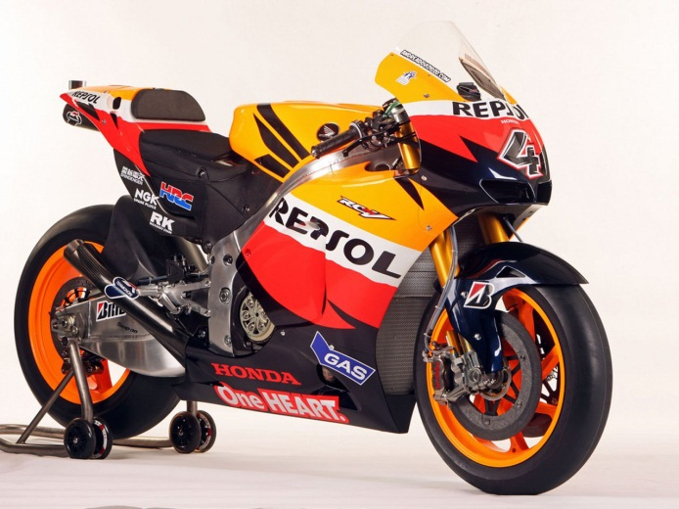
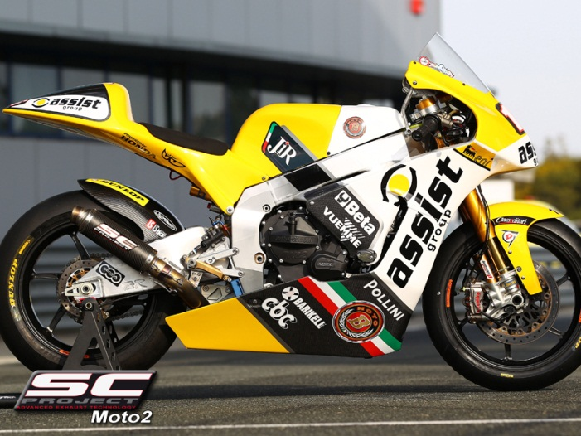
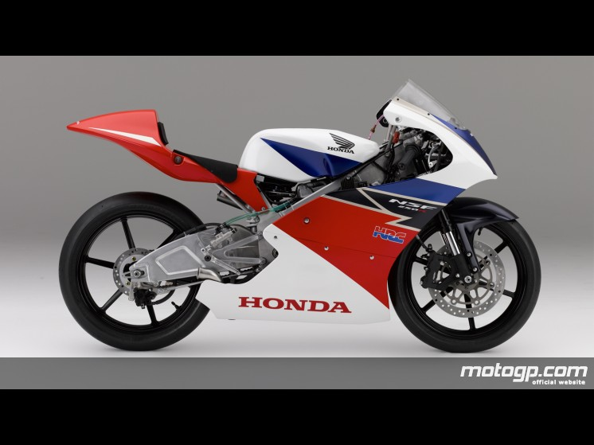
Road Racing World Championship Grand Prix is the premier championship of motorcycle road racing. MotoGP has a rich history with Grand Prix events having taken place in every corner of the world throughout the last 62 years. It is currently divided into three classes: MotoGP, Moto2 and Moto3.

Slide 3
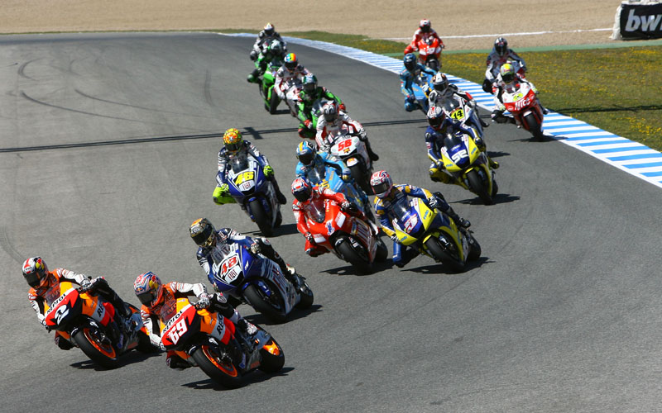
MotoGP class
MotoGP is the 1000cc class.
Constructors in MotoGP: Ducati, Honda, Suzuki, Yamaha.
Racers reach very high speeds. Maximum speed is 349 km/h.

Slide 4
Season
Each season there are currently 18 matches in 16 countries
(Spain hosts three races, Qatar, Turkey, China, France, Italy, United Kingdom, Netherlands, Germany, Czech Republic, San Marino, Portugal, Japan, Australia and Malaysia).
Starting series consists of three columns and is comprised of about twenty riders.
scoring system
P | 1 | 2 | 3 | 4 | 5 | 6 | 7 | 8 | 9 | 10 | 11 | 12 | 13 | 14 | 15
P | 25 | 20 | 16 | 13 | 11 | 10 | 9 | 8 | 7 | 6 | 5 | 4 | 3 | 2 | 1

Slide 5
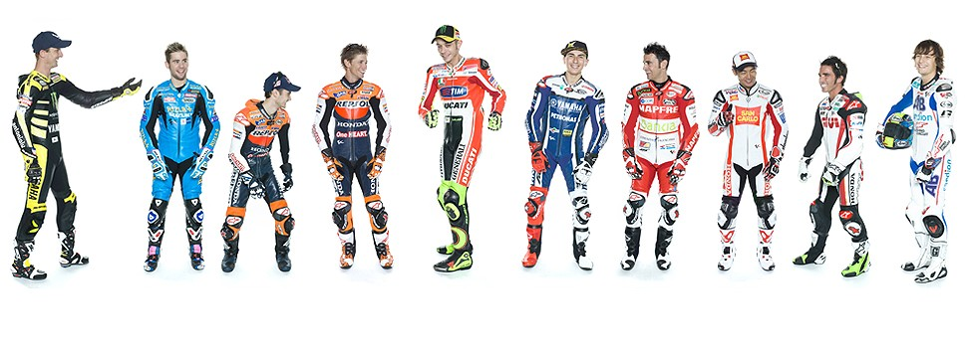
Racers all season traveling from racetrack to racetrack. In the 2011 season there were 25 riders from eight countries. Racers are very exposed to the risk. It’s unthinkable that a MotoGP rider would be seen on track without the most essential of safety items – a good crash helmet.
Racers

Slide 6
The motorcycles used in MotoGP are purpose-built racing bikes ‘prototypes’ which are not available for purchase by the general public and cannot be legally ridden on public roads.
Bikes

Slide 7
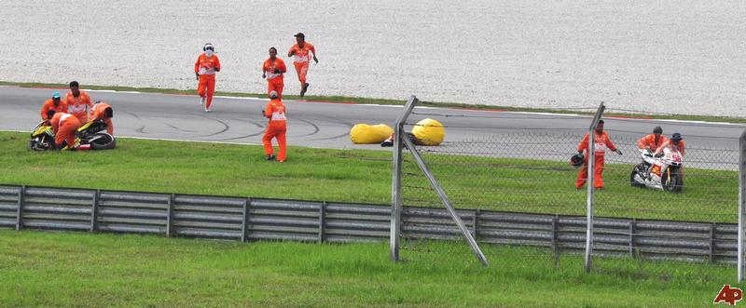
Medical assistance
Racing motorcycles at more than 340 km/h can be a risky business.
Number of crashes during practice or races over the course of the season often reaches more than 500.
So is medical assistance onsite at each circuit is of vital importance.

Slide 8
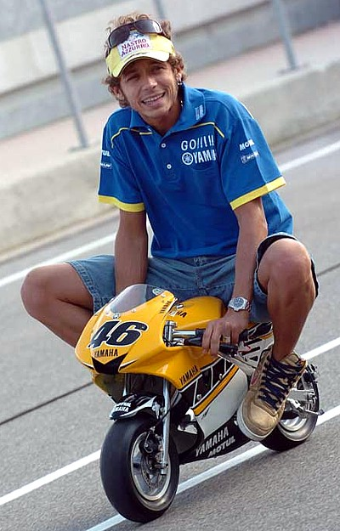
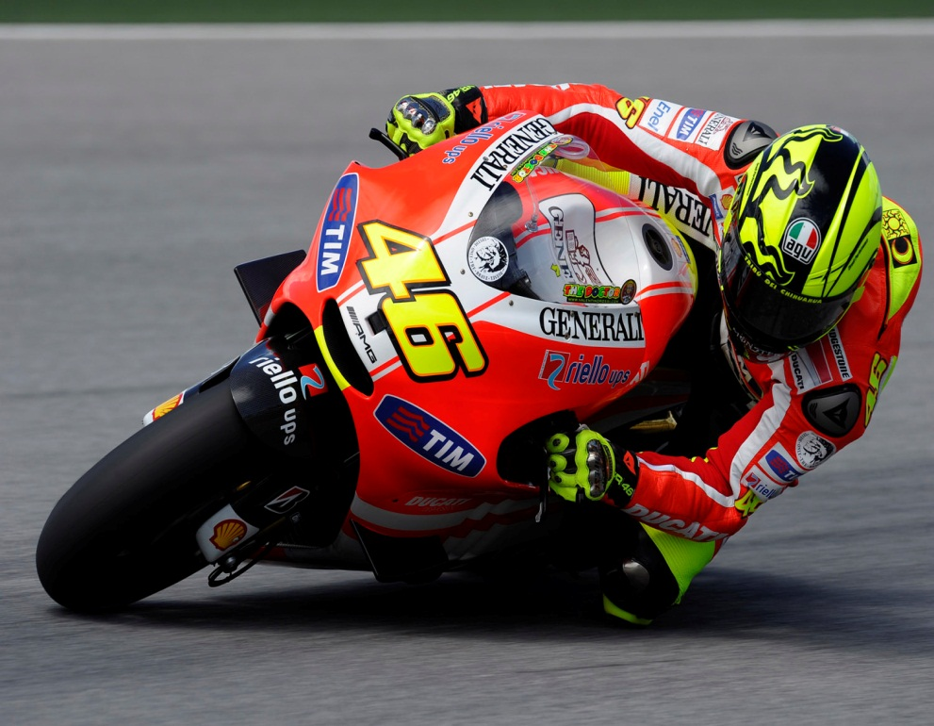
Valentino Rossi
Valentino is one of the best riders in the world and the only one who became world champion in four different classes
He's called The Doctor.
The engine has the number 46 and he drive for Ducati

