Slide 1
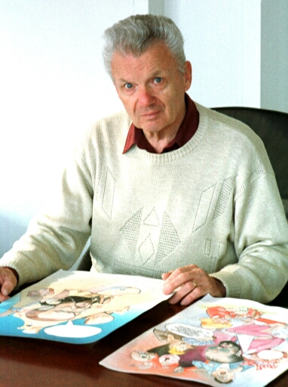
Miki Muster
Beginner of Slovene comic strip

Slide 2
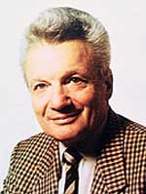
Miki Muster
Miki Muster was born in Murska Sobota on November 22, 1925.
His father was employed as first physician in mining hospital.

Slide 3
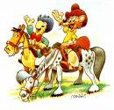
childhood
He went through early childhood in Krmelj, where he finished first class of primary school.
He completed all remaning classes in Ljubljana.
He went to the cinema at 12 years, where he saw animated film. He said that he was poisoned at that time.
Than he decided, that he will go to America, because comic strips weren’t popular in Europe.

Slide 4
After primary school
After completed primary school, he trained at gimnazija and than on art academy in Ljubljana, there he finished study of sculpture.
He was employed as journalist since 1953 by 1937 in newspaper company of TT (Weekly stand).
He was creating successfully in Germany since 1937 by 1990.
He got status of free artist on January 1, 1974.

Slide 5
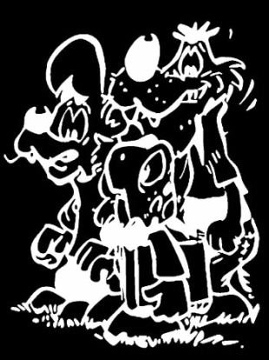
How did he become popular
When they issued before many years new weekly newspaper PPP (Poletove zgodbe in prigode), they searched for Slovene authors of comic strip. They wanted fairy tale for last side and ordered it at Disney.
Because comic strip didn’t come in time, Miki Muster had to make it. He had to draw animals: fox, wolf, bear and badger.
Muster’s heroes are Zvitorepec, Lakotnik and later also a turtle Trdonja.

Slide 6
His heroes
Lakotnik, Zvitorepec and Trdonja; these are heroes, which marked Miki Muster.
They also prohibited Muster, because he was too courageous. He couldn’t draw Zvitorepec for one year.
This heroes was paintes in 43 episodes. Al his stories, except fifth, was reprinted at least once again.

Slide 7
Pattern and name of Miki
Only role model in that time was Walt Disney and Muster was being taught by him, however he didn’t copy him never. He also said, that he is more avoiding violence.
He is grateful to his parents for his name. They have chosen name Miklavž and in Murska Sobota, where he was born, all Miklavž were Mikis and he is al life Miki.

Slide 8
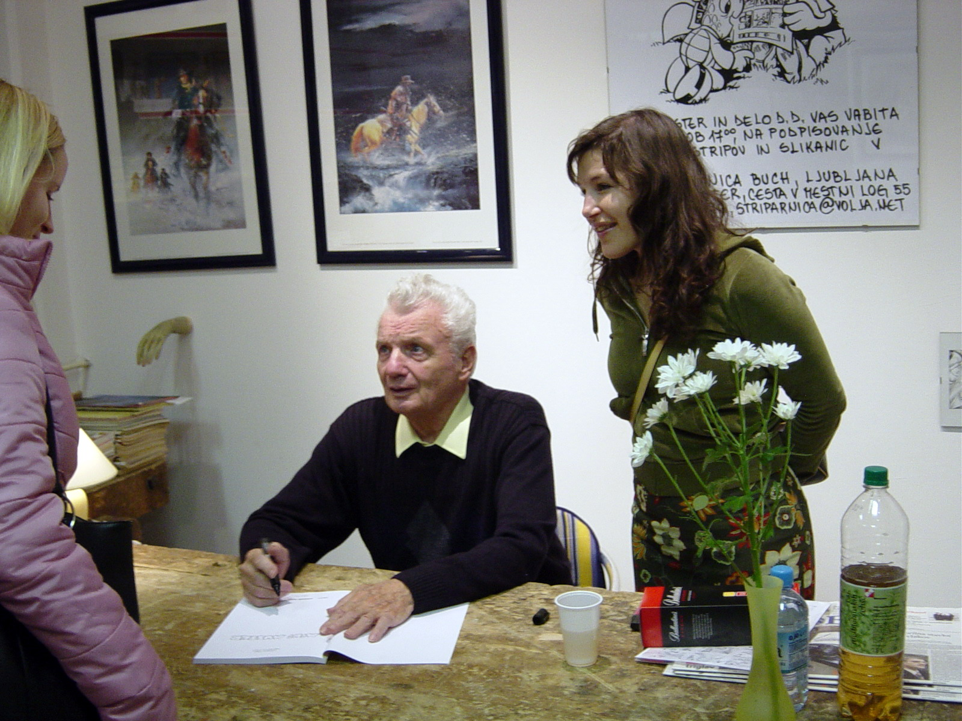
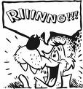
Miki Muster today
Miki Muster lives today and creates in calm part of Ljubljana, in Rožna Dolina.
Today, his stories are in preaparing for translation to lot of other languages.

Slide 9
