Slide 1
My own coin designs
Osnovna šola Gornja Radgona
Šolsko leto 2010/2011
Predmet Angleščina

Slide 2
Hello Everyone!
I choosed this task, because I like Art.
I had to design new coins for Slovenia, and today I will describe them.

Slide 3
0, 1 €
Aljaž Tower represents Triglav.
Aljaž Tower (Aljažev stolp) is a tower on the summit of a highest Slovenian Mount Triglav.
It was designed by Jakob Aljaž, Slovenian composer and mountaineer.
Why?
I’ve decided to insert Aljaž Tower, because I tought, that Triglav is too common.

Slide 4
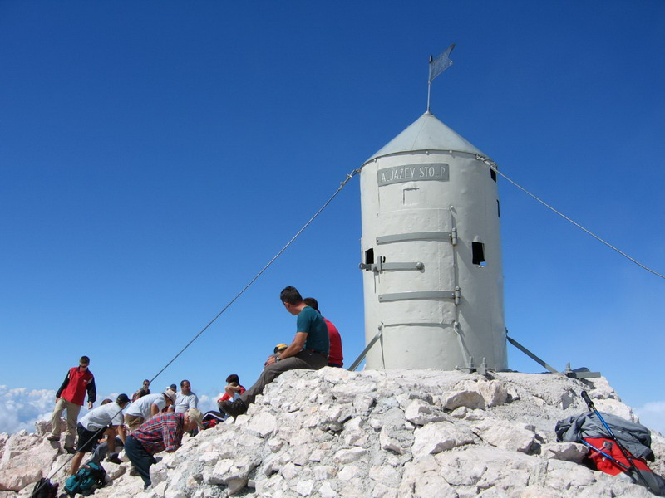

Slide 5
0,2 €
Pen
It represents Slovenian writers, because we have alot of them (Such as France Prešeren, Oton Župančič, Srečko Kosovel, Ivan Cankar, Desa Muck, Dane Zajc, …)

Slide 6
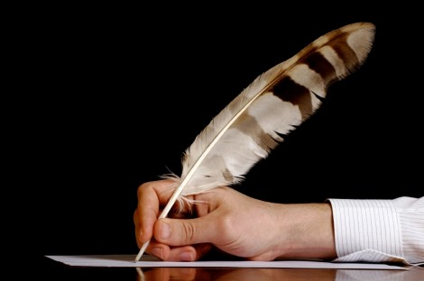

Slide 7
0,5 € Blaze
I choosed tipical Slovenian Knafelc Blaze. It represents mountains.
In Slovenia, we have Alot of mountains and Mountain trails, and they are marked with Paint Blazers.
Slovenian hiking and other Trails are marked by a red and white round sign known as Knafelc blaze after their designer, Alojz Knafelc. They have been used since 1922.

Slide 8
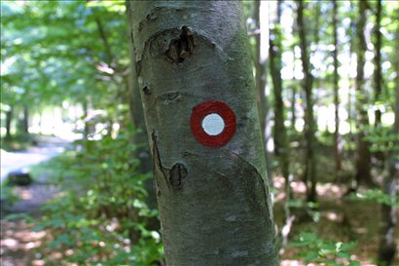

Slide 9
0,10€
Park
I choosed a bench and a tree behind it, to represent Slovenian parks.
Why?
10% of Slovenia is covered with the parks.

Slide 10
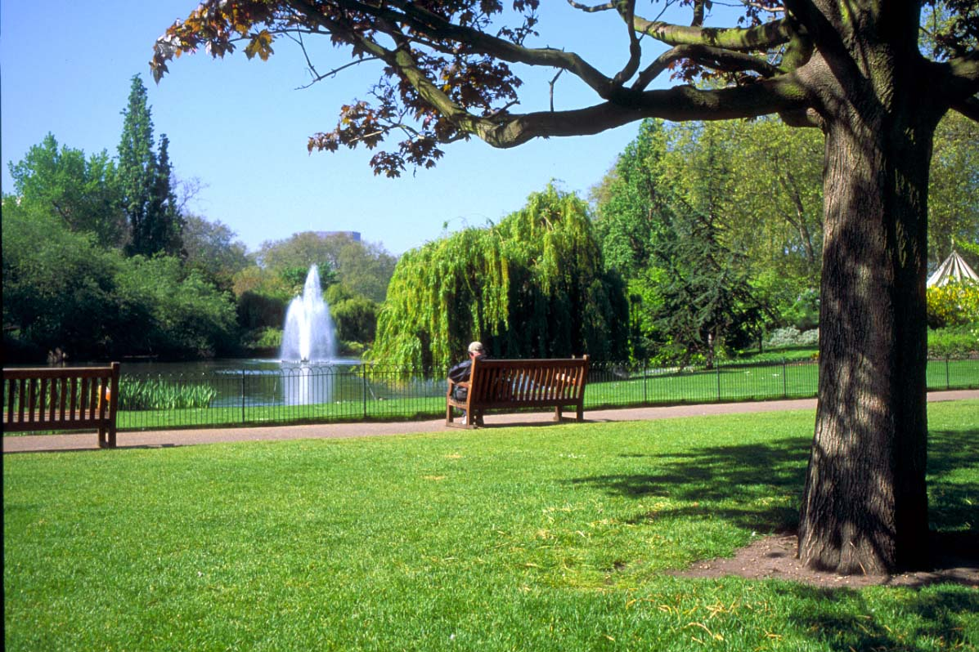

Slide 11
0,20 €
Lipizzan
Lipizzan breed takes its name from one of the first studs located near the Kras village of Lipica, Slovenia.
Lipizzaner is a breed of horse, and he comes from House of Habsburg, today associated with nations of Austria, Slovenia and Croatia.

Slide 12
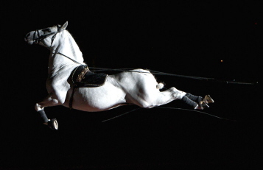

Slide 13
0,50€
Church
Slovenia is on the top of the European list of churches; It has the largest number of churches, in terms of population.

Slide 14
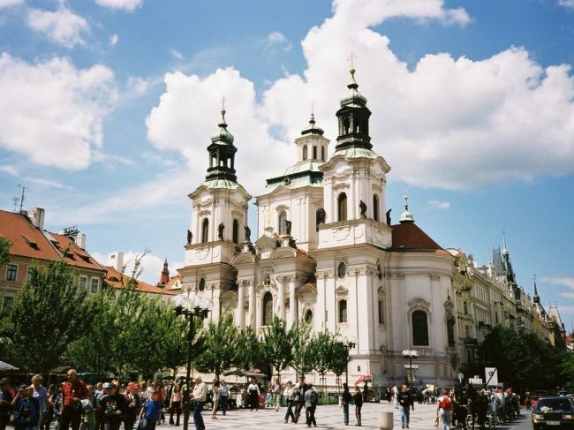

Slide 15
1€
Carniolan honey bee
The Carniolan honey bee is native to Slovenia.

Slide 16
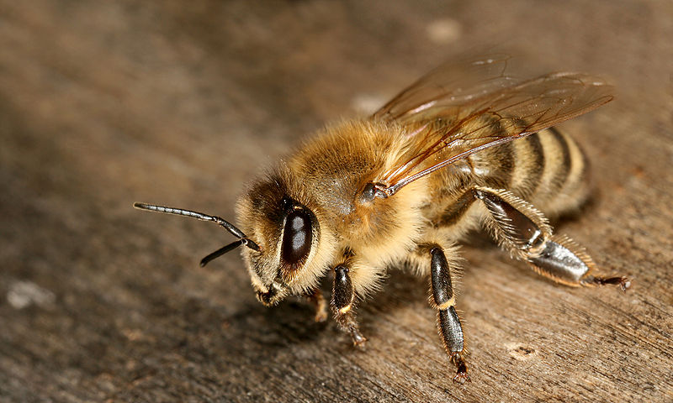

Slide 17
2€
Brown bear
I choosed Brown bear, because Popularity of Brown bears in Slovenian woods is the biggest in Europe.

Slide 18
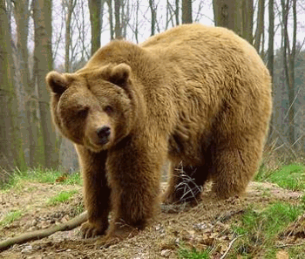

Slide 19
Thank you!

