Slide 1
NATURAL DISASTERS

Slide 2
EARTHQUAKE
Earthquake is a shaking of the ground caused by the sudden breaking and shifting of large sections of Earth's rocky outer shell. Earthquakes are among the most powerful events on earth, and their results can be terrifying. A severe earthquake may release energy 10,000 times as great as that of the first atomic bomb. Rock movements during an earthquake can make rivers change their course. Earthquakes can trigger landslides that cause great damage and loss of life. Large earthquakes beneath the ocean can create a series of huge, destructive waves called tsunamis that flood coasts for many miles.
Earthquakes almost never kill people directly. Instead, many deaths and injuries result from falling objects and the collapse of buildings, bridges, and other structures. Fire resulting from broken gas or power lines is another major danger during a quake. Spills of hazardous chemicals are also a concern during an earthquake.
The force of an earthquake depends on how much rock breaks and how far it shifts. Powerful earthquakes can shake firm ground violently for great distances. During minor earthquakes, the vibration may be no greater than the vibration caused by a passing truck.
On average, a powerful earthquake occurs less than once every two years. At least 40 moderate earthquakes cause damage somewhere in the world each year. Scientists estimate that more than 8,000 minor earthquakes occur each day without causing any damage. Of those, only about 1,100 are strong enough to be felt.

Slide 3
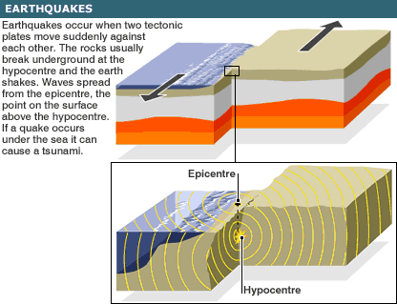

Slide 4
TSUNAMIS
An earthquake on the ocean floor can give a tremendous push to surrounding seawater and create one or more, larger, destructive waves called tsunamis, also known as seismic sea waves. Some people call tsunamis tidal waves, but scientists think the term is misleading because the waves are not caused by the tide. Tsunamis may build to heights of more than 30 meters when they reach shallow water near shore. In the open ocean, tsunamis typically move at speeds of 800 to 970 kilometers per hour. They can travel great distances while diminishing little in size and can flood coastal areas thousands of miles or kilometers from their source.

Slide 5
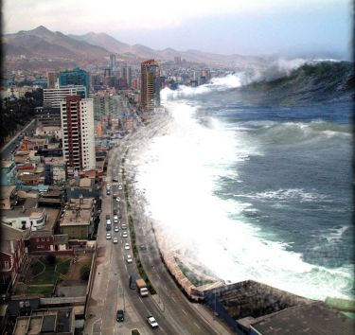

Slide 6
HURRICANES-TYPHOONS
A hurricane is a powerful, swirling storm that begins over a warm sea. Hurricanes form in waters near the equator, and then they move toward the poles.
The winds of a hurricane swirl around a calm central zone called the eye surrounded by a band of tall, dark clouds called the eyewall. The eye is usually 16 to 64 kilometers in diameter and is free of rain and large clouds. In the eyewall, large changes in pressure create the hurricane's strongest winds. These winds can reach nearly 320 kilometers per hour. Damaging winds may extend 400 kilometers away from the eye.

Slide 7
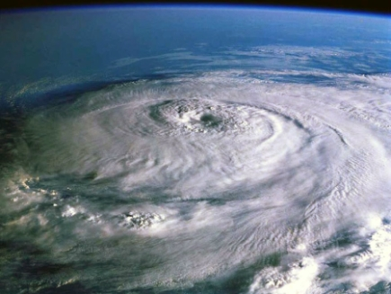

Slide 8
VOLCANO
A volcano is an opening in a planet's surface, which allows hot, molten rock, ash, and gases to escape from below the surface. Volcanic activity involving the extrusion of rock tends to form mountains or features like mountains over a period of time.
Volcanoes are generally found where tectonic plates are coming towards one another. By contrast, volcanoes are usually created where two tectonic plates slide past one another. Volcanoes can also form where there is stretching and thinning of the Earth's crust, such as in the African Rift Valley, the Wells Gray-Clearwater volcanic field and the Rio Grande Rift in North America and the European Rhine Graben with its Eifel volcanoes.

Slide 9
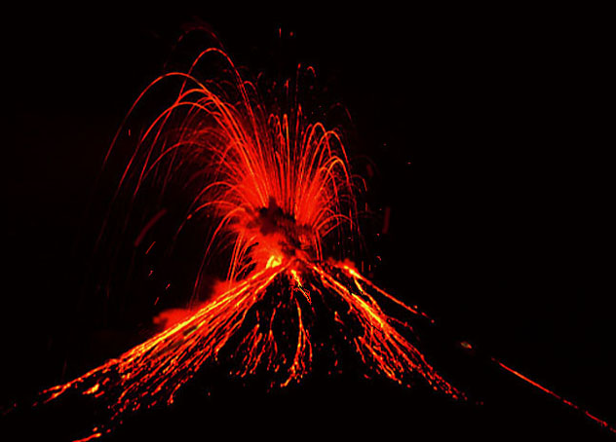

Slide 10
TORNADO
A tornado is a violent, rotating column of air which is in contact with both the surface of the earth and a cloud . Tornadoes come in many sizes but are typically in the form of a visible condensation tunnel, whose narrow end touches the earth and is often circled by a cloud of debris.
Most tornadoes have wind speeds between 64 km/h and 177 km/h, are approximately 75 m across, and travel several kilometers before disappearing. Some turn with wind speeds of more than 480 km/h, stretch more than 1.6 km across, and stay on the ground for dozens of miles (more than 100 km).
Although tornadoes have been observed on every continent except Antarctica, most occur in the United States. They also commonly occur in southern Canada, south-central and eastern Asia, South America, Southern Africa, southeast Europe, Western Australia, and New Zealand.

Slide 11
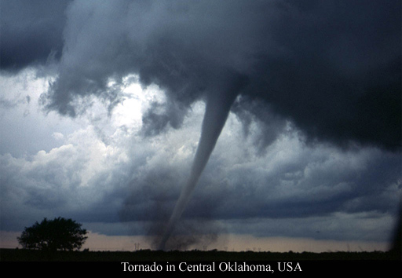

Slide 12
FLOOD
A flood is an overflow of an expanse of water that submerges land. In the sense of "flowing water", the word may also be applied to the inflow of the tide. Flooding may result from the volume of water within, such as a river or lake, exceeding the total capacity of its bounds, with a terrifying result. It can also occur in rivers, when the strength of the river is so high it flows out of the river channel, particularly at bends or meanders.

Slide 13
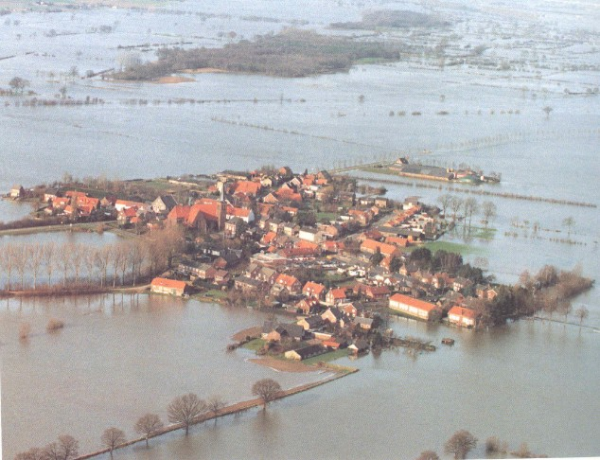

Slide 14
AVALANCHE
Disastrous avalanches occur when massive parts of snow break loose from a mountainside and shatter like broken glass as they race downhill. These moving masses can reach speeds of 130 kilometers per hour within about five seconds. Victims caught in these events seldom escape. Avalanches are most common during and in the 24 hours right after a storm that dumps 12 inches (30 centimeters) or more of fresh snow. The quick pileup overloads the underlying snowpack, which causes a weak layer beneath the slab to fracture. The layers are an archive of winter weather: Big dumps, drought, rain, a hard freeze, and more snow. How the layers bond often determines how easily one will weaken and cause a slide.

Slide 15
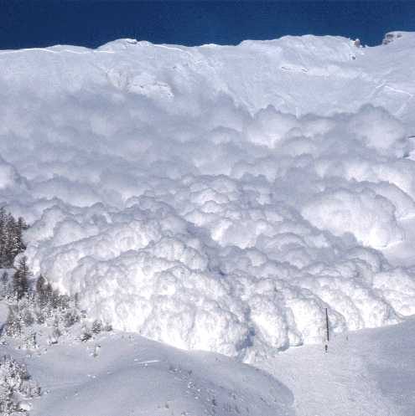

Slide 16
BYE BYE
Tnx for listening.
Have a nice day

