Slide 1
NEW ORLEANS
School year:2007-2008
School: OŠ Prestranek

Slide 2
General information about New Orleans
New Orleans is the largest city in Louisiana.
The city is located in the southeast section of the state between two other states: Texas and Mississippi.
It is near the Gulf of Mexico.
The city is surrounded by water and lies under the sea level.

Slide 3
More about New Orleans
Country : United States
State: Louisiana
Parish: Orleans
Founded: 1718
Mayor: C. Ray Nagin
Population (2006):
*City → 223.388
*Density → 973/km²

Slide 4
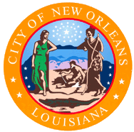
Flag and seal
This is a flag and this is a seal

Slide 5
New Orleans today
In New Orleans you can find French and Spanish settlers, West and African Slaves, Carribean planters and italien immigrants. All of them make the city special.
FOOD AND DRINK:
New Orleans is famous for food and drink.
A funny tradition is eating black beans with rice every Monday, because in the past Monday was the washing day and therefore women didn´t have time for cooking.

Slide 7
Foundation and early settlement
The city was founded in the year 1682 by the French discoverer “Robert Cavalier”.
Sixteen years later an expedition under Ludwig fourteen founded a new colony; so Lousiana became the state.
In 1717 three French men founded the city of NEW ORLEANS.
The city was named Duc d´Orleans

Slide 8
The French Quarter
Today you can still visit the French Quarter.
In the center of this quarter is the Jackson Square in front of the St.Louis cathedral.
At this place slaves and criminals were executed.
Most of the architecture is Spanish, not French.

Slide 9
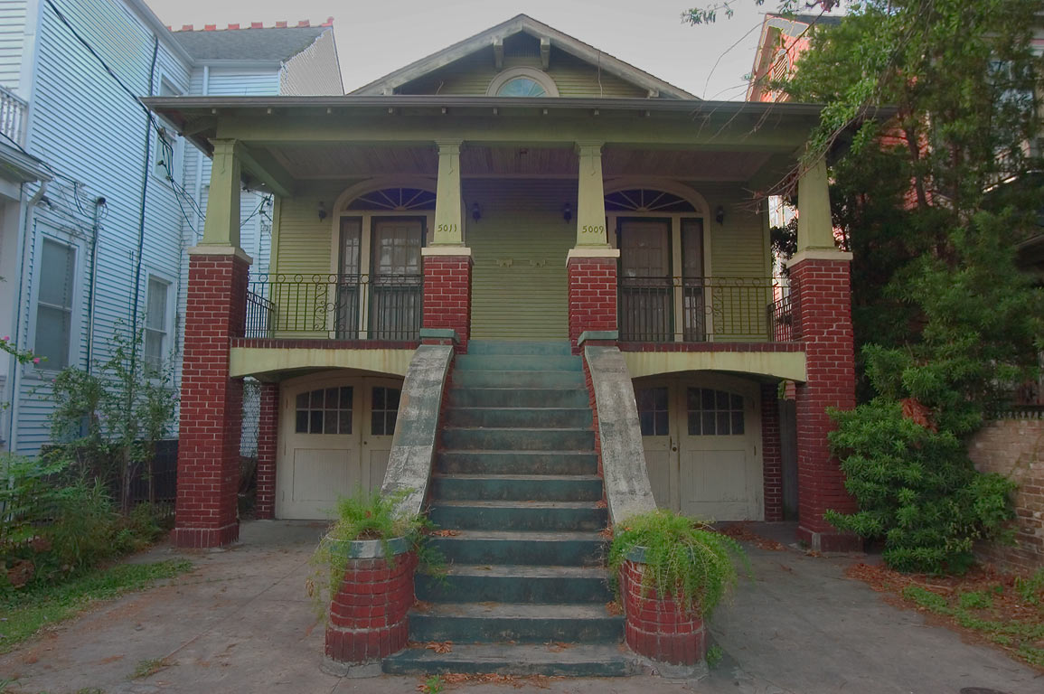
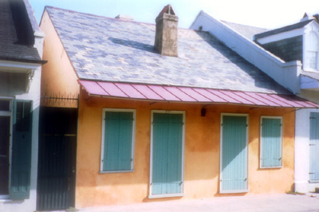
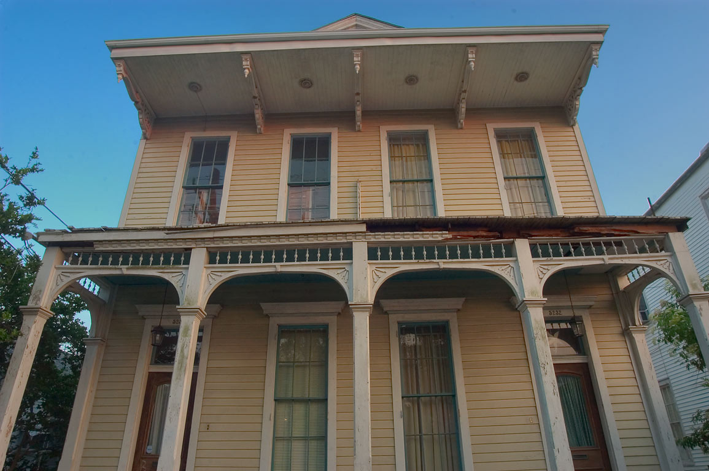
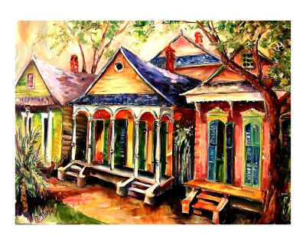
Typical houses of New Orleans
Tourist are able to have a look on the typical creole cottages, the double gallery houses and the shotgun-houses.
double gallery houses
Creole cottage
shotgun house

Slide 10
New Orleans – the birthplace of jazz
New Orleans is also called the “birthplace of Jazz”, because slaves of the Westindian Islands came together every Sunday at the Congo Square.
This square is named today “Louis Armstrong Park”. There they practiced African rhythms and dances,what is now Jazz.

Slide 11
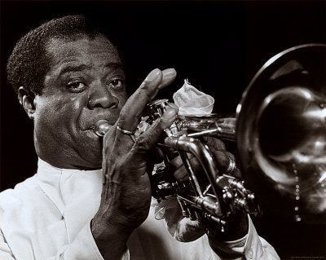
Jazz
Jazz was born around 1895 in New Orleans, this music is the product of the Africans.
It was a new style of music.

Slide 12
Some jazz artists
Duke Ellington (1899–1974)
Louis Armstrong (1901–1971)
Earl Hines (1903–1983)
Count Basie (1904–1984)
Fats Waller (1904–1943)
Sun Ra (1914-1993)
Dizzy Gillespie (1917–1993)

Slide 13
Links and literature
http://en.wikipedia.org/wiki/List_of_jazz_musicians
http://en.wikipedia.org/wiki/Jazz
http://en.wikipedia.org/wiki/New_Orleans
http://en.wikipedia.org/wiki/Louis_Armstrong
http://www.gnocdc.org/tertiary/shotgun.html
http://www.lerntippsammlung.de/New-Orleans.html

