Slide 1


Slide 2
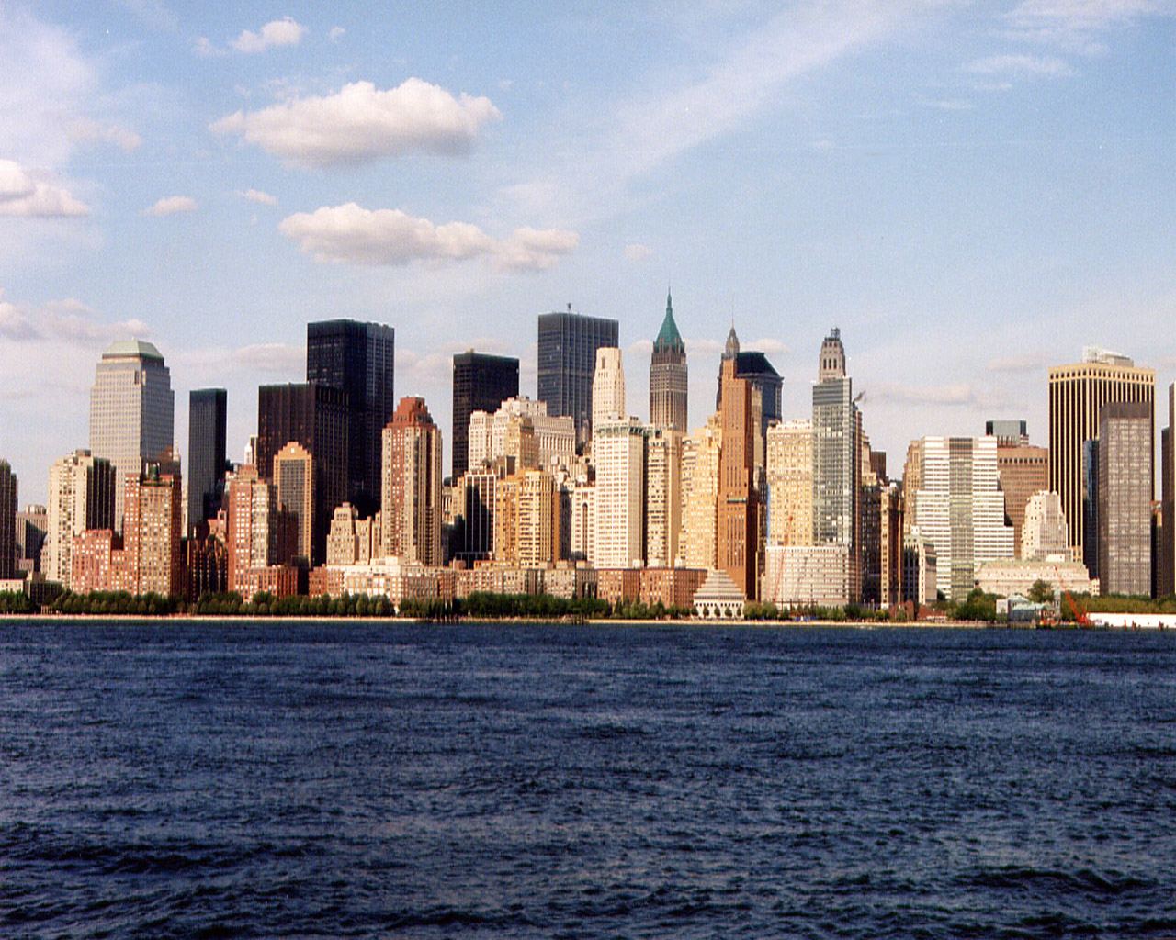
Uvod:
New York has somethink for everyone.

Slide 3
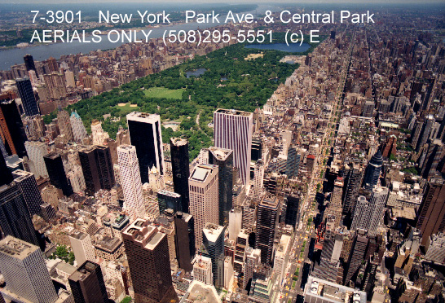

Central park
The park will surprise you with its amazing greenery and foliage.
It is grea place to run, walk your dog, take a picnic or just get away from the noisy city.

Slide 4
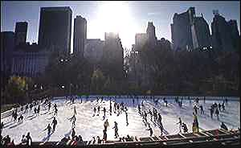

Slide 5
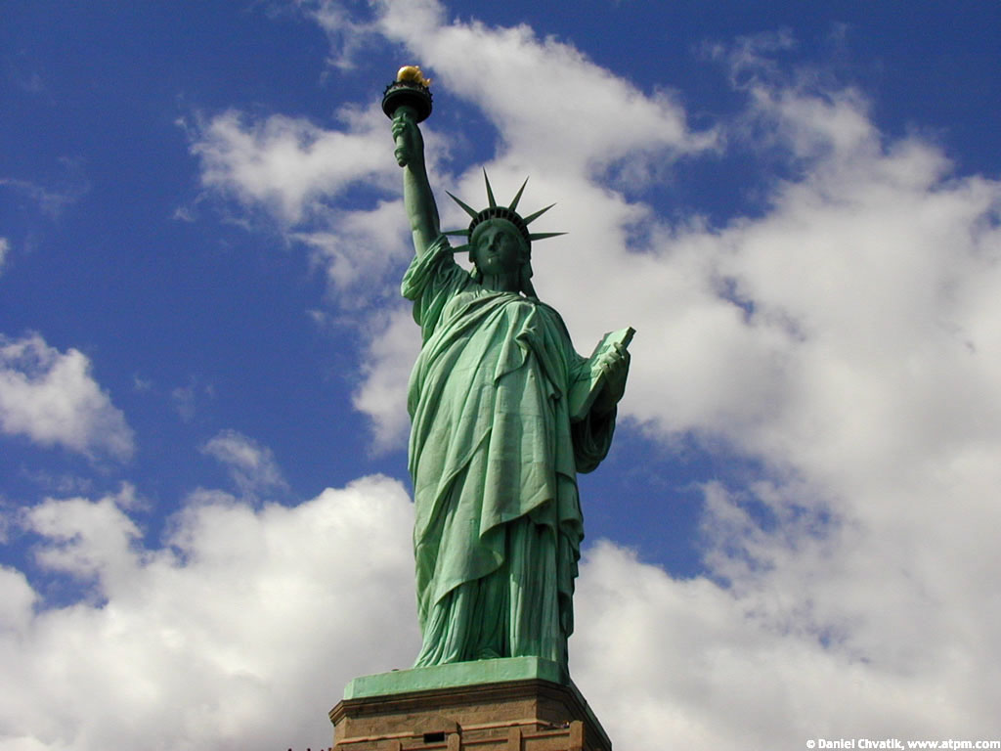
Statue of Liberty

Slide 6
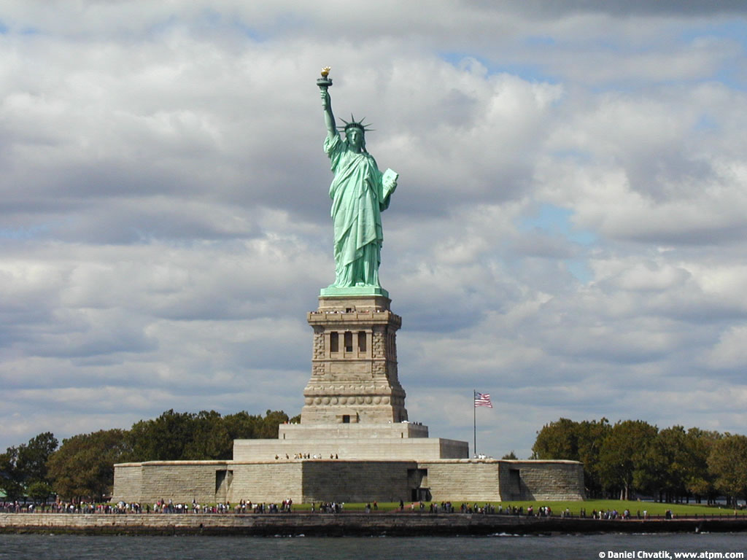
USA most popular symbol.

Slide 7
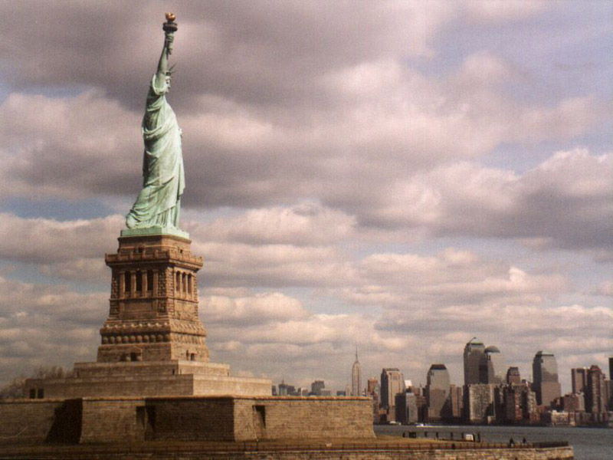

Slide 8
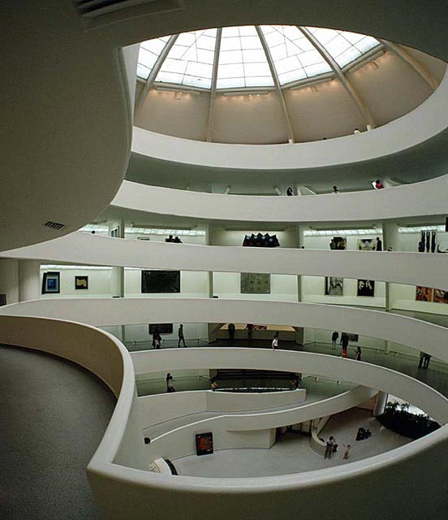
Museums:
The Metropolitan Museum of art
The Moseum of Modern art
The MOMA is an art lover’s dream come true.
The moseum of modern art

Slide 9
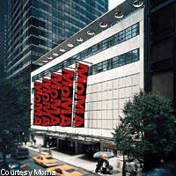

Slide 10
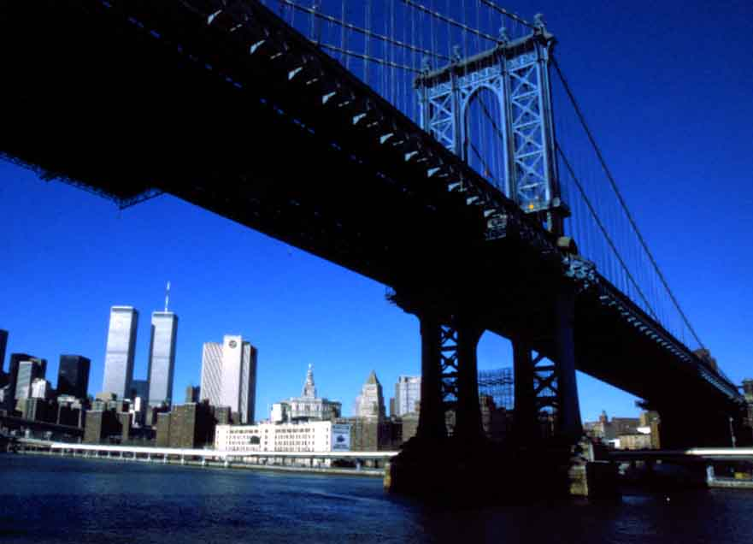
Brooklyn Bridge
For turist photogenic attraction.
For New Yorkers the shortest way to get to work

Slide 11
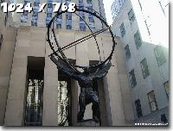
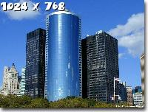

Times Square

Slide 12
Manhattan

Slide 13
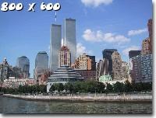

Slide 14
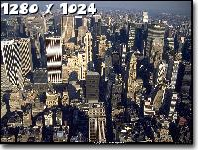

Slide 15

Terrorist attack:

Slide 16
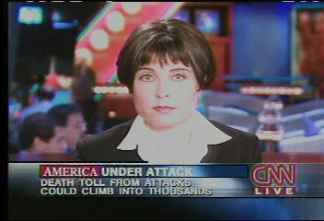

Slide 17
Gradivo:
New York city (city guides)(2002)(Let’s Go)
New York city (lonely planet ) (1997)
AND INTERNET

