Slide 1
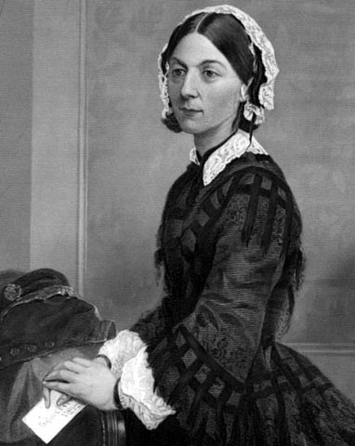
FLORENCE NIGHTINGALE
( 1829 - 1910 )

Slide 2
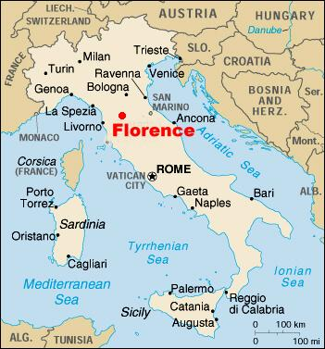
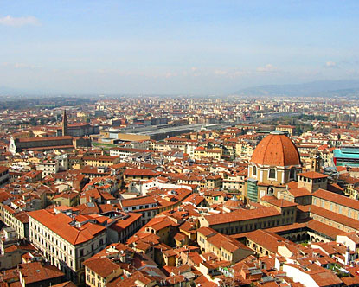
She was born in Florence, Italy on May 12, 1829

Slide 3
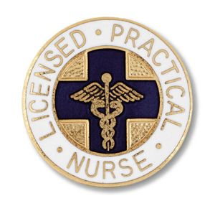
From 1837 to 1839 she traveled with her parents in Europe and the suffering she saws aroused an interest in nursing. She visited hospital whenever possible.

Slide 4
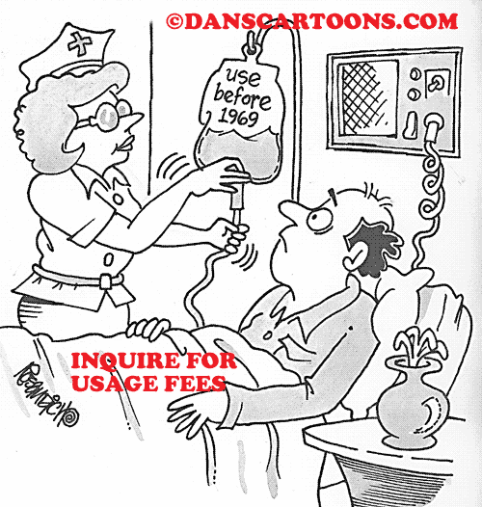
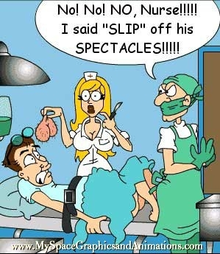
In 1849 she traveled in Italy, Greece and Egypt
Then she returned to England determined to study nursing despite the disapproval of her parents

Slide 5
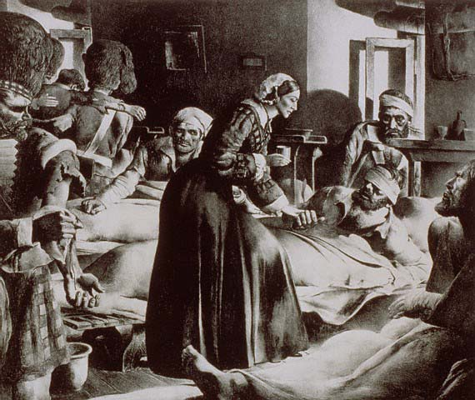
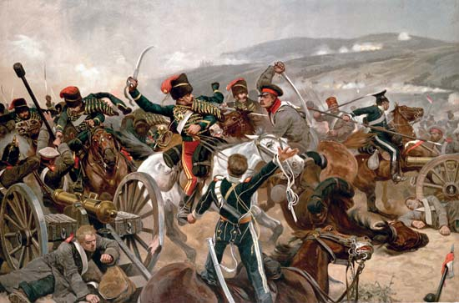
After the Crimean War broke out in 1834 Nightingale was stirred by newspaper reports about be primitive sanitation methods and grossly inadequate nursing facilities at the large British barracks – hospital at Uskuda.
She dispatched a letter to the British minister of war, volunteering her services in Crimea.

Slide 6
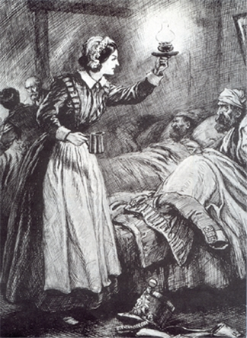
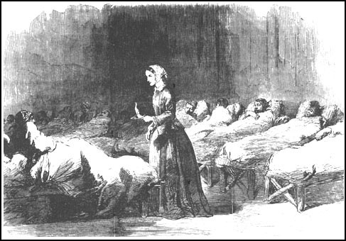
Although Nightingale contracted a severe illness in the Crimes in 1855, she stayed with her hospital until the end of war in 1856.
Nightingale became a national hero and was called “ the Lady with the lamp “ and “ the Angel of the Crimea “.

Slide 7
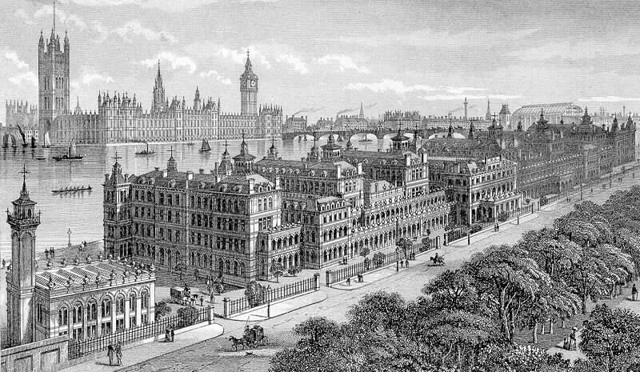
In 1860 her best known work, noted on nursing was published. It laid down principles of nursing careful observation and sensitivity on the patient’s needs. With a public fund raised in tribute to her services in the Crimea Nightingale founded the Nightingale School and home for nurses at Saint Thomas’s hospital in London.

Slide 8
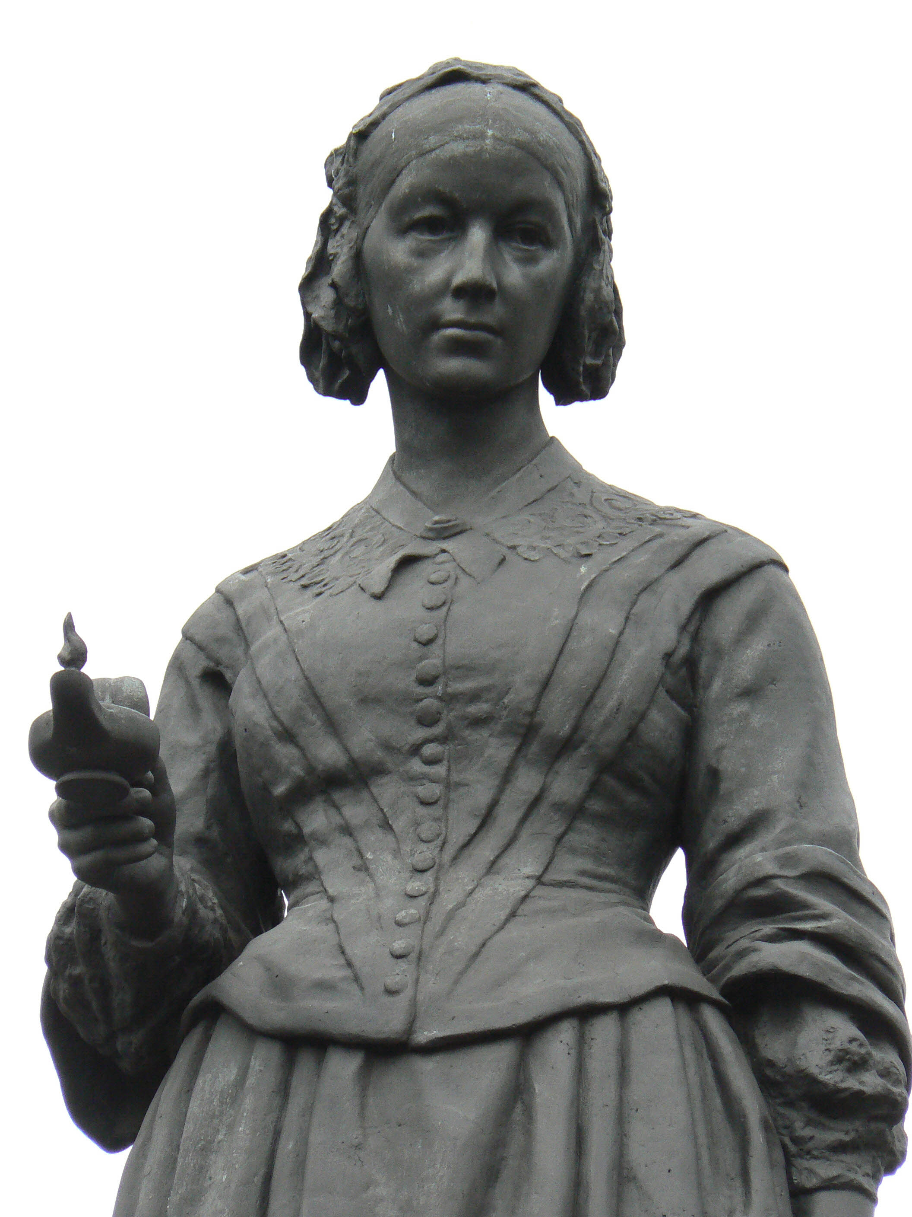
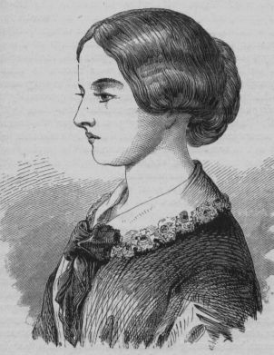
Nightingale is considered the first nursing theorist, one of her theories was the environment theory. It incorporated the restoration of the usual health status of the nurse’s clients into the delivery of health care – it is still practiced today.

Slide 9
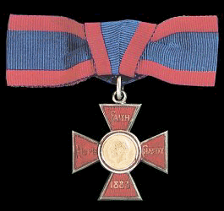
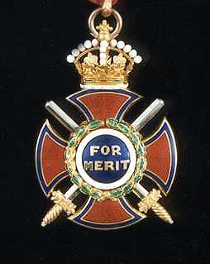
Altrough Florence Nightingale was bedridden for many years, she campaigned tirelessly to improve health standards, publishing 100 books, reports and pamphlets.
In recognition of her hard work Queen Victoria awarded Miss Nightingale the Royal Red Cross in 1883. In her old age she received many honors including the Order of Merit ( 1907 ) becoming the first woman to receive it.

Slide 10
LITERATURA
www.wikipedia.org

