Slide 1
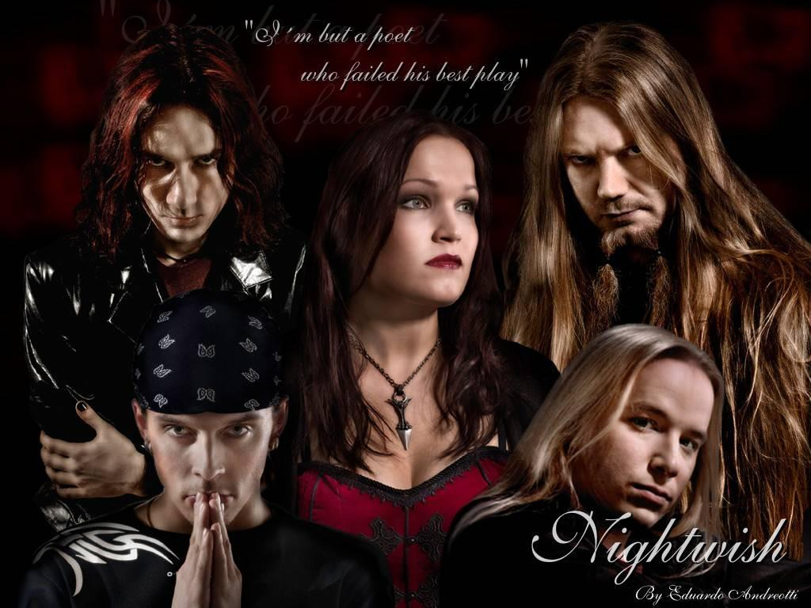
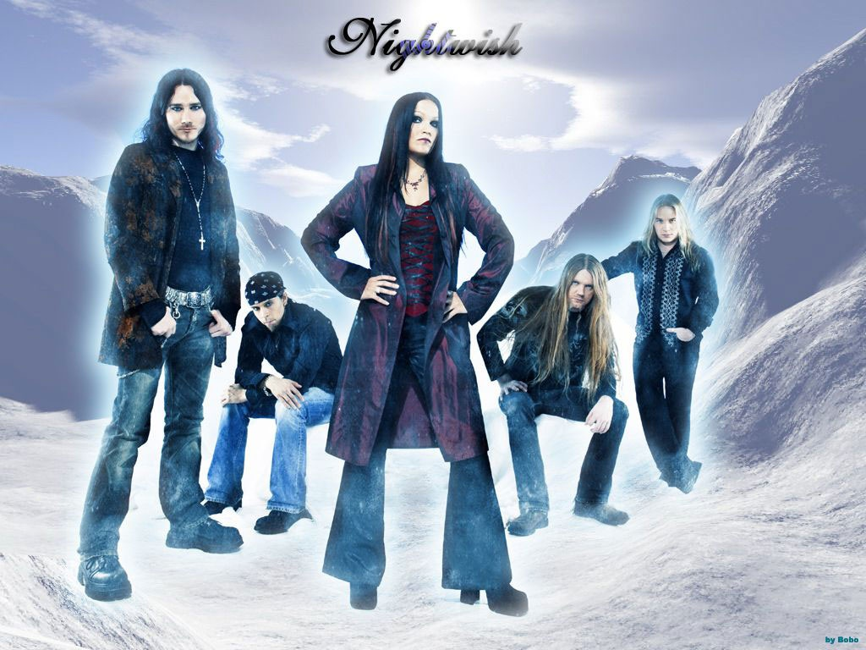

Slide 2
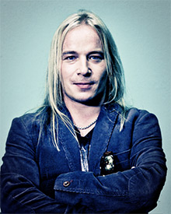
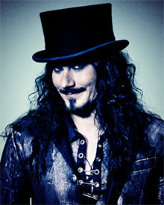
Symphonic metal (1996),
by lead songwriter, keyboardplayer Tuomas Holopainen,
by guitarist Emppu Vuorinen,
by vocalist Tarja Turunen,
Kitee, Finland.

Slide 3
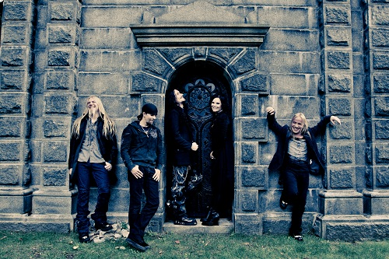
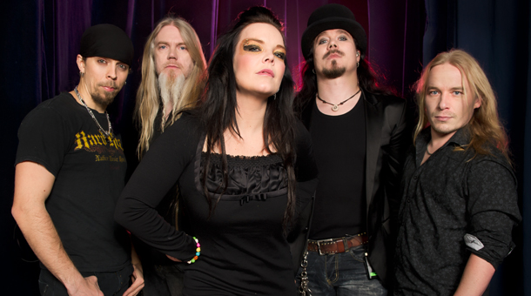
Nightwish performs symphonic metal with soaring female vocals,
their music has been described as “bombastic heavy, symphonic and cinematic, with keyboards and strings creating a gothic atmosphere”.

Slide 4
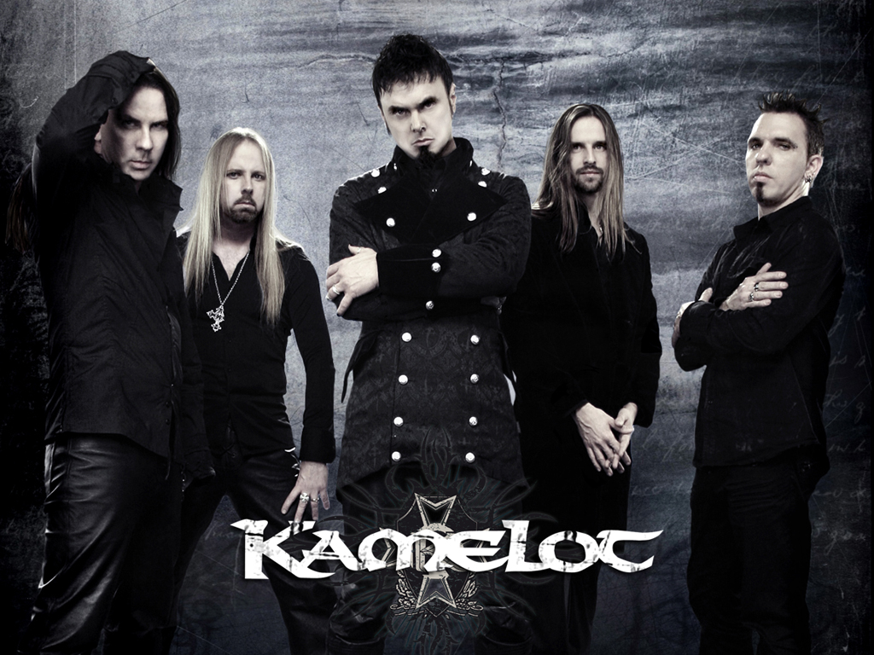
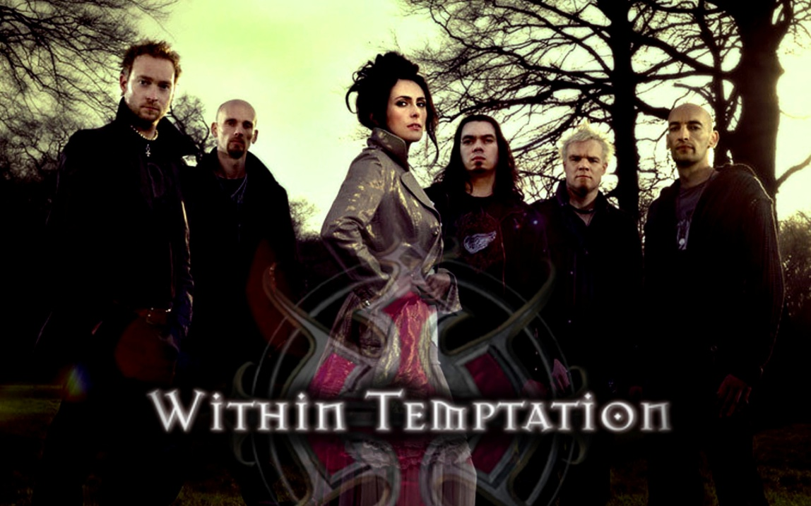
The usage of a female vocalist has become a sort of trademark, many bands has that style of music such as Evanescence, Within Temptation, Kamelot.

Slide 5
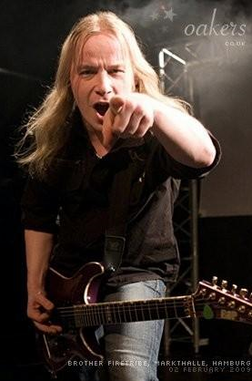
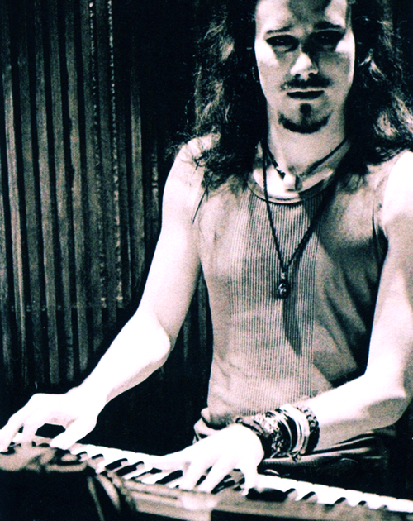
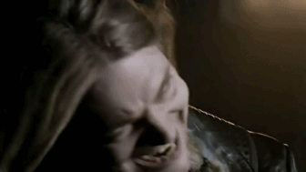
Current members:
Tuomas Holopainen - keyboards
(1996–present),
Emppu Vuorinen - guitars (1996–present),
Jukka Nevalainen - drums (1997–present),
Marco Hietala - bass, vocals (2002–present).

Slide 6
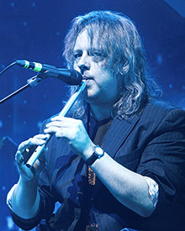
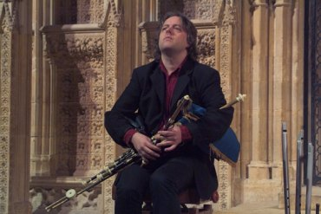
Session and touring musicians
Troy Donockley : Uillean pipes, tin whistle, backing vocals (2007–present),
Floor Jansen - lead vocals (2012-present).

Slide 7
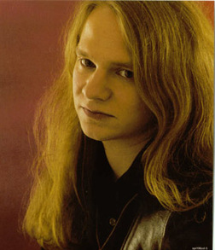
FORMER MEMBERS
Tarja Turunen - lead vocals (1996–2005),
Anette Olzon- lead vocals (2007–2012),
Sami Vänskä- bass (1998–2001).

Slide 8
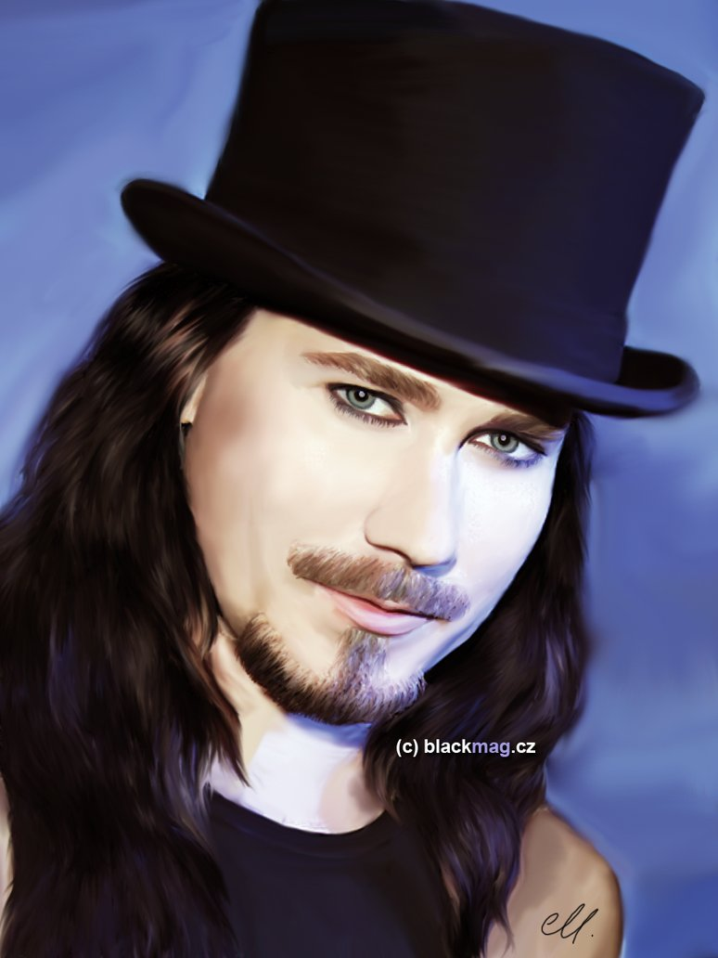
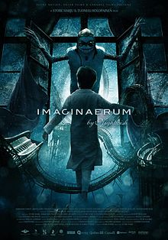
Tuomas Holopainen
Several songs in movie soundtracks, including recent collaboration with Nightwish male vocalist Marco Hietala on "While Your Lips Are Still Red", for the Finnish film Lieksa! (2007).

Slide 9
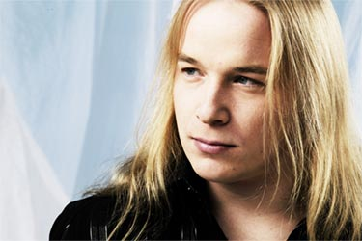
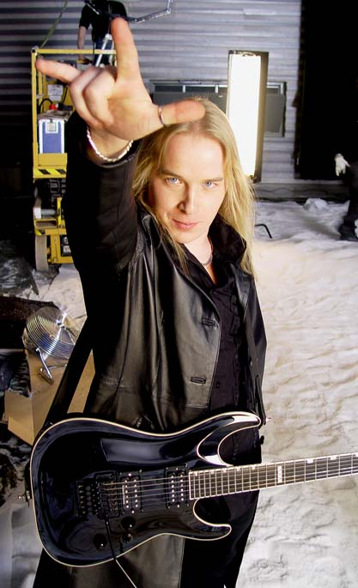
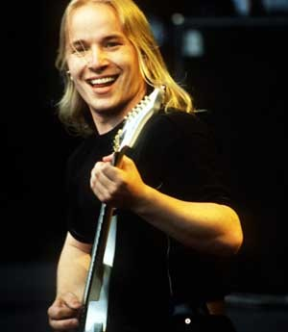
Emppu Vuorinen
A rhythm player, often supporting the keyboard or orchestral parts of songs,
Lead melodies and solos which are more melodic than those of most metal bands.

Slide 10
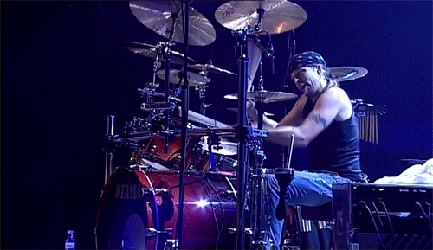
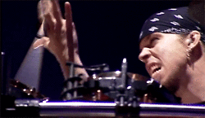
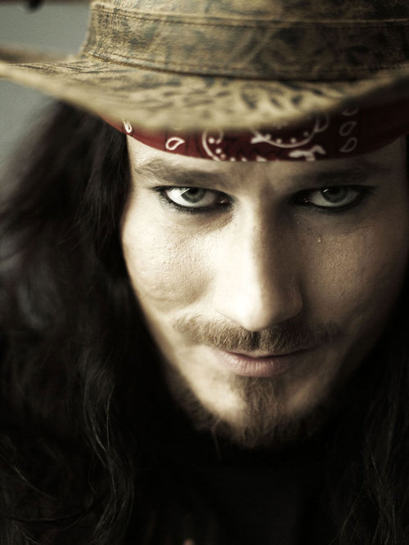
Jukka Nevalainen
The drummer,
at the age of 17 (1991) has already been contacted by Tuomas Holopainen.,
acoustic mood music project ,
Emppu suggested Jukka to Tuomas.

Slide 11
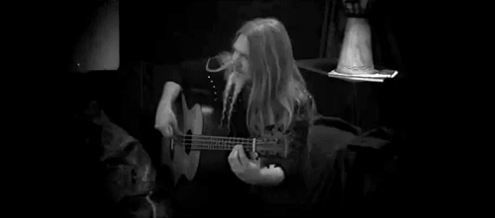
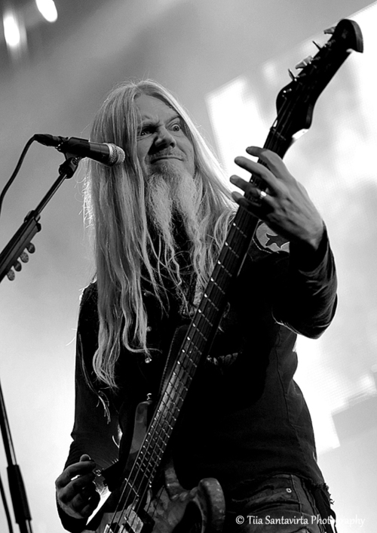
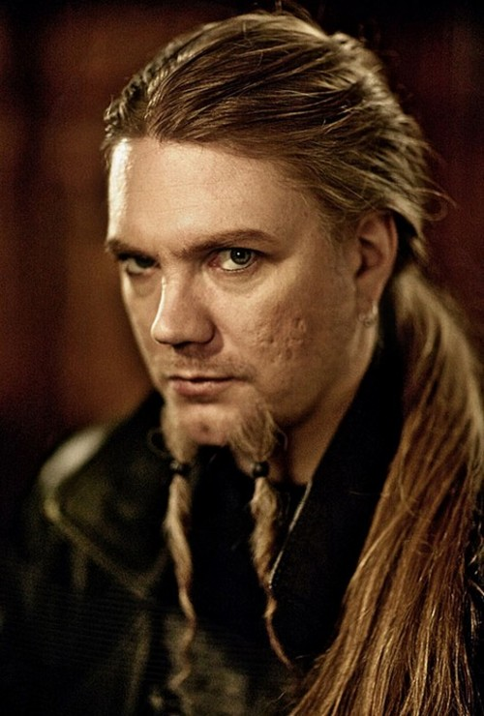
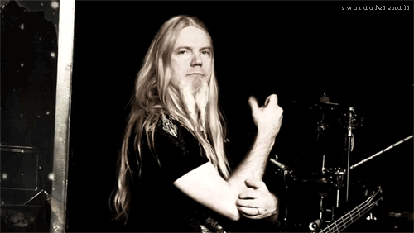
Marco Hietala
He is also the vocalist, composer and lyricist for Tarot,
Upon his arrival to Nightwish, several songs were written to contain duets with the Nightwish vocalist Tarja Turunen,
The Phantom Of The Opera (Century Child).

Slide 12
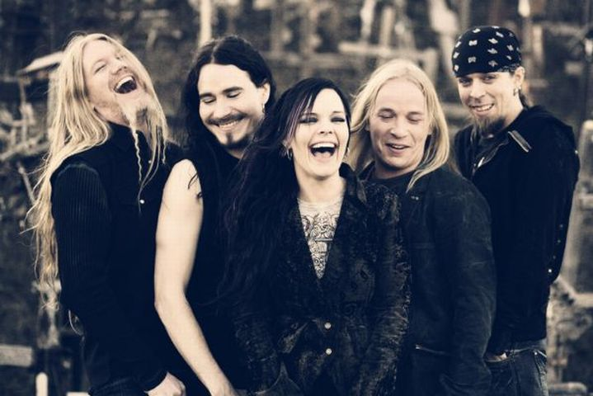
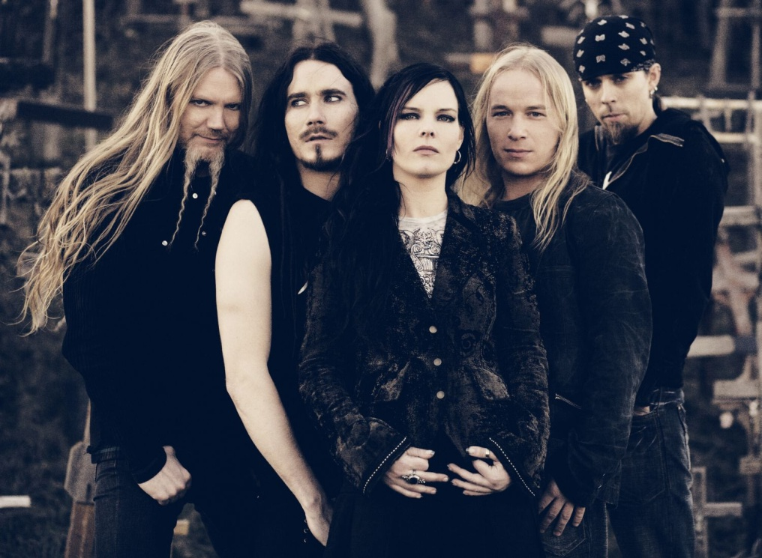
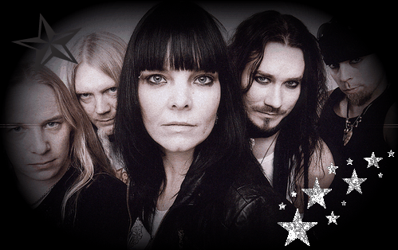
ALBUMS
Angels Fall First (1997),
Oceanborn (1998),
Wishmaster (2000),
Century Child (2002),
Once (2004),
Dark Passion Play (2007),
Imaginaerum (2011).

Slide 13
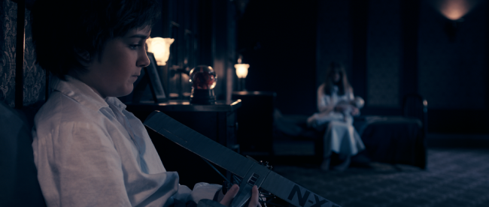
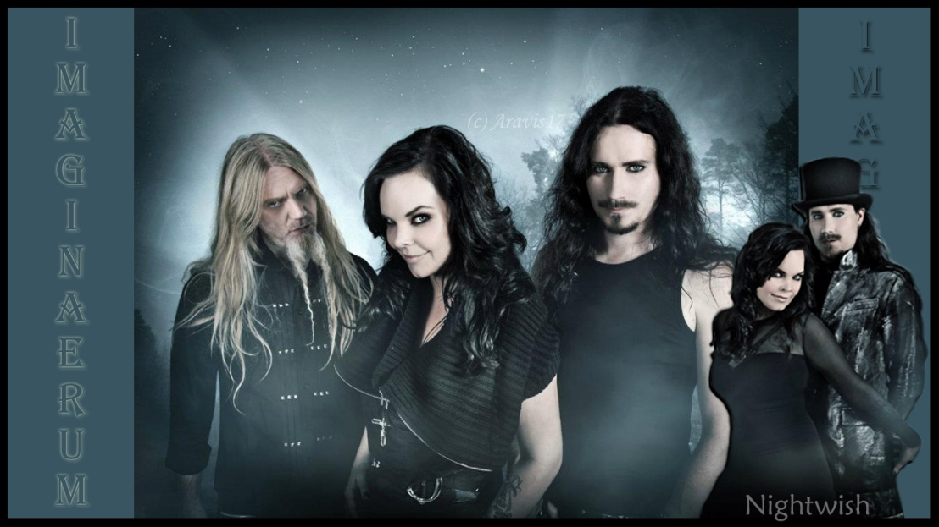
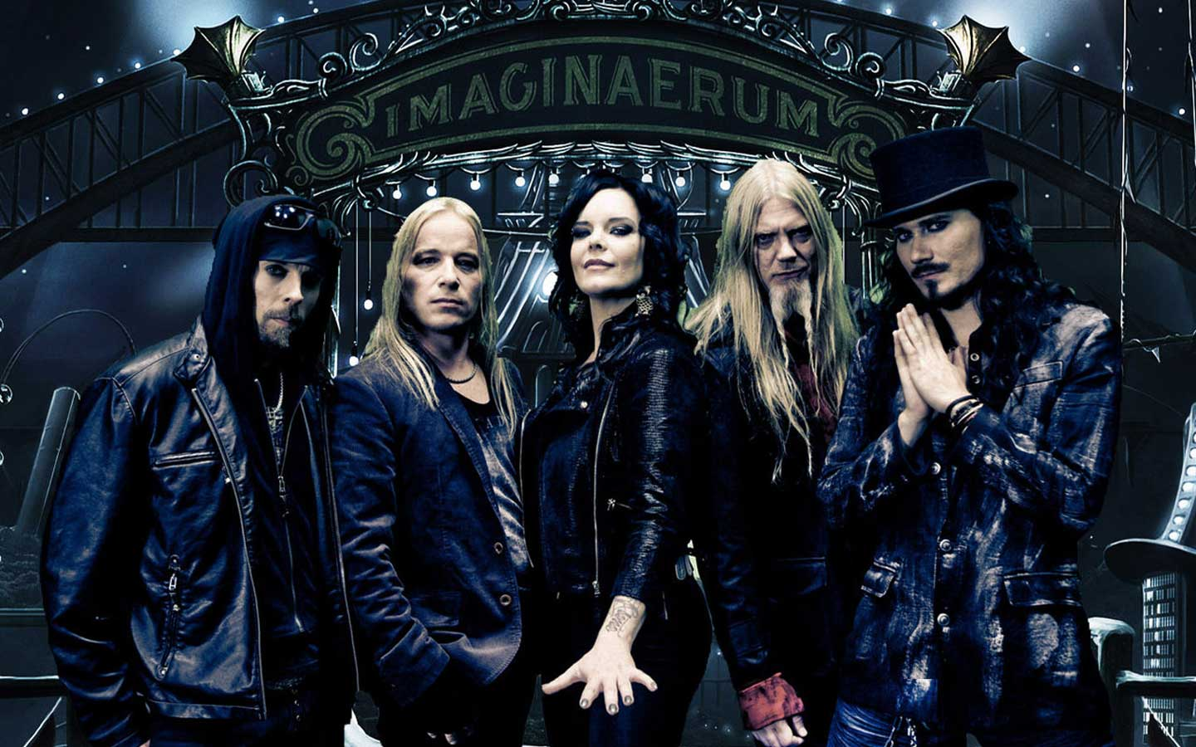
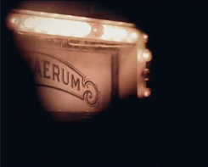
Imaginaerum (2012)
Drama, fantasy and musical.
Imaginaerum tells the story of an elderly composer, Tom, who suffers from severe dementia. As he has had the disease for years and has regressed into childhood, he remembers practically nothing from his adult life. His music, friends, all his past including the memory of his daughter are a blur in his mind. All he has left is the imagination of a ten year old boy. As he drifts away into coma, it seems impossible to get back what he has lost. Or is it? The film is a journey between two different dimensions. Tom travels through his imaginary world seeking answers and finding memories etc.

Slide 14
SOURCES
http://www.imdb.com/title/tt1959409/synopsis?ref_=tt_ov_pl
http://nightwish.com/en/band/biography
http://en.wikipedia.org/wiki/Nightwish

