Slide 2
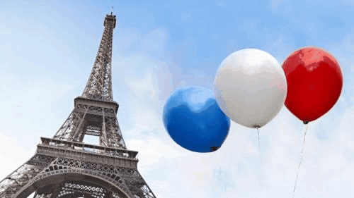
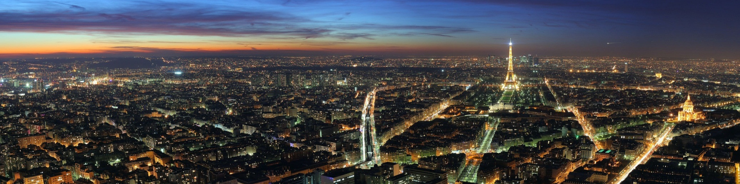
About Paris
Capital and largest city
Northern France
Seine
2 million (12)
Different culture
35m-130m

Slide 4
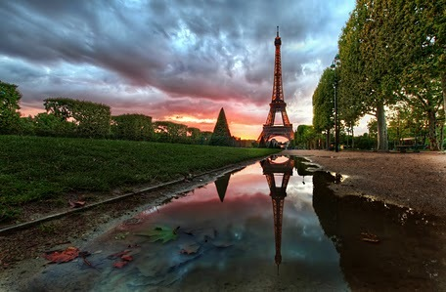
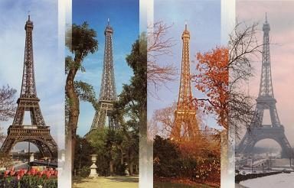
Climate
Oceanic climate
Sudden showers
0°C-25°C

Slide 5
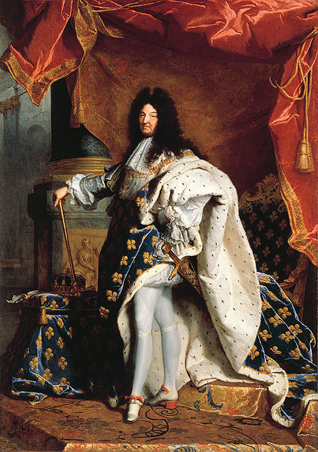
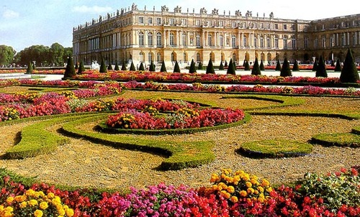
History
The Romans
Louis XIV
Peace negotiation
Development

Slide 6
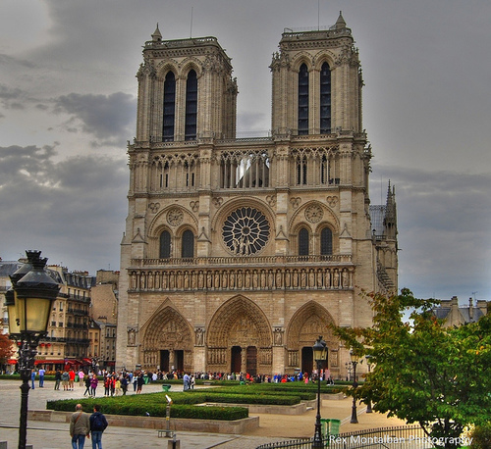
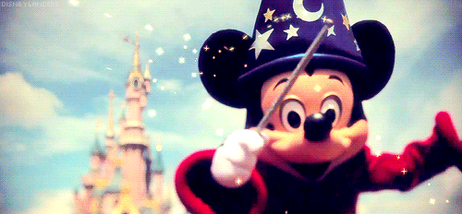
Sights
Eiffel tower
Notre Dame
Napoleonic Arc de Triomphe
Louvre museum
Tuileries Gardens
Champs-Elysees…
Disneyland

Slide 7
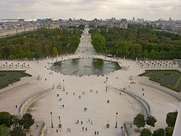
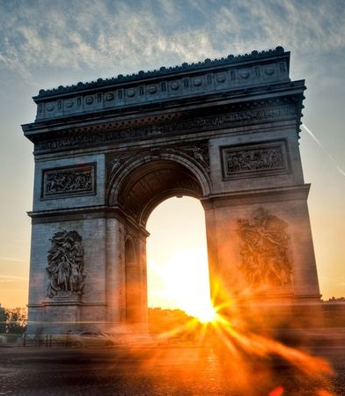
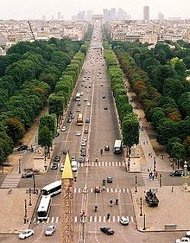
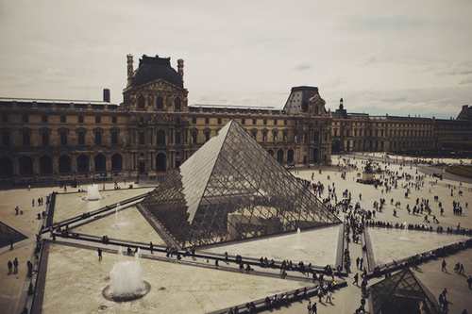
Tuileries Gardens
Napoleonic Arc de Triomphe
Champs-Elysees
Louvre museum

Slide 8
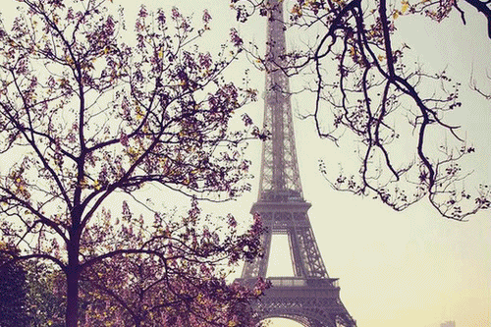
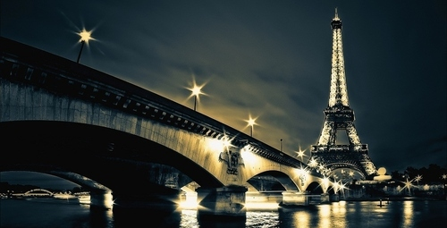
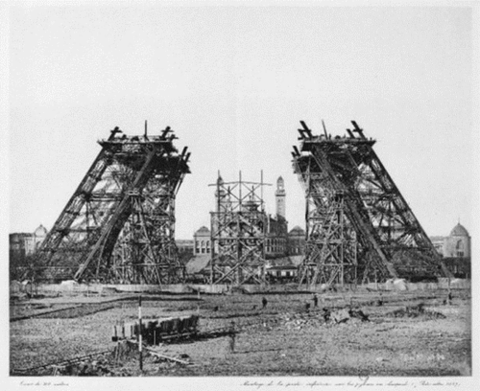
Eiffel tower
World Exhibition 1889
Gustave Eiffel
1887-1889
320,75m high
Dark brown

Slide 9
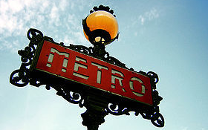
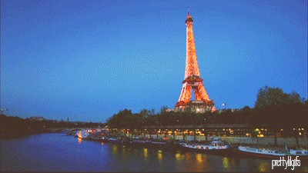
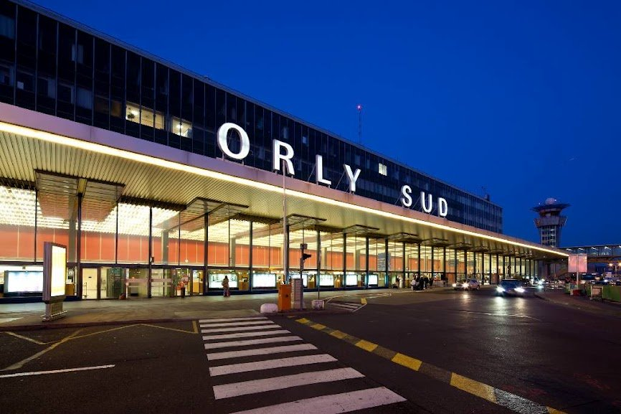
Transport
Four airports
Paris Metro
Important highway

Slide 10
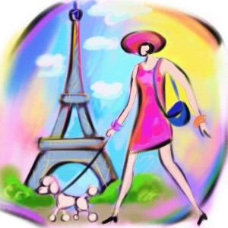
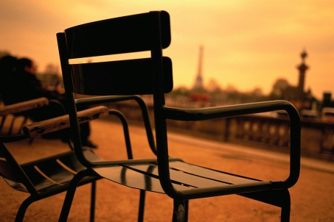
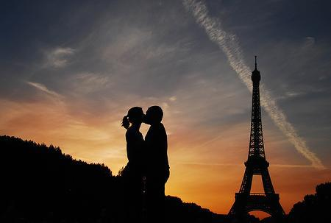
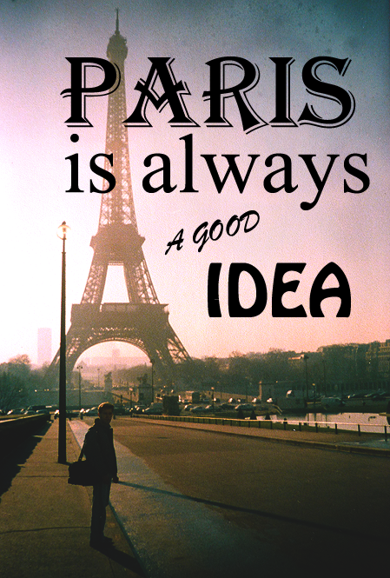
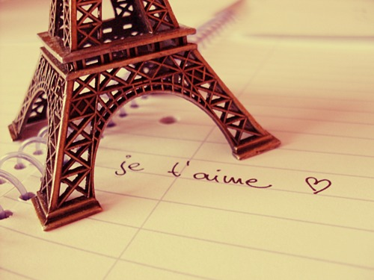
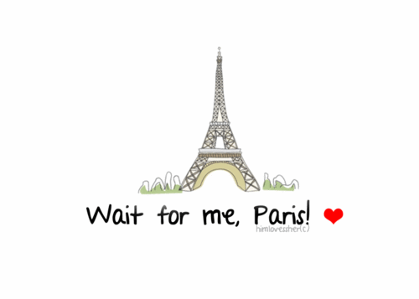
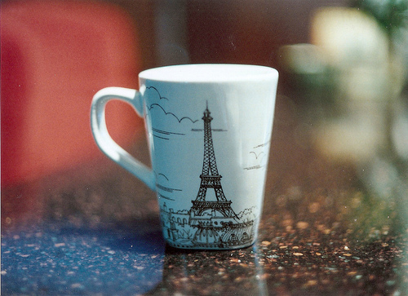
For the End
City of lovers
Tourist destination

Slide 11
Authority
Pictures: internet
http://en.wikipedia.org/wiki/Eiffel_Tower
http://en.wikipedia.org/wiki/Paris

