Slide 1
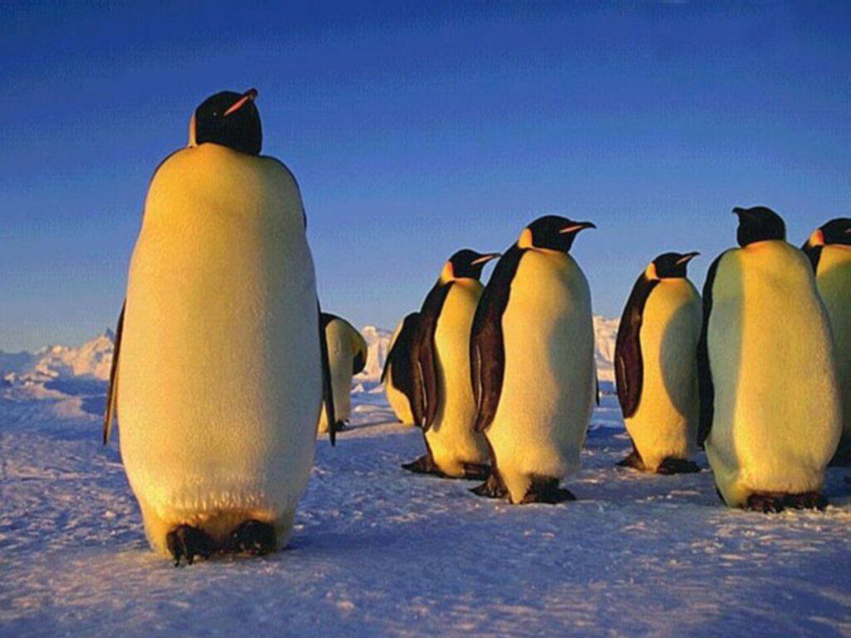
PENGUINS
English

Slide 2
LIVING SPACE
On the most cold continent
A lot of underski fat

Slide 3
BODY COMPOSITION
Short-side
Group of birds
Good swimmers
Can’t fly

Slide 4
MOVING
Little and stubby
Balance -> short tail
They move their weight from one leg on the other-> rock

Slide 5
KEPPING BODY TEMPERATURE
A lot of fathers
Underskin fat

Slide 6
NESTING
Usually in colonies
Female-> one egg
Male penguin lay egg several months or weeks
Female-> Hunt

Slide 7
SWIMMING
Excelent swimmers and divers
Swallow chach under the water
Longest dive-> 20 minuts

Slide 8
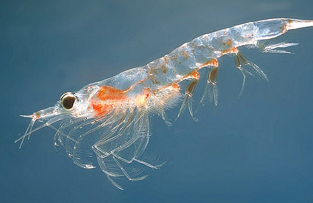
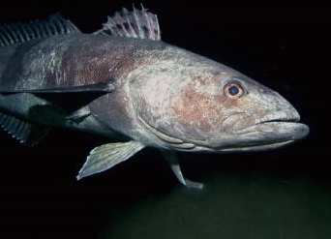
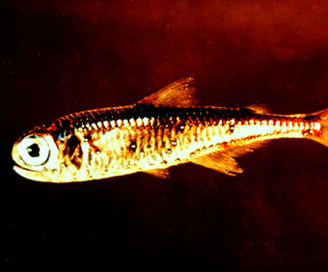
FOOD
Mostly fishes
Squids
Fleshing shrimps

Slide 9
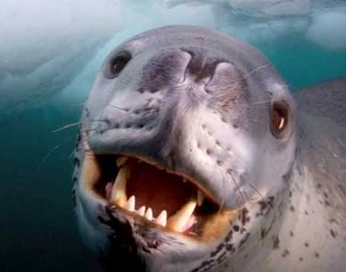
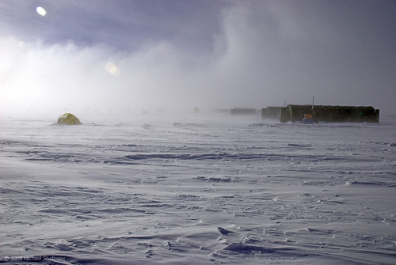
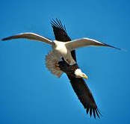
ENEMIES
Orcas
Sea leopards
Eagles robbers
Ice storms

Slide 10
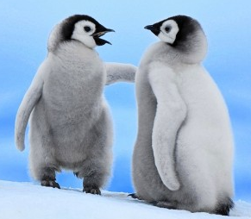
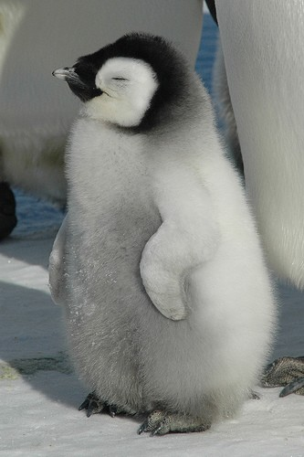
THANKS
FOR
WATCHING
AND
LISTENING!
YOUR PENGUINS!

