Slide 1
Brad Pitt

Slide 2
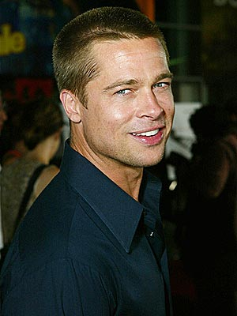
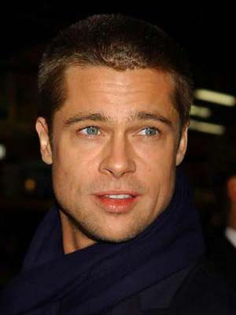
Brad Pitt is a famouse Holiwood actor and producer. He has acted in many films and TV series, and for his work has been olso nominated for Golden globe and for Academy award prize.

Slide 3
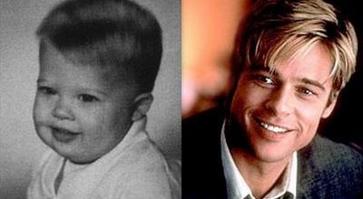
Brad Pitt was born in Oklahoma in 1963. He has olso had a younger brother and a sister. Soon after he was born his familly moved house in Missouri. There he went to high school and he olso played golf and tennis.
In 1982 after high school he was going to Missoury university, where he wanted to study journalism. But in 1985, two weeks before he ended university he went to Los Angeles, where he started to study the act.

Slide 4
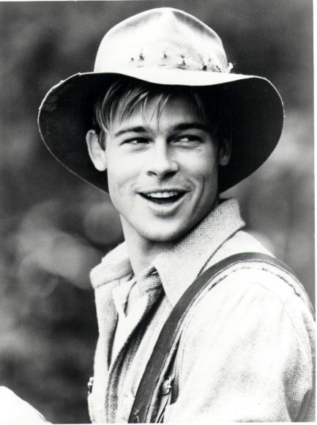
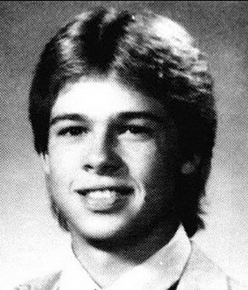
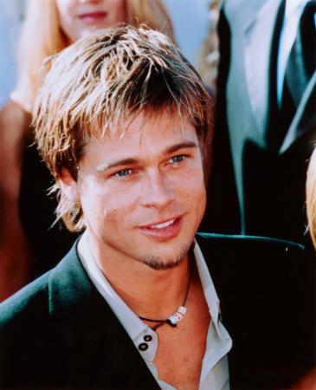
When he was in L.A. he had to pay study, so he worked as a driver and he olso wore a chicken costum, for one company.
When he lived in L.A. he met Roy London, who was a teacher for the act. He descovered his talent and soon Brad apeard in TV series. In 1987 saw him film directors, and in the same year he acted in his first movie.
In 1994 he became one of the most famouse actor on the world. A few years later he got olso MTV movie prize, and in 1995 he was nominated for the oscars.

Slide 5
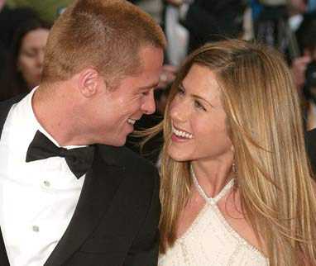
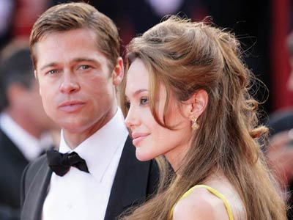
In 1998 he met Jenifer Aniston on the set of one TV seria, and over two years they got married. Their wadding was one of the most expencive ever, but over five years they divorced.
In 2005 Bradmet Angelina Jolie on the set of film Mr. and Mrs. Smith. They fell in love and in 2006 they got their first baby. Today they have six children.

Slide 6
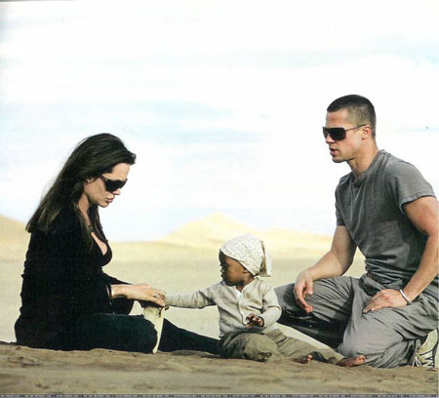
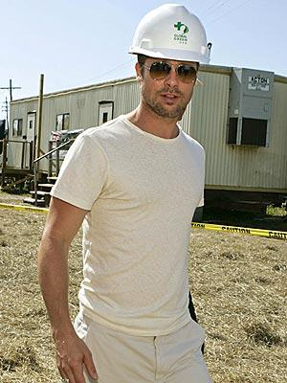
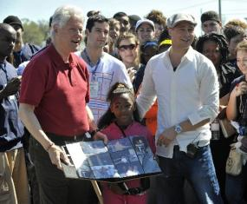
Since 2005 with his wife Angelina they have olso participed in many humanitarian organizationsand in 2006 they olso created their own organization. In last five years they have donated more than 20 millions of dolars for poor children and other things.

Slide 7
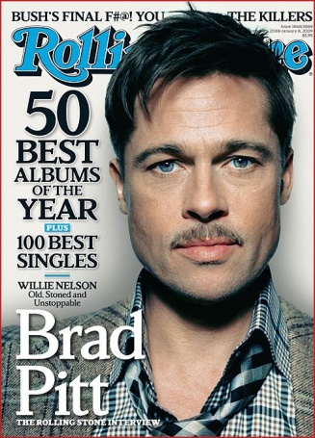
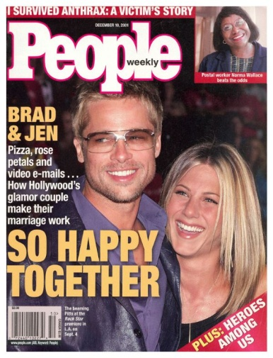
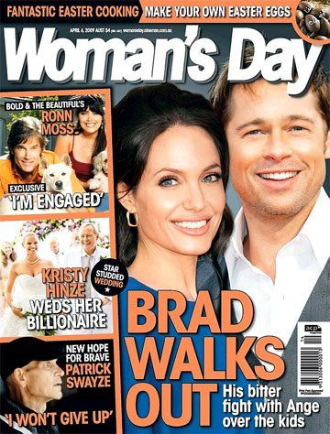
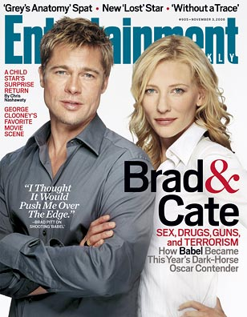
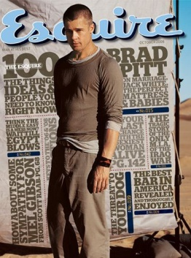
Now when Brad is so famouse he always appeards in magazines and newspapers. He’s olso one of the richest actores on the world and he normally does many interviews.

Slide 8
Thank you for attention!

