Slide 1
POLLUTION

Slide 2
Pollution is the introduction of contaminants into the environment.
It’s a global problem
All living things depend on Earth’s supply of air and water.
Three major types of pollution:
AIR POLLUTION
WATER POLLUTION
LAND POLLUTION

Slide 3
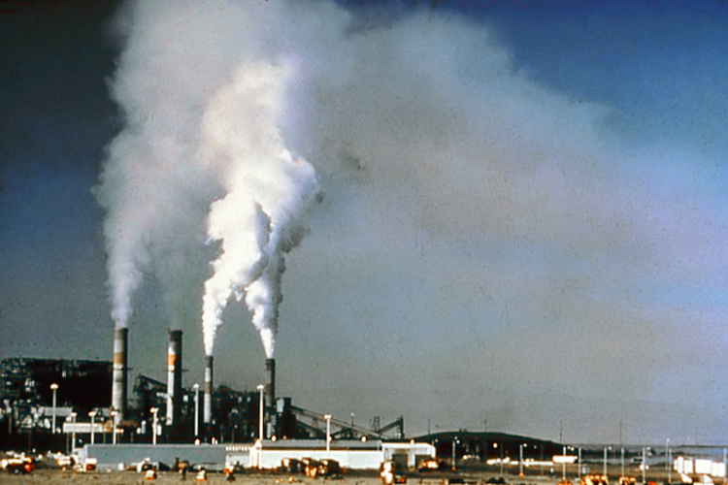
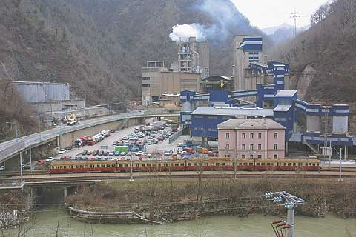
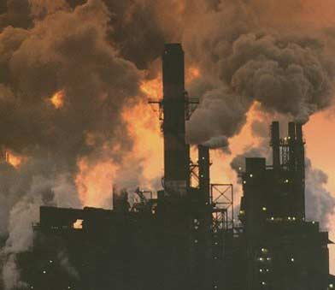
AIR POLLUTION
It’s is the accumulation of hazardous substances into the atmosphere that danger human life and other living matter.
Air pollution can be visible or invisible

Slide 4
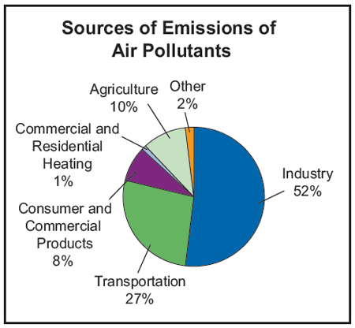
WHAT CAUSES AIR POLLUTION?
Natural disasters
Transportation
Industry
Greenhouse gases

Slide 5
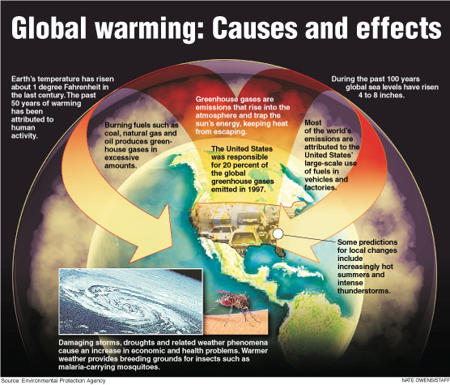
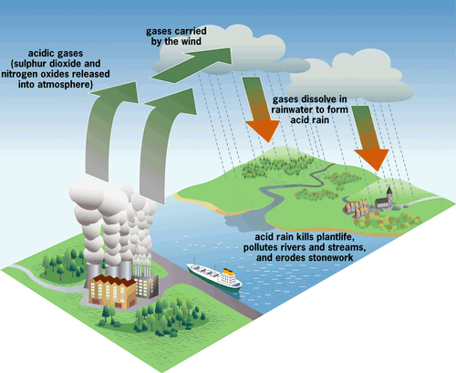
WHAT ARE THE RESULTS OF AIR POLLUTION?
Global warming
Acid rain

Slide 6
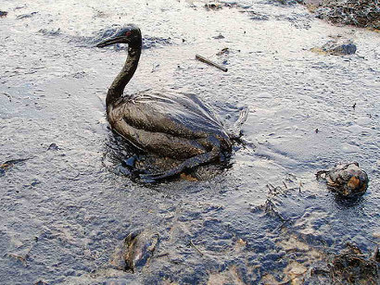
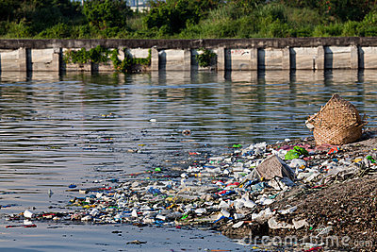
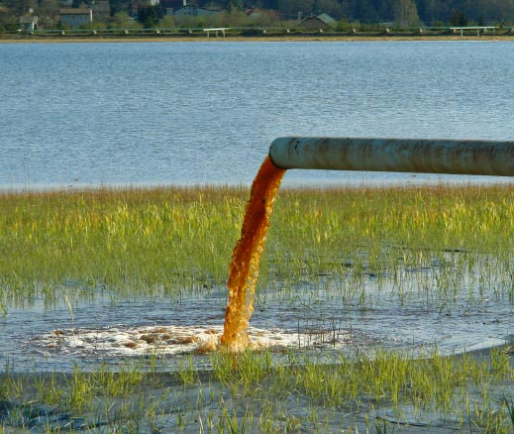
WATER POLLUTION
It’s the introduction of chemical, biological and physical matter into large bodies of water that degrade the quality of life that lives in it and consumes it.

Slide 7
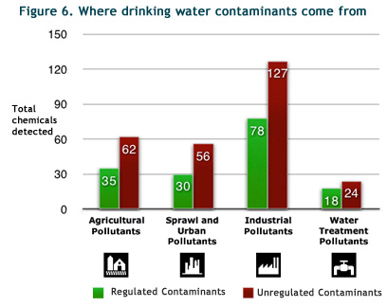
WHAT CAUSES WATER POLLUTION?
Chemical pesticides
Fertilizers
Garbage

Slide 8
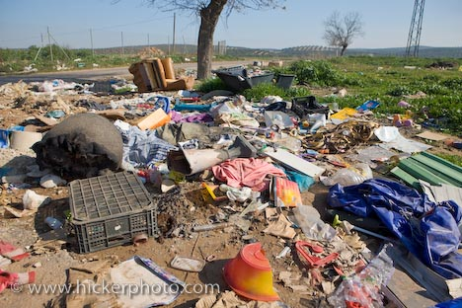
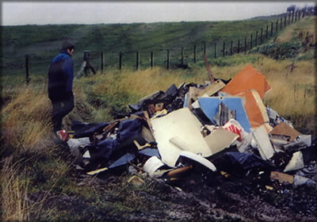
LAND POLLUTION
It’s pollution of the Earth’s natural land surface by industrial, commercial, domestic and agricultural activities.

Slide 9
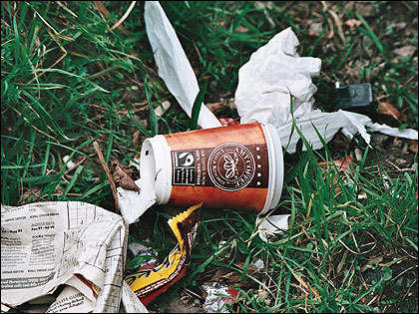
WHAT CAUSES LAND POLLUTION?
Pesticides
Fertilizers
Trash

Slide 10
CONSEQUENCES OF AIR, WATER AND LAND POLLUTION ON HUMAN HEALTH
Short-term effects
Long-term effects

Slide 11
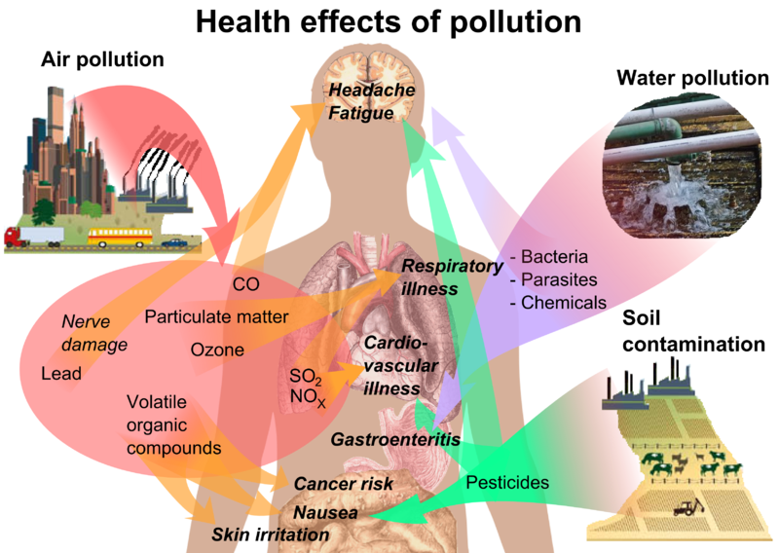

Slide 12
OTHER TYPES OF POLLUTION
SOUND or NOISE POLLUTION - human, animal, or machine-created environmental noise that disrupts the activity or balance of human or animal life.
LIGHT POLLUTION - is excessive and in most cases unnecessary direct or indirect artificial light that increases the level of brightness in the environment.

Slide 13
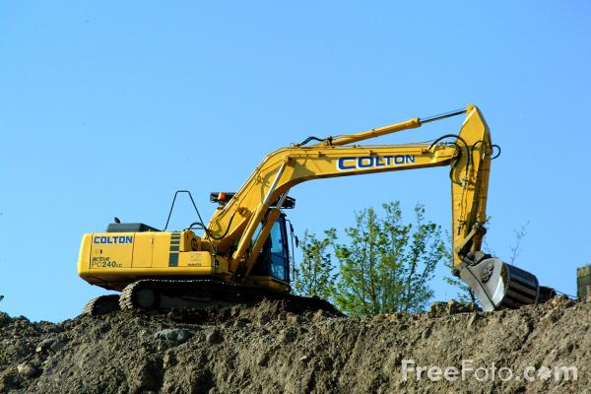
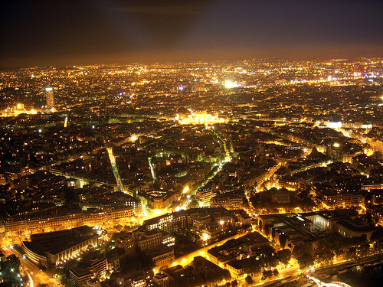
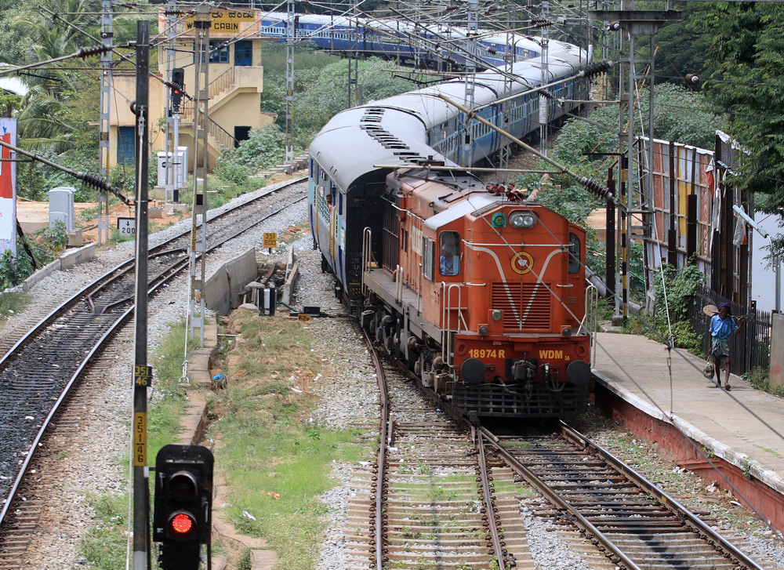
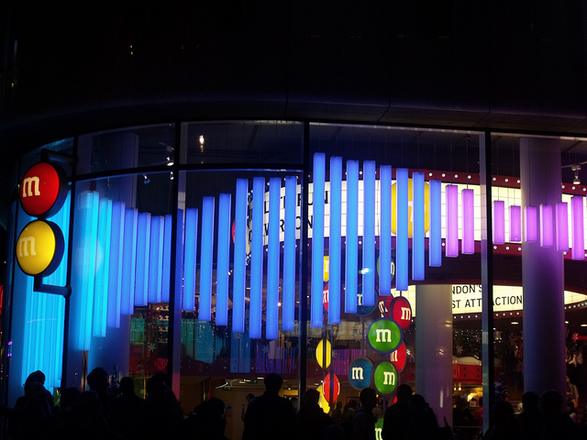
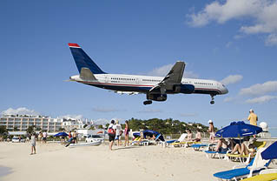

Slide 14
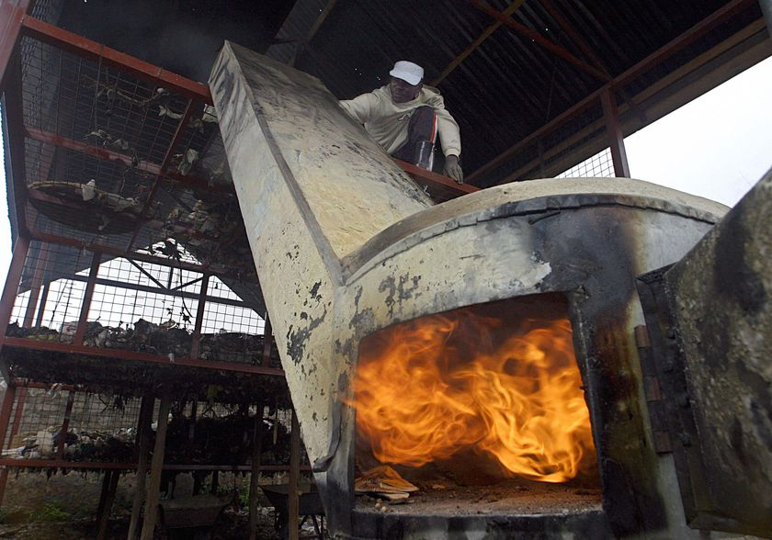
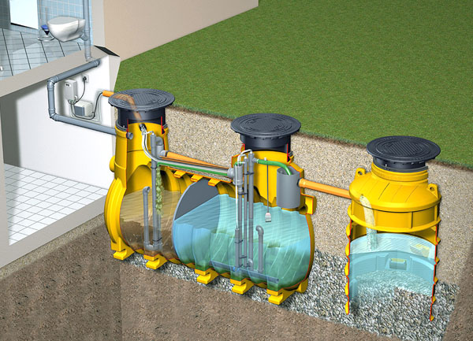
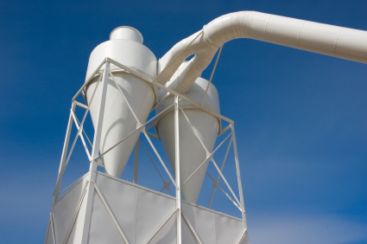
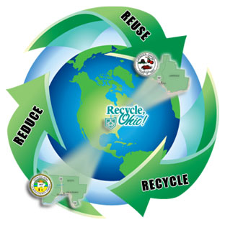
REDUCING POLLUTION
Reducing pollution requires environmental, political, and economic leadership.
Recycling
Incineration
Filtration of the air
Purifying plants

Slide 15
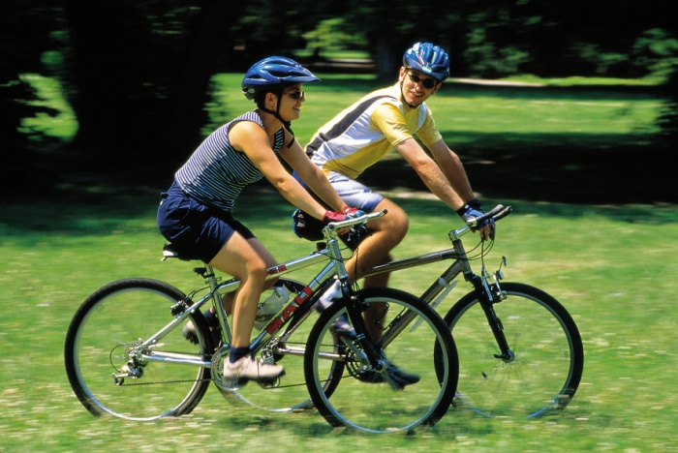
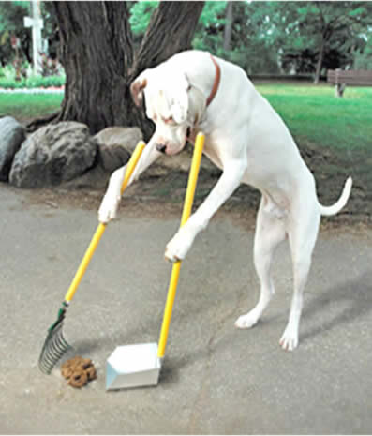
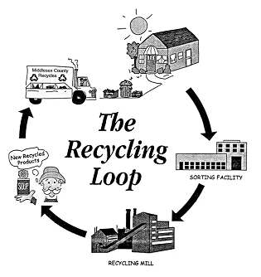
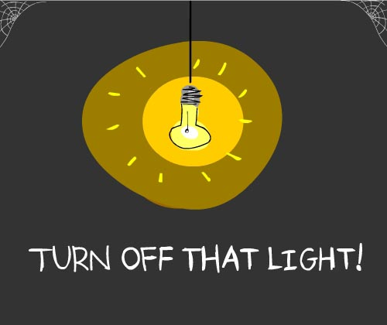
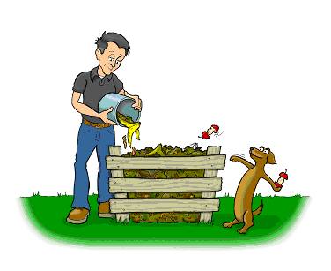
WHAT CAN WE DO TO STOP POLLUTION?

Slide 16
STATISTICS
10 Most Polluted Countries in the World (2011)
1. Mongolia
2. Botswana
3. Pakistan
4. Senegal
5. Saudi Arabia
6. Egypt
7. United Arab Emirates
8. Iran
9. Nigeria
10. Kuwait

Slide 17
10 Most Air-Polluted Cities in the U.S. (2011)
1. Bakersfield, California
2. Fresno, California
3. Riverside/San Bernardino/Ontario, California
4. Fairbanks, Alaska
5. Modesto, California
6. Hilo, Hawaii
7. Visalia-Porterville, California
8. Hanford-Corcoran, California
9. San Diego, California
10. Pittsburgh, Pennsylvania

Slide 18
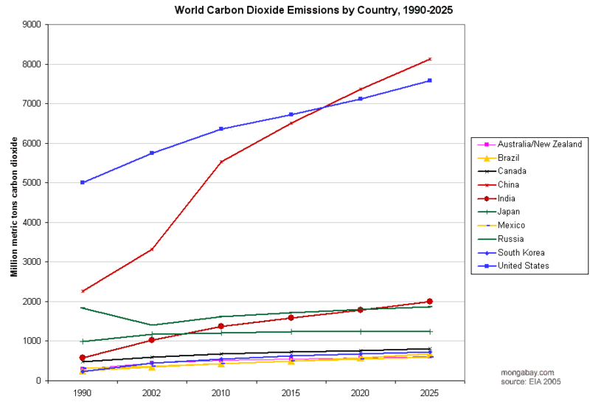

Slide 19
INTERESTING FACTS ABOUT POLLUTION
Approximately 1/3 of male fish in British rivers are in the process of changing sex due to pollution. Hormones in human sewage, including those produced by the female contraceptive pill, are thought to be the main cause.
Fourteen billion pounds of garbage, mostly plastic, is dumped into the ocean every year.
Over 1 million seabirds are killed by plastic waste per year. Over 100,000 sea mammals and countless fish are killed per year due to pollution.
Each person in the U.S. produces about 4 pounds (2 kg) of garbage a day.
Antarctica is the cleanest place on Earth and is protected by strong antipollution laws.

Slide 20
SOURCES
http://education.nationalgeographic.com/education/?ar_a=1
http://www.greenstudentu.com/encyclopedia/pollution
http://en.wikipedia.org/wiki/Pollution
http://www.bcb.uwc.ac.za/sci_ed/grade10/ecology/conservation/poll.htm
http://facts.randomhistory.com/pollution-facts.html
http://www.google.com

