Slide 1
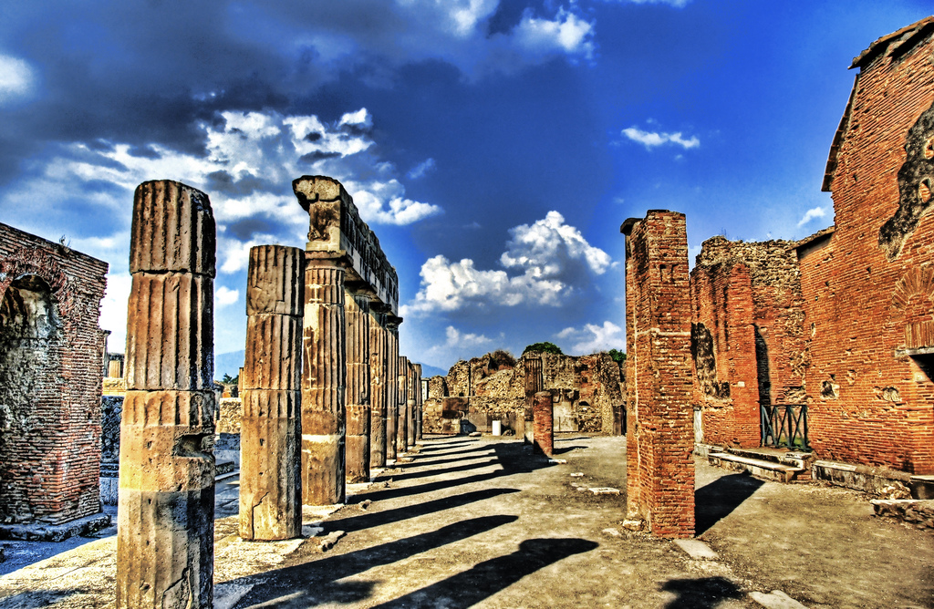
POMPEII

Slide 2
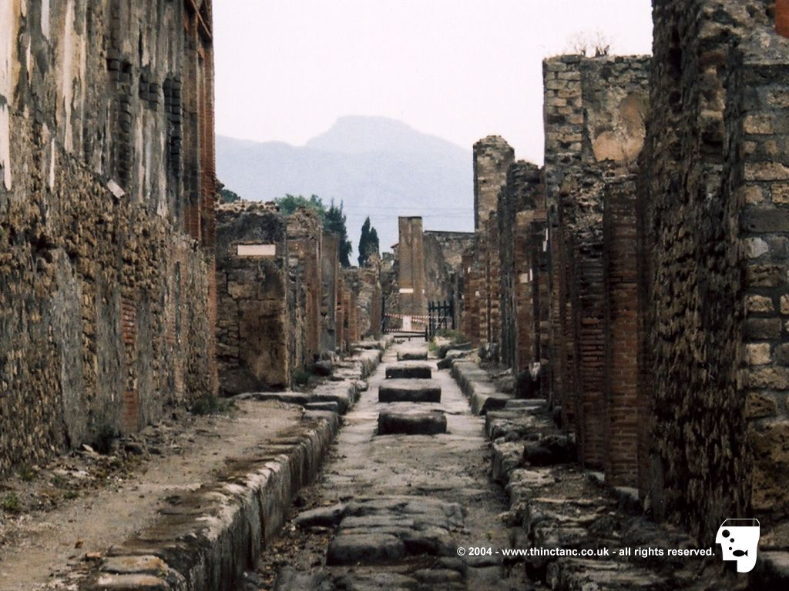
City
Life before disaster was quite good. In Pompeii there were a few shops, restaurants and lots of houses. Poor people lived in small ones and rich people lived in bigger houses- called villas. Villa had a big gardens, colourfull rooms, living areas, a dining room and a holy place. Poor people didn't have enough money to afford big gardens, so they had smaller rooms and those were not so decorated. People in the city wore tunics, which were mostly white colored. Richer men had a white tunics with lots of different patterns.

Slide 3
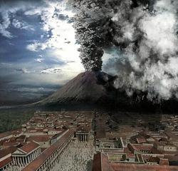
The day of the eruption
City lies a few kilometers away from the volcano Vesuvius. On the day of the eruption in the afternoon, something exploded. Then a big black clouds showed above Vesuv. It all spreaded over Pompeii and then air was full of ash. It all filled the streets and the whole city. Few escaped, but most of them didn't have that luck. Cause people back then didn't know much about that kind of disasters, they just watched the eruption and didn't go anywhere. The people and the buildings of Pompeii were covered in up to twelve layers of ash, which rained down for about 6 hours.

Slide 4
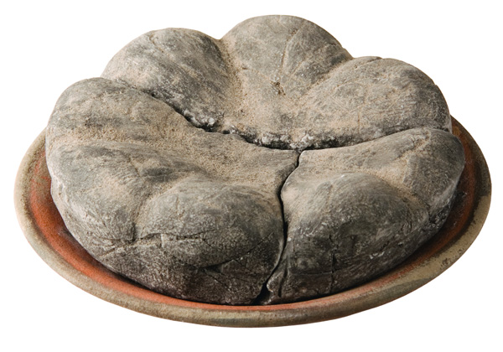
Finding the lost city
City was found at least one hundred years ago, when a local farmer hit something with a plow. Then they orderd to dig and to find treasure under the ground. So they found Pompeii again.
People buried in ash appear to be wearing warmer clothing than the light summer clothes that would be expected in August. So far there is no definitive theory as to why there should be such an apparent discrepancy.

Slide 5
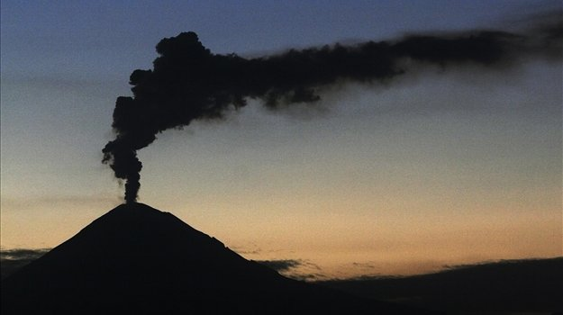
Pompeii today
Today you can go to Pompeii as a turist. Because archaeologists found few hundred vases, they saved most of them in a safe place. They exhibited a few.

