Slide 1
PowerPoint vs Prezi

Slide 2
Table of content
History of PowerPoint
Versions of PowerPoint
Short history of Prezi
Comparison/Conclusion
Sources

Slide 3
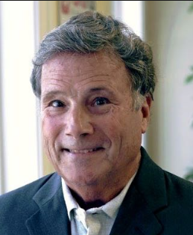
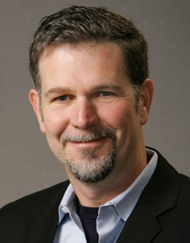
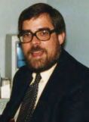
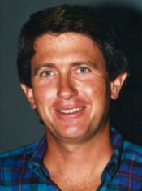
History of PowerPoint
Forethought,inc.
Future Product
FactFinder and Typing Intrigue
Start of Presenter

Slide 4
PowerPoint 2.0
May 1990
FontWare
Concept of style
PowerPoint graph (DDE technology)
Complete-saving

Slide 5
PowerPoint 3.0
Minor improvements
Animations for transition
Library of pictures
TrueType

Slide 6
PowerPoint 95
C++ code
Meeting Minder
Action notes
Slide Navigator

Slide 7
PowerPoint 97
VBA language
SlideFinder
Special Effects
Update on graph
ActiveX

Slide 8
PowerPoint 2000
Auto-Fix Text
PowerPoint table editor
Animated pictures

Slide 9
PowerPoint 2002
OfficeXP
Ask a Question Box
Voice dictation
GIF Library
Print preview

Slide 10
PowerPoint 2003
IFM
SmartTag
Shared WorkSpace Taskpane
Prenos na CD

Slide 11
PowerPoint 2007
Izboljšan uporabniški vmesnik
Predogled animacij
PDF.,XMF.
Več učinkov

Slide 12
PowerPoint 2013
Used Sources, Presented proposals
New BackGrounds
EyeDropper
Cloud Saving
Improved phone and tablet experience

Slide 13
PowerPoint 2016
Latest version
Figure Drawing
Tell me That
Recording
Smart LookUp

Slide 14
Prezi
Founded in 2009
Visual Storytelling software
Over 85 million users
Investment from TED
2012 Iphone app
2016 Prezi Bussines

Slide 15
Conclusion
PowerPoint has an advantage
Prezi is too simple
Presentation software is improving

Slide 16
Sources
http://archive.computerhistory.org/resources/access/text/2012/06/102745695-01-acc.pdf
http://www.robertgaskins.com/powerpoint-history/
https://www.glisser.com/media/the-History-of-PowerPoint.pdf
https://prezi.com/

